Slide 1


WELCOME!
MPB | Leadership Accelerated
May 2025
Cohort 18

Slide 2
Housekeeping
Meals
Workout
Scan the QR code on your folders to access the Resource Center
Sharktank presentations
Feedback
CPE
Check Ins and Upcoming Events
Our Team

Slide 3
A Discussion on AI
MPB | Leadership Accelerated
May 2025
David Toth
Notes:
“How are you empowering your people to experiment with AI?”
“Is your IT team a roadblock or a launchpad for innovation?”
“Which area of your firm could see the biggest productivity leap in the next 6 months with the right AI tool?”
“What’s the most surprising or unintended use of AI you’ve seen at your firm?

Slide 4
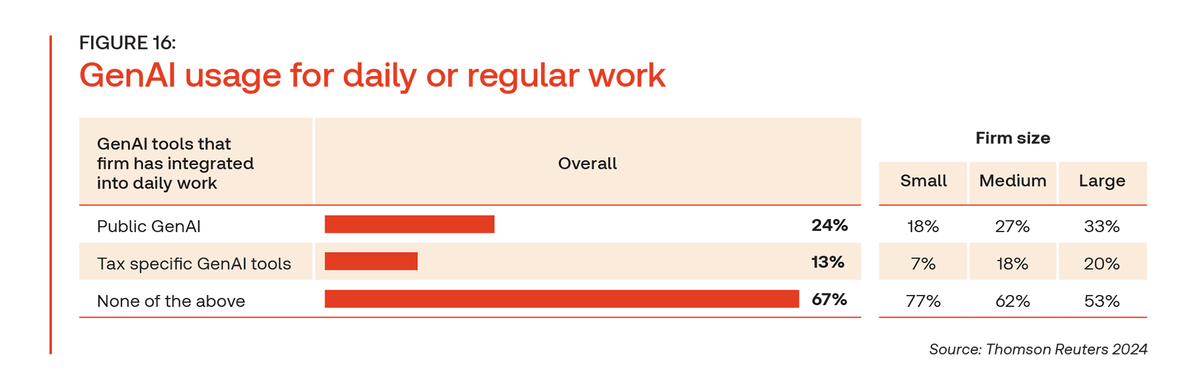
Topics
Data Governance
AI Policy
Presentations
Content
Operations
  CX
  EX
  Processes and workflows

Slide 5
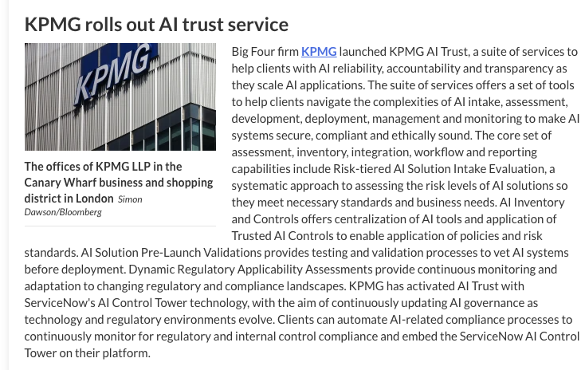
The Big 4 are going All-In
PwC Investing $1B in AI (2023)
Deloitte’s launches AI Academy for all employees
EY invests $B to integrate AI into Accounting and Audit Platform (2025)
Artificial intelligence is revolutionizing the accounting industry, with 73% of firms embracing AI-driven automation that cuts processing time by up to 60%, reduces errors by 30%, and is projected to surpass $16.7 billion by 2027.

Slide 6
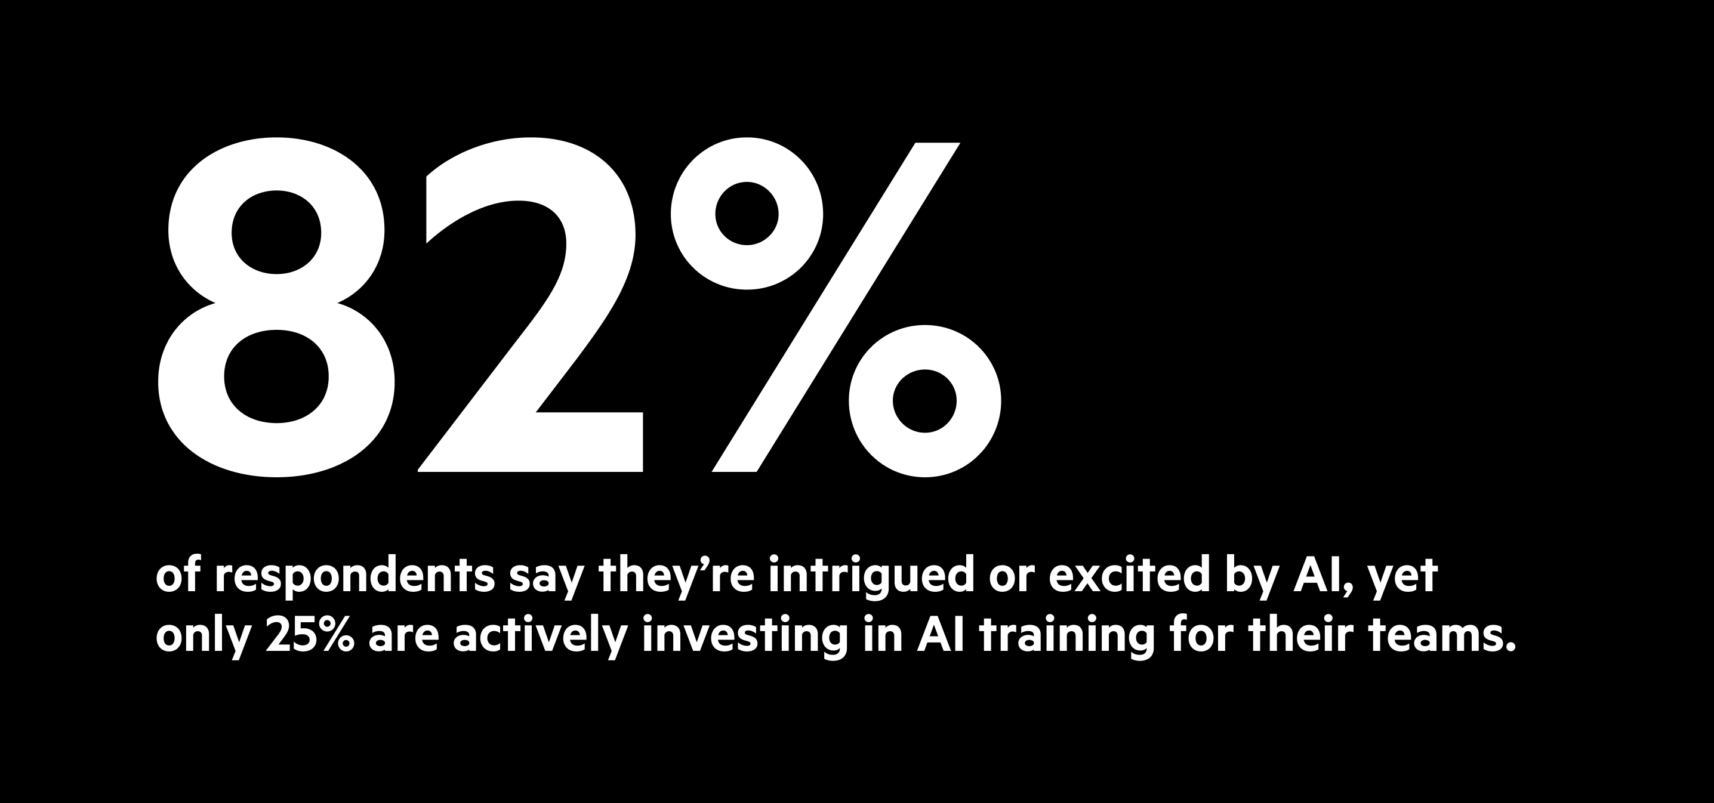
Notes:
What is your tax department now? What will it be

Slide 7
Where are you at on your AI journey?

Slide 8
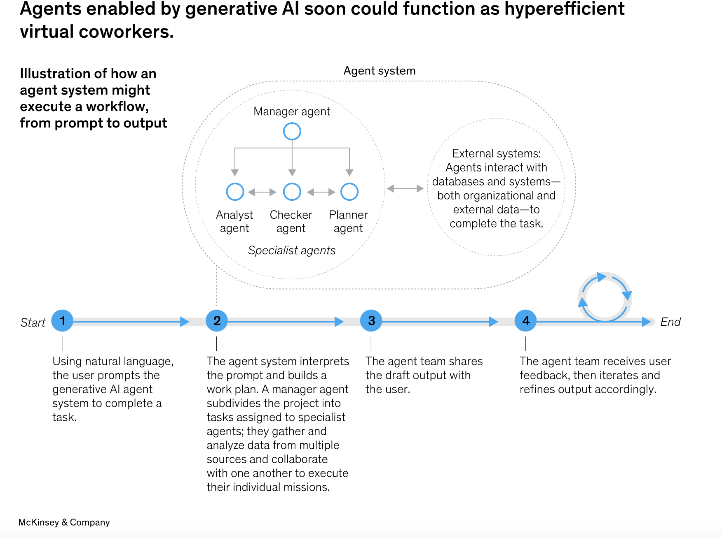
Where is AI going?

Slide 9

Data Governance
Where is your data
Who has access to it
The value of your data
Notes:
Who owns AI governance at your firm today?
Do you have a written policy about using tools like ChatGPT or Copilot?
What’s your client disclosure policy around AI use in deliverables?

Slide 10
AI in Core Services
Audit
AI-driven anomaly detection and fraud risk analysis (e.g. MindBridge AI)
Automated document review and evidence gathering
Continuous audit models using real-time data streams
Tax
NLP tools scanning legislation and IRS updates for impact
Return prep automation for simple and mid-tier clients
AI-enhanced client onboarding, organizer review, and planning scenarios
Compliance
AI tools for workflow monitoring and deadline tracking
Red flag identification in regulatory filings
Secure document parsing

Slide 11
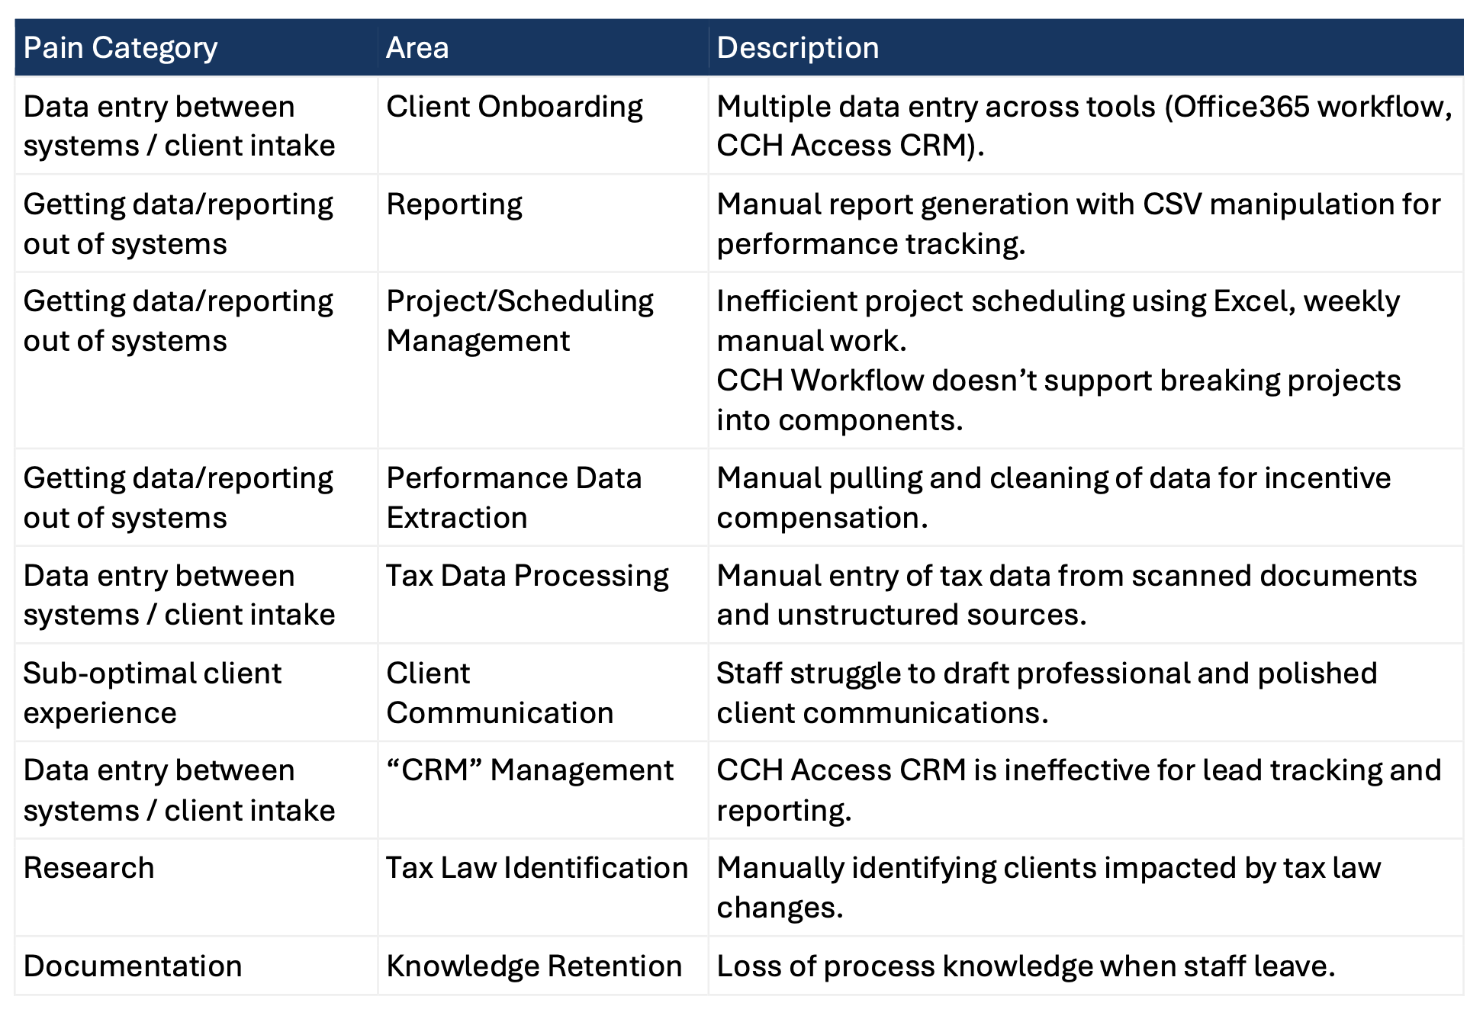

Slide 12
Case Studies
Custom GPT for Ops Data
Project: Custom GPT that queries specific HR, IT, and ops policy data
Outcome:
● Employee time savings from
inefficient searches
● Reduced time spent by the ops
team on answering repetitive
questions
MSFT Copilot Leverage
Project: Customized plan and training for Copilot use
Outcome:
● Increased employee productivity from better use of MSFT Copilot
● Improved client experience from better Copilot-assisted emails
AI-Assisted Documentation
Project: AI-assisted process for
updating documentation and data (i.e. Hubspot update for proposals won)
Outcome:
● Employee time savings from more accurate and efficient information retrieval

Slide 13


Slide 14
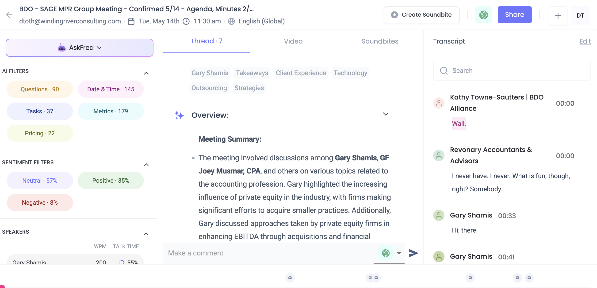
AI for Meetings

Slide 15
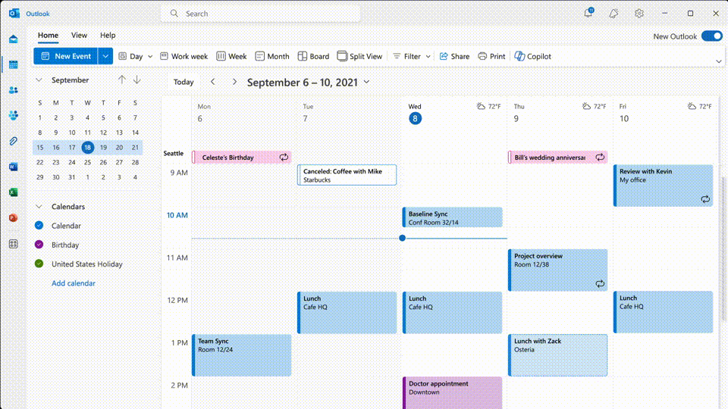
AI for Calendar

Slide 16
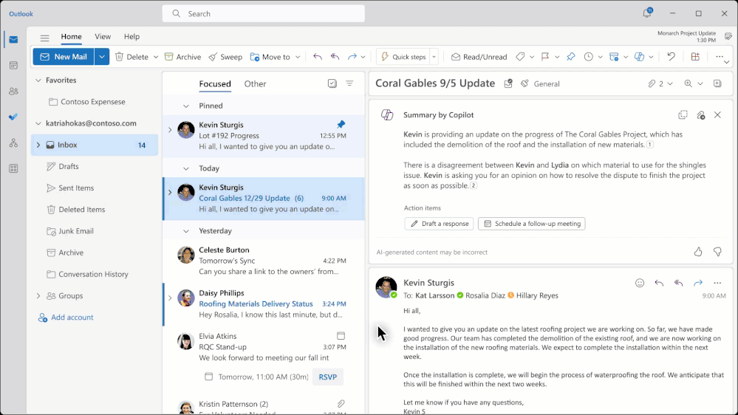
AI for Tasks

Slide 17
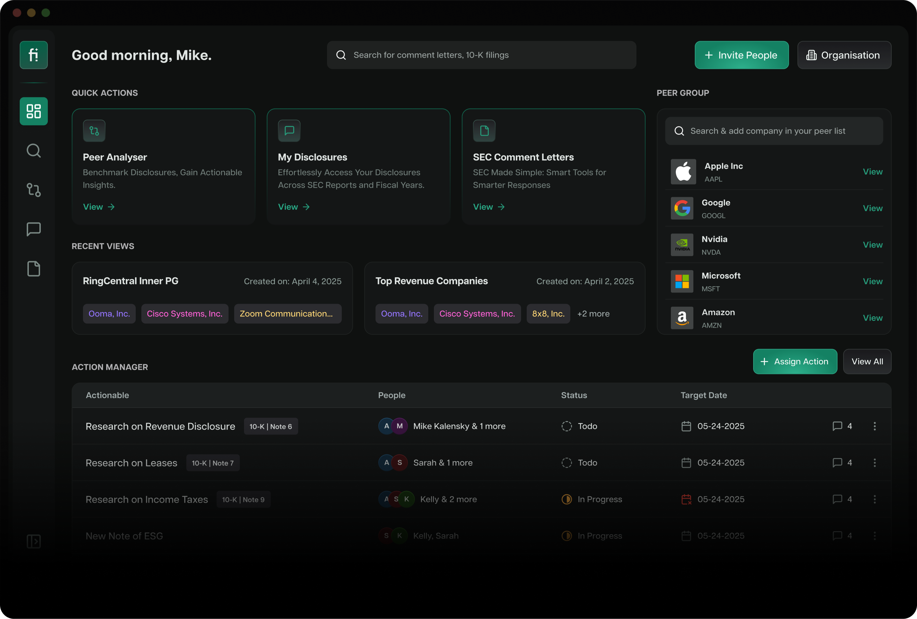
AI for SEC Compliance
Notes:
Finrep empowers you to capture every critical insight, ensuring your disclosures are not just compliant but set a new industry standard.

Slide 18
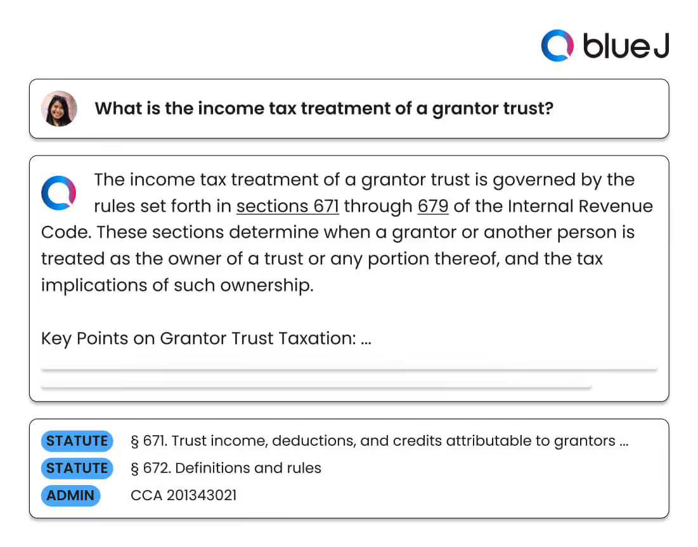
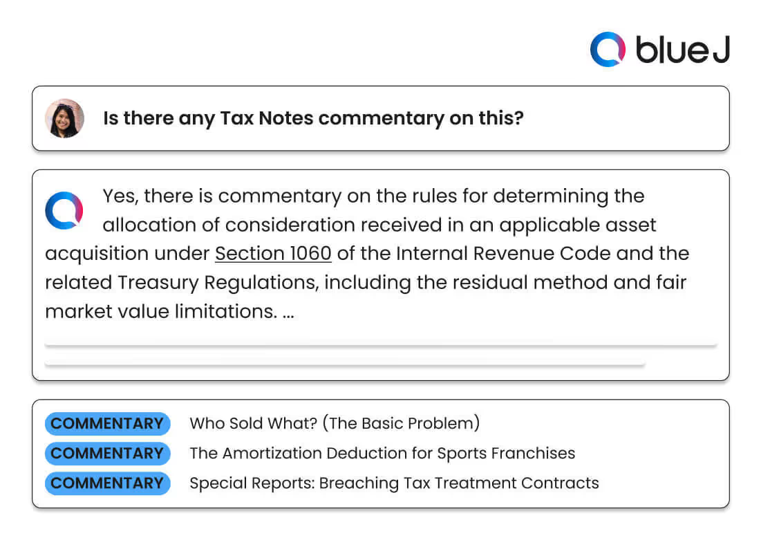
AI for Tax
Notes:
Complete hours of tax research in seconds. Blue J’s generative AI solution instantly delivers verifiable tax answers and drafts high-quality communications, so you can focus on creating exceptional client experiences.

Slide 19
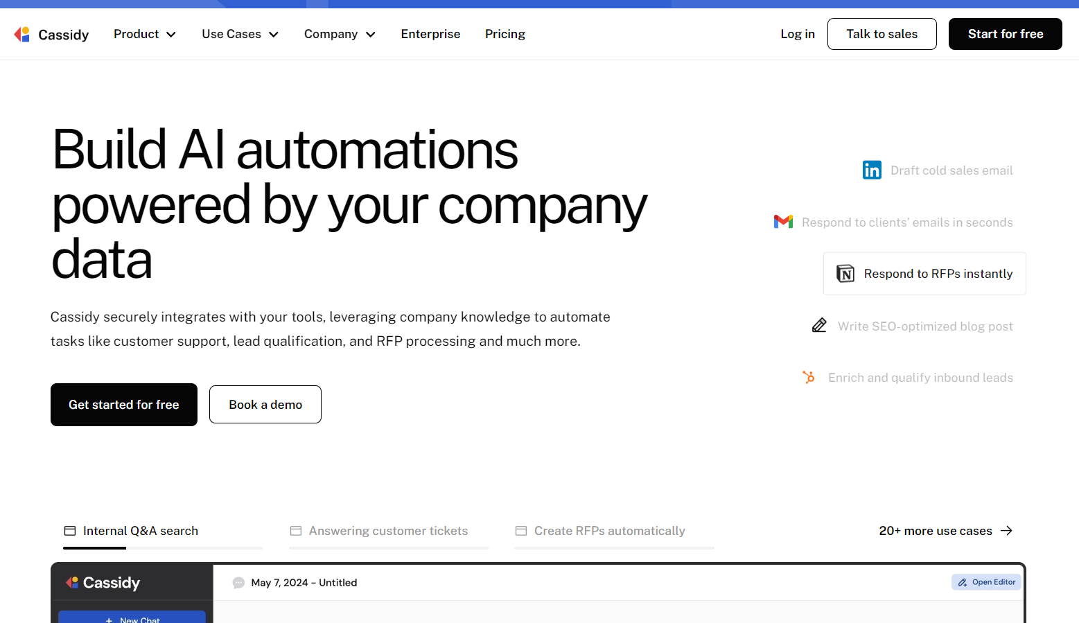
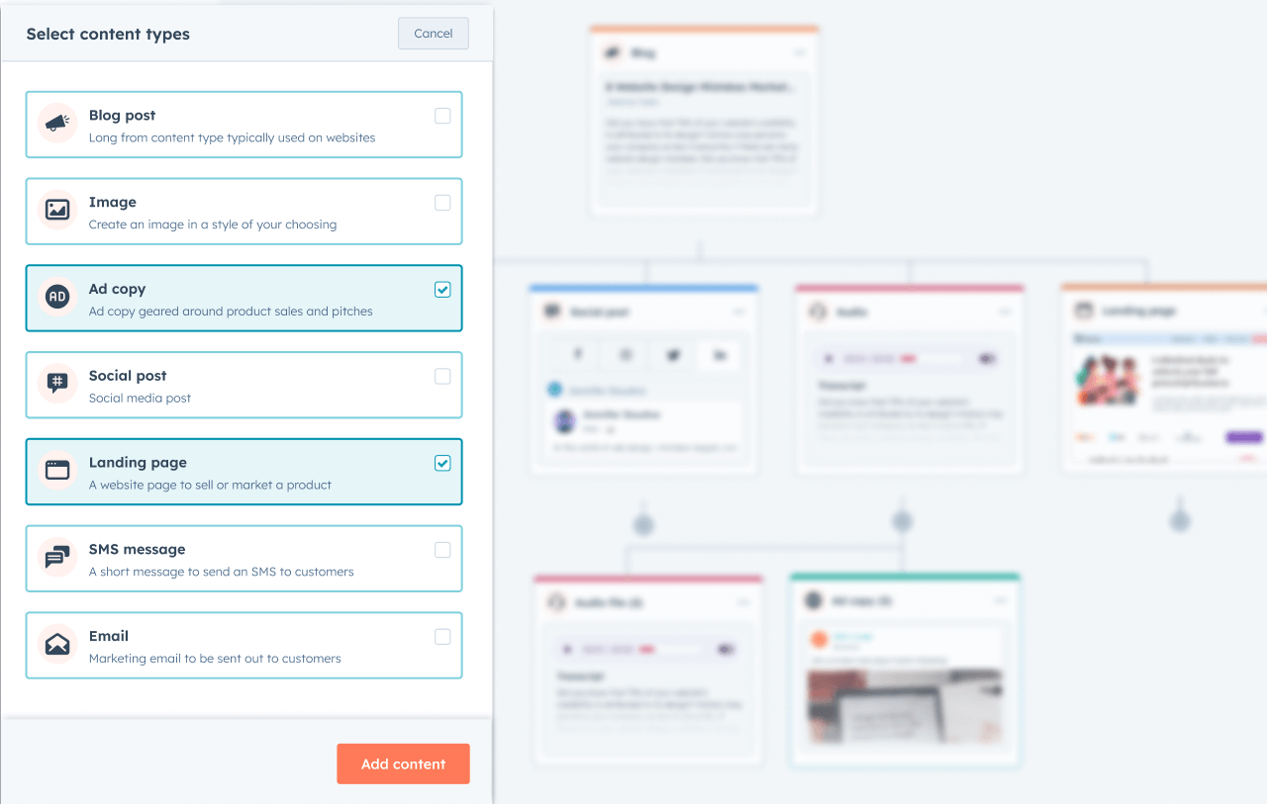
AI for Content
AI Chat
AI Assistants
AI Workflow Automation
Multiple Different LLMs Models
Integrated Knowledge Base
Popular Third Party Integrations
Notes:
Speed – 3x Content Output
Less Cost
Less SME Frustration
Equal or Better Performance
Acceptable Level of Quality
40% Increase #1-3 KW’s
500% Increase in SERP Features
Leads are up 15-20%
QTD: 9 More Clients Q3 v. Q2

Slide 20


JCMO AI Agents

Slide 21
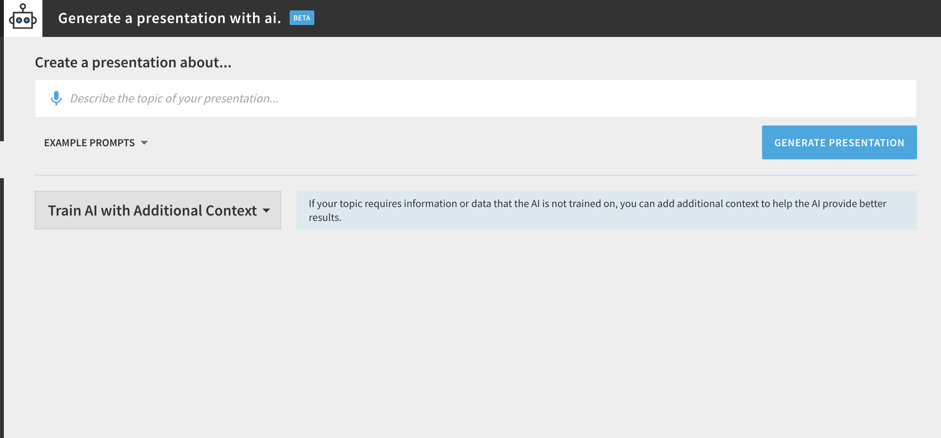
AI for Presentations

Slide 22
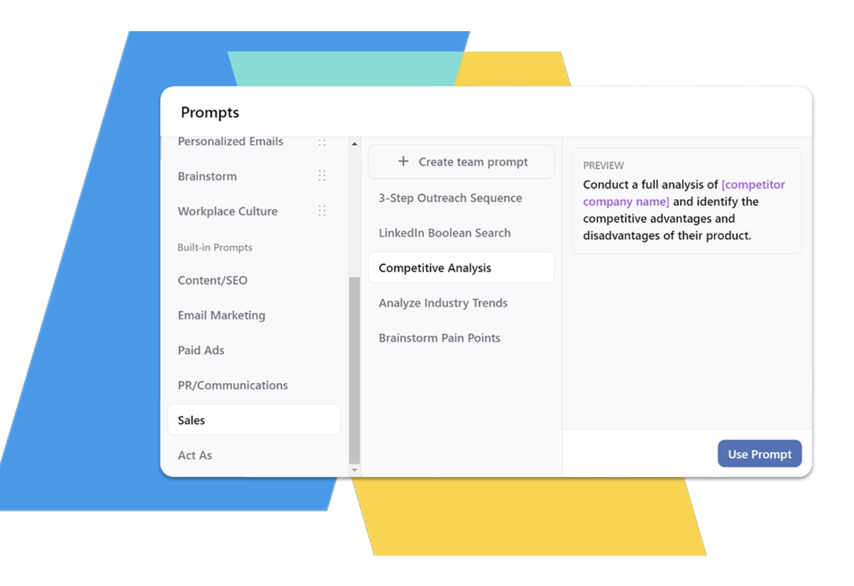
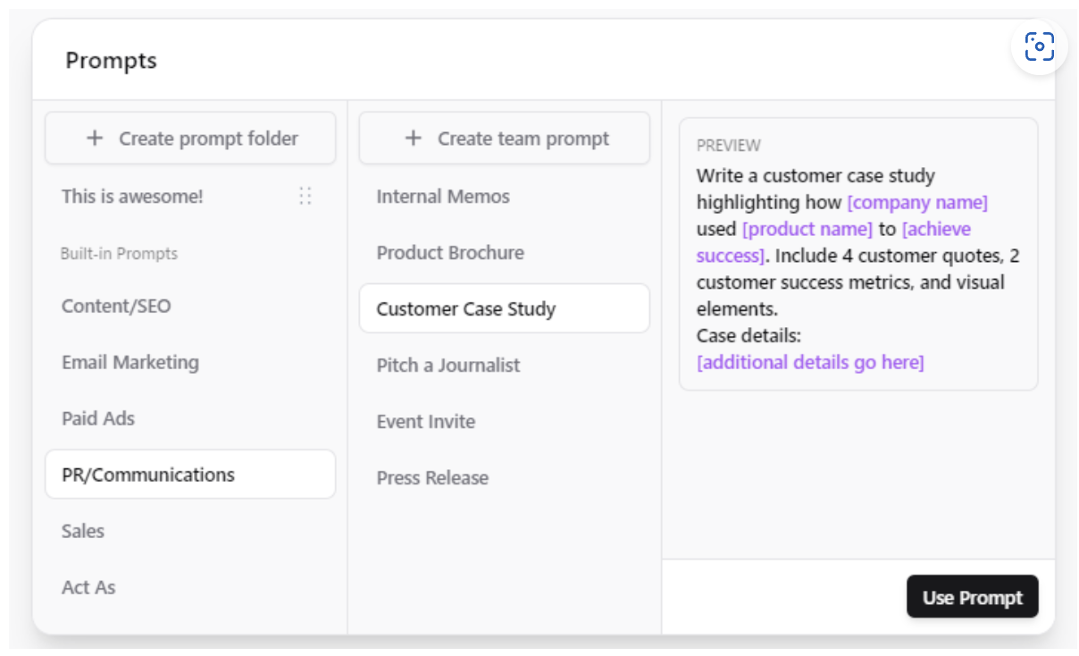
Prompt Libraries
Notes:
Enabling rapid discovery and reuse of prompts to accelerate development cycles
Reducing duplicate work and prompt re-creation across teams
Providing access to highly optimized, pre-tested prompts to boost output quality
Facilitating sharing of best practices for prompt engineering
Fostering consistency in outputs across applications
Centralizing tribal knowledge around prompts into a shared resource

Slide 23
What’s the Risk of Doing Nothing?
Talent attraction and retention
Client expectation gap
Margin compression
Cyber/data risk from rogue AI use

Slide 24
Three Strategic Concepts
Efficiency: Internal productivity (content, admin, onboarding)
Enablement: Enhancing decision-making, workflows, and communication
Transformation: Reimagining client service and business models

Slide 25

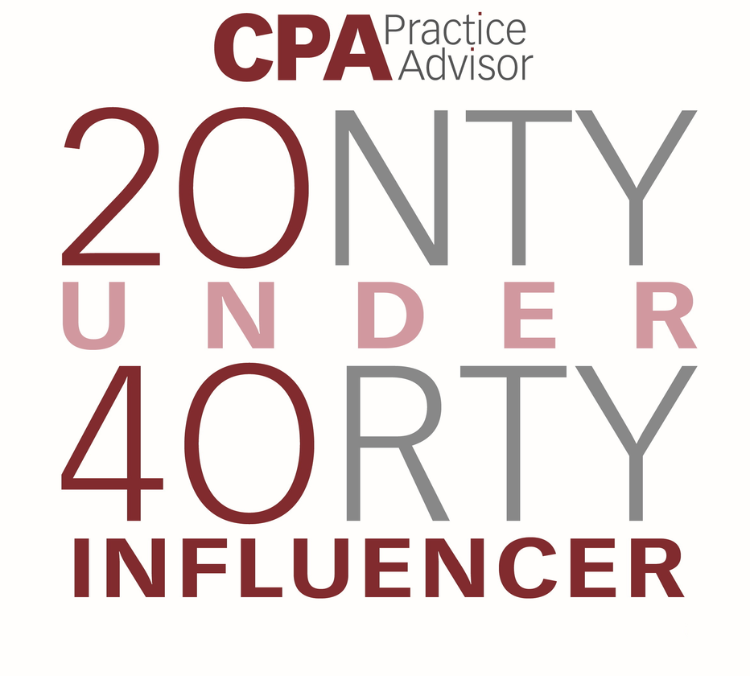
Thank You
CONTACT
Dtoth@WindingRiverConsulting.com
p: 440.723.3653
f: 440.723.3654
SKILLS
Leader, Speaker, Influencer
Change Agent

