Slide 1


Executive Presence
Personal Branding & LinkedIn
October, 2026
David Toth

Slide 2
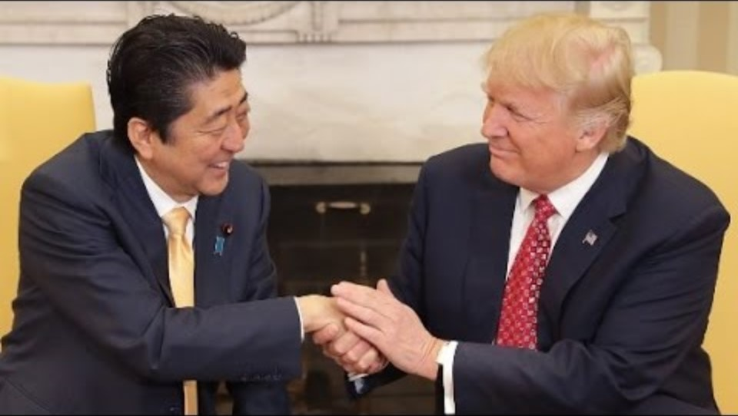
The Handshake
Notes:
Japanese Prime Minister Shinzo Abe

Slide 3
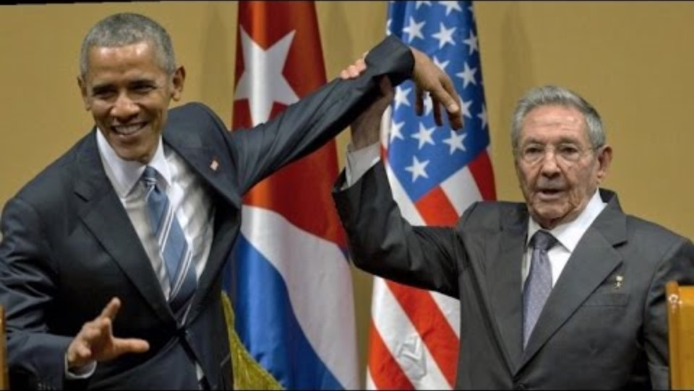
The Handshake
Notes:
Raul Castro

Slide 4
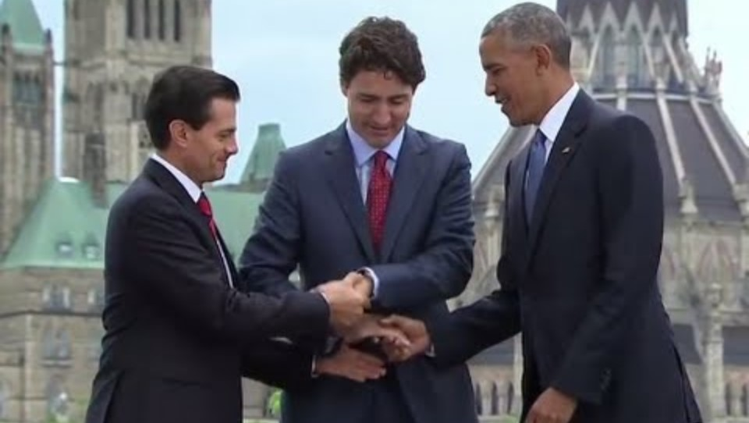
The Handshake
Notes:
Canadian prime minister Justin Trudeau
Mexican President Enrique Pena Nieto

Slide 5
Who has the most memorable handshake?

Slide 6
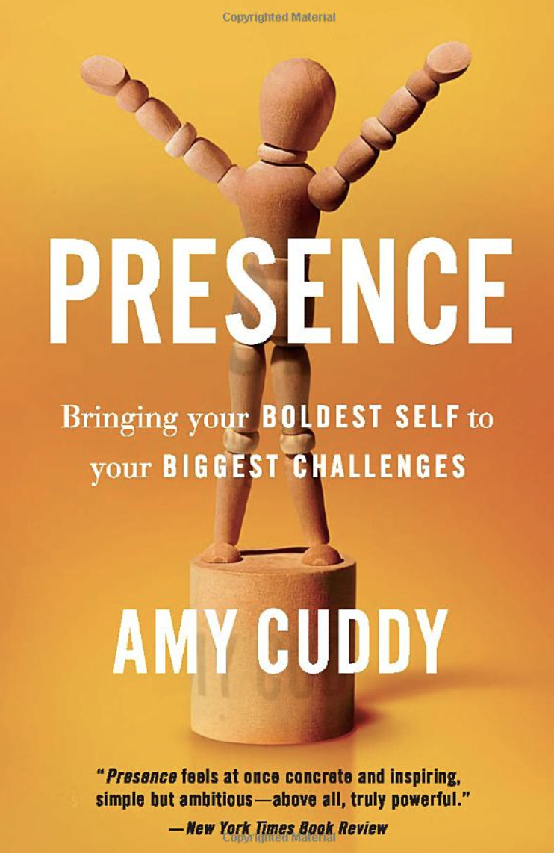
“The research I’ve been doing for years now joins a large body of inquiry into a quality I call presence. Presence stems from believing in and trusting yourself—your real, honest feelings, values, and abilities. That’s important, because if you don’t trust yourself, how can others trust you? Whether we are talking in front of two people or five thousand, interviewing for a job, negotiating for a raise, or pitching a business idea to potential investors, speaking up for ourselves or speaking up for someone else, we all face daunting moments that must be met with poise if we want to feel good about ourselves and make progress in our lives. Presence gives us the power to rise to these moments."

Slide 7
Your posture is evidence of how you feel about yourself, and by improving it, even right now, you will become more self-confident.

Slide 8
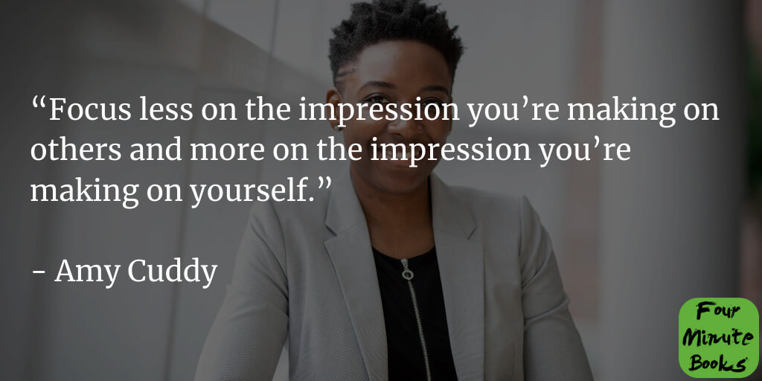

Slide 9
Executive Presence

Slide 10
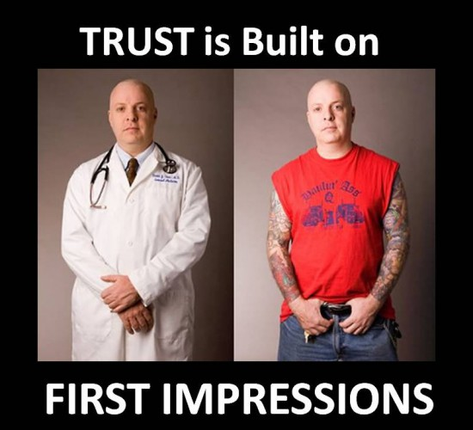
First Impressions

Slide 11

Executive Presence
Easy to recognize, hard to define
Appearance
Communication
Gravitas
Notes:
Inspire Confidence

Slide 12
Executive presence is about your ability to inspire confidence:
Inspiring confidence in your subordinates that you’re the leader they want to follow
Inspiring confidence among peers that you’re capable and reliable
Inspiring confidence among senior leaders that you have the potential for great achievements.

Slide 13
Your Executive Presence
How would you characterize your own Presence?
I’m good!
Not bad, could be better.
Oh, boy!
Huh?

Slide 14
Let’s Get Personal
Your Brand

Slide 15
A Brand…
is more than just a name, logo, or product.
It's the overall perception and emotional connection a customer has with a company, product, or service.
It encompasses the public's feeling, opinions, and experiences, influencing how they perceive its value, quality, and overall identity.
A brand is what people think it is, not just what the company says it is.

Slide 16
What others say about you when you’re not in the room.

Slide 17
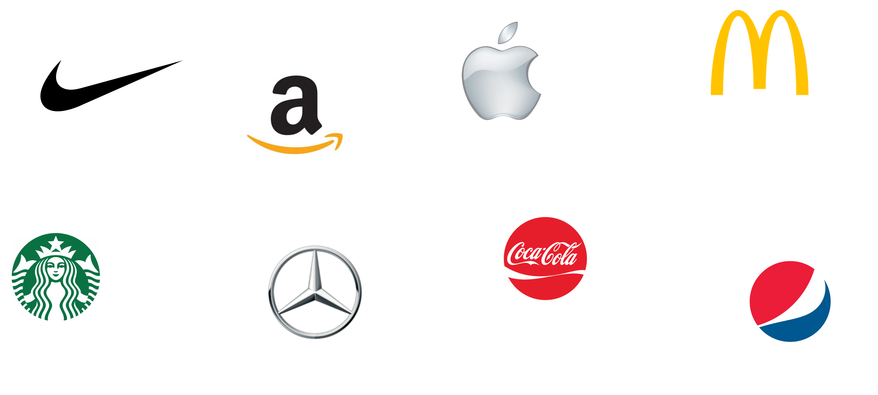
Notes:
A strong brand builds positive associations in people's minds, while a logo serves as a visual cue to trigger those associations.
Pause on recognition
“Take a second and look at these logos. Without me saying anything, you already have feelings and assumptions about each.”
Highlight immediacy
“Notice how fast that happened. That’s the power of a brand — it bypasses facts and goes straight to perception.”
Make it personal
“Now think about this: when people hear your name in a closed-door meeting — what comes to mind that quickly? That’s your personal brand at work.”
Perception > Product. Most people haven’t even used every one of these brands personally, but they believe something about them (luxury, reliability, value, innovation) because of brand narrative.
Your brand works the same way. Colleagues, clients, and future partners form opinions about you — often before they’ve worked deeply with you — based on signals, reputation, and word of mouth.

Slide 18
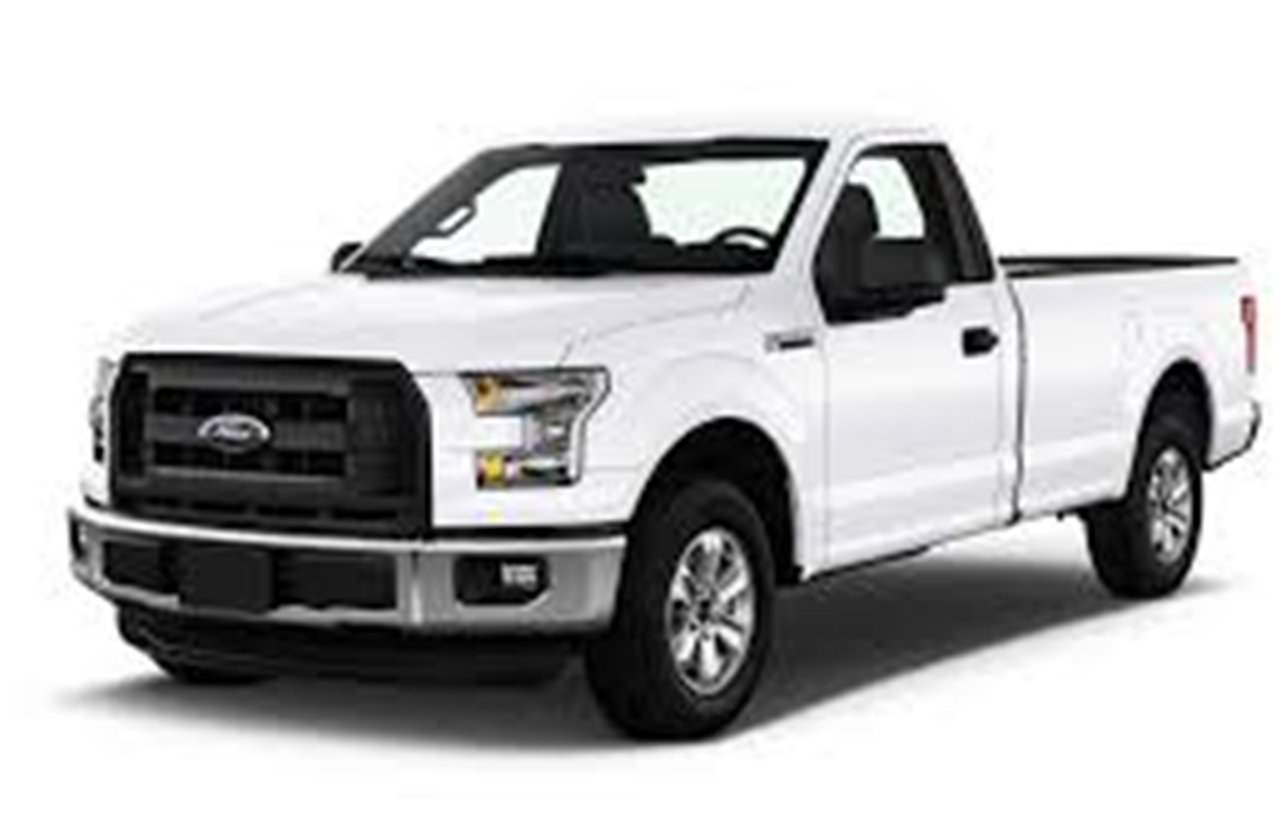
Notes:
he 2024 J.D. Power U.S. Automotive Brand Loyalty Study shows 65.1% of Ford truck owners (predominantly F‑Series buyers) repurchased within the brand—leading the pack.

Slide 19
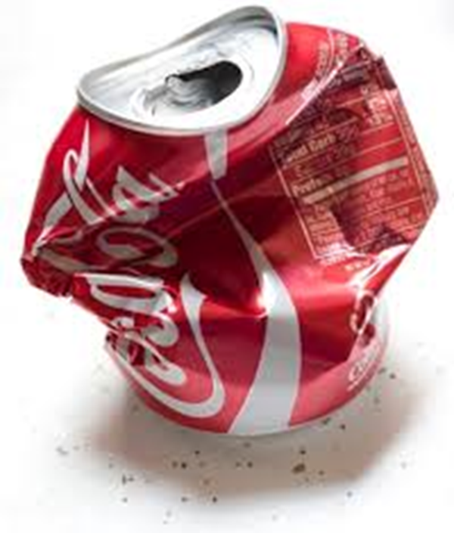
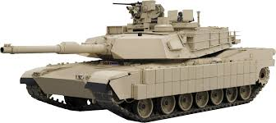
Notes:
Aluminum is a commodity. So how do you differentiate?
Leverages authority
Reality: The material isn’t magical—it’s aluminum. It has pros (lighter weight, corrosion resistance) and cons (more expensive repairs, different dent characteristics).
Perception: The truck now feels futuristic, high-tech, and rugged. The story neutralized skeptics and gave Ford a talking point that competitors struggled to counter.
Net result: They reframed a potential liability (using aluminum instead of steel) into a brand strength—and loyalty numbers show it stuck.
Coke cans and tanks share aluminum, but Ford turned “commodity metal” into a differentiator through brilliant brand framing. They sold the story more than the substance—and the market rewarded them.

Slide 20
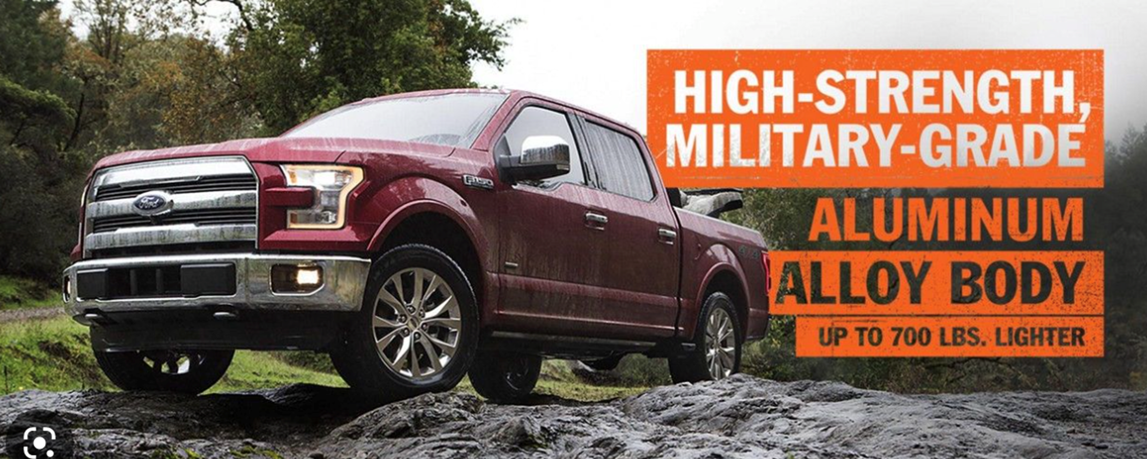

Slide 21
YOUR Brand
Notes:
Personal branding is becoming less of a competitive edge and more of a requirement for anyone looking to grow their business; get that dream job; or take their career to the next level.

Slide 22
Personal (Business) Brand
Your brand is how people perceive you compared to others in like roles.
Who are you?
What do you do?
What’s most important to you?
What do you stand for?
What value do you bring?
Why do people like you?
Why do people trust you?
What is a non-negotiable?
How and where do you communicate it?
How would people describe you?

Slide 23
Overlap*
You
Your Profile
Firm
Company Profile
*Articles, announcements, events, deadlines, industry changes/updates, new hires, etc.

Slide 24
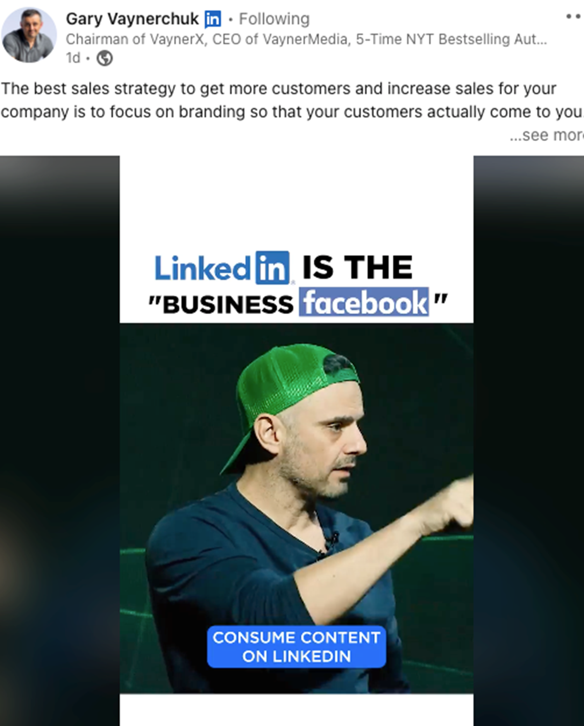
Your DIGITAL (Personal) Brand

Slide 25
80%

Slide 26
40% of monthly active users visit LinkedIn daily.
4 out of 5 people on LinkedIn “drive business decisions”
Americans aged 30 to 49 used LinkedIn the most
LinkedIn posts with images see 2x higher comment rates
82% of B2B marketers see success on LinkedIn

Slide 27
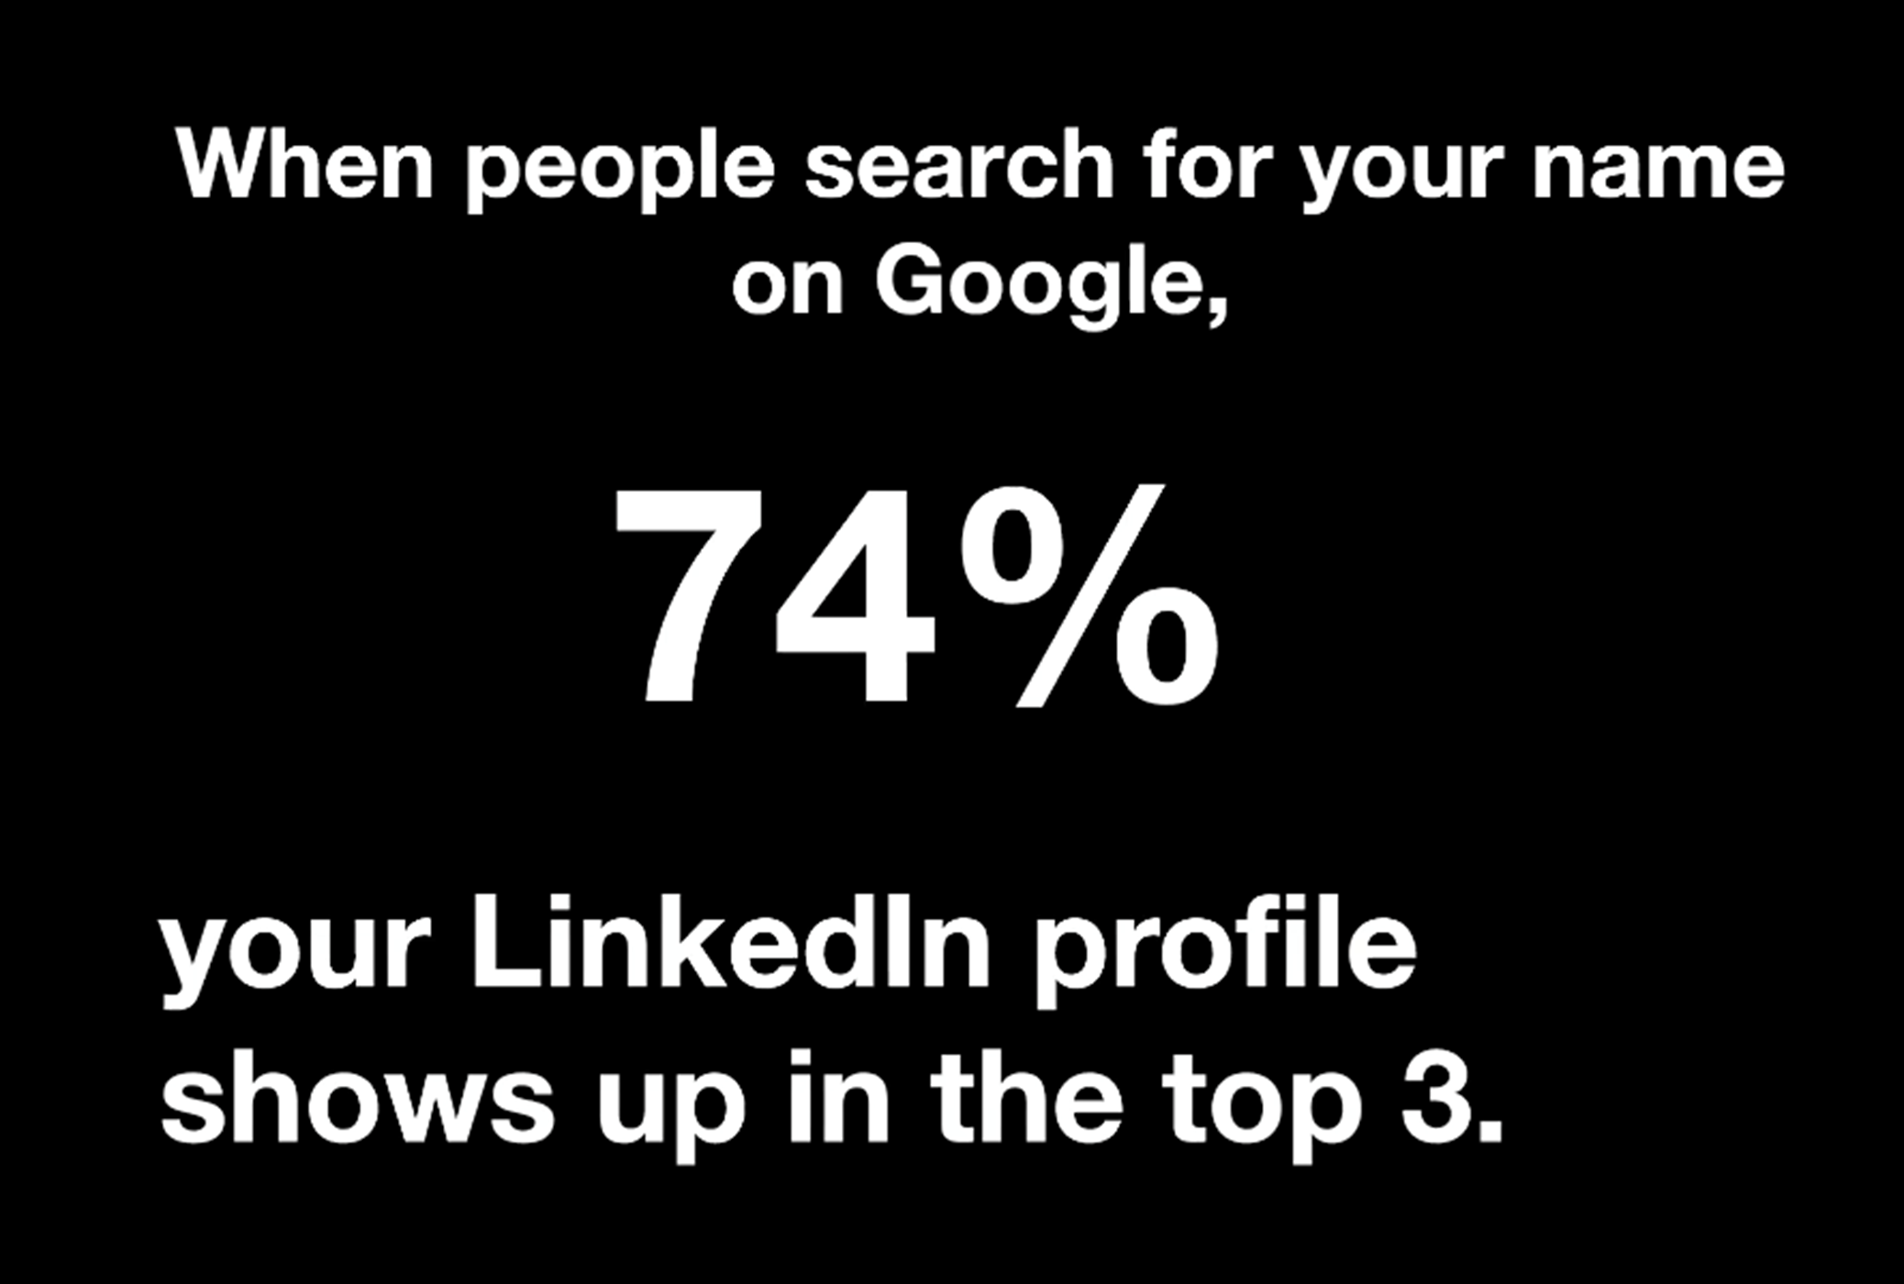
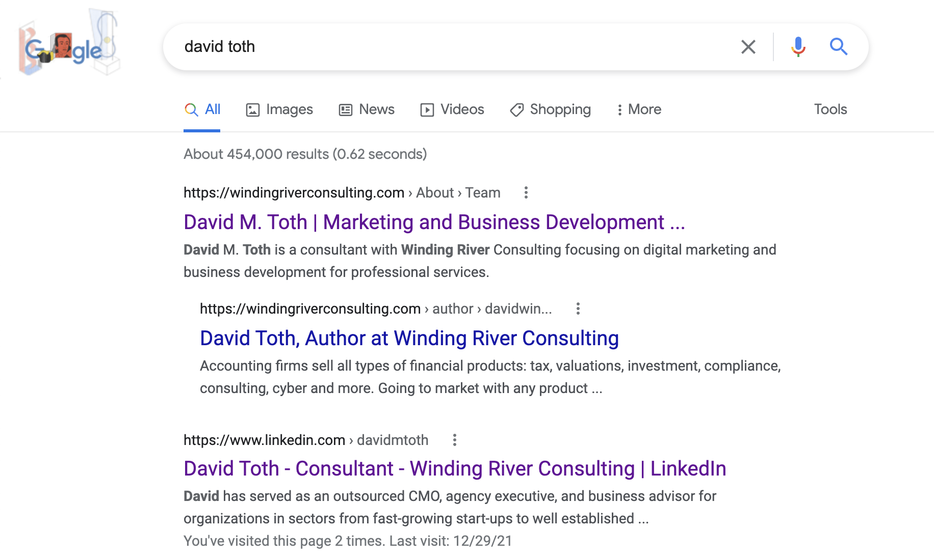

Slide 28
Social Selling
Establish your professional brand - Complete your profile with the customer in mind. Become a thought-leader by publishing meaningful posts.
Find the right people - Identify better prospects in less time using efficient search and research tools
Engage with insights - Discover and share conversation-worthy updates to create and grow relationships.
Build relationships - Strengthen your network by connecting and establishing trust with decision makers

Slide 29
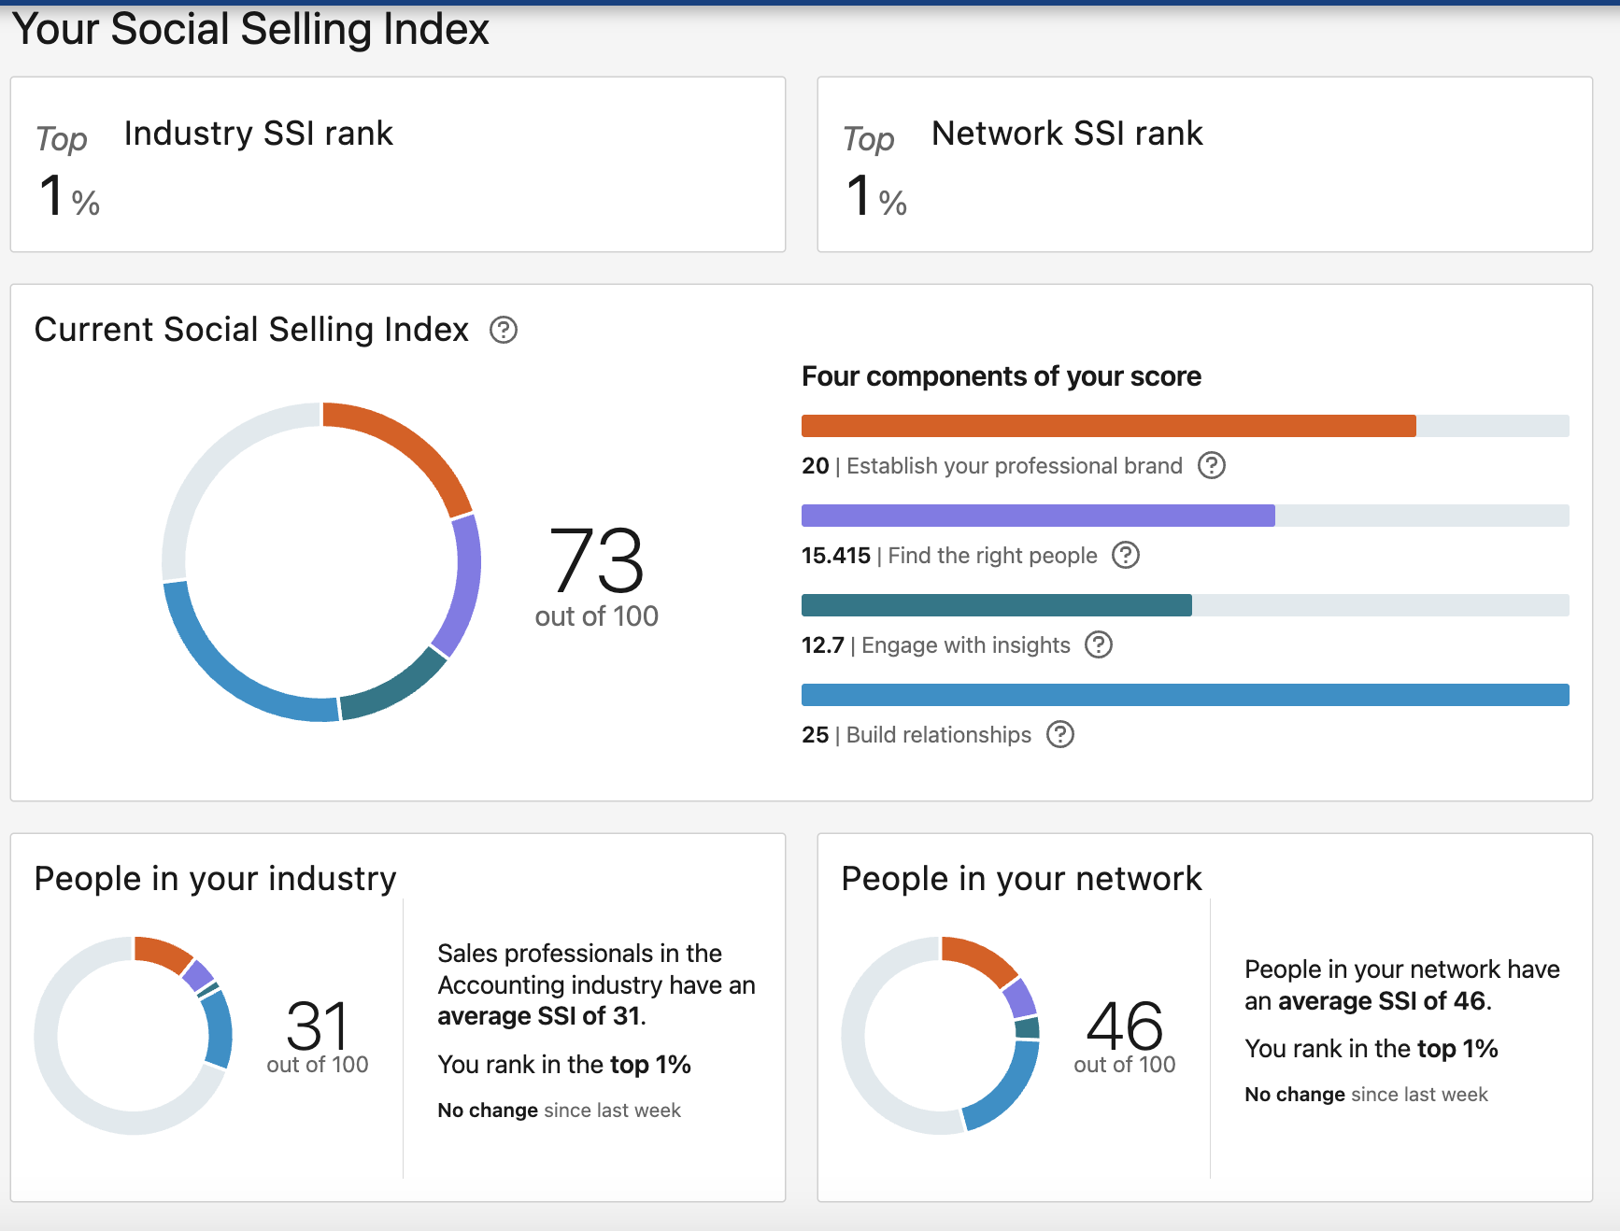
Social Selling Index Score
The Social Selling Index (SSI) | LinkedIn Sales Solutions

Slide 30
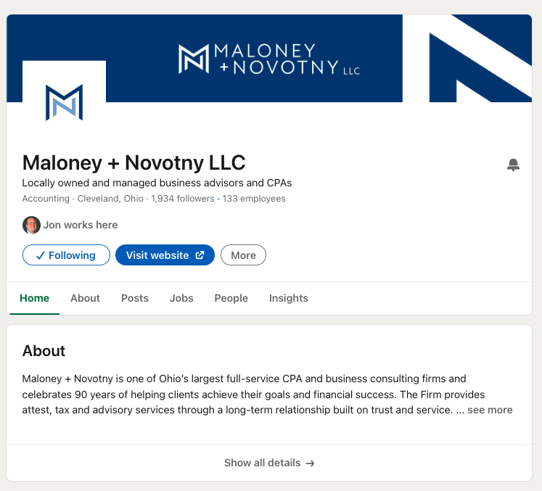
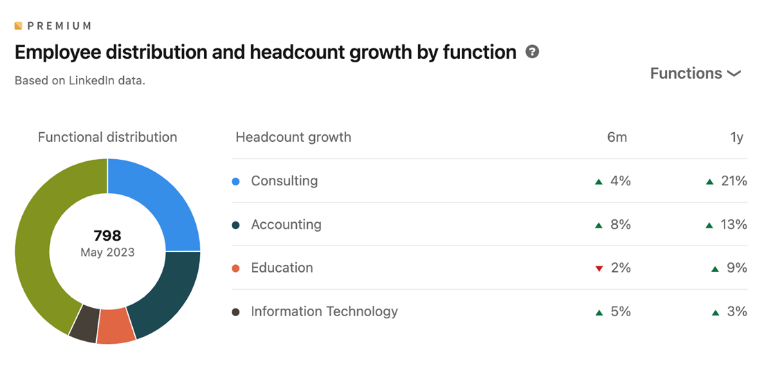
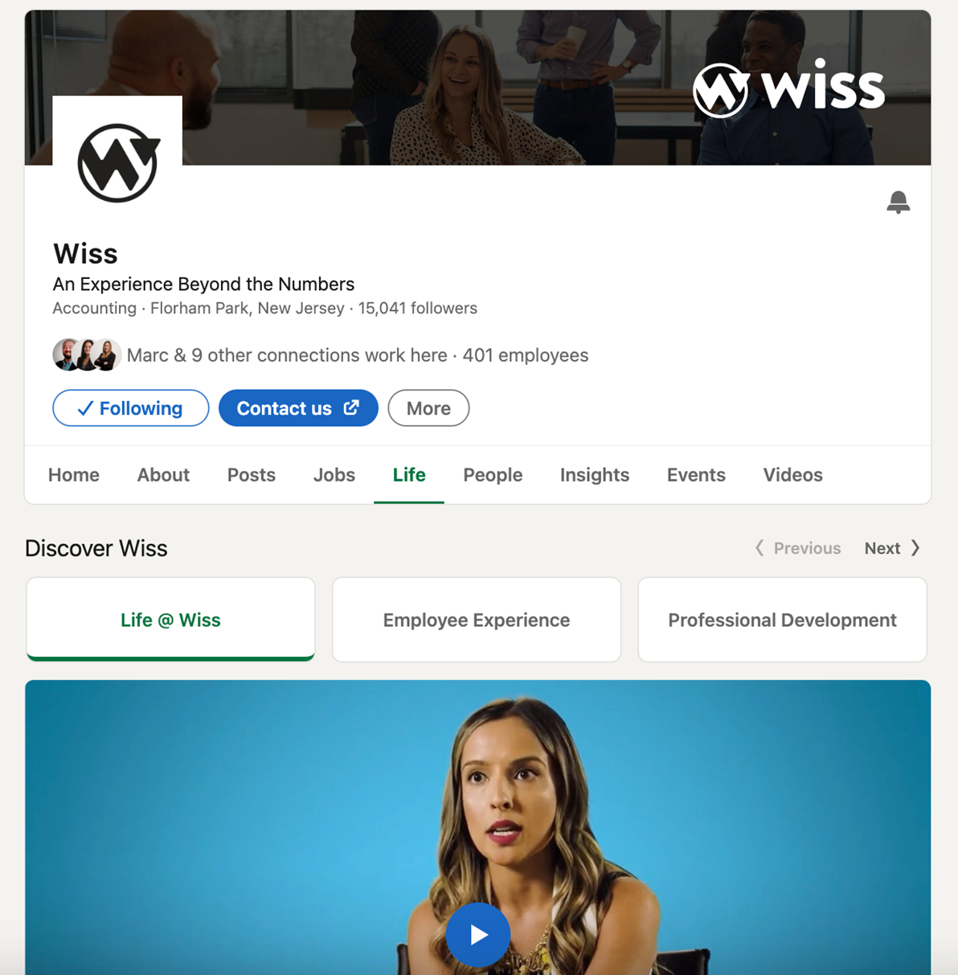
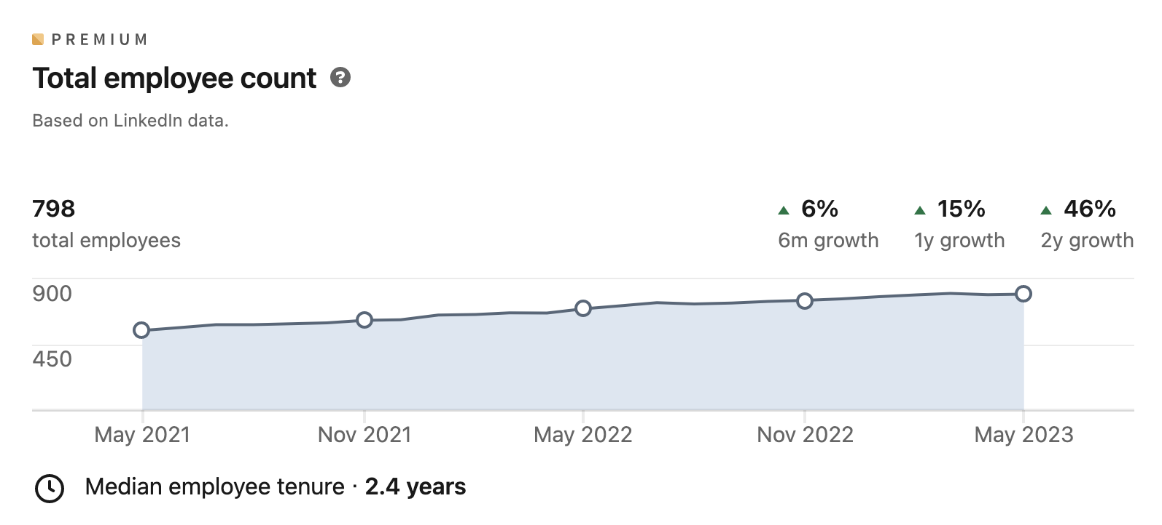
A Business Page

Slide 31
Personal vs Business
 | Personal Page | Business Page
Purpose | Showcase individual skills and experience | Promote a company, its brand, and culture
Who it represents | Individuals | Organizations
Focus | Your career journey, achievements, and qualifications | Company information, products, services, and news
Connections | Build a network of professional contacts | Grow brand awareness and attract followers
Engagement | High (through comments, likes, and shares) | Lower (organic reach can be limited)
Content | A mix of professional and personal content (articles, updates, discussions) | Company updates, job postings, industry news, and thought leadership content
Activity | Can actively connect with others, join groups, participate in discussions | Limited activity options
Advertising | Limited paid advertising options | Access to a wider range of paid advertising features
Analytics | Provides insights into your profile views and engagement | Provides insights into page views, follower demographics, and content performance

Slide 32
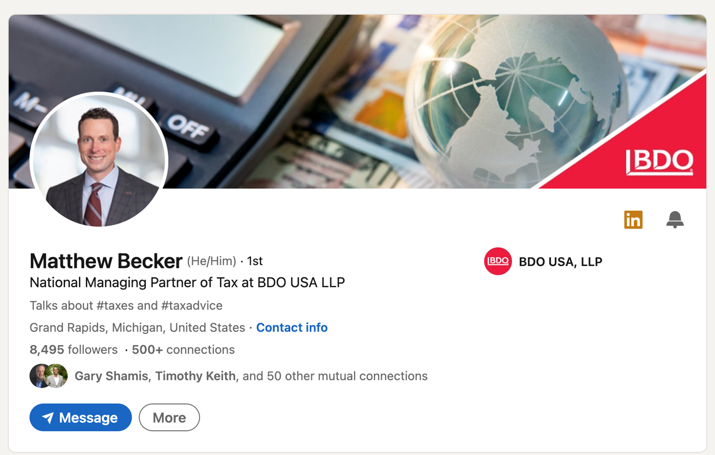
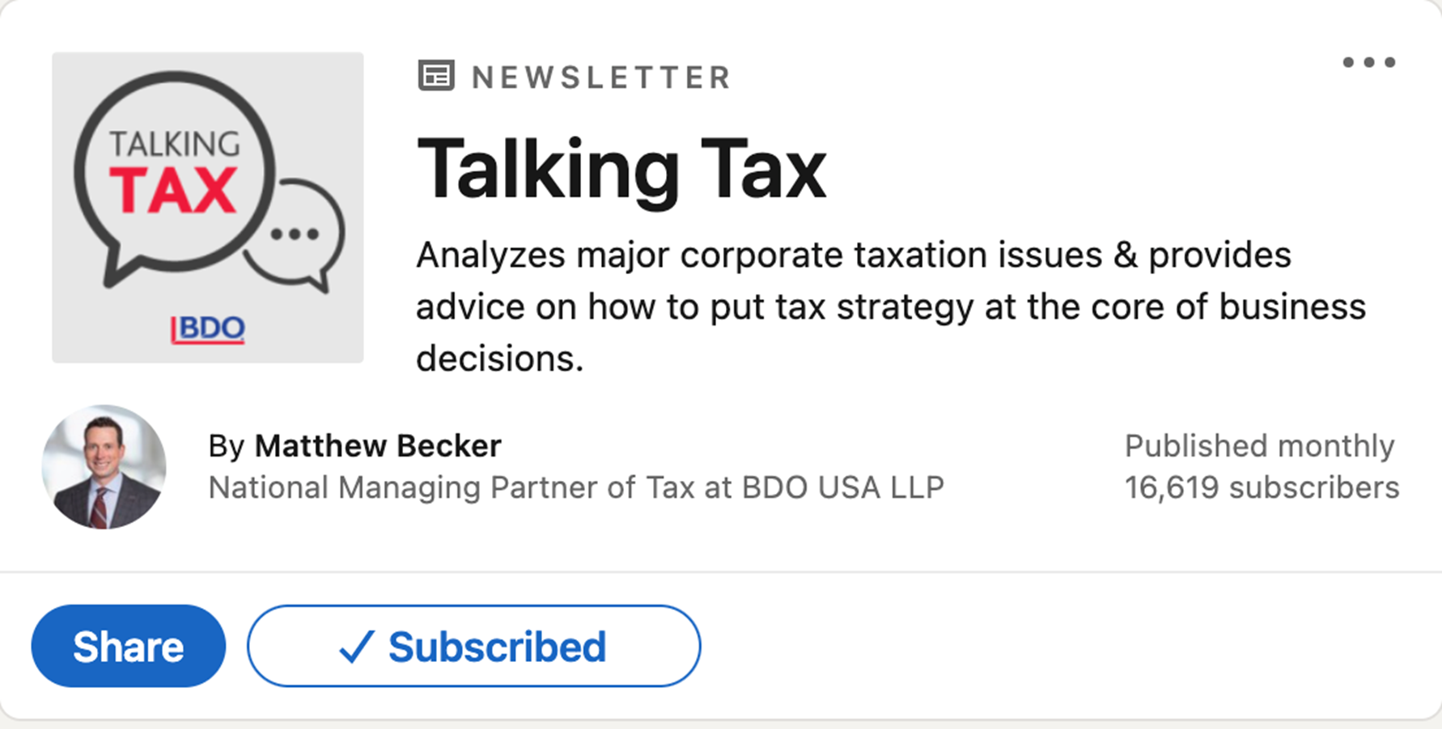
Personal + Business

Slide 33
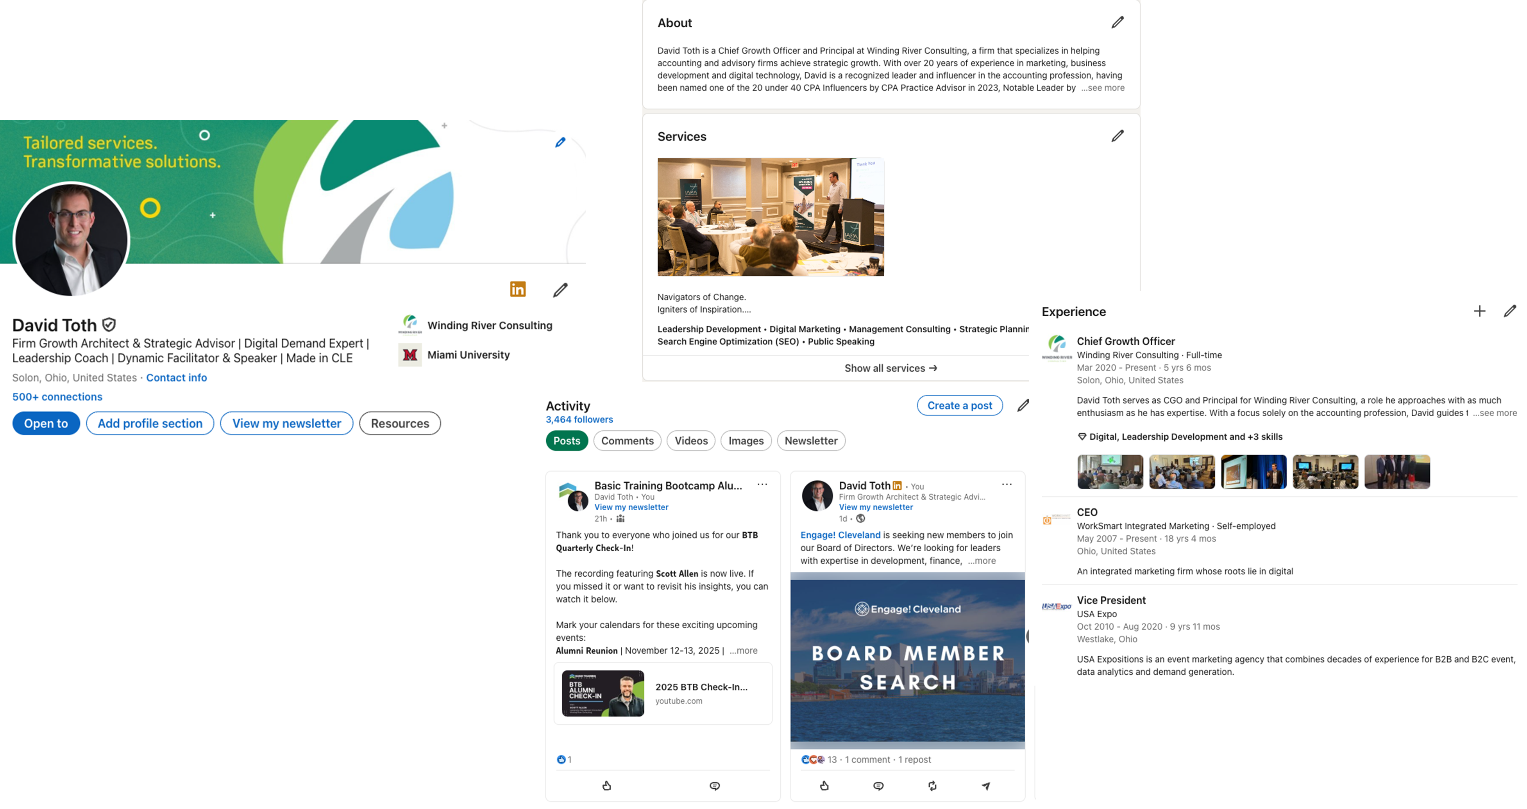
A Personal Page

Slide 34
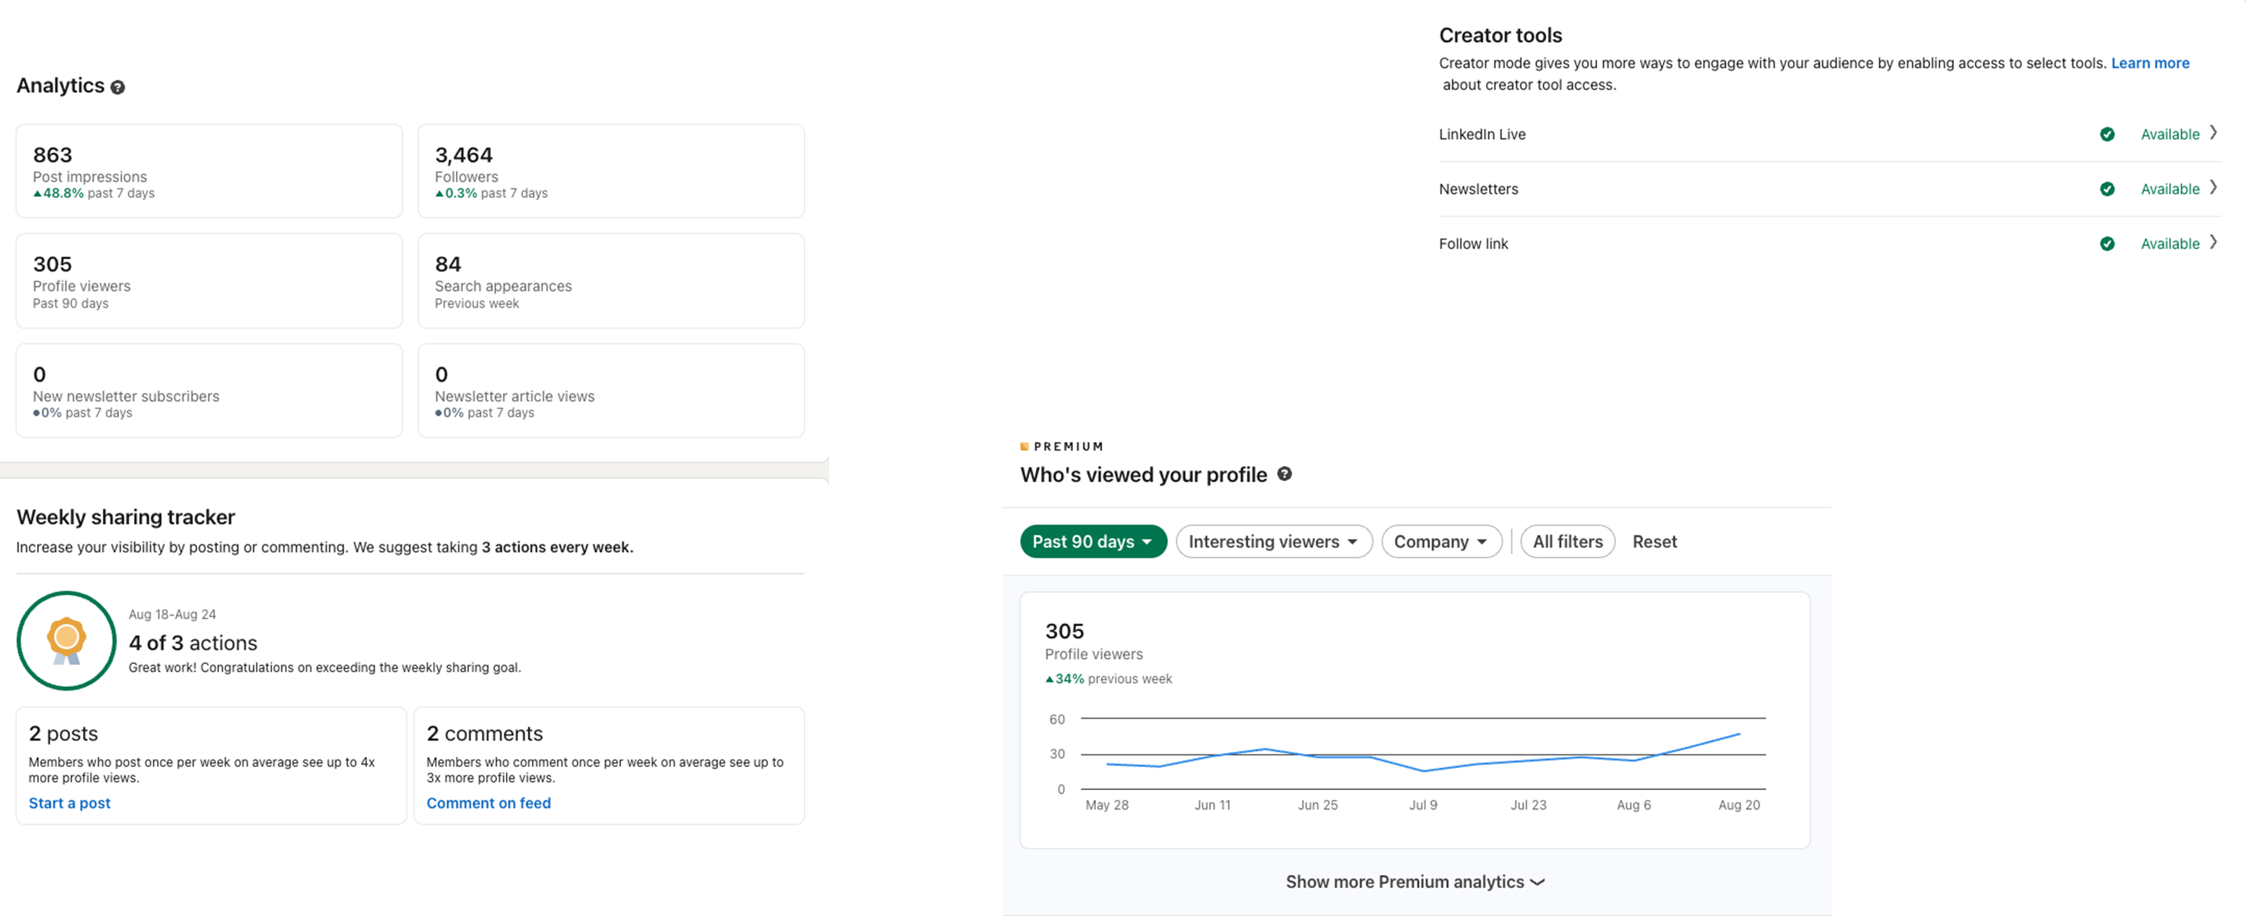
A Personal Page

Slide 35
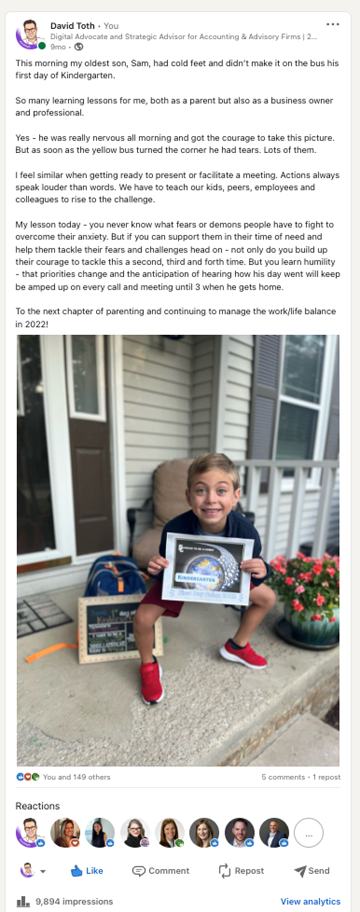
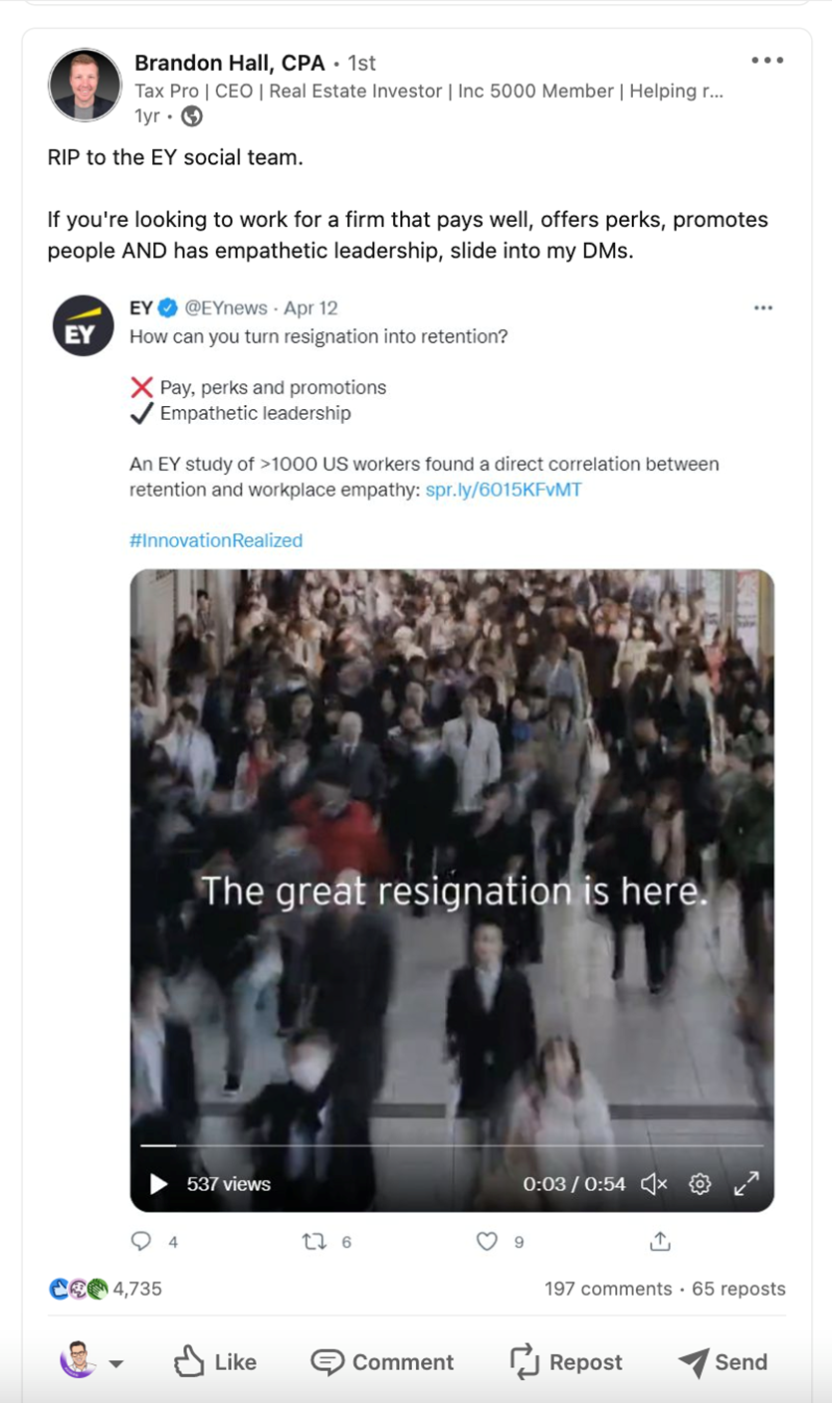
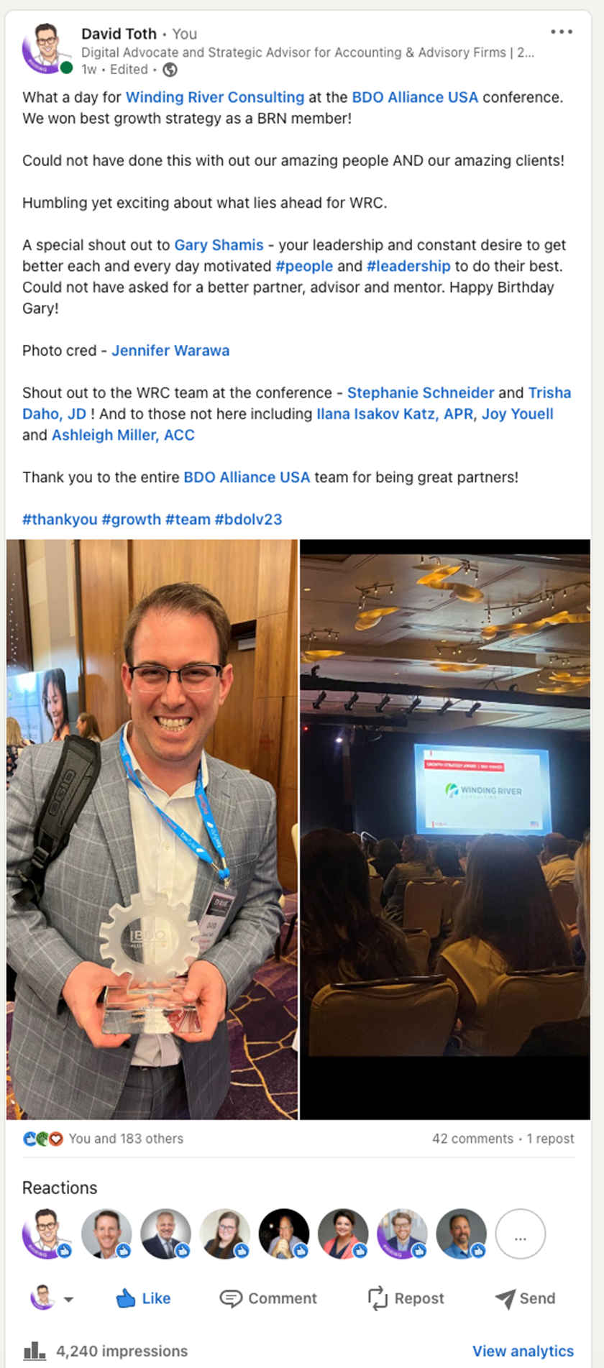
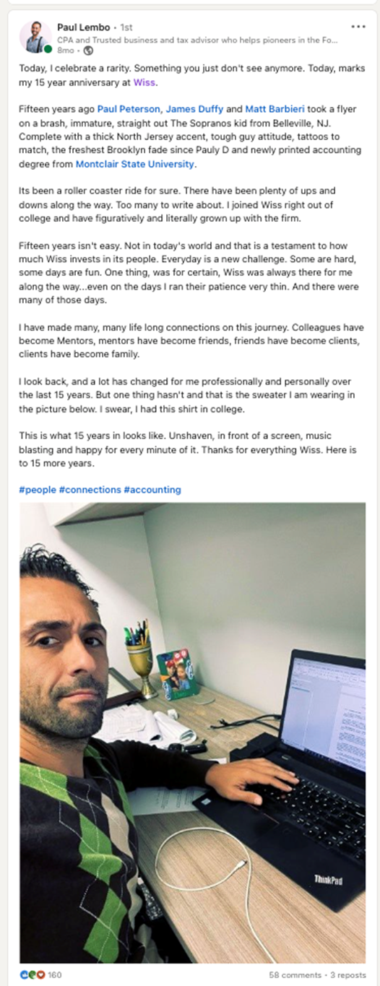
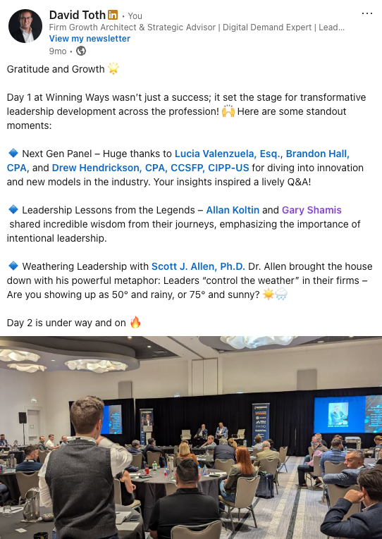
A Personal Page

Slide 36
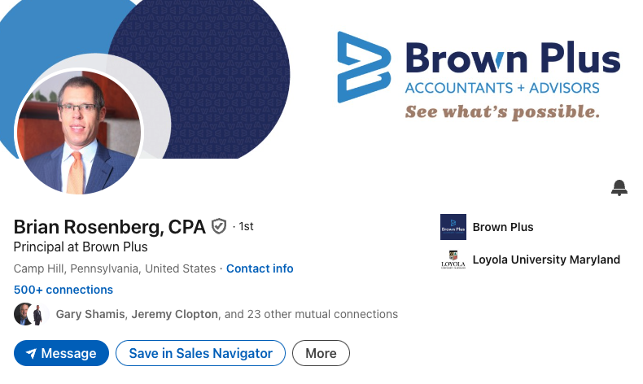
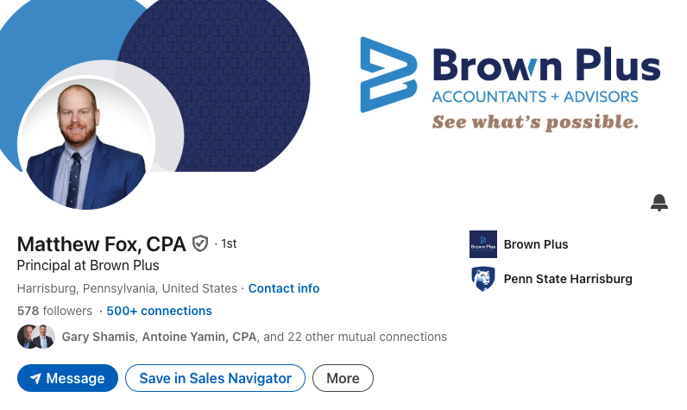
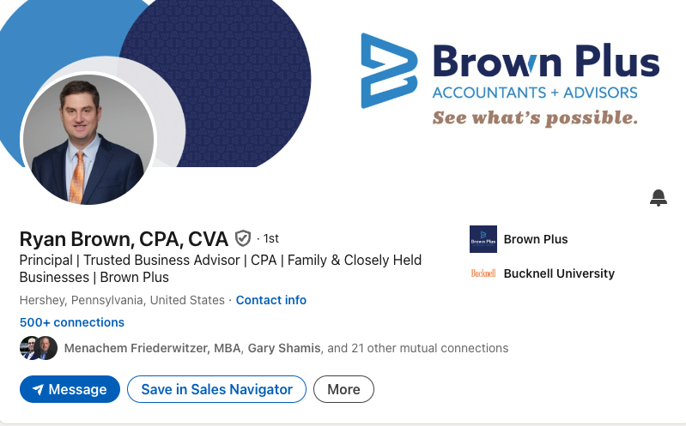
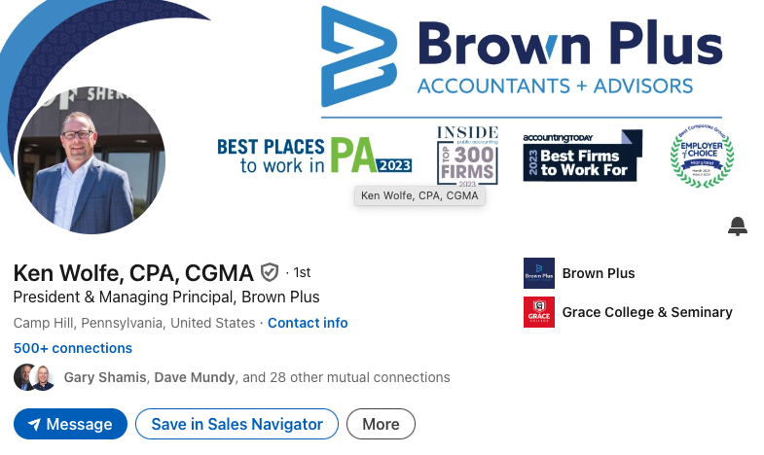
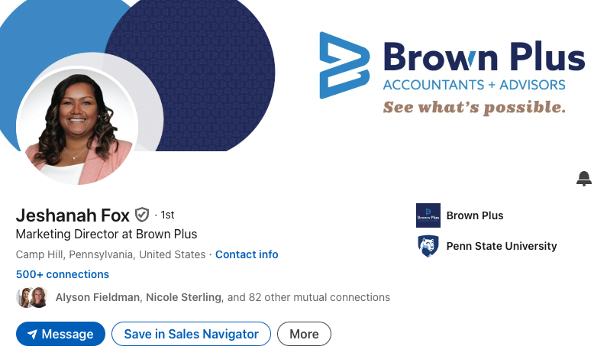

Slide 37
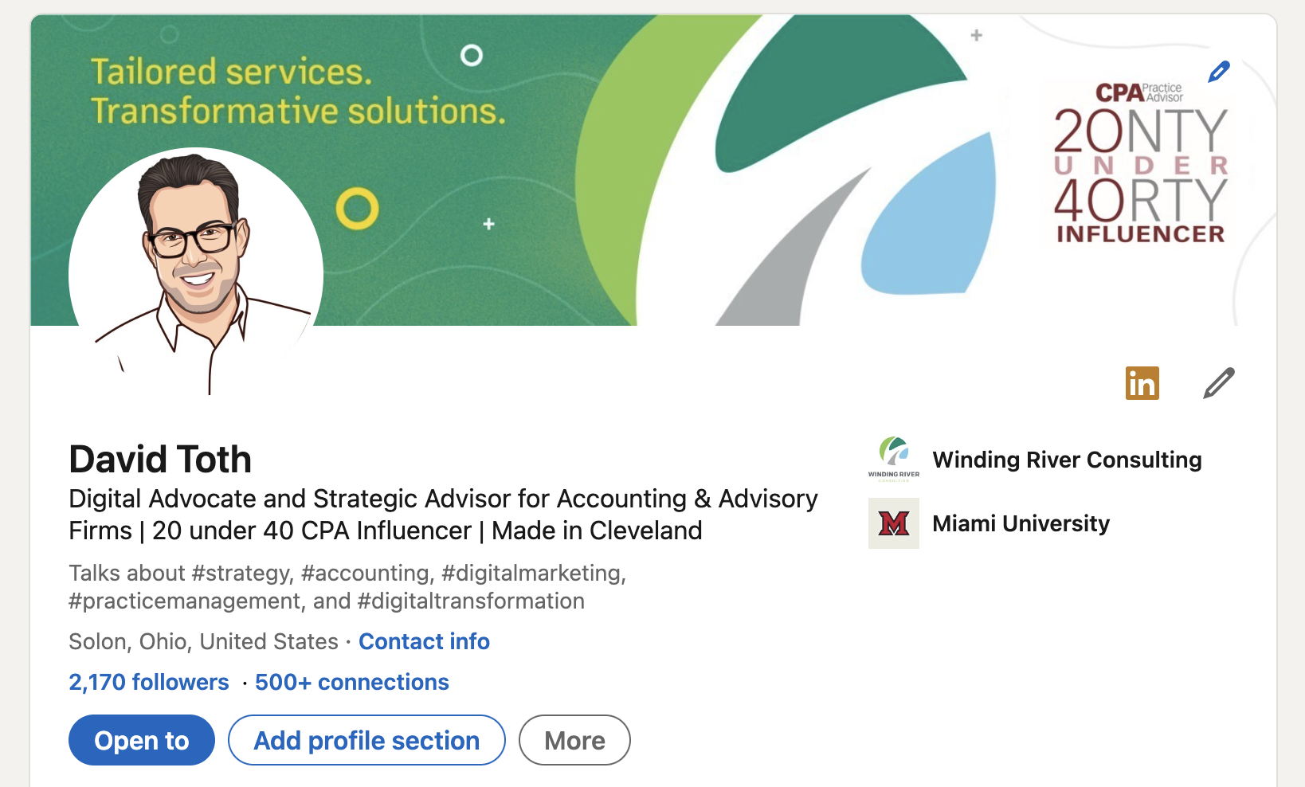
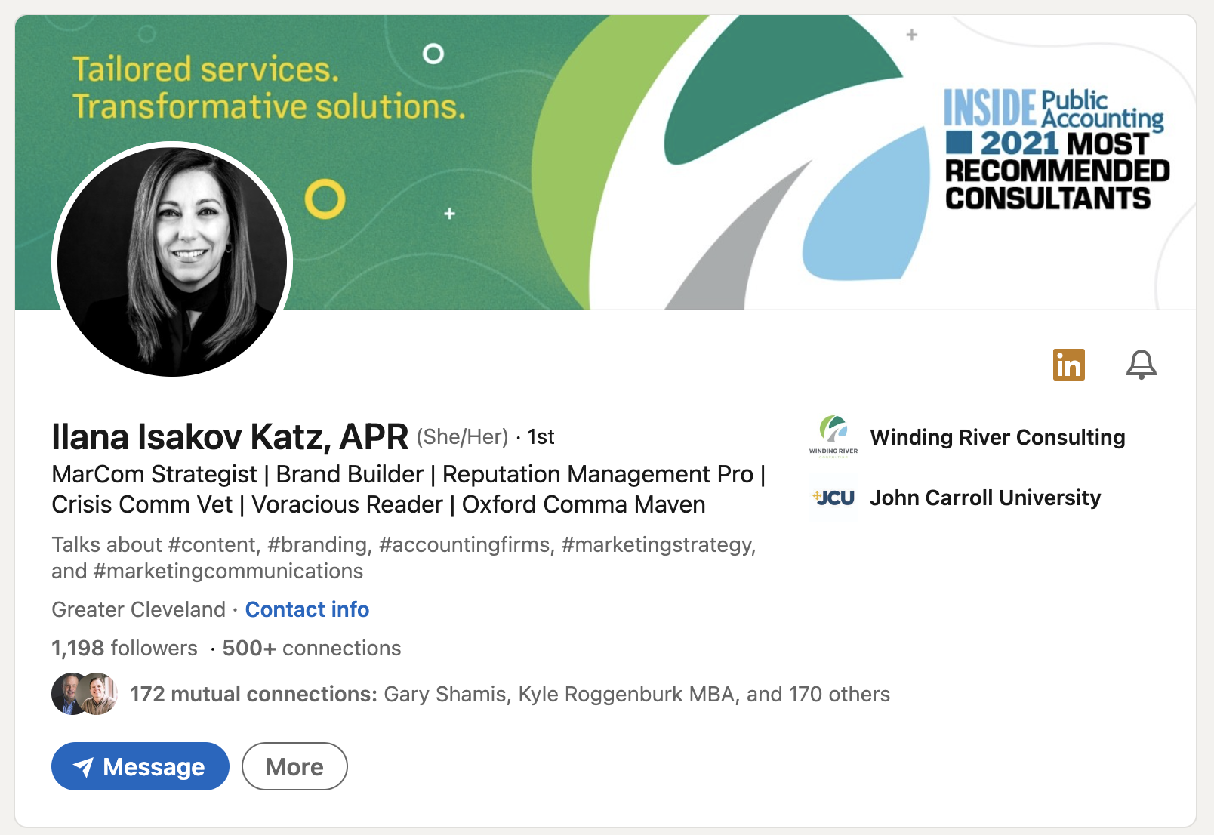
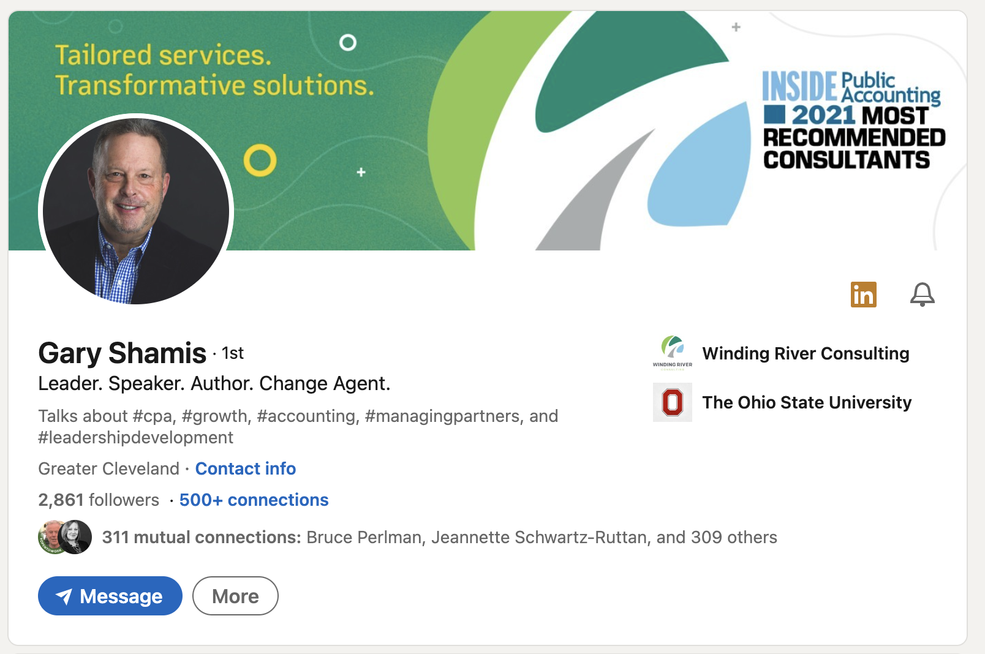

Slide 38
Your Profiles

Slide 39
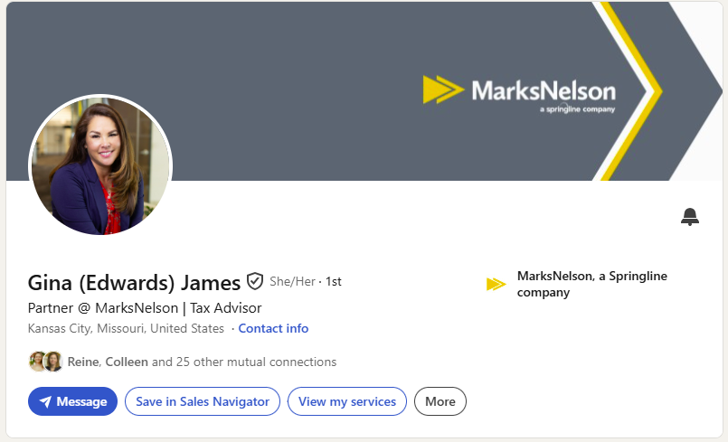
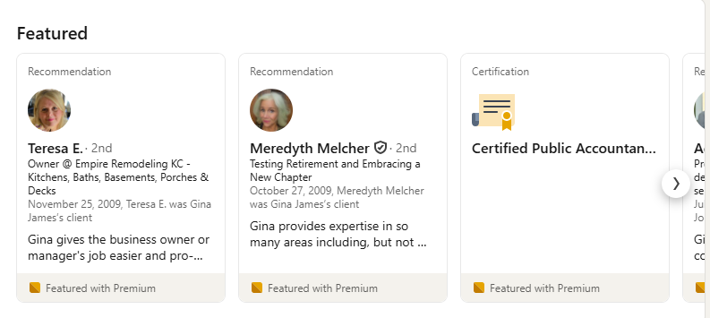
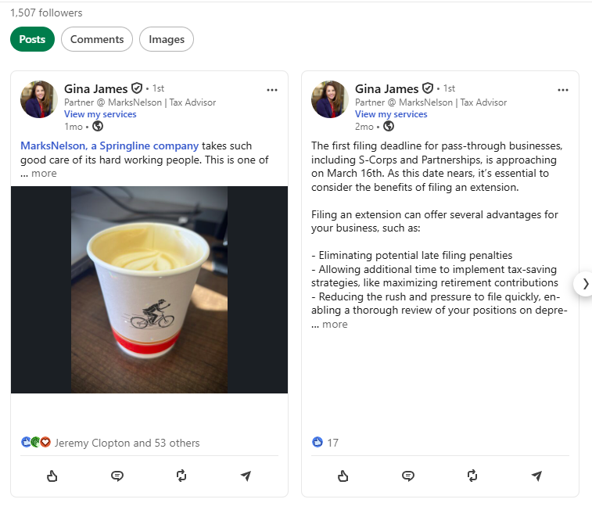
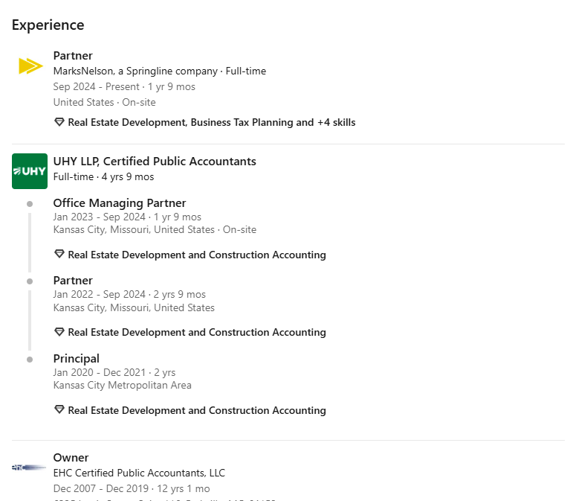
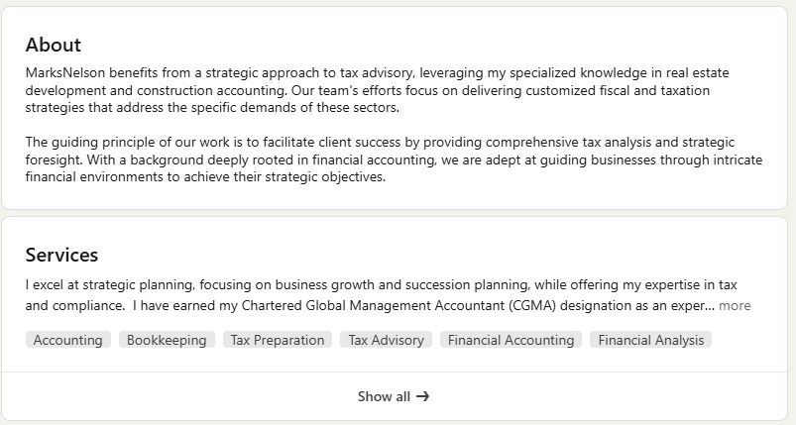
Notes:
Gina James | LinkedIn

Slide 40
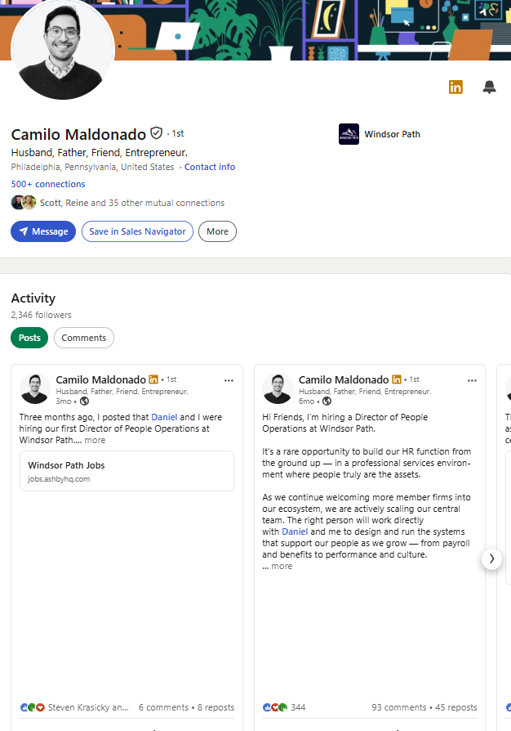
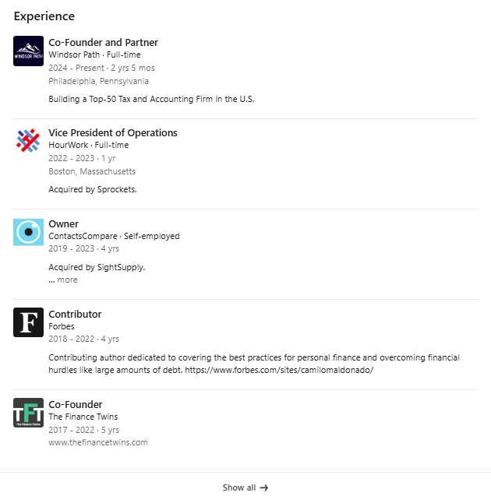
Notes:
Camilo Maldonado | LinkedIn

Slide 41
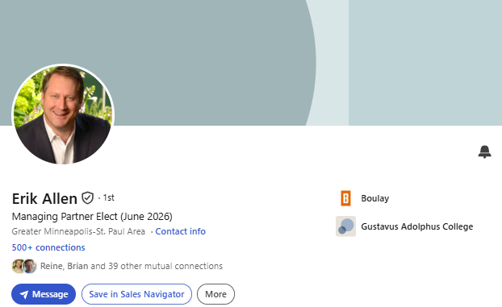
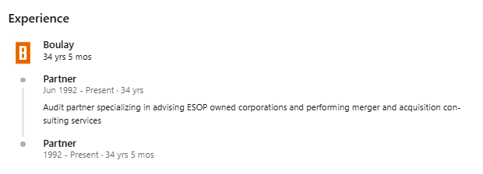
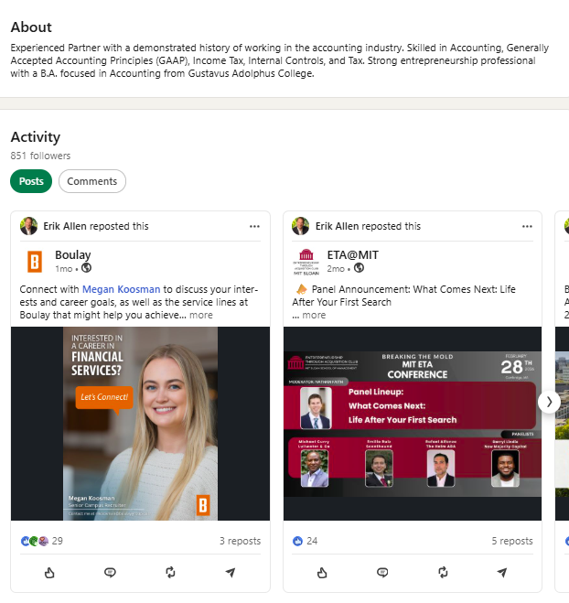
Notes:
Erik Allen | LinkedIn

Slide 42
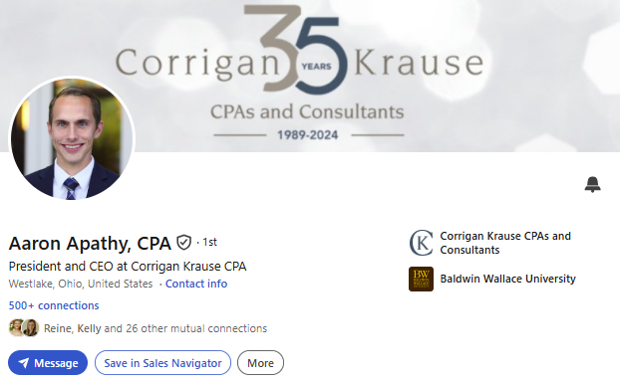
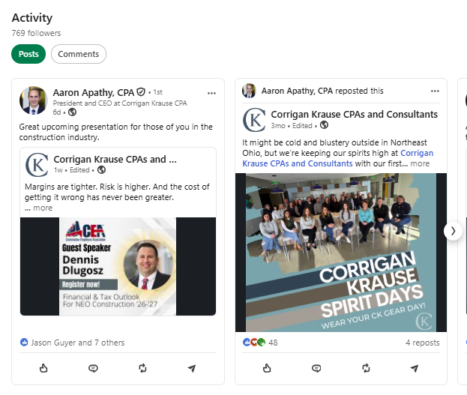
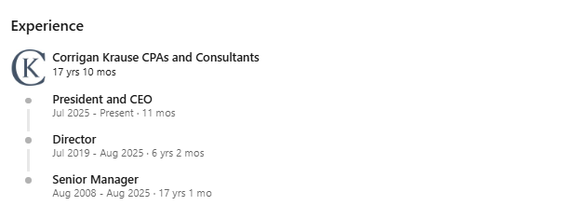
Notes:
Aaron Apathy, CPA | LinkedIn

Slide 43
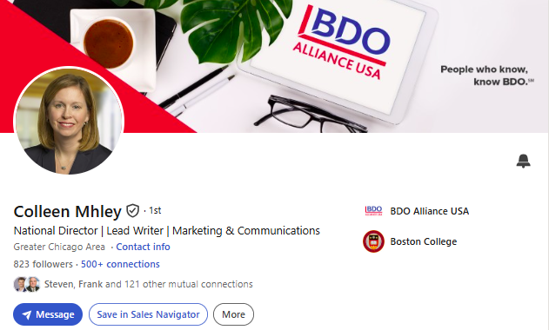


Notes:
Colleen Mhley | LinkedIn

Slide 44


Notes:
Paula Lathrop, CPA | LinkedIn

Slide 45



Notes:
Kevin Kroskey, CFP®, MBA | LinkedIn

Slide 46



Notes:
Irwin Steinberg | LinkedIn

Slide 47
Ways to Engage Personally
Follow your firm’s company page to ensure you receive notifications
Login to LinkedIn 3-5 times per week to check your feed and make new connections
Respond to comments and like or react to posts from industry leaders, authoritative pages, colleagues, and/or friends
Share content from authoritative sources on your feed (industry journals, Tier 1 news publications, accounting experts) – be sure to add commentary
Like, react, share your firm’s posts (you will be notified when the company page has a new post)
Join accounting and/or industry specific LinkedIn groups and regularly engage
Create your own new content with the goal of posting once a week
Tag firm, or tag individuals (using “@”) in work-related posts

Slide 48
Ways to Engage Personally
Follow your firm’s company page to ensure you receive notifications
Login to LinkedIn 3-5 times per week to check your feed and make new connections
Respond to comments and like or react to posts from industry leaders, authoritative pages, colleagues, and/or friends
Share content from authoritative sources on your feed (industry journals, Tier 1 news publications, accounting experts) – be sure to add commentary
Like, react, share your firm’s posts (you will be notified when the company page has a new post)
Join accounting and/or industry specific LinkedIn groups and regularly engage
Create your own new content with the goal of posting once a week
Tag firm, or tag individuals (using “@”) in work-related posts

Slide 49
LinkedIn Features

Slide 50

The Bell

Slide 51


Service Page

Slide 52




Tools

Slide 53




Who’s Viewed Your Profile

Slide 54



Newsletter

Slide 55

Video
Videos get shared 20 times more than any other content format on LinkedIn.

Slide 56




Search Filters

Slide 57


Thank You
CONTACT
Dtoth@WindingRiverConsulting.com
p: 440.723.3653
f: 440.723.3654
SKILLS
Leader, Speaker, Influencer
Change Agent

Slide 58



SCAN HERE
Scan the QR Code
To complete our survey
and receive CPE credits

