Slide 1


WELCOME!
MPB | Leadership Accelerated
May, 2025
Cohort 19

Slide 2
Pre-Bootcamp Survey
Top Challenges Faced by Leaders:
Time Management: Many respondents mentioned difficulty managing their time, balancing responsibilities, and finding time to focus on strategic goals.
  "Time to evaluate the Service Line and stay ahead of client needs."
  "Hours in a day / 'getting it all done' / Sustainable workload."
  "Switching between tasks and maintaining focus.“
Delegation and Team Management: Leaders struggle with effectively delegating tasks and managing team performance.
  "Showing up as a leader while being present for the team."
  "Managing people with different personalities and skill sets."
  "Driving firm growth while handling team dynamics.“
Strategic Planning and Goal Execution: Participants face challenges in setting clear goals and executing them effectively.
  "Time to execute goals and visions."
  "Balancing long-term strategy with day-to-day operations."
  "Maintaining focus on strategic initiatives."

Slide 3
Pre-Bootcamp Survey
Top Goals for the MPB Program:
Leadership Skill Enhancement: Participants are looking to refine their leadership abilities, including decision-making and communication.
  "Tools to help me manage this role more effectively."
  "Better understanding of what it takes to be a successful leader."
  "Strategies to improve leadership impact.“
Networking and Peer Learning: Many are seeking to connect with other leaders and learn from their experiences.
  "Learn from other leaders who might have more experience."
  "Networking and strategies to improve my approach."
  "Gaining perspectives from peers.“
Strategic Decision-Making: Gaining clarity and confidence in making leadership decisions.
  "Understanding how to set and achieve strategic goals."
  "Making better, faster decisions."
  "Getting new approaches for problem-solving."

Slide 4
Pre-Bootcamp Survey
Most Desired Leadership Skills:
Effective Communication: Respondents emphasized the importance of giving feedback, managing difficult conversations, and presenting ideas clearly.
  "How to give feedback effectively and impactfully."
  "Setting and holding clear expectations with the team."
  "Communicating decisions and direction clearly.“
Emotional Intelligence and Self-Management: Balancing personal well-being with leadership responsibilities was frequently mentioned.
  "Ability to balance self-care/health with life and work."
  "Understanding how to manage stress and maintain motivation."
  "Managing emotions and avoiding burnout.“
Strategic Thinking and Financial Knowledge: A few respondents highlighted the need for better strategic planning and financial acumen.
  "Financial/accounting knowledge."
  "Understanding the big picture while handling details."
  "Balancing long-term strategy with immediate priorities."

Slide 5
Strategy & Execution
MPB | Leadership Accelerated
May, 2025
Gary S. Shamis, M. Acc

Slide 6

Strategy without Execution is a waste of time.
Execution without strategy is
a road to nowhere.

Slide 7

Strategy & Execution
Bread & Butter
Peanut Butter & Jelly
Salt & Pepper
Strategy &
Execution

Slide 8
“Good enough” isn’t good enough anymore.
“…everyone needs to find their extra – their unique value contribution that makes them stand out in whatever is their field of employment. Average is over.”
Friedman, Thomas L. (2012, January 24). Average Is Over. The New York Times.

Slide 9
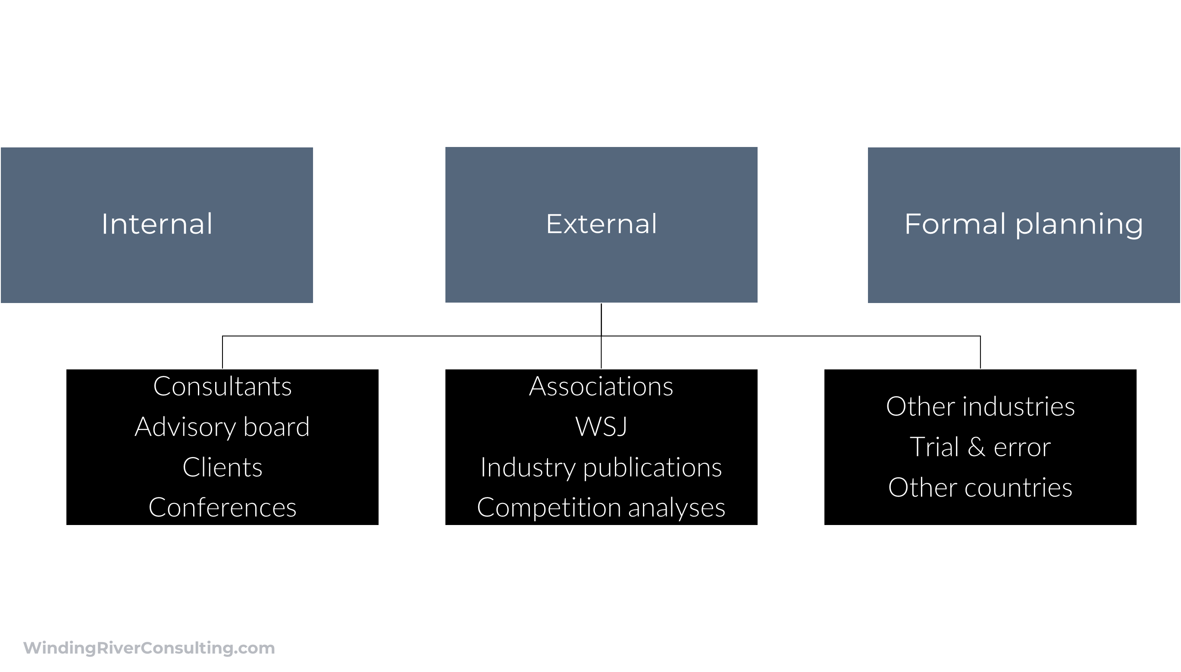
How do you develop strategy?

Slide 10
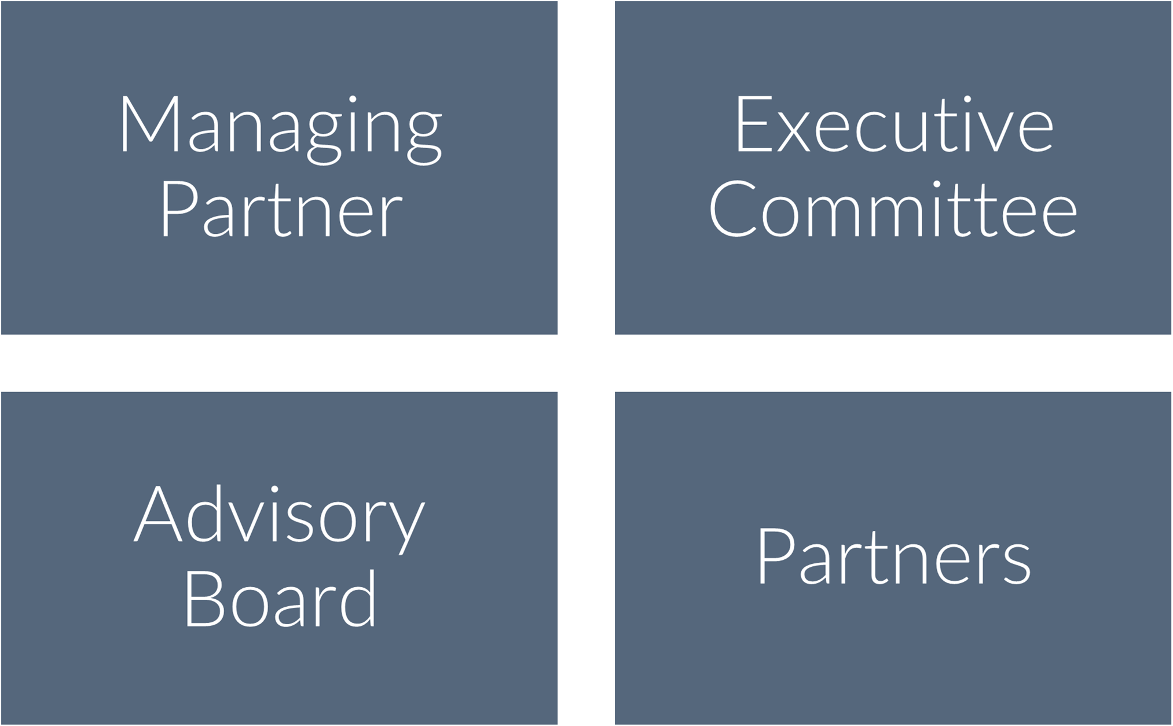
Who Develops Strategy?

Slide 11
Where/why do you develop strategy?

Slide 12
Strategy Tied to
Values

Slide 13
Overarching
Strategy

Slide 14

S.W.O.T. Analysis
Strengths
Weaknesses
Opportunities
Threats

Slide 15
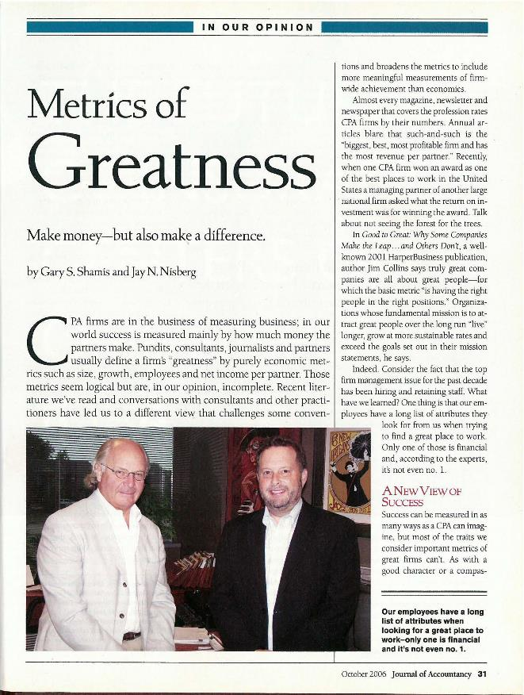
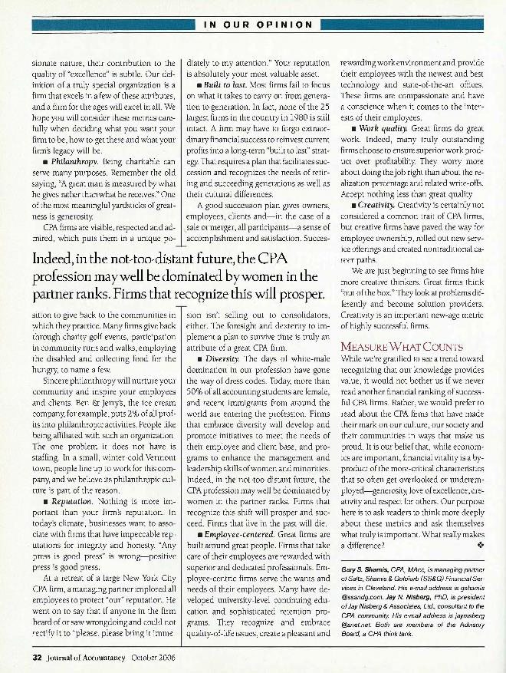
Firm/Partner Goals

Slide 16
You Can’t Do
Everything.

Slide 17
Careful, very careful selection.

Slide 18
Execution
Overall responsibility
My Consulting experience
Accountability
  Advisory Board
  MP/Exec.

Slide 19
Carve Out
Time to
Execute

Slide 20



Charge Hours: Less is More

Slide 21
Strategic Initatives
Those responsible
Accountability
Manageable
e.g., Develop a plan to lower the firm’s turnover rate?
Add in business development professional to the sales business development, and marketing efforts?

Slide 22
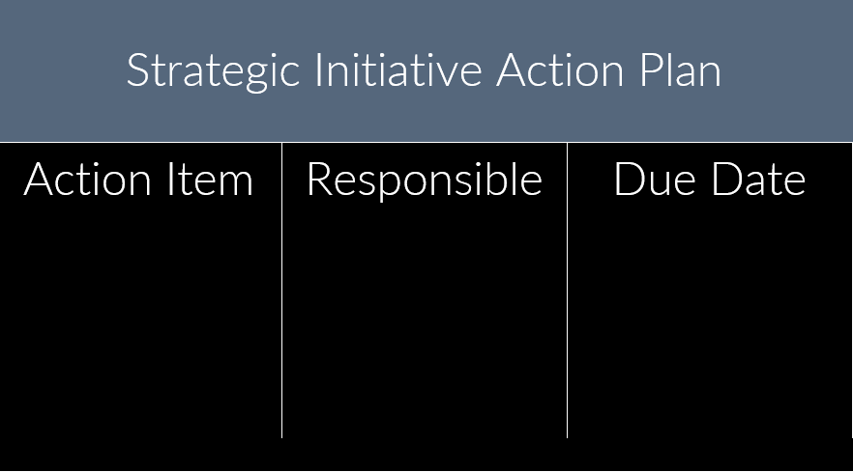
Strategic Initatives

Slide 23
Regular Updates

Slide 24
Continuum
Semi-annual
Quarterly

Slide 25

Thank You
CONTACT
GShamis@WindingRiverConsulting.com
p: 440.723.3653
f: 440.723.3654
SKILLS
Leader, Speaker, Author, Change Agent

