Slide 1



WELCOME!
May, 2026
Cohort 21

Slide 2
HOUSEKEEPING
Meals
Dinners are offsite
  Monday (MPB) – McCormick & Schmidts at 6
  Tuesday (MPB and BTB) – Shuttle to Crust Brewing, meet in Lobby around 6
Breakfast (8:00 AM – 9:00 AM) / Lunch (12:30) – Upper Ashburn
Workout – Each morning at 7:00 AM
Tuesday AM – Guggenheim
Wednesday AM – Hara
Scan the QR code on your folders to access the Resource Center
Intersession date – July 8th at 1:00 PM CT

Slide 3
HOUSEKEEPING
iLabs Presentation – Wednesday at 10:00 AM
Time each day allocated to work on this
Feedback & CPE
Scan the QR code at the end of each session and complete the survey
Winning Ways
Reunion: November 11-12, 2026
Conference: November 12-13, 2026

Slide 4

HOUSEKEEPING

Slide 5

MPB | Leadership Accelerated
Hot Topics:
Tips and Tricks That work
May, 2026
Gary S. Shamis, M. Acc

Slide 6

CPA

Slide 7
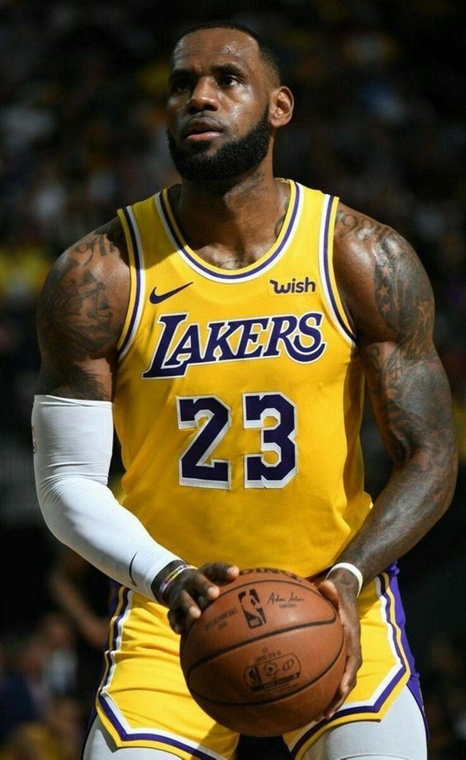
Talent is King
Surround yourself with the best talent
Elevate the talent to fill potential

Slide 8

Strengths vs. Weaknesses

Slide 9



Charge Hours: Less is More

Slide 10

You
Are
Being
Watched

Slide 11
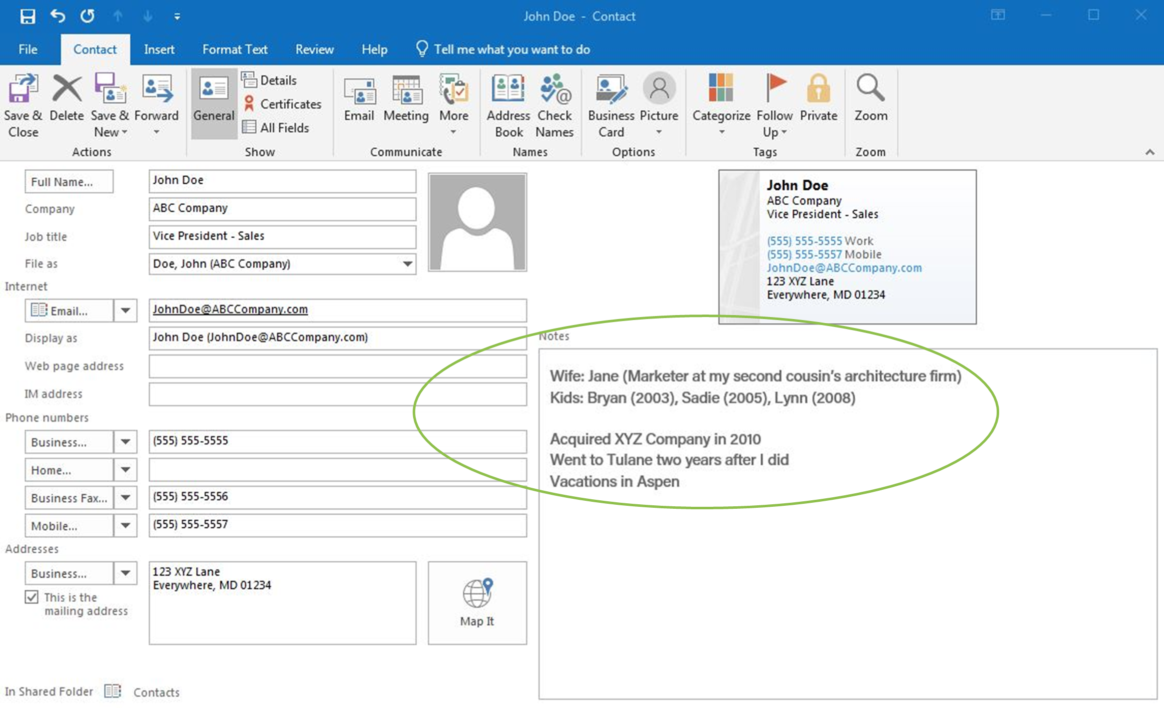
Microsoft
Outlook

Slide 12

Breakfasts & Lunches:
Staff-related
Practice Development
Work/Life Balance

Slide 13

Walk
Around

Slide 14

Thank
Yous

Slide 15
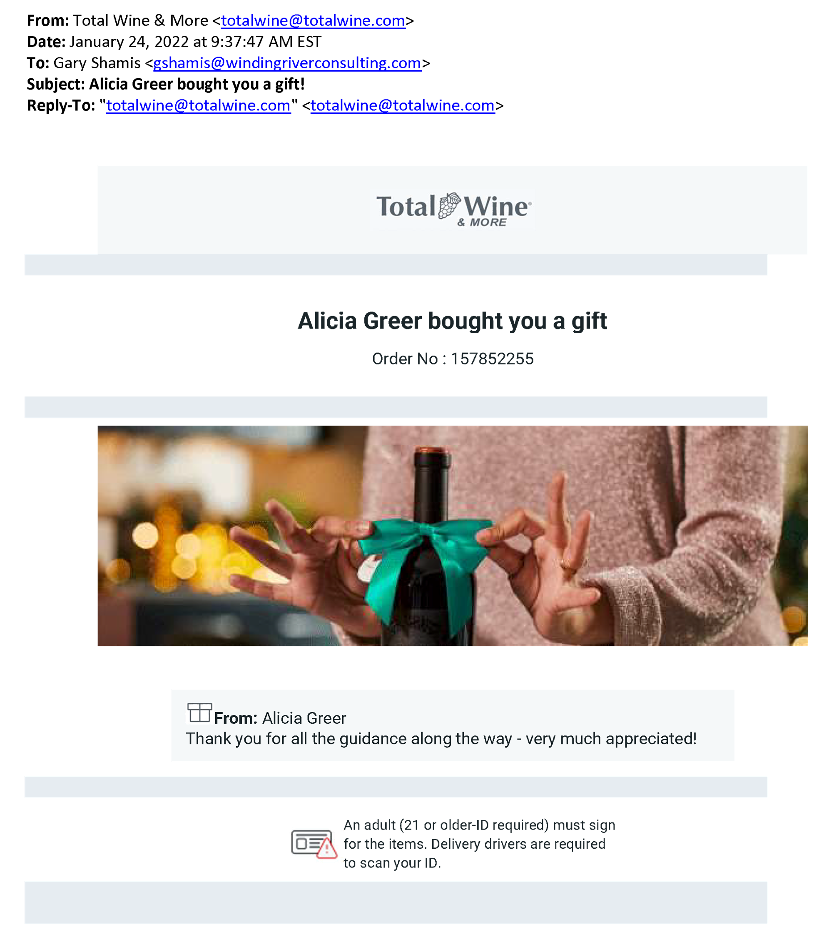
Thank
Yous

Slide 16

Master &
Embrace
Difficult
Discussions

Slide 17

Develop Lines of
Communication

Slide 18

Flow-through
Revenues

Slide 19
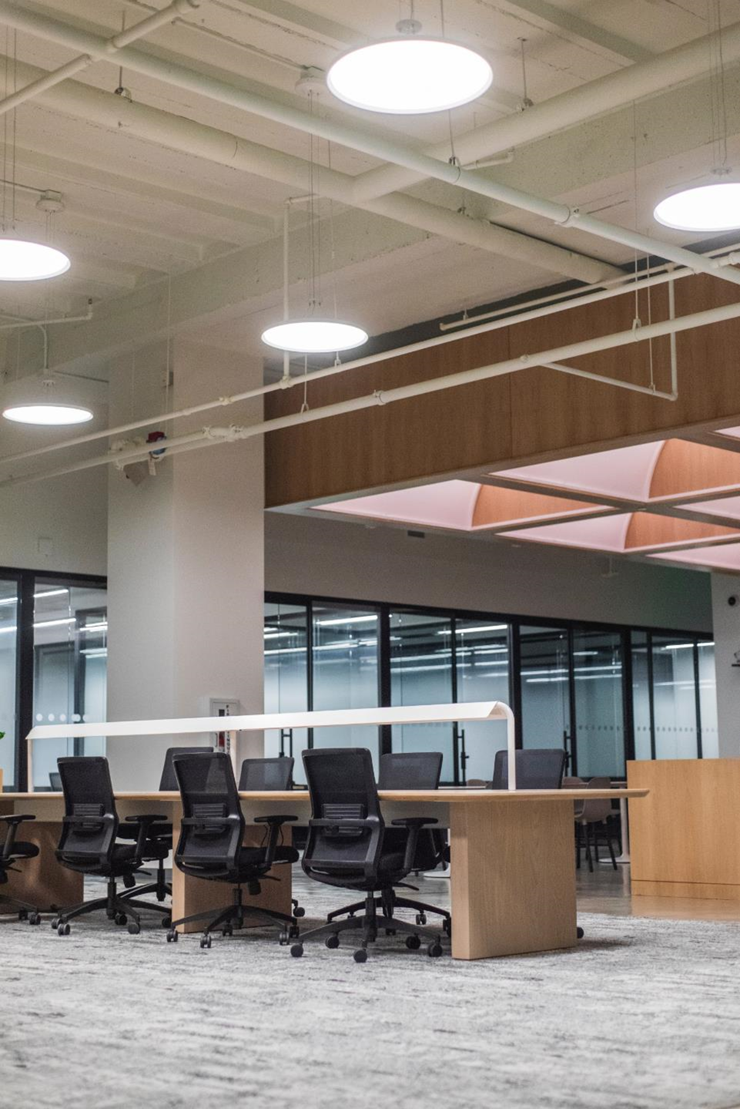
Environment
Checks

Slide 20

Competition
Meetings

Slide 21

Listen to all
Opportunities
Slippery Slope?

Slide 22
Gary,
Thanks for thinking of us but this wouldn’t be something we would be interested in at this time. I understand the business case, but it wouldn’t be core to our current strategy. I may have a client or two that may be interested. I’d be glad to reach out if that would be helpful to you.
Take care,

Slide 23

Own the Blame
Share the Fame

Slide 24

Call Your
Receptionists
All Offices

Slide 25

Pick Your Battles

Slide 26

Delegation &
Accountability

Slide 27
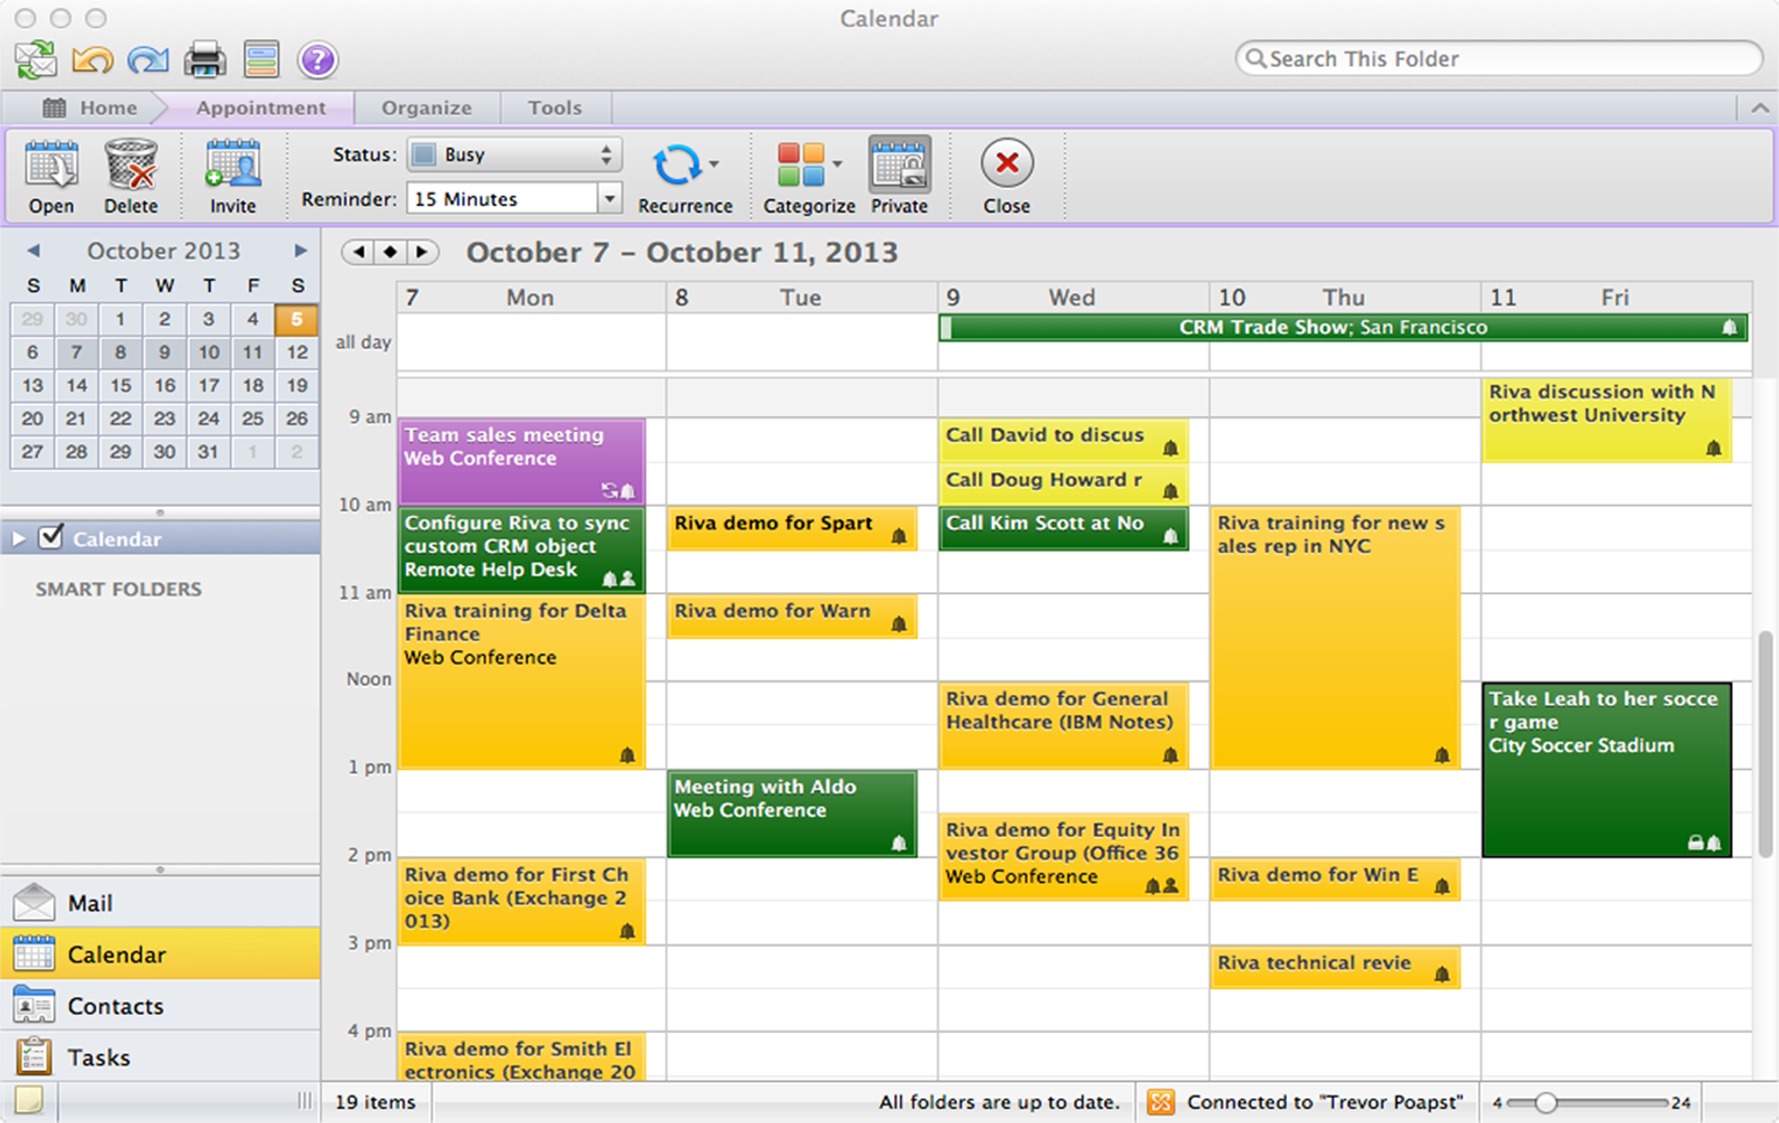
Time
Management

Slide 28

This Is a Business

Slide 29

Niche
Strategy

Slide 30
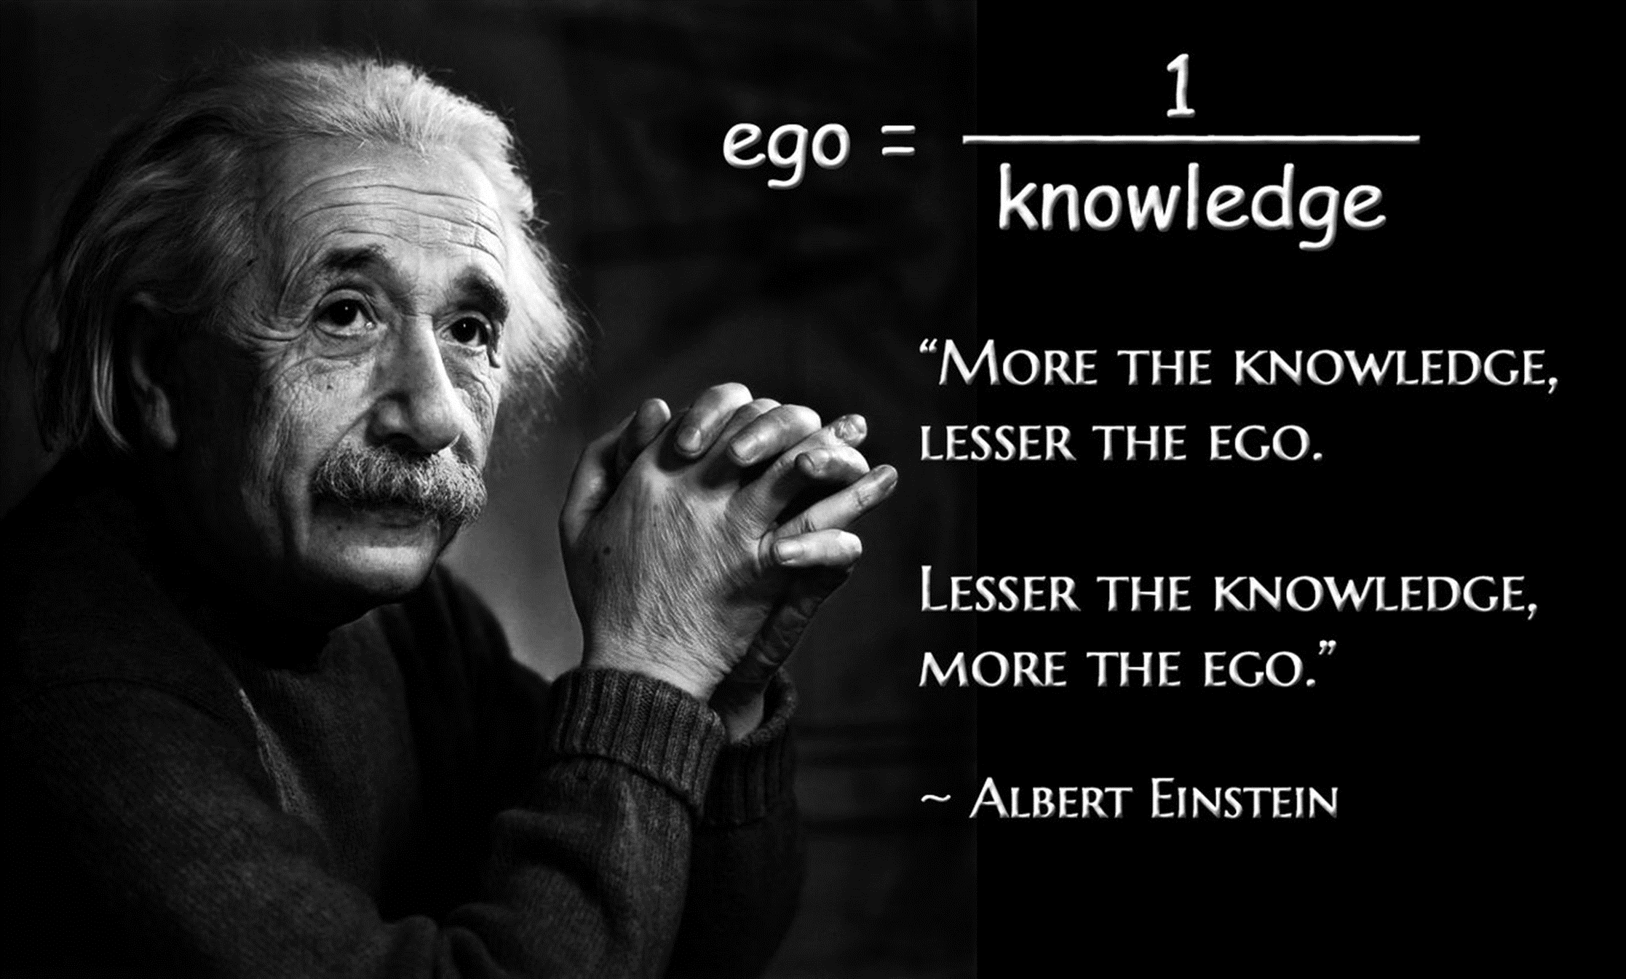
Park
Your Ego

Slide 31

Early
is Late

Slide 32

Perfect
Follow-up

Slide 33
Billing Based Upon Value

Slide 34

Detached Retina
Time to Fix
Related Fee
30 Minutes
$20,000

Slide 35

Engagement Letter
Generally, when we do work for a client, the related fees are based upon hours worked at the professional rate (and generally the bill is predetermined based upon a negotiation.)
Occasionally, we do work for a client that is of extraordinary value that does not prescribe to the above paragraph. In these cases, we will bill accordingly to perceived and/or documented value.

Slide 36

Case 1
You represent two physicians who have the opportunity to purchase a nursing home they both provide services to.
The physicians do not have the knowledge to operate the nursing home, so they bring in a third equal partner who owns nursing homes. The nursing home partner is a friend and colleague. They invest $500k each.
A major nursing home consolidator wants to enter the market and arranges to acquire the 30 nursing homes of the third partner! The third partner includes the nursing home owned with the physicians in the purchase.
The nursing home partner does not disclose the entire situation to the physician partners. He tells them he has an offer to sell the jointly owned home for a large profit in one year’s time.
You somehow got wind of the entire sale and realize that the sale is contingent on adding in the jointly owned nursing home.
You ask your physician clients if you can negotiate the sale of the jointly owned nursing home.
After some rather explosive discussions you gain each physician an extra $1 million dollars each.
It took two hours of your time.
32
What do you charge the physicians?

Slide 37
Case 2
You get hired by a public restaurant company to do a thorough review of their prior tax returns and current tax strategy.
The pre-determined pricing is time based. Estimated at 40 hours at $300/hour = $12,000.00
In the first hour of the engagement your partner finds an error in the tip credit calculation that will result in a $3 million dollar refund.
Your partner immediately calls you with the information. You instruct the partner to continue the assignment without disclosing the positive finding.
The public company sells at a 12 times cash flow multiple. This find will likely, create a $36 million dollar increase in value.
33
How will you communicate this to the client?
What will you propose the related fee be?

Slide 38
Being Prepared
Is A Must

Slide 39

Thank You
CONTACT
GShamis@WindingRiverConsulting.com
p: 440.723.3653
f: 440.723.3654
SKILLS
Leader, Speaker, Author,
Change Agent

Slide 40
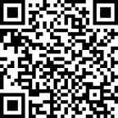

SCAN HERE
Scan the QR Code
To complete our survey
and receive CPE credits

