Slide 1


A Framework for Organizational Development and Governance
May, 2026
Gary S. Shamis, M. Acc

Slide 2







Begins
Ends

Slide 3

Governance
Democracy
Executive Committee
Dictatorship
Corporate

Slide 4

Decisions
New Partners
Termination of partners
Merge up
Merge down
Copy machines
Receptionist
Logo
Wall color

Slide 5
Disenfranchising

Slide 6

Shareholders
Executive Committee
Managing Partner / CEO
Infrastructure
Technical
COO
COO
Tax
Audit
CAS
HR
Marketing
Tech
Accounting
Advisory Board
Geographic Office
Local Managing Partner
Community Facing

Slide 7
Building a C-Suite

Slide 8
Committee Structure

Slide 9
COO or No?

Slide 10

CHANGE IS HARD… CHANGE IS CRITICAL
SPEED OF CHANGE…
ESPECIALLY THE CHANGE PART

Slide 11



All events will be at the Loews Chicago O’Hare Hotel
Cohort 21:
May 18-20, 2026
October 19-21, 2026
Cohort 22:
October 19-21, 2026
May 17-19, 2027
Cohort 23:
May 17-19, 2027
October 18-20, 2027
Cohort 4:
May 19-21, 2026
Cohort 5:
Oct 20-22, 2026
Cohort 6:
May 18-20, 2027
Cohort 7:
October 19-21, 2027
November 12-13, 2026
Alumni Reunion
November 11-12, 2026
Leadership Programs
03 © Winding River Consulting 2026

Slide 12
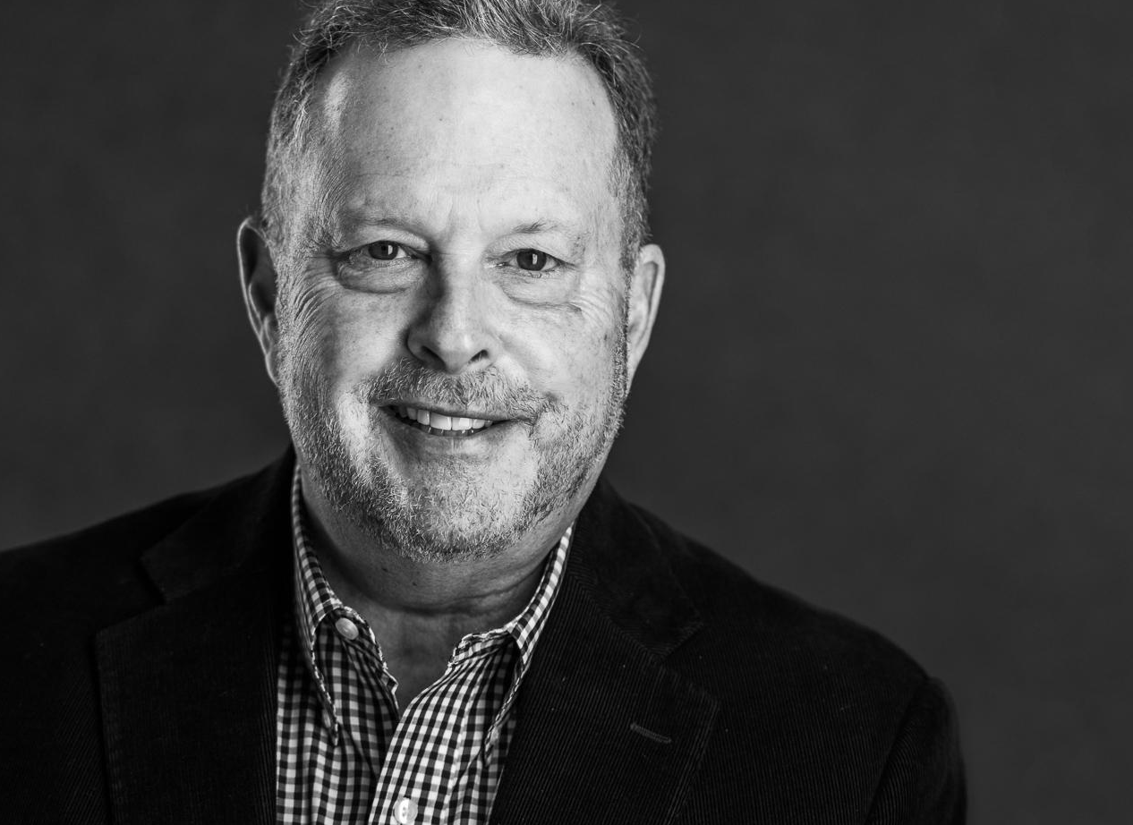
Thank You
CONTACT
GShamis@WindingRiverConsulting.com
p: 440.723.3653
f: 440.723.3654
SKILLS
Leader, Speaker, Author,
Change Agent

