Slide 1



WELCOME!
October, 2026
Cohort 22

Slide 2
HOUSEKEEPING
Meals
Dinners are offsite
  Monday (MPB) – McCormick & Schmidts at 6
  Tuesday (MPB and BTB) – Shuttle to Fat Rosie's, meet in Lobby at 6
Breakfast (8:00 AM – 9:00 AM) / Lunch (12:30) – Upper Ashburn
Workout – Each morning at 7:00 AM
Tuesday AM – Warhol B
Wednesday AM – Warhol B
Scan the QR code on your folders to access the Resource Center
Intersession date – July 8th at 1:00 PM CT

Slide 3
HOUSEKEEPING
iLabs Presentation – Wednesday at 10:00 AM
Time each day allocated to work on this
Feedback & CPE
Scan the QR code at the end of each session and complete the survey
Winning Ways
Reunion: November 11-12, 2026
Conference: November 12-13, 2026

Slide 4
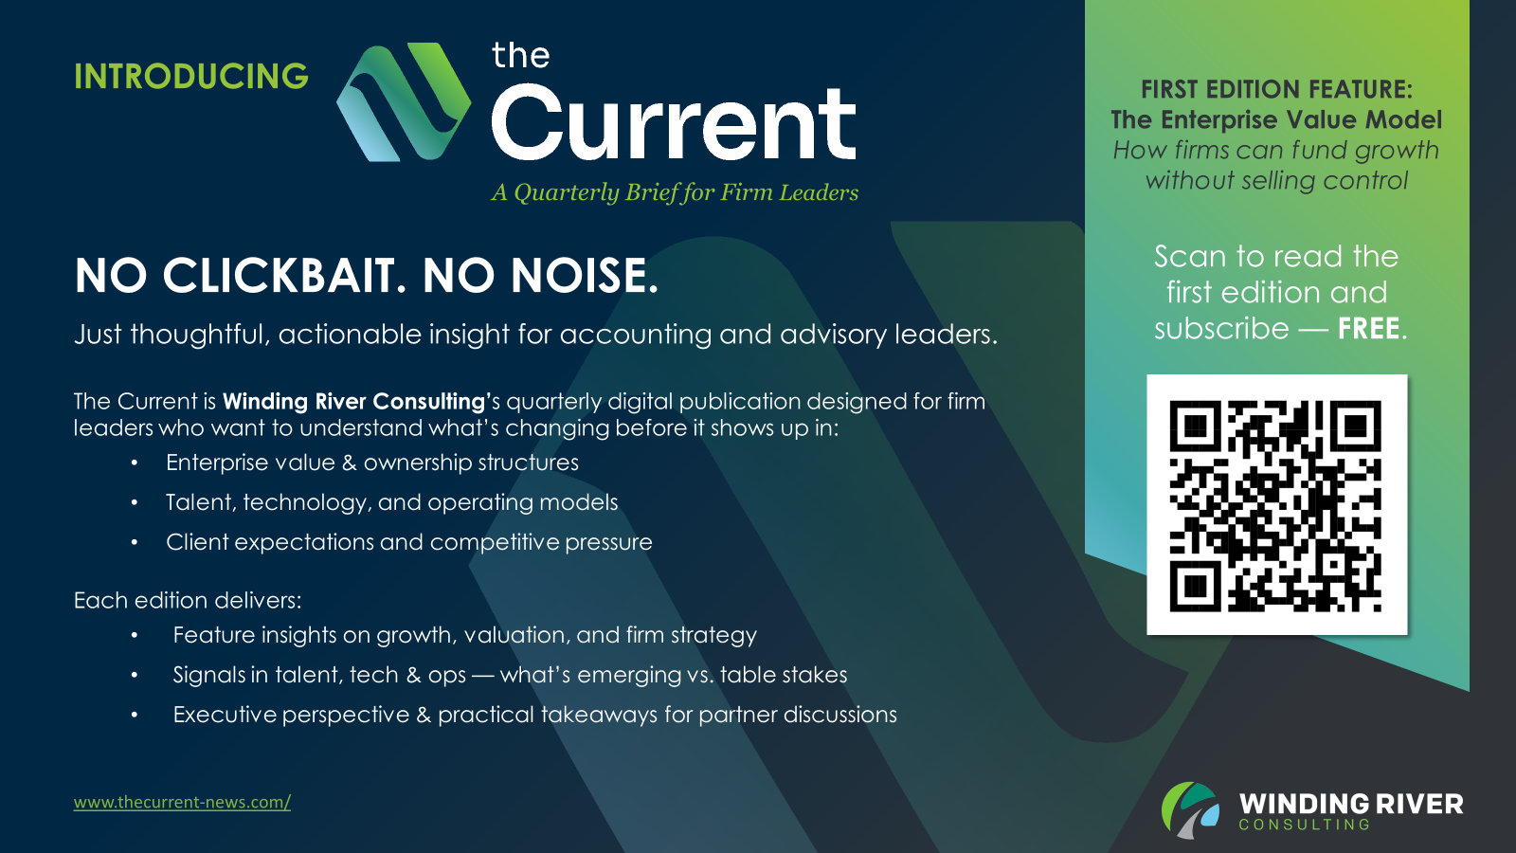
HOUSEKEEPING

Slide 5
Ice Breaker
What one thing are you scared about?
One thing you are super excited about?

Slide 6
Top Leadership Challenges
What Cohort 21 Is Wrestling With Today
Delegation & Developing the Next Layer
Pushing client work down, managing growth expectations, and building leaders — not just accountants
Accountability & Follow-Through
Driving accountability in tracking, hours, and execution — translating strategy into consistent delivery.
Culture, Change & Competing Priorities
Reviving a strong post-COVID culture, leading change, and balancing multiple priorities against a backdrop of AI and a sales-driven mindset.
Notes:
STORY CUE: 'Execution Gaps' is your opening. Drop in the holding-leaders-accountable story — the firm that had a great strategic plan but no one ran weekly cadence on it.

Slide 7
What They Wish They'd Learned Earlier
Skills Cohort 21 Would Have Built Sooner
Delegation
Letting go of work that should sit lower in the firm — and trusting others to carry it — would have reduced stress and accelerated growth.
Courage & Hard Conversations
Developing a stronger backbone — making difficult decisions and accepting you can't please everyone.
Coaching, Listening & Self-Awareness
Leading people to see their own potential, listening better, and understanding the business of public accounting — leadership is less about having the answers, more about building others.
Notes:
STORY CUE: 'Execution Gaps' is your opening. Drop in the holding-leaders-accountable story — the firm that had a great strategic plan but no one ran weekly cadence on it.

Slide 8
How Cohort 21 Sees the Profession
Top Challenges Facing Accounting Today
AI — Universal, Urgent, Unsettled
Named by every respondent — what tools to use, how to adopt them responsibly, and how that reshapes staff, judgment, and client service.
Talent & Future Leaders
Talent shortages, flexible schedules, generational transitions, and developing the next wave of firm leaders.
Business Model in Transition
Private equity and consolidation, flaws in the billable hour, and the shift from transactional pricing to outcome- and advisory-based client relationships.
Notes:
STORY CUE: 'Execution Gaps' is your opening. Drop in the holding-leaders-accountable story — the firm that had a great strategic plan but no one ran weekly cadence on it.

Slide 9
Strategy, Execution, and the Horizon Mindset
Turning Vision Into Action
May, 2026
Brian Blaha

Slide 10
Strategy + Execution
"Strategy without execution is a waste of time.
Execution without strategy is a road to nowhere."
STRATEGY
Direction
Vision
Prioritization
EXECUTION
Action
Accountability
Results
ALIGNMENT
Notes:
Open with the gears metaphor. Strategy + Execution must be in alignment.

Slide 11
Ownership Defines Accountability
Strategy is everyone's responsibility — but not everyone's role.
Board of Directors
Own the strategic direction.
"
If everyone's responsible,
no one is accountable.
LEADERS
Own the translation.
TEAMS
Own the execution.
Notes:
STORY CUE: Share the accountability story — the industry leader who built strategy but didn't drive ownership. What changed when the partners stepped into the role of owning strategic direction vs. delegating it to a committee.

Slide 12
Why is Execution So Hard?
Common Barriers
1
Lack of clarity and alignment.
Strategies exist on paper, not in people's calendars.
Ideas Ideas Ideas
Ideas Ideas
Initiatives & Priorities
2
Too many priorities — not enough focus.
Everything is urgent; nothing is finished.
3
No cadence of accountability.
Decisions made; no one tracks follow-through.
4
Time-starved leaders stuck in delivery.
Partners pulled back into H1 work.
IMPACT
What else? — open discussion
Notes:
STORY CUE: This is where the 'too many priorities' moment lands hardest. Reference the consistent-process story — what happens when a firm tries to run 17 firmwide initiatives without a filter, vs. what happens when leadership chooses 3 quarterly Rocks.

Slide 13
You Can’t Do Everything.
High Impact/​ Low Effort​ ​ Quick Wins​ | High Impact/​ High Effort​ ​ Strategic Initiatives​
Low Impact/​ Low Effort​ ​ Incremental Improvements​ | Low Impact/​ High Effort​ ​ Resource Drains​
Higher Impact
Lower Impact
Low Effort
High Effort
Notes:
Use the 2x2 to make the prioritization point. STORY CUE: Consistent process story — a firm that ran every initiative as a strategic initiative until everyone burned out.

Slide 14
The Horizon Model
Leading Across Three Timeframes
H1
OPERATIONAL
H2
STRATEGIC
H3
VISIONARY
0 – 12 MONTHS
2 – 3 YEARS
5 – 10 YEARS
LEADERSHIP ROLE
Manager / Executer
FOCUS
Delivering Today
LEADERSHIP ROLE
Builder / Innovator
FOCUS
Building Next
LEADERSHIP ROLE
Architect / Strategist
FOCUS
Shaping the Future
KEY QUESTION
"What must we accomplish now?"
KEY QUESTION
"What will drive growth?"
KEY QUESTION
"What could we become?"
Notes:
Anchor of the deck. Walk through each horizon. After H1, pause and ask: 'How many of you spend 80%+ of your time here?' Hands will go up. That's the setup for the next slide.

Slide 15
Where Are You Spending Your Time?
EXERCISE
Estimate the % of your week spent in each horizon — and what activities live there.
H1 — Operational
H2 — Strategic
H3 — Visionary
% OF MY WEEK
____ %
% OF MY WEEK
____ %
% OF MY WEEK
____ %
ACTIVITIES
_______________________
_______________________
_______________________
ACTIVITIES
_______________________
_______________________
_______________________
ACTIVITIES
_______________________
_______________________
_______________________
Notes:
Have them write actual percentages and 2-3 activities per horizon. Most partners will discover 80-90% of time is in H1. That's the wake-up call. Pair-share for 90 seconds before debriefing.

Slide 16
PART TWO
Overarching Strategy
From horizons to a clear North Star.

Slide 17
The Power of a Clear North Star
Firm Values
People
Growth
Notes:
North Star — Firm Values, People, Growth. Tie back to the cohort themes from slide 5.

Slide 18
Firm Foundation
Vision, Values & Goals — anchor the firm before plotting trajectory.
01
CORE PURPOSE
02
CORE VALUES
03
NICHE / IDEAL CLIENT
Why do we exist — beyond making money?
The reason partners and staff stay through the hard quarters.
3–5 values guiding how we work with clients, staff, and each other.
Behaviors you'd hire, fire, and reward against.
Who are we best positioned to serve?
Where our expertise compounds — and where we say no.
Notes:
Foundation slide 1 of 3 in V/TO. Anchor here before moving to trajectory.

Slide 19
Firm Trajectory
10 years → 3 years → 1 year
10-YEAR TARGET
3-YEAR VISION
1-YEAR PLAN
Long-term vision for the firm.
Revenue scale, ownership structure, market position.
What does success look like in 3 years?
Revenue, profit, client mix, service-line balance.
Specific goals for this year.
3–5 firmwide priorities. Owners. Metrics.
Notes:
Trajectory slide 2 of 3. STORY CUE: Setting meaningful financial and growth targets — share the story about a firm that picked vanity metrics vs. one that picked metrics that actually moved partner behavior.

Slide 20
Personal Alignment
Firm vision only works when partners can see themselves in it.
ISSUES / BARRIERS
PERSONAL VISION STATEMENT
What's getting in the way of progress today?
People. Process. Partner alignment.
Name them. Own them. Solve them in Identify Discuss Solve (IDS).
Where am I going as a leader in this firm?
Role. Impact. Legacy.
Firm V/TO only works when each partner has a personal one.
Notes:
Final V/TO slide. Tie it back to the partner role. STORY CUE: Hold-leaders-accountable story works well here.

Slide 21
Accountability and Cadence
Three disciplines that turn strategy into rhythm.
1
OWNERSHIP
2
CADENCE
3
MOMENTUM
Who owns what?
Every Rock has one accountable name. Not a committee.
Quarterly Rocks. Weekly IDS.
A rhythm partners can sustain — not another methodology.
Simple scorecards, not just KPIs.
Measure what moves behavior — leading indicators over lagging.
The Rhythm: Quarterly Rocks → Monthly Reviews → Weekly IDS → Daily Discipline
Notes:
EOS Rocks/IDS adapted for CPA. Keep simple — partners don't want a methodology, they want a rhythm.

Slide 22
From Concept to Commitment
Take 90 seconds. Then share with the person next to you.
1
2
What is ONE action this week that moves you closer to your North Star?
Which horizon do you need to rebalance toward this quarter?
Be specific. Calendar it. Tell someone.
Where will you spend less time so this can grow?
Write here...
Write here...
Notes:
FORCE the writing. 90 seconds silent write, then 2-min pair share, then 2-3 share aloud.

Slide 23
STRATEGY IS EASY.
EXECUTION IS HARD.
The best leaders make both intentional.
Notes:
Pause. Hold the silence. Then close.

Slide 24
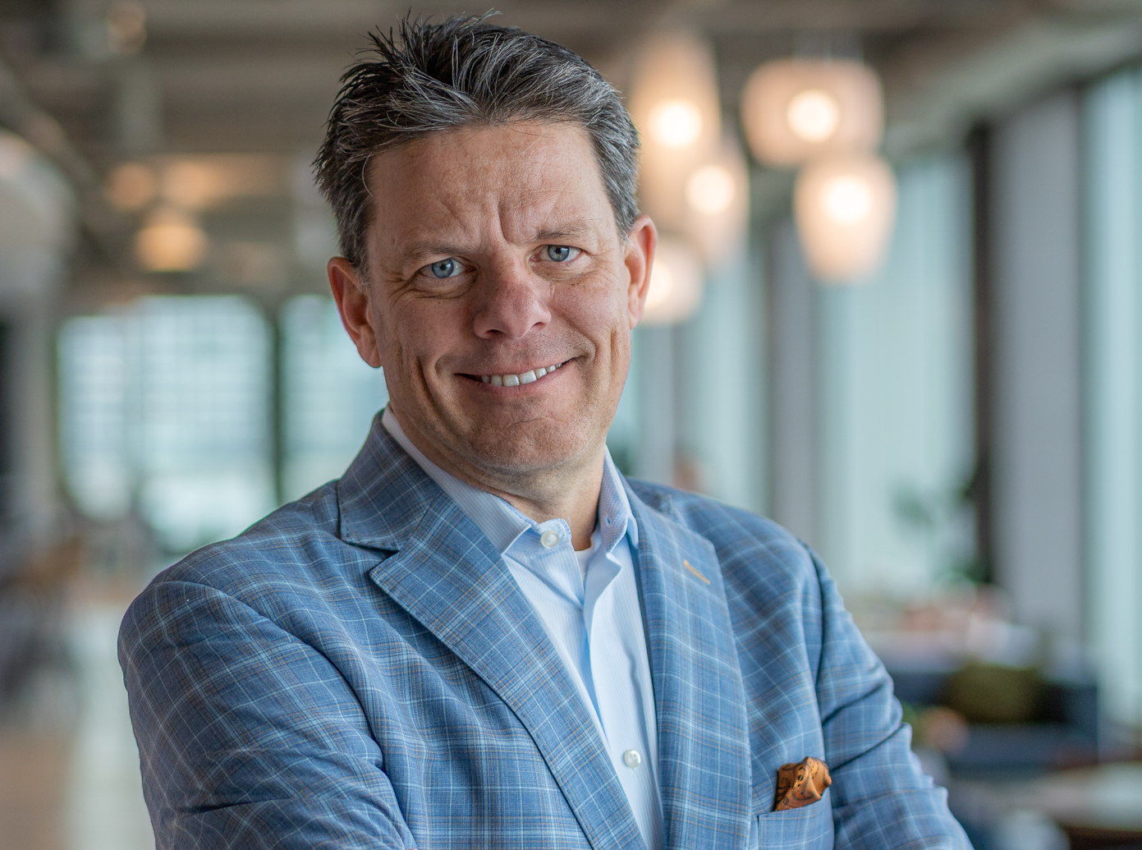
Thank You
Contact
Bblaha@windingriverconsulting.com
(920) 562-3068
Skills
Leader, Speaker, Author, Change Agent

Slide 25


SCAN HERE
Scan the QR Code
To complete our survey
and receive CPE credits

