Slide 1



WELCOME!
May, 2026
Cohort 21

Slide 2
HOUSEKEEPING
Meals
Dinners are offsite, refer to the agenda for meeting times. Tuesday is with BTB.
Breakfast / Lunch – Upper Ashburn
Workout – Each morning at 7:00 AM
Tuesday AM – Guggenheim
Wednesday AM – Hara
Scan the QR code on your folders to access the Resource Center
Intersession date – July 8th at 1:00 PM CT

Slide 3
HOUSEKEEPING
iLabs Presentation – Wednesday at 10:00 AM
Time each day allocated to work on this
Feedback & CPE
Scan the QR code associated with each session and complete the survey
Winning Ways Reunion
November 11-12, 2026
Our Team
David, Gary, Brian, Ilana, Trisha, Scott, Daniel, Bruce and Reine

Slide 4
Ice Breaker
What one thing are you scared about?
One thing you are super excited about?

Slide 5
What’s Top of Mind for Leaders?
Themes Emerging Across the Cohort
Talent & Culture
Retention, accountability, and leadership pipeline development are front-and-center; firms are balancing growth demands with sustaining health, people-first cultures.
Growth Pressures
Leaders are navigating plateauing organize growth, tightening markets, and shifting client expectations toward advisory and value creation.
Change Fatigue
The speed of transformation– AI, M&A, hybrid work– had left many leaders asking how to sustain focus and energy without losing direction.

Slide 6
Leadership & Execution Challenges
What Keeps you up at Night?
Execution Gaps
Clear strategies exist, but follow=through, ownership, and accountability mechanisms are inconsistent.
Capacity vs. Priority
Competing demands (client delivery vs. firm strategy) hinder momentum on firmwide initiatives.
Alignment
Leaders recognize the need for more shared vision– cross-functional clarity around what success looks like across horizons (12 months vs. 3 years).
Courageous Conversations
Several noted the need to address underperformance and cultural drift directly, not indirectly.

Slide 7
Opportunities on the Horizon
Where This Cohort Can Lead Differently?
Intentional Leadership
Build cultures by design– anchored by a clear North Star and modeled behaviors, not accidental evolution.
Advisory Mindset
Embrace “new ways to CPA”– shifting from technical delivery to insight, curiosity, and relationship depth.
Cross-Serving and Collaboration
Break silos; unlock growth by connecting people, clients, and service lines.
Future-Ready Firms
Apply horizon thinking to connect today’s actions with long-term transformation– AI adoption, ownership, evolution, and leadership succession.

Slide 8
Strategy, Execution, and the Horizon Mindset
Turning Vision Into Action
May, 2026
Brian Blaha

Slide 9
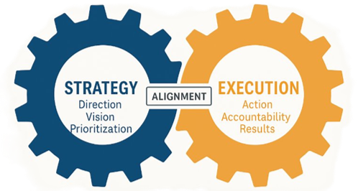
Strategy without Execution is a waste of time.
Execution without strategy is a road to nowhere.

Slide 10

Ownership Defines Accountability
Strategy is everyone’s responsibility– but not everyone’s role.
Partner’s own strategic direction; leaders own translation; teams own execution.
“If everyone’s responsible, no one is accountable.”

Slide 11
Why is Execution So Hard?
Ideas
Common Barriers:
Ideas
Lack of clarity of alignment.
Too many priorities– not enough focus.
No cadence of accountability.
Time-starved leaders stuck in delivery.
What else?
Ideas
Ideas
Initiatives & Priorities
Impact

Slide 12
You Can’t Do Everything.
High Impact/​ Low Effort​ ​ Quick Wins​ | High Impact/​ High Effort​ ​ Strategic Initiatives​
Low Impact/​ Low Effort​ ​ Incremental Improvements​ | Low Impact/​ High Effort​ ​ Resource Drains​
Higher Impact
Lower Impact
Low Effort
High Effort

Slide 13
The Horizon Model: Leading Across Timeframes
H1 - Operational
Focus:
H2 - Strategic
Focus:
H3 - Visionary
Focus:
Delivering Today
Timeframe:
0-12 Months
Leadership Role
Manager/Executer
Example Question:
“What must we accomplish now?”
Building Next
Timeframe:
2-3 years
Leadership Role
Builder/Innovator
Example Question:
“What will drive growth?”
Shaping the future
Timeframe:
5-10 years
Leadership Role:
Architect/Strategist
Example Question:
“What could we become?”

Slide 14
Where Are You Spending Your Time?
H1 - Operational
Activities:
H2 - Strategic
Activities:
H3 - Vision
Activities

Slide 15
Overarching
Strategy

Slide 16
The Power of a Clear North Star
Firm Values
People
Growth

Slide 17
Aligning Vision, Values, and Personal Goals
Core Purpose / Why We Exist​ ​ Why do we exist beyond making money?​ | 2. Core Values​ ​ 3-5 values guiding how we work with clients, staff, partners.​ | 3. Niche / Ideal Client​ ​ Who are we best positioned to serve?​
4. 10-Year Target​ ​ What is the long-term vision for the firm?​ | 5. 3-Year Vision​ ​ What does success look like in 3 years? Revenue, profit, client mix, etc.​
6. 1-Year Plan​ ​ Specific goals for the next year​ | 7. Issues / Barriers​ ​ What's getting in the way of progress today?​ | 8. Personal Vision Statement​ ​ Leadership Alignment.​

Slide 18
Execution Through Accountability and Cadence
Assign ownership: “Who owns what?”
Set cadence: Quarterly ‘Rocks’ – Weekly Issues “IDS”.
Measure momentum: Use simple scorecards, not just KPIs.
Plan
Execute
Review
Adjust

Slide 19

From Concept to Commitment
What's one action that aligns you closer to the North Star?
What horizon do you need to rebalance toward this quarter?

Slide 20


Strategy is Easy. Execution is Hard.
But the best leaders make both intentional.

Slide 21
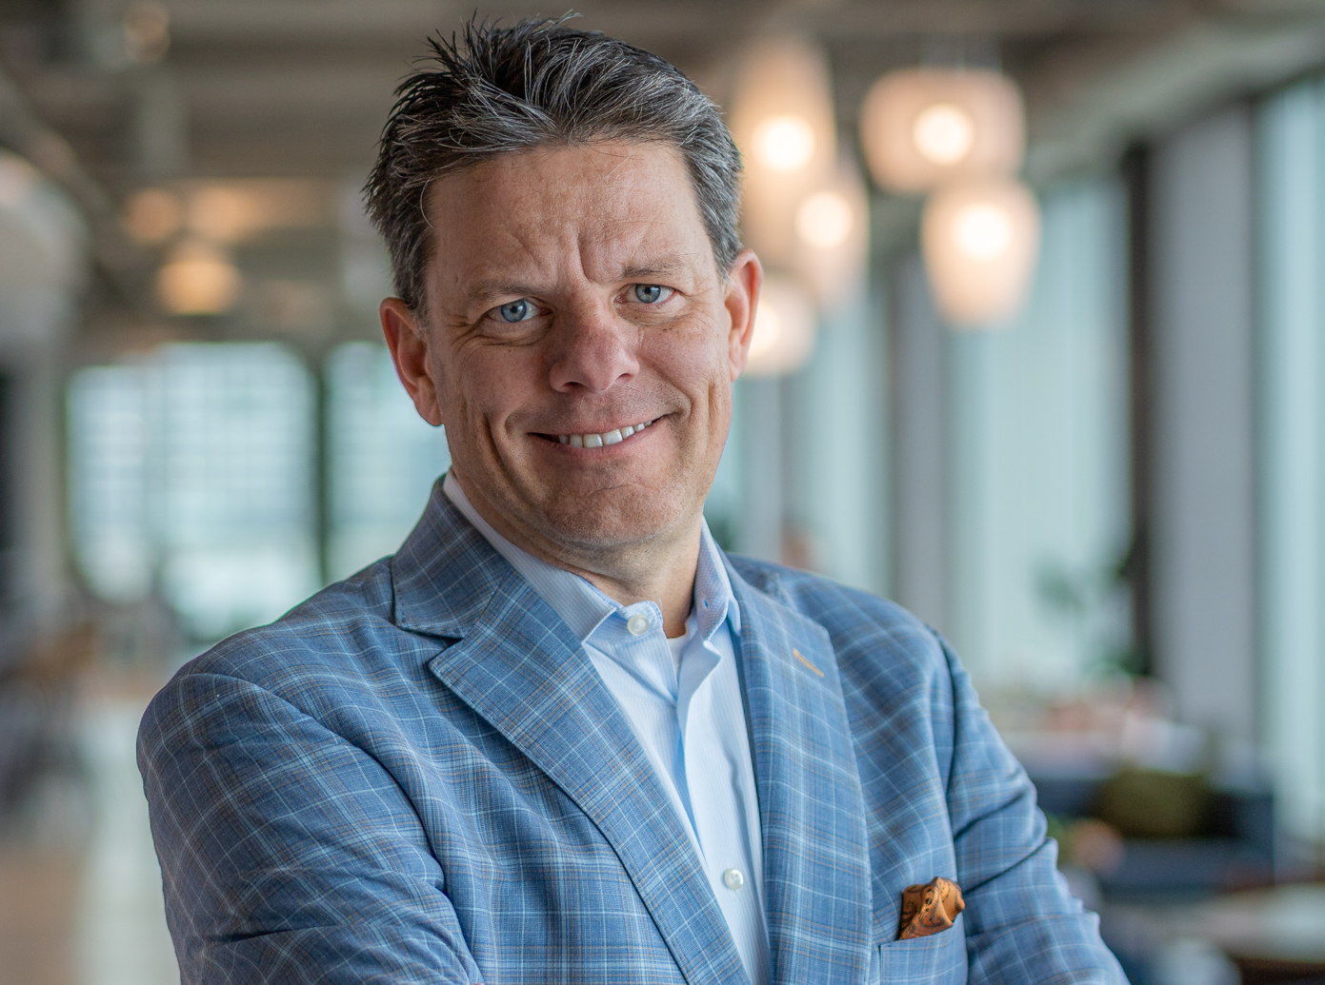
Thank You
Contact
Email
Phone #
Skills
Leader, Speaker, Author, Change Agent

