Slide 1



The Energy Advantage: Health as a Leadership Asset
May, 2026
Daniel Golub

Slide 2
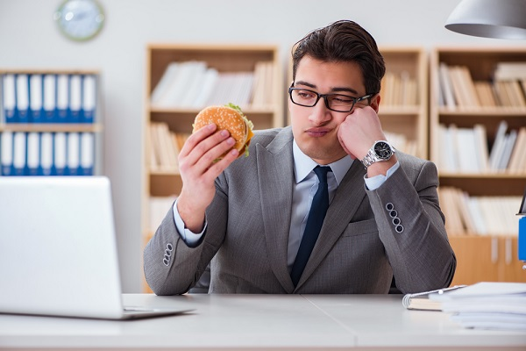
Wake Up Call
Obese
Overweight
40%
70%
Obesity Rates the last fifty
years
300% Increase
Unhealthy Diets + Limited Movement
66%
Productivity Decrease

Slide 3
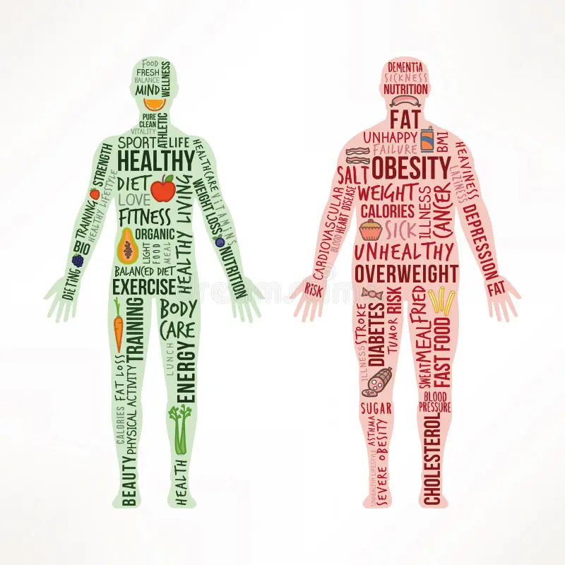

Health as a Leadership Asset
Your energy determines your output.
You cannot “outperform” your energy.

Slide 4
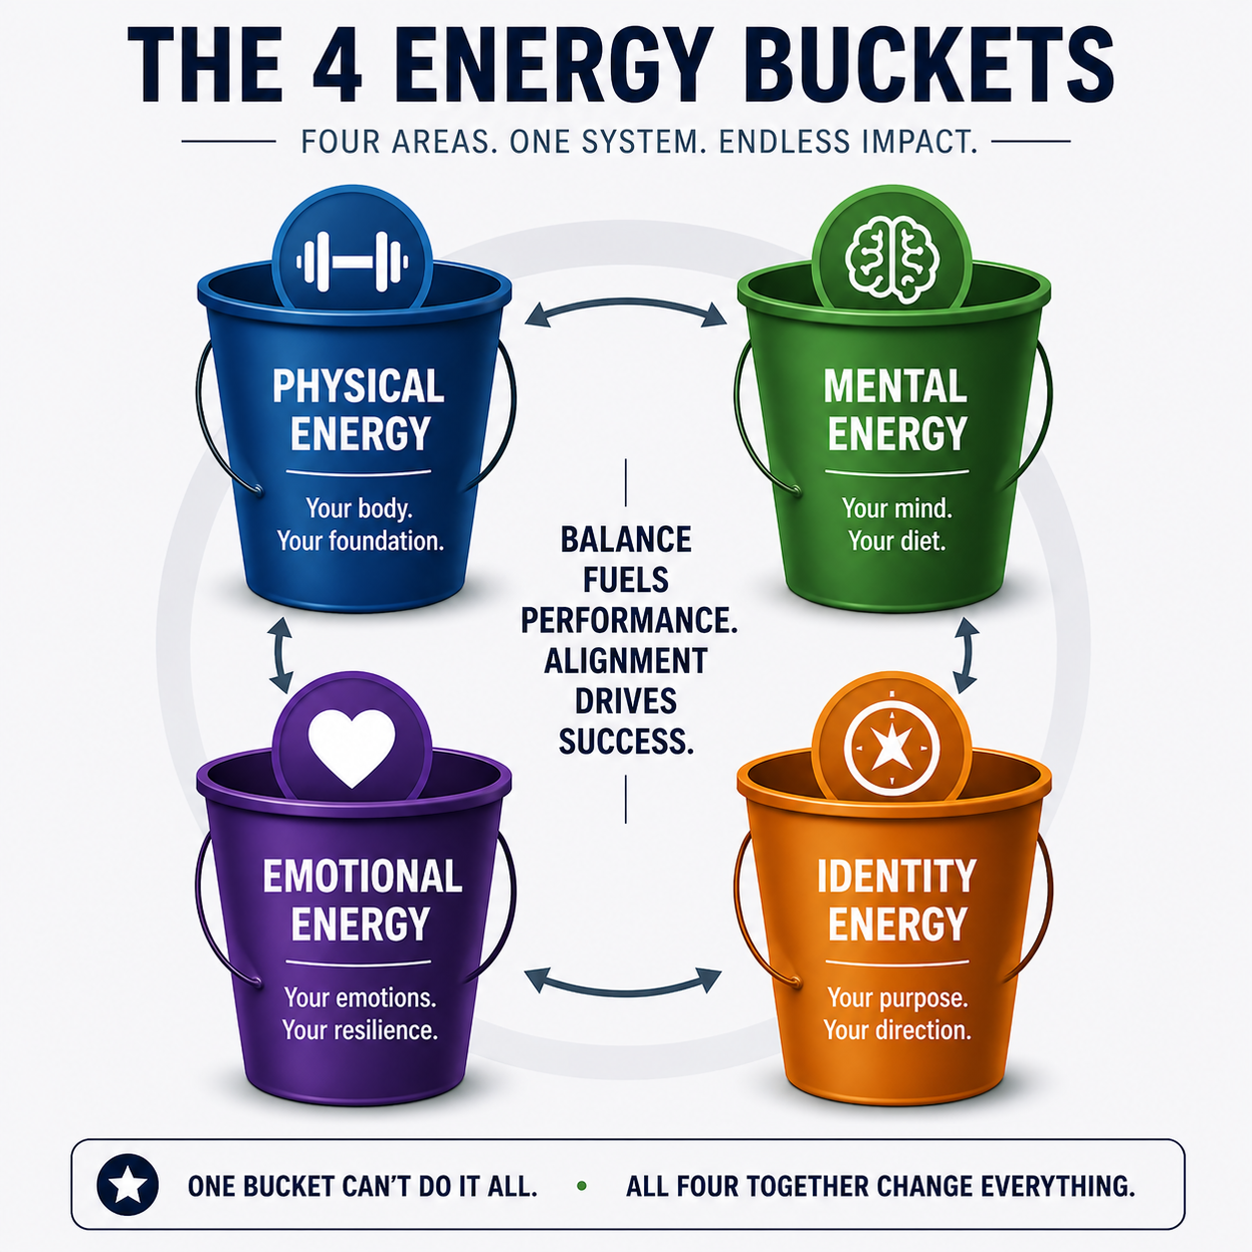
The 4 Health and Energy Buckets
1. Physical
2. Mental
3. Emotional
4. Identity

Slide 5
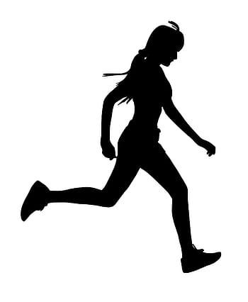
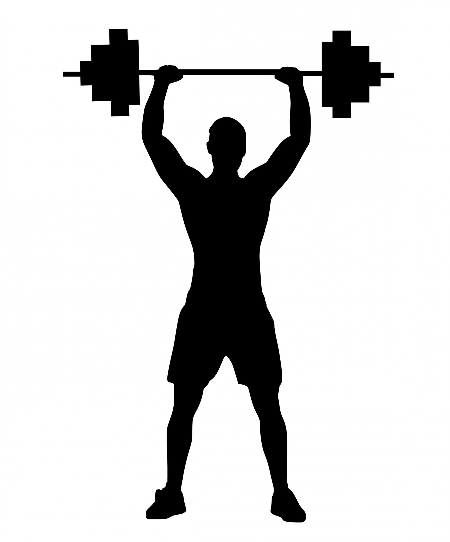
1. Physical Health + Energy
Exercise Methods
Low Intensity, Long Duration
High Intensity, Short Duration
Uses Oxygen to meet energy demands
Relies on energy sources (glycogen) stored in muscles
Aerobic
Anaerobic

Slide 6
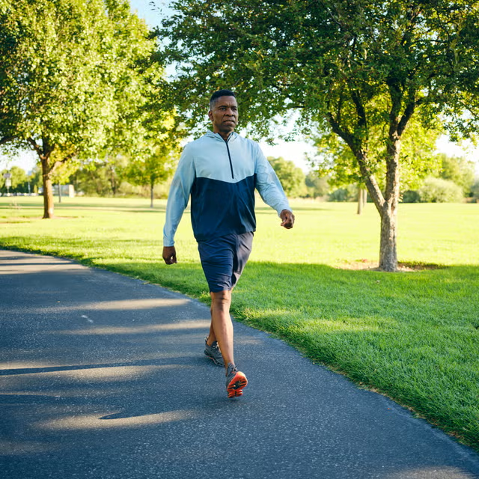
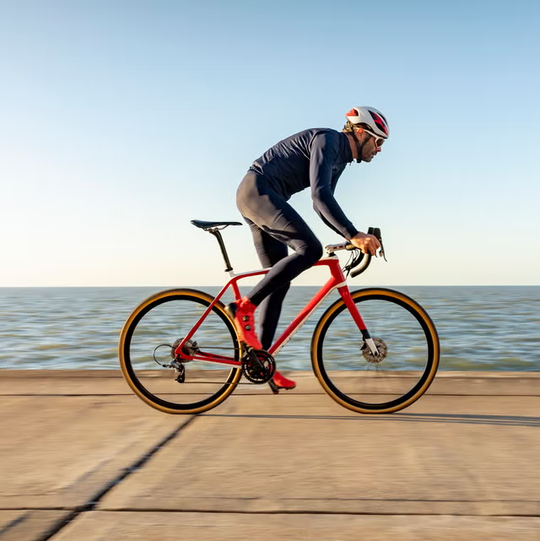
1. Physical Health + Energy
Aerobic exercise examples
walking
light jogging
light cycling
elliptical machine
hiking
stairmaster
active mobility

Slide 7

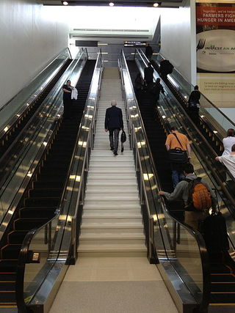
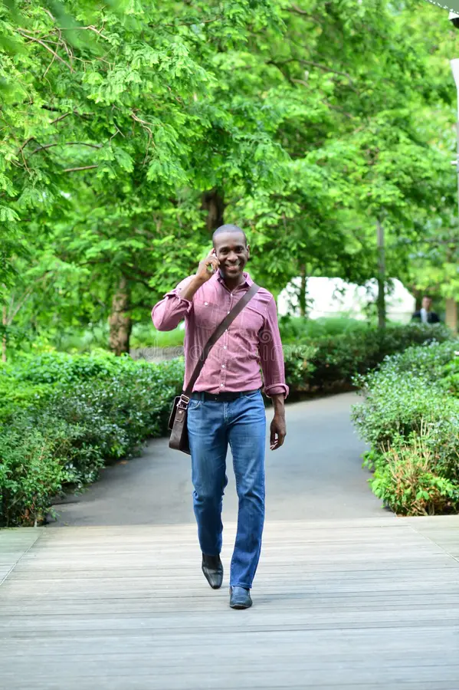
1. Physical Health + Energy
Aerobic LIFESTYLE
Walk while on calls/texting
Stairs instead of elevator/escalator
Active with kids
CDC guidline: 150 minutes per week moderate aerobic activity

Slide 8
1. Physical Health + Energy
Aerobic LIFESTYLE
You don’t need to become a runner or athlete, you just need consistent movement that gets your heartrate up.

Slide 9
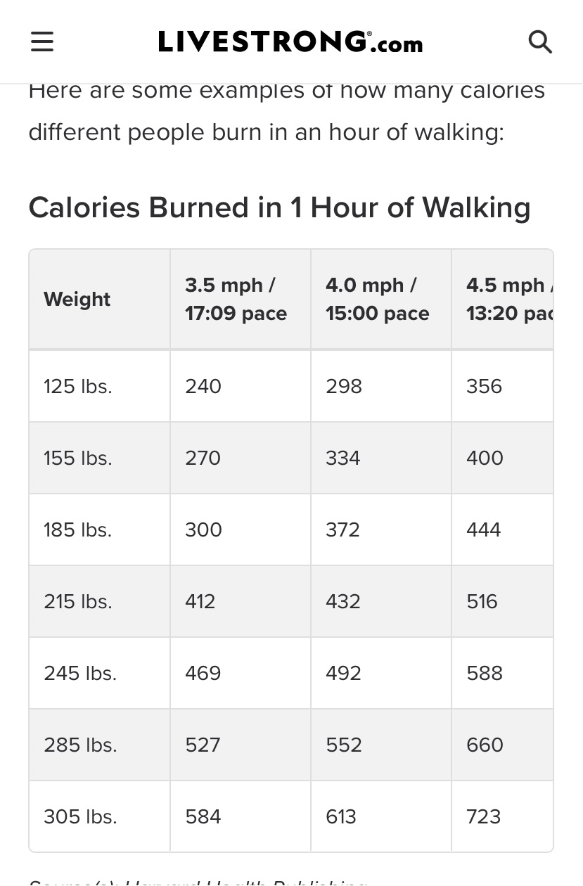
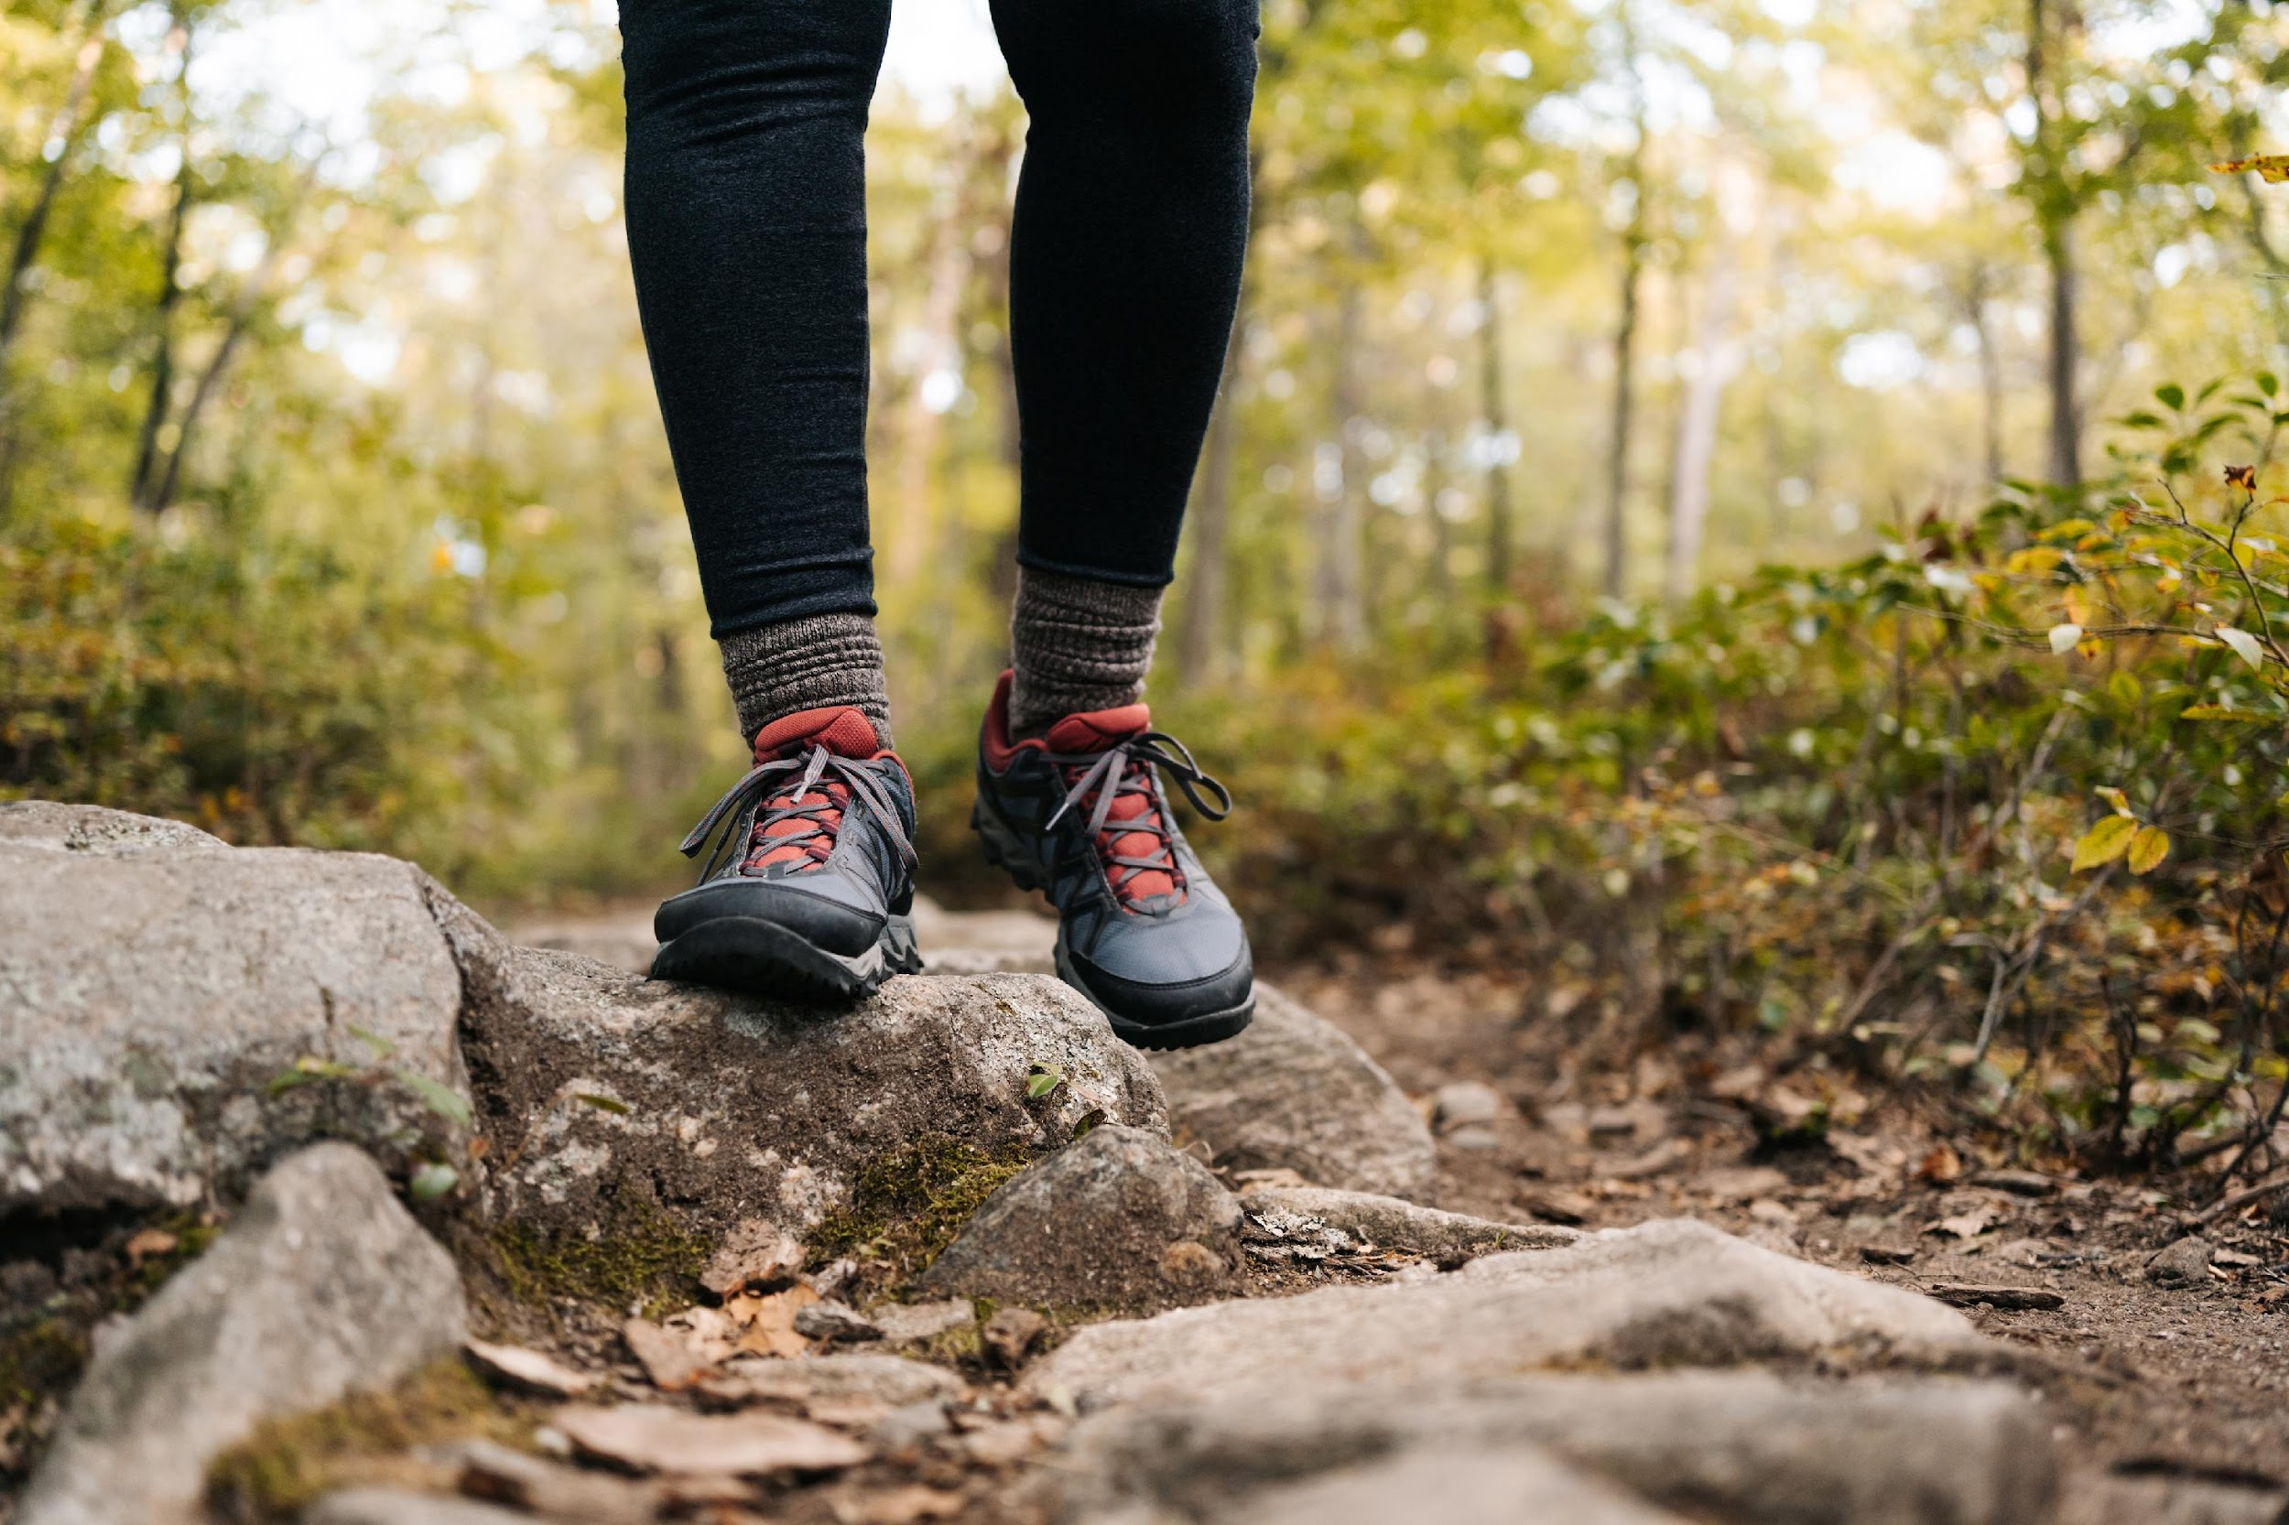
1. Physical Health + Energy
Aerobic exercise - walking

Slide 10
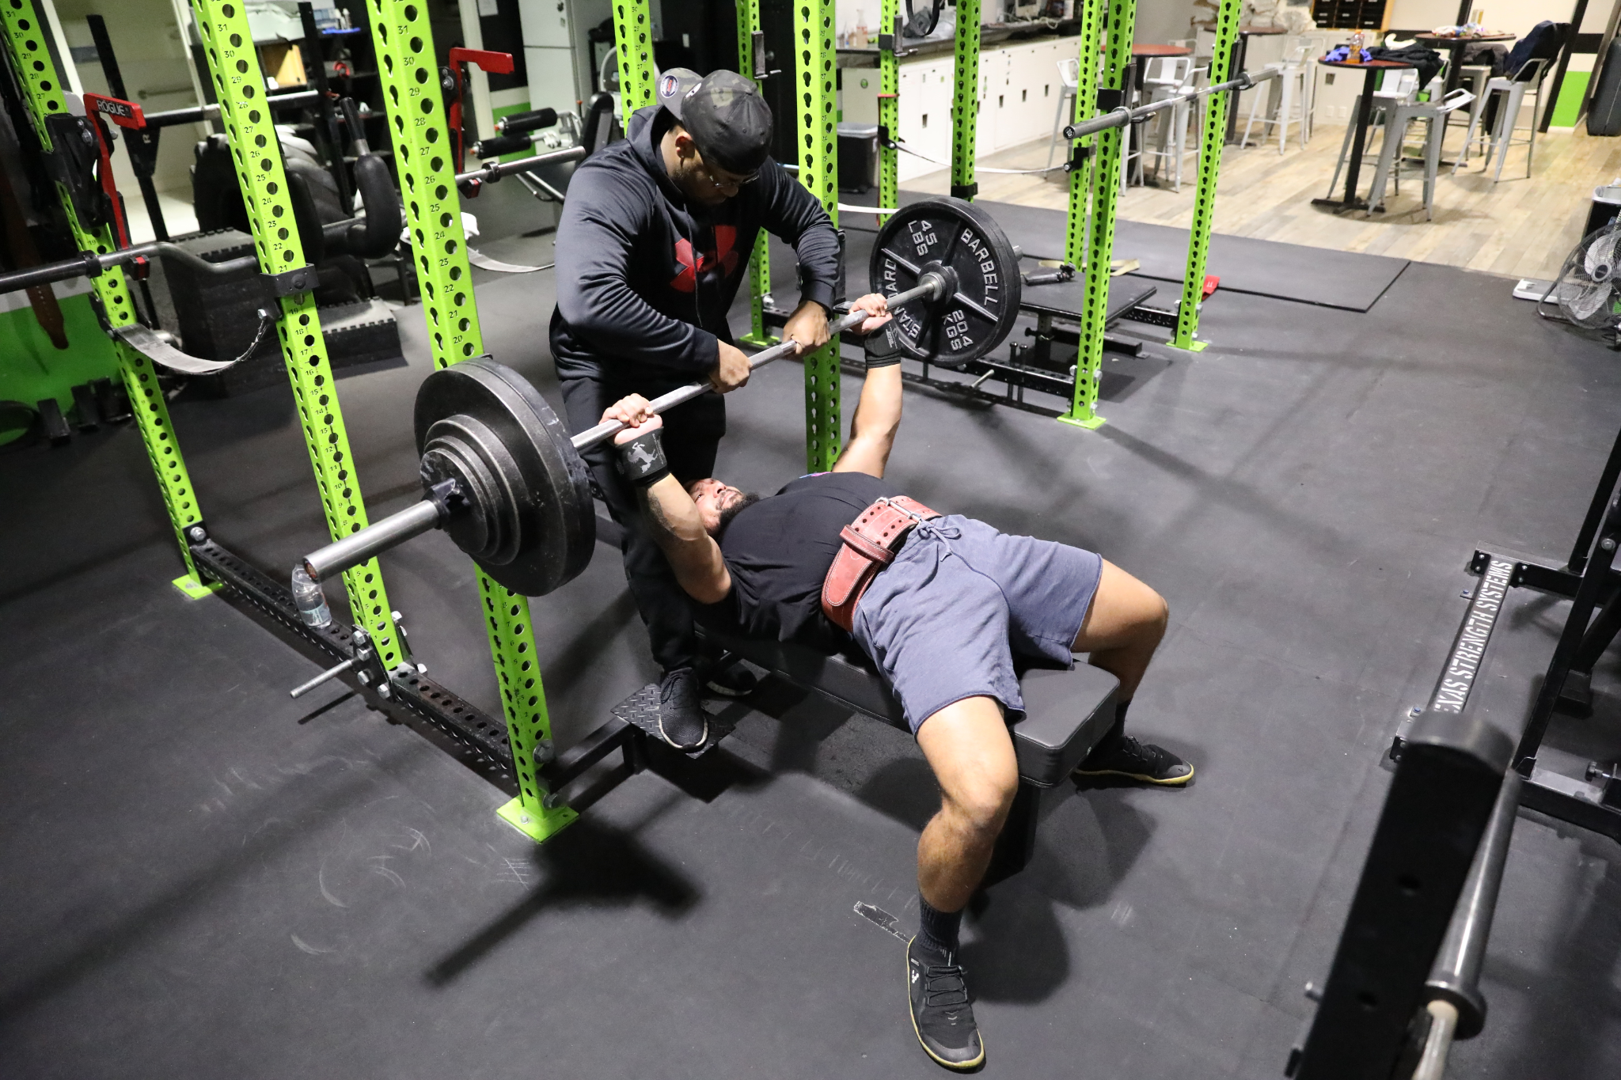
1. Physical Health + Energy
Anaerobic exercise examples
Weightlifting (squats, curls, bench, deadlift)
HIIT workouts
Sprints
All out biking/rowing
High effort resistance training
*difficult to hold a conversation*

Slide 11
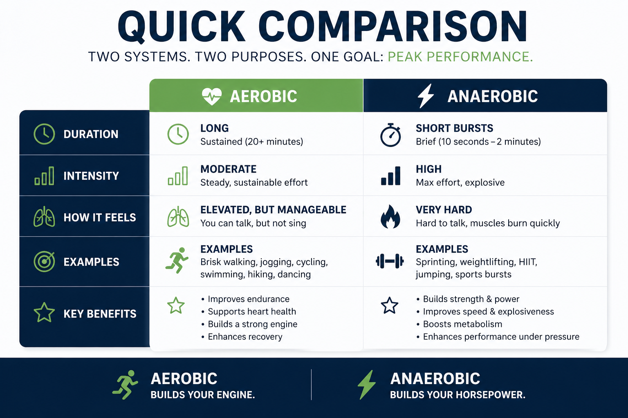
1. Physical Health + Energy

Slide 12
1. Physical Health + Energy
Exercise Styles
The best training plan offers a combination of the BIG 3 major components:
Cardio
Strength
Flexibility/Mobility

Slide 13
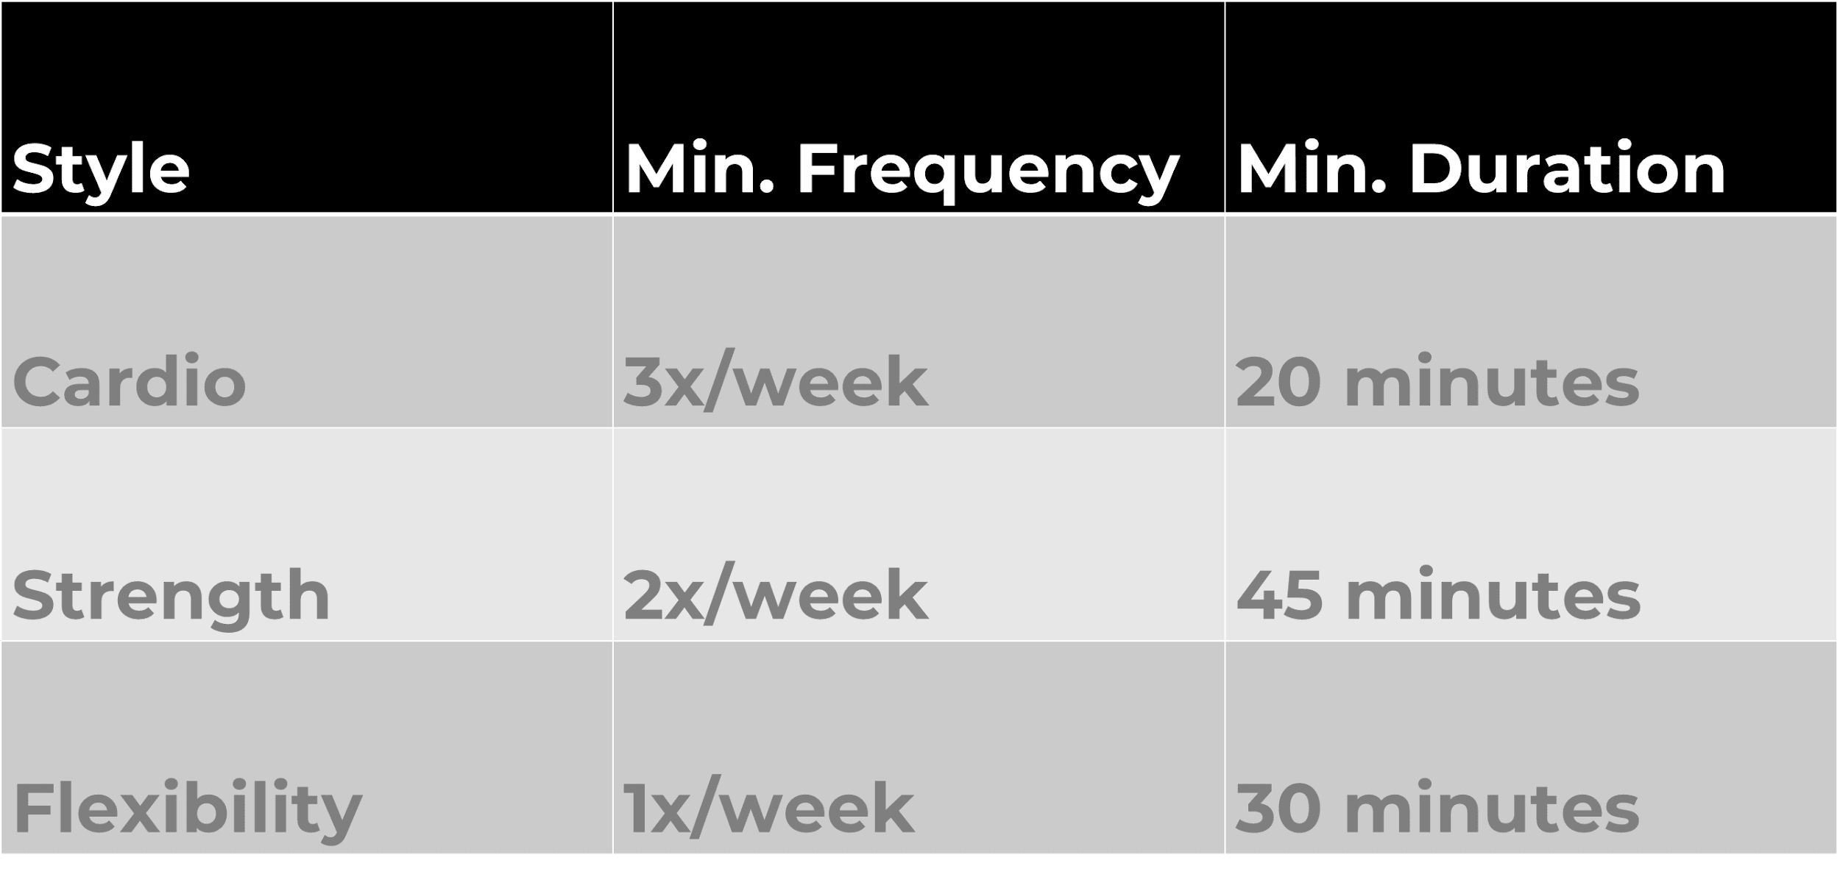
1. Physical Health + Energy
Exercise Frequency

Slide 14
1. Physical Health + Energy
Most people know where they stand, but few are intentional about improving it
On a scale of 1-10, how would you rate your energy on a typical workday
What is one habit in your daily routine that is helping your physical health + energy bucket? What is one habit that is hurting it?

Slide 15



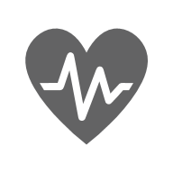

2. Mental Health + Energy
Benefits of Wellness & Nutrition for You
Higher productivity
Set example
Improved sense of wellbeing
Improved health
Increased stamina and longevity

Slide 16


2. Mental Health + Energy
Benefits of Wellness & Nutrition for Your Employees
Higher productivity
Higher Engagement
Improved health
Greater Loyalty

Slide 17
2. Mental Health + Energy
Potential Mental Health + Energy Problems
Brain Fog
Less Patience
Less strategic thinking
Less energy for family and friends after the work day

Slide 18
2. Mental Health + Energy
YOU ARE WHAT YOU EAT
Study: “The relationship of a healthy diet with the level of productivity among office workers” by Mahendika et al. (Feb. 2025)
Data obtained from 210 respondents showed that workers who eat a healthy diet tend to have higher work productivity compared to those who do not maintain a good diet.

Slide 19
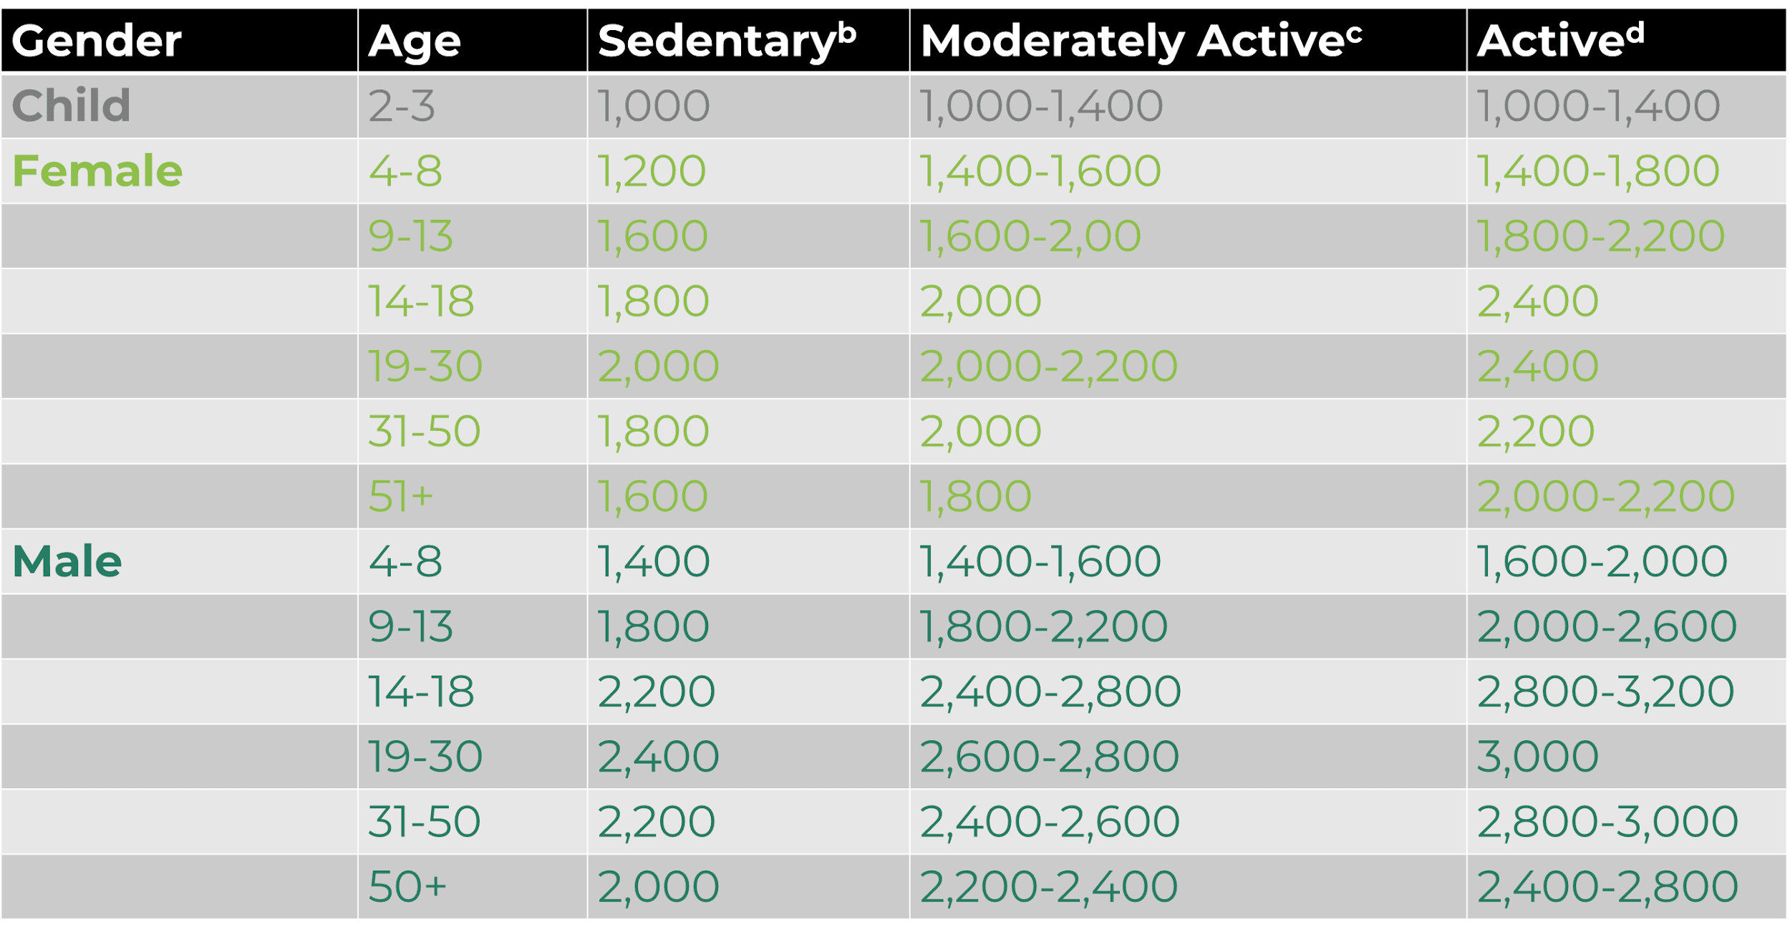
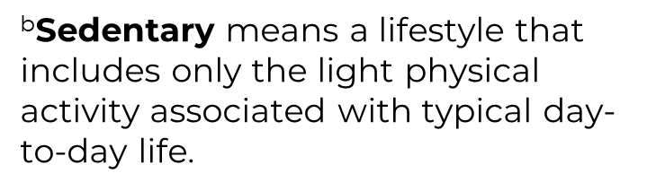
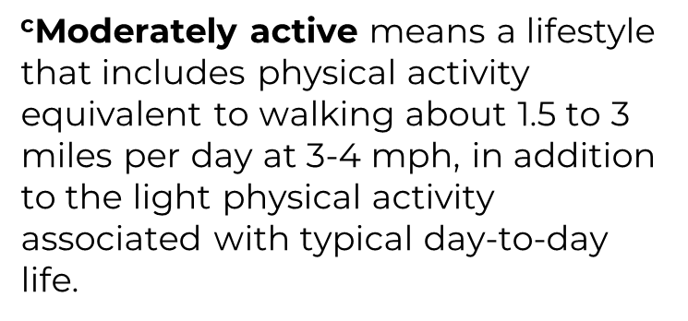
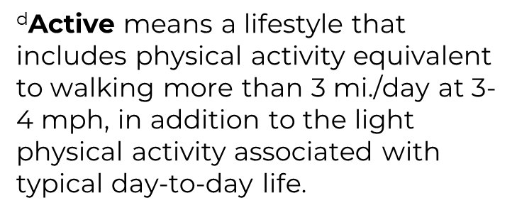
2. Mental Health + Energy
Nutrition and
Calorie Intake

Slide 20
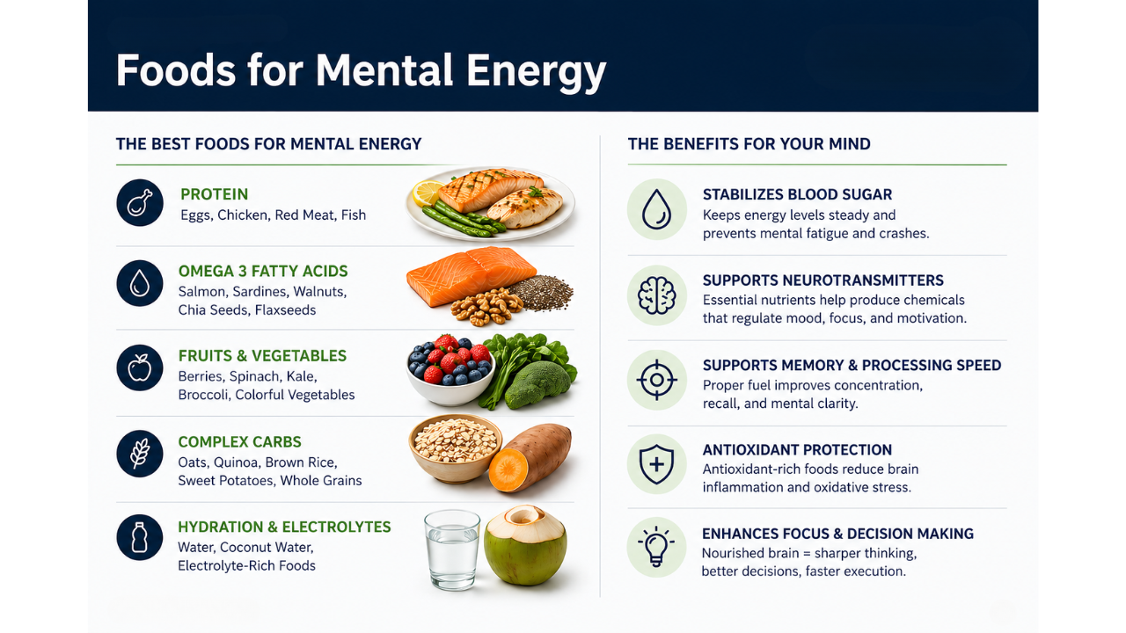
2. Mental Health + Energy

Slide 21
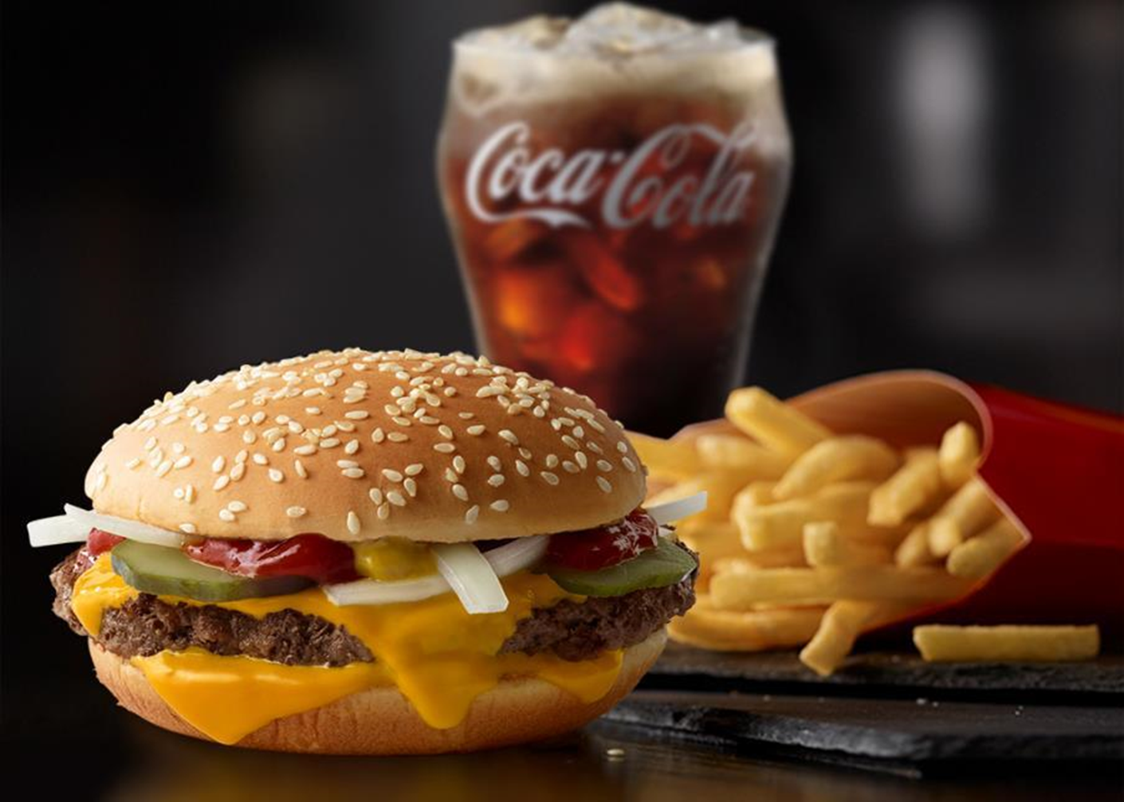
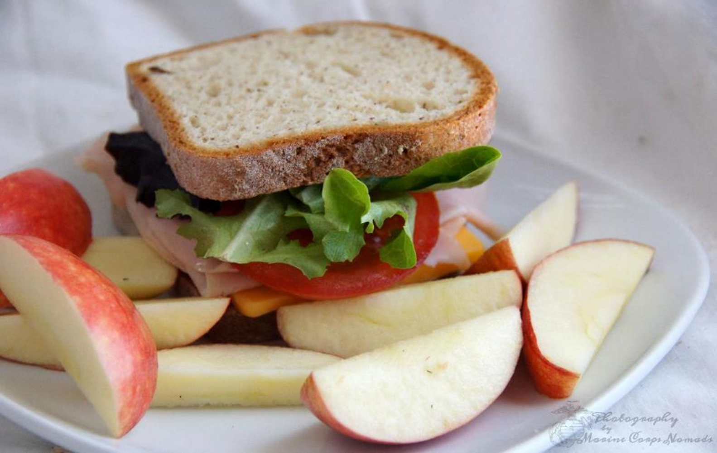
2. Mental Health + Energy
Diet + Nutrition
Quarter Pounder, Large Fries, Coke 1320 Calories
Turkey sandwich, 2 apples, & Water 510 Calories
Small Daily Choices like this will result in weight loss and healthier habits.

Slide 22

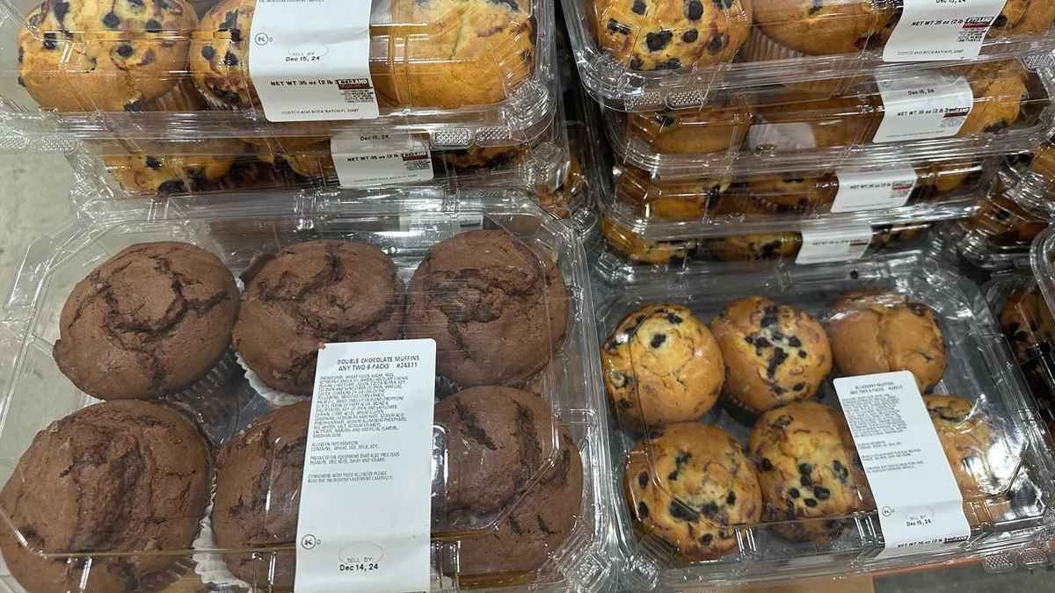

2. Mental Health + Energy
Diet + Nutrition
Cup of Berries and a Banana 175 Calories
1 Costco Muffin 600 Calories
Small Daily Choices like this will result in weight loss and healthier habits.

Slide 23
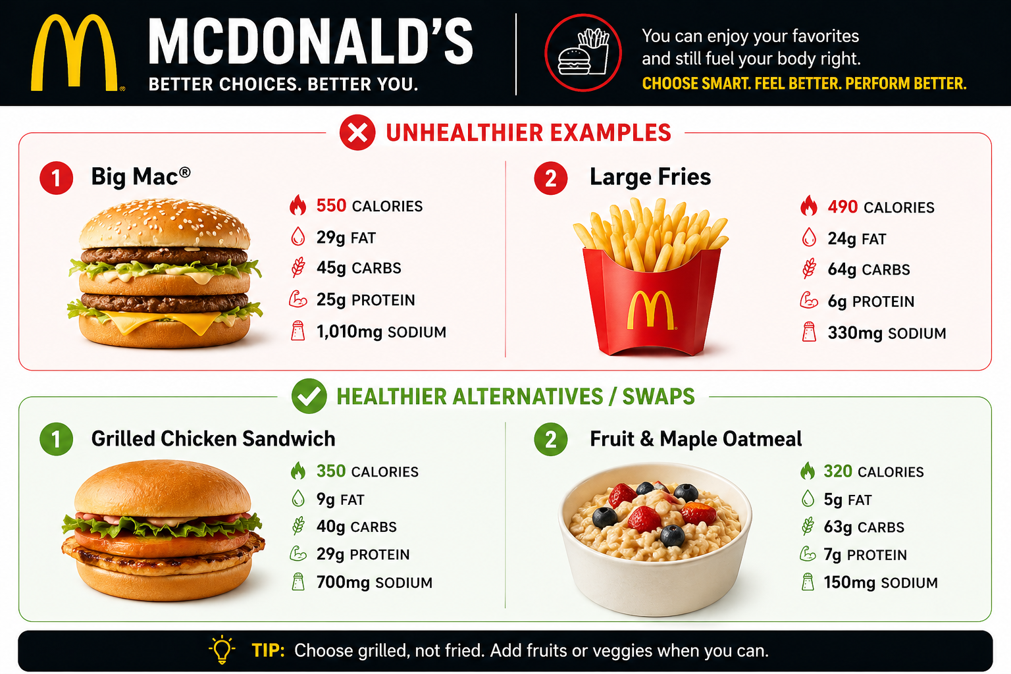
2. Mental Health + Energy

Slide 24
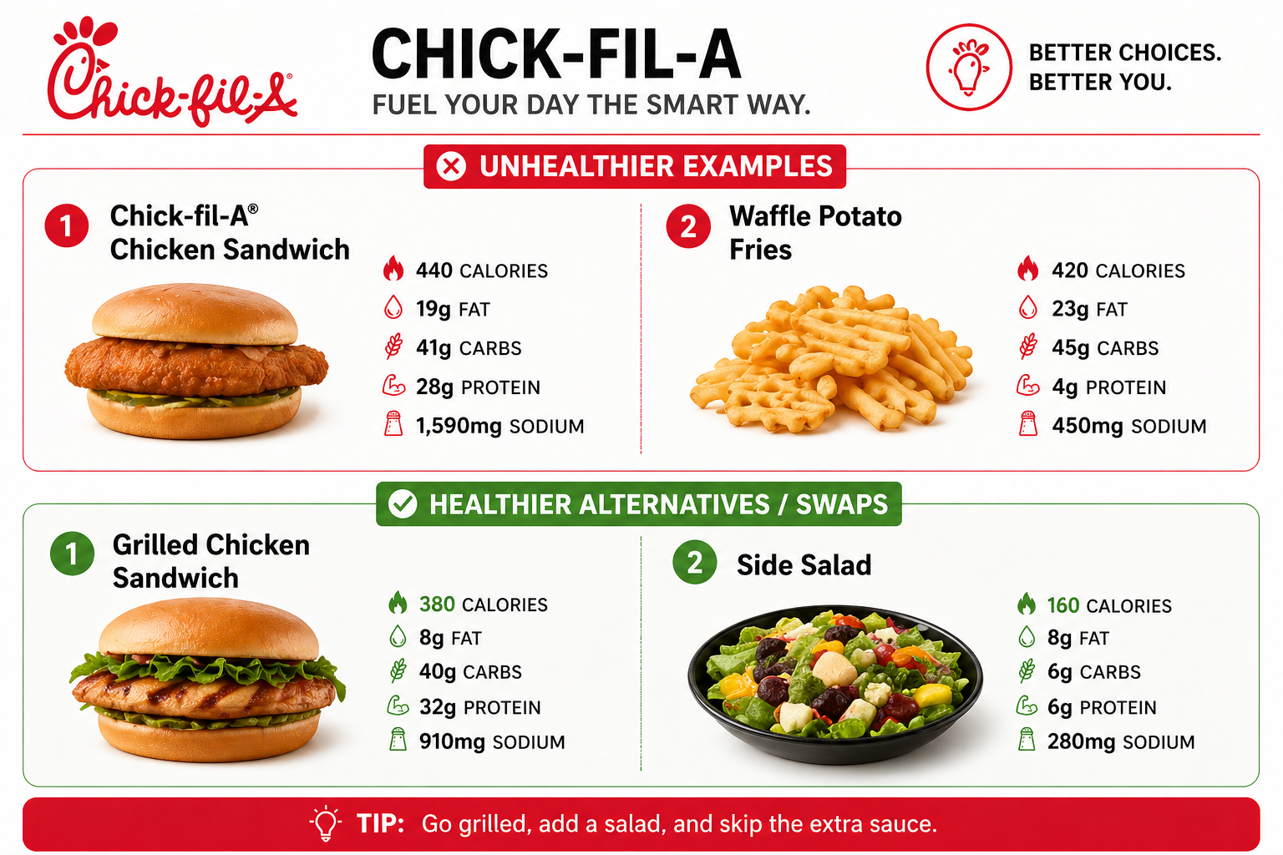
2. Mental Health + Energy

Slide 25
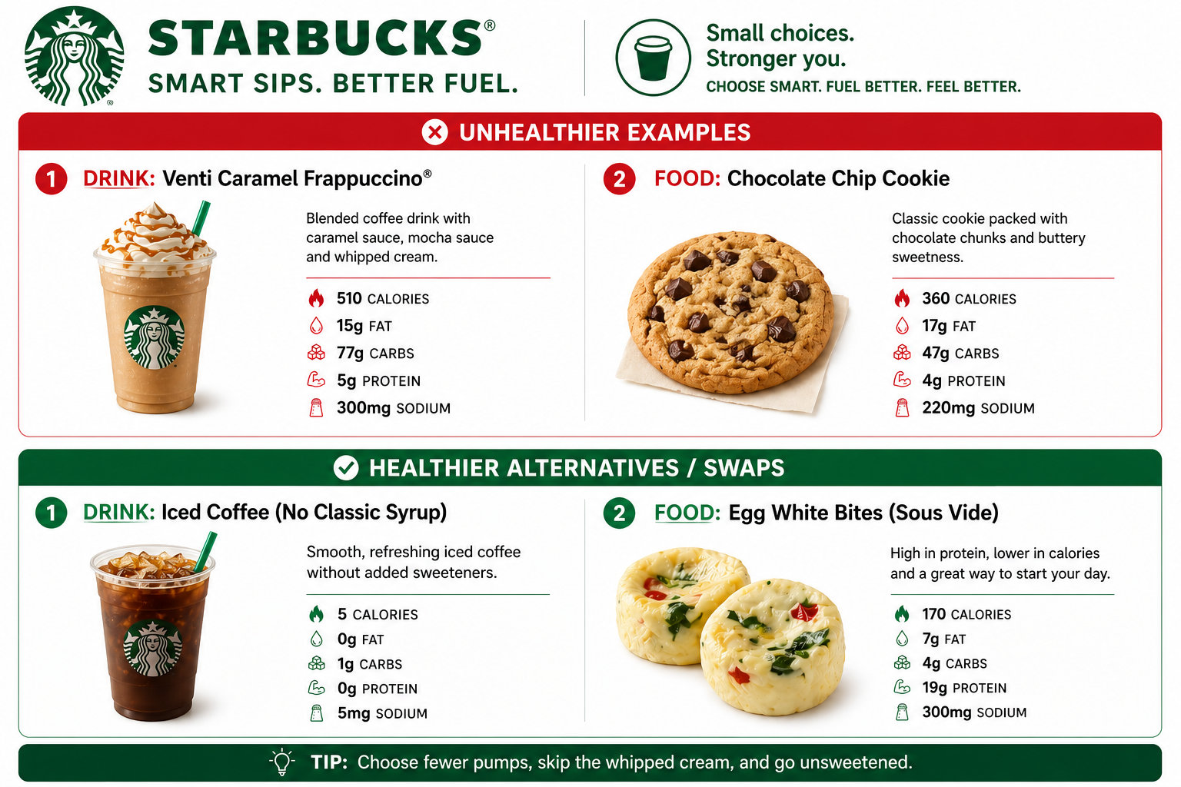
2. Mental Health + Energy

Slide 26
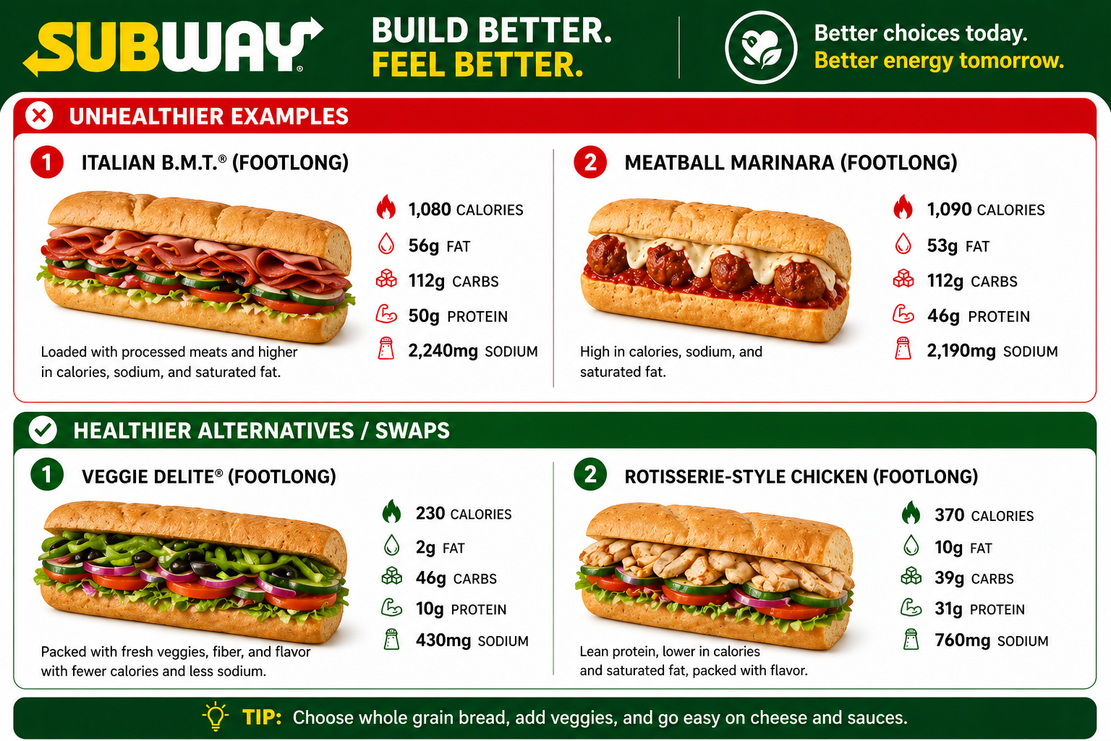
2. Mental Health + Energy

Slide 27
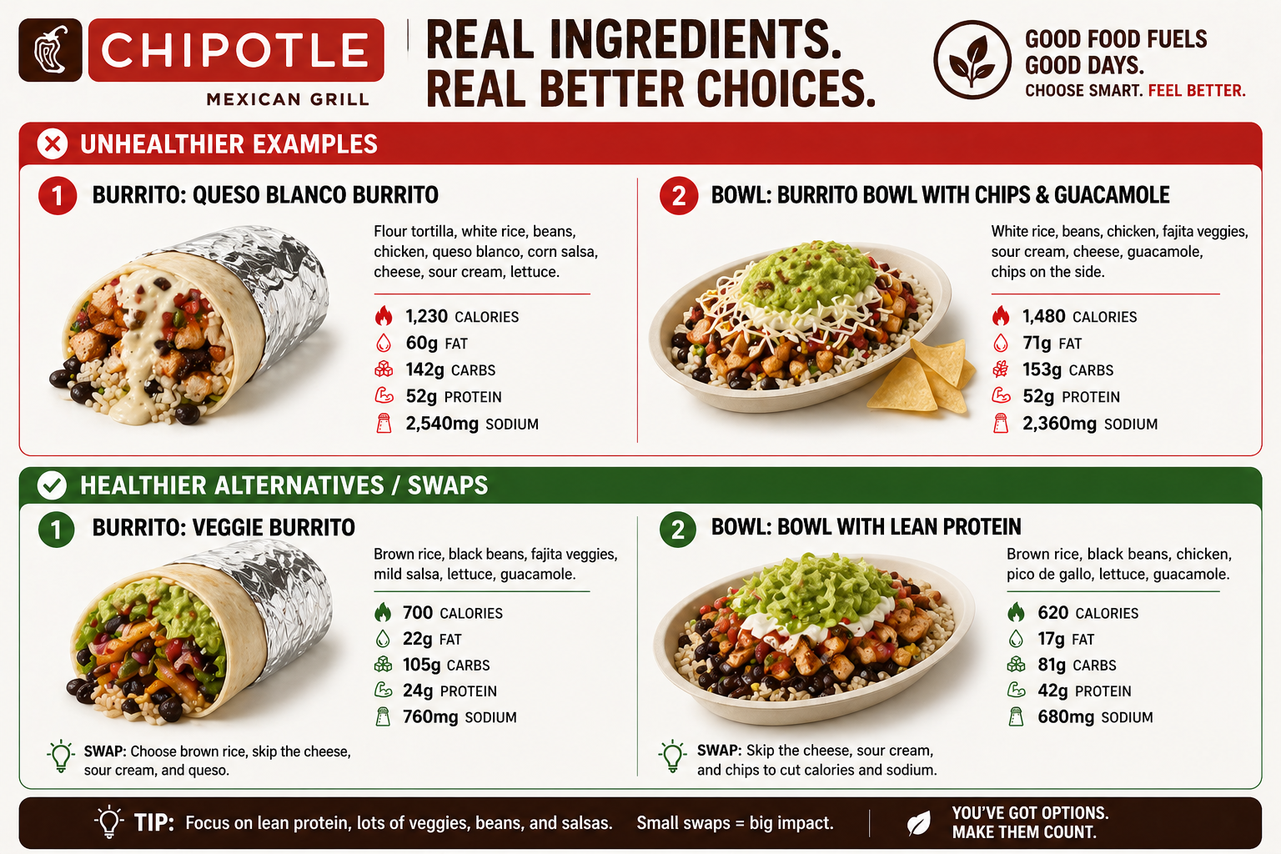
2. Mental Health + Energy

Slide 28
2. Mental Health + Energy
Most people know where they stand, but few are intentional about improving it
If I looked at what you ate yesterday, would it support high-level performance - or work against it?
What one dietary change can you make to improve your mental clarity and productivity throughout the workday?

Slide 29
3. Emotional Health + Energy
Your Emotional State becomes your teams environment

Slide 30

3. Emotional Health + Energy
Benefits of Mindfulness in the Workplace
A reduction in job stress
Decreased feelings of anxiety and depression
Increased focus and ability to drown out distraction
Increased self-awareness and regulation of emotions
Improved body satisfaction
Mindfulness really does promote physical, emotional and mental wellbeing, allowing for increased productivity.

Slide 31

3. Emotional Health + Energy
Resilient
Stable
In Control

Slide 32
3. Emotional Health + Energy
The ability to handle stress, stay composed, and show up positively for others.
Problem: Big Client Issue comes up. How will you respond?
Your Response: Don’t react irrationally – stay calm, think clearly, respond intentionally.
Problem: Deal Falls Through. How will you respond?
Your Response: Don’t lash out, treat it as a learning experience and a lesson, not a loss. Bounce back quickly and set a good example.

Slide 33
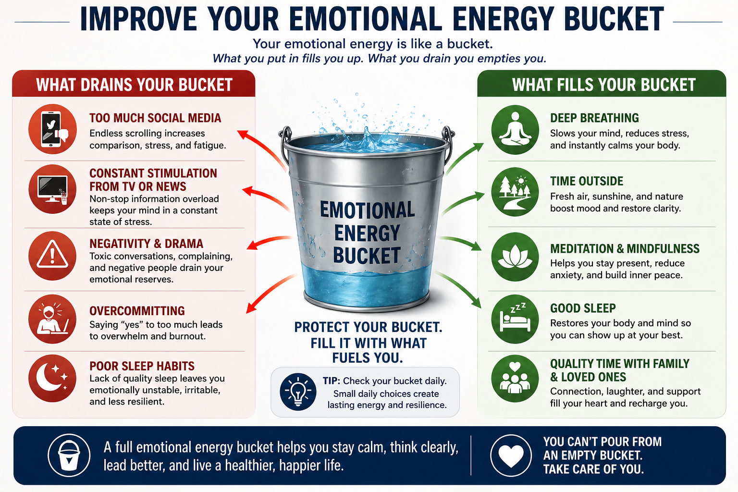
3. Emotional Health + Energy

Slide 34
3. Emotional Health + Energy
Most people know where they stand, but few are intentional about improving it
How do you typically show up when you’re under stress? Is that how a leader would handle adversity?
What kind of energy do you think your team experiences from you on a day-to-day basis? Do you think you can make any improvements?

Slide 35
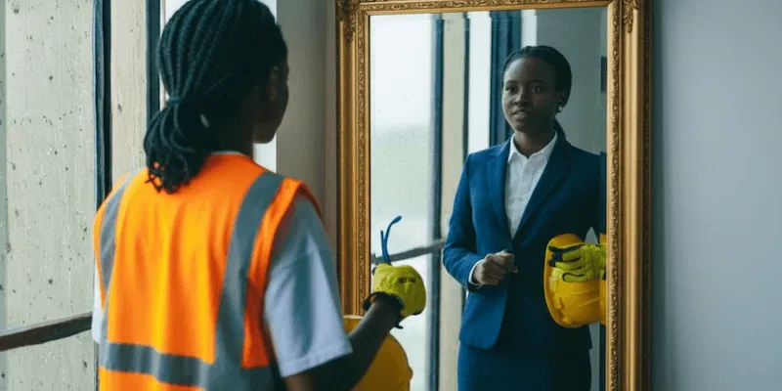

4. Identity Health + Energy
Identity = The Driver
(Where you’re going)
In Charge of Everything
Mental = The GPS
(Clarity)
Physical = The Engine
(Capacity)
Emotional = The Tires
(Control)
When your mind is clear, you think better
When your body feels good, you show up consistently through action
When you’re resilient and emotionally strong, you are grounded

Slide 36
4. Identity Health + Energy
It is bigger than you.
The decisions that you make impact the lives of many.
Taking care of your health decreases the chances of any obstacles for you during your work career.

Slide 37
4. Identity Health + Energy
Without a strong identity, your other buckets cannot be filled
Ask yourself…
Who do I do it for?
What do I want to accomplish?
Why does my work matter?

Slide 38
4. Identity Health + Energy
Most people know where they stand, but few are intentional about improving it
Does the way you live your day-to-day life reflect the person you want to be? Physically, Mentally, and Emotionally, to complete your identity.
Are you clear on who you want to be as a leader, and are your daily actions supporting that?
What is your why? Remember your purpose and why you are building what you’re building.

Slide 39







Guided Meditation
Mindfulness
Mindfulness creates a space within, a quiet shift in focus and attention that helps the mind and body rest and reset. This allows us to respond to ourselves and our lives rather than reacting instantly, which in turn soothes the entire range of unpleasant anxiety symptoms.
5 MINUTE Guided Meditation
Take a seat. Find a place that feels calm and quiet.
Set a time limit 5-10 min works to begin.
Notice your body
Feel your breath
Notice when your mind has wandered
Be kind to your wandering mind

Slide 40
Final Thoughts
You have a million problems until you have a health problem.
Then you only have 1 problem.

Slide 41
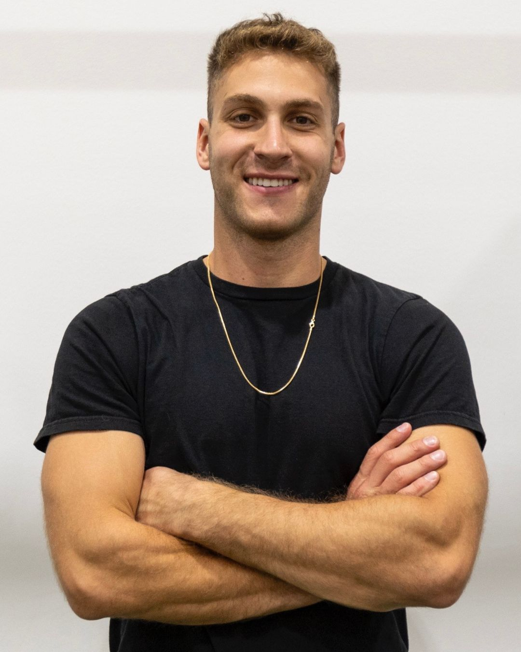
THANK YOU
Daniel Golub
Former Collegiate + Professional Athlete
Current Founder + Owner of DG Elite
Fitness
Social Media
Speaking Events
Health + Wellness
Mindset + Motivation
Work Number: (847) 529-1200
Email: danielgolubfitness@gmail.com

