Slide 1



AI & The Accounting Profession
“The future is already here – it’s just not evenly distributed.”
– William Gibson
October, 2026
David Toth

Slide 2
A quick show of hands
An honest temperature check — hands up if it applies, and keep them up if the next one does.
01
Your firm did anything with AI in 2025
02
You have something in production today
03
You've named or hired a dedicated AI lead

Slide 3

Who believes that 6 months from now, firms will be able to do…
100% of their tax return workflows with AI?
How about 24 months? 36?

Slide 4
The Big 4…
KPMG
PWC
DELOITTE
EY
+ Microsoft
Firm-wide AI
+ Google Cloud
EY.ai platform
$2B
$1B
$3B
Firm-wide
announced AI investment
announced AI investment
announced AI investment
announced AI investment

Slide 5
Every 7 months
The length of work AI can autonomously complete is doubling.
Early 2025: ~1 hour of human work
Mid-2026: ~4 hours, on trajectory
2027: A full workday
Source: METR, "Measuring AI Ability to Complete Long Tasks" (March 2025). Refresh before delivery.

Slide 6
The Pace of Change
The race to 100 million users
ChatGPT
2 months
TikTok
9 months
Instagram
30 months

Slide 7
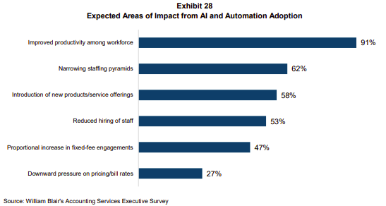
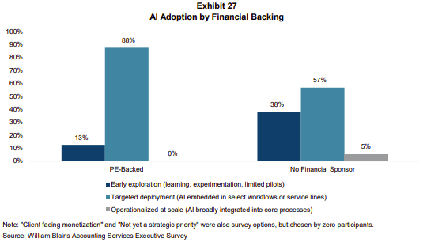
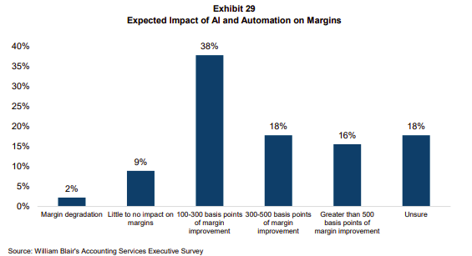
AI Adoption & Expectations
The race to 100 million users

Slide 8
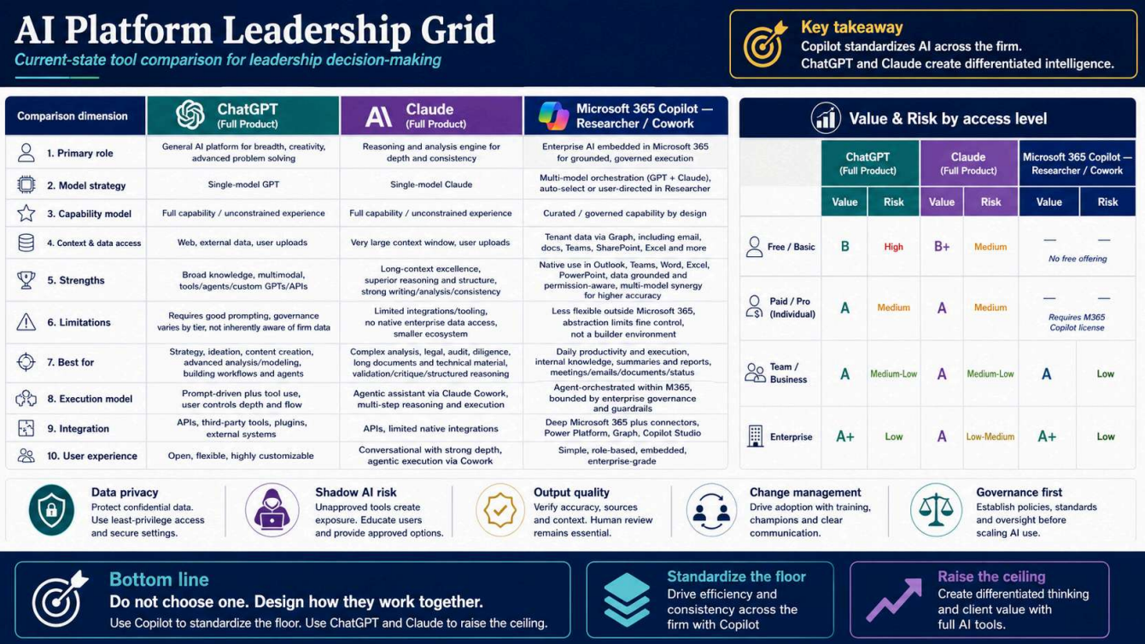

Slide 9
Strategy – Top Down or Bottom Up
TOP-DOWN
BOTTOM-UP
Set the vision firm-wide
AI policy, vendor selection, training budget, named ownership.
Pros
Alignment, governance, faster scale, defensible against risk.
Cons
Slower start. Risk of buying the wrong tool before practitioners know what they need.
Let practitioners experiment
Personal tools, custom GPTs, light pilots inside real workflows.
Pros
Rapid learning, real use cases surface, fluency builds quickly.
Cons
Shadow IT, data leakage, no leverage across the firm, training duplicated.

Slide 10
Where are you / your firm at on your AI journey?

Slide 11
What is your firm doing?
01
ONE thing you're doing personally with AI that's working
Could be ChatGPT for emails, Claude for memos, anything.
02
ONE thing your firm has deployed — or tried and abandoned or succeeded
Tool, workflow, pilot. What worked, what didn't, what surprised you.
03
ONE question you wish you knew the answer to
We'll come back to these as themes for the rest of the session.

Slide 12
Everyday Wins
MEETINGS
CALENDAR
Recap, action items, queryable transcripts.
Auto-block deep work. Defend focus time.
TOOLS
TOOLS
Fireflies • Otter • Granola • Read.ai
Reclaim • Motion • Cal.com AI • Copilot
GROWTH & CONTENT
TASKS
Drafts at 10x speed. LinkedIn, newsletter, thought leadership.
Inbox triage. Draft replies. Custom workflows.
TOOLS
TOOLS
Claude • ChatGPT • Copilot • Custom GPTs
Superhuman AI • Claude Projects • Custom GPTs • Copilot

Slide 13
THE DEATH OF TOOLS
VIBE CODING
When natural language becomes the interface, the bar for owning a separate tool rises fast.
LIVE DEMO PROMPT
IMPLICATIONS
"Build me a recurring journal-entry validator that flags entries posted outside business hours, above 2σ from the rolling 90-day mean, or to suspense accounts. Read from a sample CSV. Output a flagged-items report I can hand to the audit team."
→ Working Python in 30 seconds.
→ No IT ticket. No vendor. No procurement.
→ Your senior built it on a lunch break.
Some point solutions become superfluous
Why pay $50/seat for a tool you can replicate in an afternoon?
Custom workflows become cheap
What used to be a 6-month dev cycle is now an afternoon.
Your moat is DATA and PEOPLE
Not your tool stack. The stack is now commoditizing.

Slide 14
To Wrap Things Up…
01
THE CURVE IS STEEPENING
Whatever you assumed six months ago is already wrong. Re-baseline every quarter — not every plan cycle.
02
YOUR DATA IS YOUR EDGE
Governance isn't a brake — it's the steering wheel. Locate, classify, and contain before you accelerate.
03
START WITH PEOPLE, NOT TOOLS
The firms that win are the ones whose practitioners are AI-fluent. Tools follow fluency, not the other way around.
04
ECONMICS WILL CHANGE
If AI compresses preparation time, hours-based pricing gets harder to defend. The firms that win will convert time savings into margin, responsiveness, advisory capacity, and better client experience.

Slide 15
A Strategic Path to
Unlocking AI's Promise
An introduction to AI strategy for CPA firm leaders
Brian Blaha | Winding River Consulting
ENGINEER YOUR GROWTH.
Notes:
Open with the story. At a recent managing-partner roundtable, my colleagues and I asked the group to name their single highest-priority topic. They told us to guess - and that the answer was only two letters. In today's landscape it was either AI or PE. I said AI, and I was right.
The whole conference proved it - you couldn't sit through a session or walk the trade-show floor without hearing about it. The AI era in accounting has arrived.
The real message for today: the hype says accounting jobs get hit hardest. I see it differently. Whatever happens next is up to us. AI is our chance to finally become the true advisor this profession has always aspired to be. And getting there is a leadership and strategy decision - not a technology purchase. That's what the next 13 minutes are about. (~1.5 min)

Slide 16




Standing still and going all-in both fail
THE CASE FOR A DISCIPLINED MIDDLE PATH
Stand still
Go all-in everywhere
A disciplined middle path
It's early - most firms are in pilot mode. But the technology moves faster than any of us can track. Wait it out and you fall behind.
Chase every tool at once and you drown in investment dollars and change fatigue - spend without return, and a team exhausted by it.
Bottom-up, top-down: build AI proficiency first, then set strategy. And don't start with a technology product.
AI layered on weak strategic foundations only magnifies what's unclear.
2
Notes:
Let's be honest about the trap. There are two ways to get this wrong.
Stand still: it's early, most firms are in pilot mode, and the temptation is to wait until things settle. But the tech moves faster than anyone can keep up with - OpenAI ships something, Claude leaps ahead, the conversation shifts before you catch your breath. Wait it out and you fall behind.
Go all-in everywhere at once: equally dangerous. You'll drown in investment dollars and in change fatigue.
The way through is a disciplined middle path: a bottom-up, top-down strategy. Build AI proficiency in your people first, then set strategy on top of it. And - sorry to the trade-show vendors - don't start with a technology product. Because AI can't be layered on a tech stack or a strategy that hasn't done the foundational thinking. If your strategy is unclear, AI will only magnify that. (~2 min)

Slide 17


Learn by doing - then put guardrails around it
STEPS 1 & 2
STEP 1
STEP 2
Learn from doing, failing, doing again
Create a governance framework
Curiosity is the core skill - learning AI mirrors how we learned as kids: try, fail, try again.
Give people the tools, training, and room to experiment - within clear guidelines.
The payoff: real, firm-specific use cases that create efficiency and new value.
It never happens organically - it must be intentional and strategic.
Decide: which products? free vs. paid (security)? what's our risk tolerance?
Protect client PII, set clear use expectations, choose client transparency, and guard against bias.
Too tight kills innovation; too loose invites risk. Find the balance.
3
Notes:
The roadmap starts with two moves that go together.
Step one - learn by doing, failing, and doing again. The skill we all have to get comfortable with is curiosity. Learning AI is no different from how we learned as kids: we try something, it works or it doesn't, and we try again until we get better. Firms owe their people the tools, the training, and the room to experiment and fail - with guidelines and governance in place. All that doing and failing produces something valuable: real use cases that create efficiencies, open new revenue, and help people serve clients more deeply.
Step two - the guardrails. A governance framework doesn't happen organically; it has to be thoughtful and intentional, because the risks are real. Ask the hard questions: What products will we allow? Are free versions off limits? Do we require paid subscriptions for security? What's our risk tolerance? Then protect client PII, set clear expectations for how AI can and can't be used, decide how transparent to be with clients, and take bias seriously. The balance point: too tight and you can't innovate; too loose and you take on unnecessary risk. (~2.5 min)

Slide 18

Inventory the work, optimize the investment
STEP
3
FIND THE PRODUCTIVITY USE CASES
Once governance is moving, inventory the workflows and jobs across the firm - this is where the use cases come into focus.
Productivity use cases are easiest to spot: remove friction, free up hours - across service lines and operations.
Document each one, weigh impact vs. ease of implementation, and quantify ROI in hours returned.
The question that matters most
“What will you do with the hours you free up?”
Inventory workflows
→
Score impact vs. effort
→
Quantify ROI in hours
Better insights · deeper client service · more clients · new services · a different talent model.
Efficiency only matters if you deploy the freed-up capacity well.
4
Notes:
Step three. Once governance is in motion, inventory the workflows and jobs being done across the business - this is where use cases come into focus.
The easiest to identify are productivity use cases: opportunities to free up hours by removing friction from routine work. They exist across every service line and in the operations that support the firm. To find them, you have to understand the workflows happening every day and where the pain points are.
From there: document the use cases, assess how meaningful each would be if solved, and weigh that against ease of implementation. And quantify ROI - if this works, how many hours do we give back to the team?
Which leads to the most important question on this slide: what will you do with those extra hours? Better insights? Greater client service? Serving more clients? Launching new services? Rethinking the talent model? Efficiency gains are great, but they only matter if you deploy the capacity well. (~2 min)

Slide 19


Imagine new value, not just efficiency
STEP
4
OPPORTUNITY & IMAGINATIVE USE CASES
Productivity gains are easiest to grasp - but the real upside is doing things differently and creating new value.
Opportunity use cases
Imaginative use cases
Take more creativity, better data, and planning - but hold real upside: serve clients more deeply, reach more clients, support entirely new services.
Bottom-up and practitioner-led. Professionals extend their own expertise to serve clients in deeper, more complete ways.
AI amplifies human judgment - it doesn't replace it. It can't be a crutch; it should extend and sharpen our thinking.
5
Notes:
Step four. Productivity gains are the easiest to get our arms around, but they may not be the most impactful over time. Some of the most powerful use cases come from doing things differently and creating new value.
Opportunity use cases require more creativity, better data structure, and more planning - but they carry significant upside. Ask: How can AI help us serve clients in a deeper, more meaningful way? How can it help us reach more clients in marketing and sales? How can it support entirely new services?
Then there's a second category - imaginative use cases. These are often bottom-up and practitioner-led. They let professionals extend their own expertise to serve clients more completely.
The throughline matters: AI can't become a crutch - it shouldn't do our thinking for us. But it can absolutely extend our thinking, sharpen it, and help us apply our expertise more broadly. AI amplifies human judgment; it doesn't replace it. (~2 min)

Slide 20



Buy, build, or borrow
STEP
5
DECIDE ON USE CASE, ECONOMICS, AND STRATEGIC VALUE
Buy
Build
Borrow
Partner with platforms where the use case justifies it. AI can democratize tools once reserved for the largest firms - letting boutique firms compete in new ways.
Build internally where it fits - especially the orchestration layer that connects your workflows, systems, and data the way you actually operate.
Leverage the learnings of others. Lean on peers, early adopters, and partners who've already made the mistakes - don't reinvent the wheel.
Not buy-or-build on principle - decide based on the use case, the economics, and the strategic value to the firm.
6
Notes:
Step five - now the vendors get their turn. Software providers hold real promise. For many firms these technologies open up capabilities that used to be available only to the largest firms - AI can democratize sophisticated tools and let boutique firms compete in new ways. But there's a catch, and it's why use-case prioritization matters: if we implement technology for technology's sake, we'll spend a lot of time and money without the return to justify it.
Three paths. BUY - partner with technology platforms where the use case is strong. BUILD - internally, especially in the orchestration layer, where you connect workflows, systems, and data in ways that fit how you actually operate. And BORROW - the one I'd add for this room - leverage the learnings of others. Lean on peers, early adopters, and partners who've already made the mistakes so you don't have to repeat them or reinvent the wheel.
The point is not to buy, build, or borrow on principle. It's to decide based on the use case, the economics, and the strategic value to the firm. (~2 min)

Slide 21

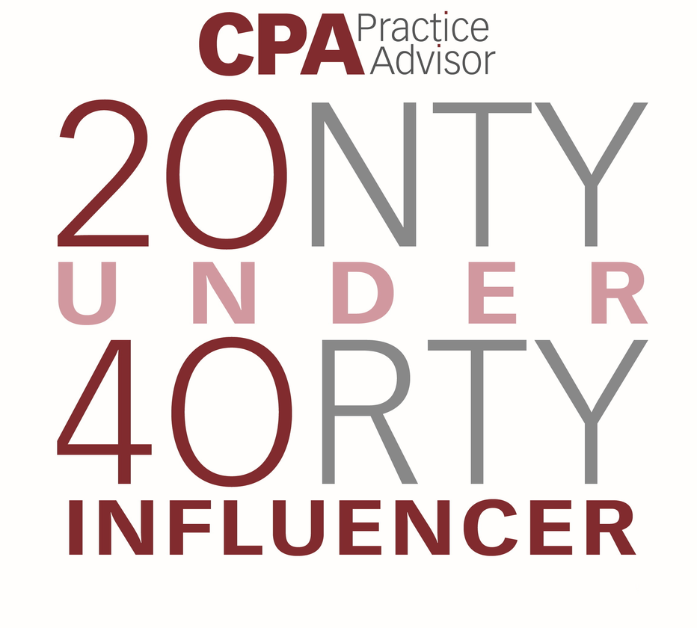
Thank You
CONTACT
Dtoth@WindingRiverConsulting.com
p: 440.723.3653
f: 440.723.3654
SKILLS
Leader, Speaker, Influencer
Change Agent

Slide 22

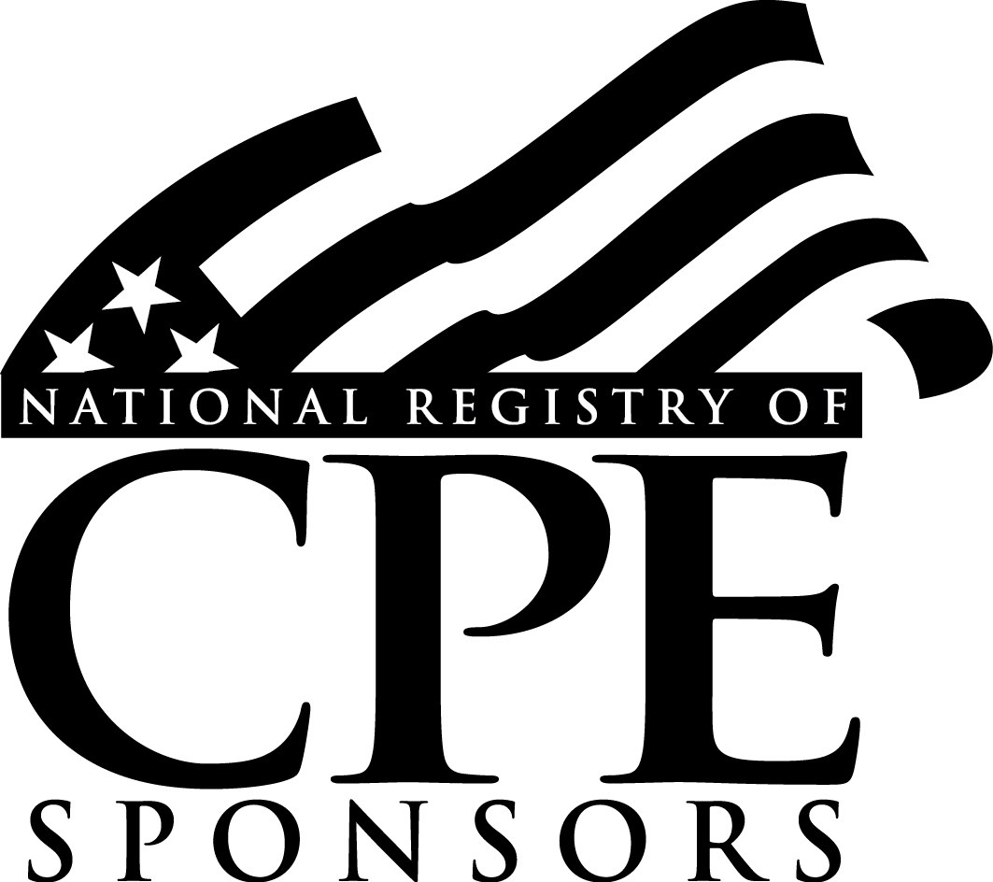
SCAN HERE
Scan the QR Code
To complete our survey
and receive CPE credits

