Slide 1


Navigating Difficult Conversations in Your Firm
MPB | Leadership Accelerated
May 2025
David Toth

Slide 2
Welcome
Uncomfortable Conversations
5 Generations in the workforce
Difficult Conversations
Scenarios

Slide 3
Look at it differently…
Nerve wracking
Root canal
Sweaty palms
Avoidance
Guilt
Conflict
Uncomfortable
Benefit
Community Building
Gift
Teamwork
Respect
Acknowledgement
Transparency
VS
Notes:
An issue arises at work for our team, could be a minor issue. And it goes unaddressed. Frustration sets in, communication constricts, tensions rise and trust evaporates and collaboration is done. Your firm cant avoid to avoid tough conversations…

Slide 4
Barriers include…
The Emotional response – what if they get emotional or angry.
2. The loss of the relationship – If I share uncomfortable news or feedback, how will that impact our relationship?
3. The fear of consequences – What will the consequences be? Will they choose not to work with me, the organization or become a client…
Notes:
The Emotional response – what if they get emotional or angry. Or we uncomfortable with the potential emotional response with the other person
The loss of the relationship – we get a long really well. If I share uncomfortable news or feedback, how will that impact our relationship?
The fear of consequences – if I have this convo, esp around feedback, what could the consequences be? Will they choose not to work with me, the organization or become a client…

Slide 5


Slide 6
Think of the last difficult conversation you avoided. What made you avoid it?
What do you wish you would have done differently?
Notes:
What are the things that make you the most nervous?
What are the biggest barriers for you?
What gets in the way ? I don’t have time… that’s fake. What makes you most nervous…
Not having these convesations or having them poorly is really bad. And most of us know this from our work.
An issue arises at work for our team, could be a minor issue. And it goes unaddressed. Frustration sets in, communication constricts, tensions rise and trust evaporates and collaboration is done. Your firm cant avoid to avoid tough conversations

Slide 7
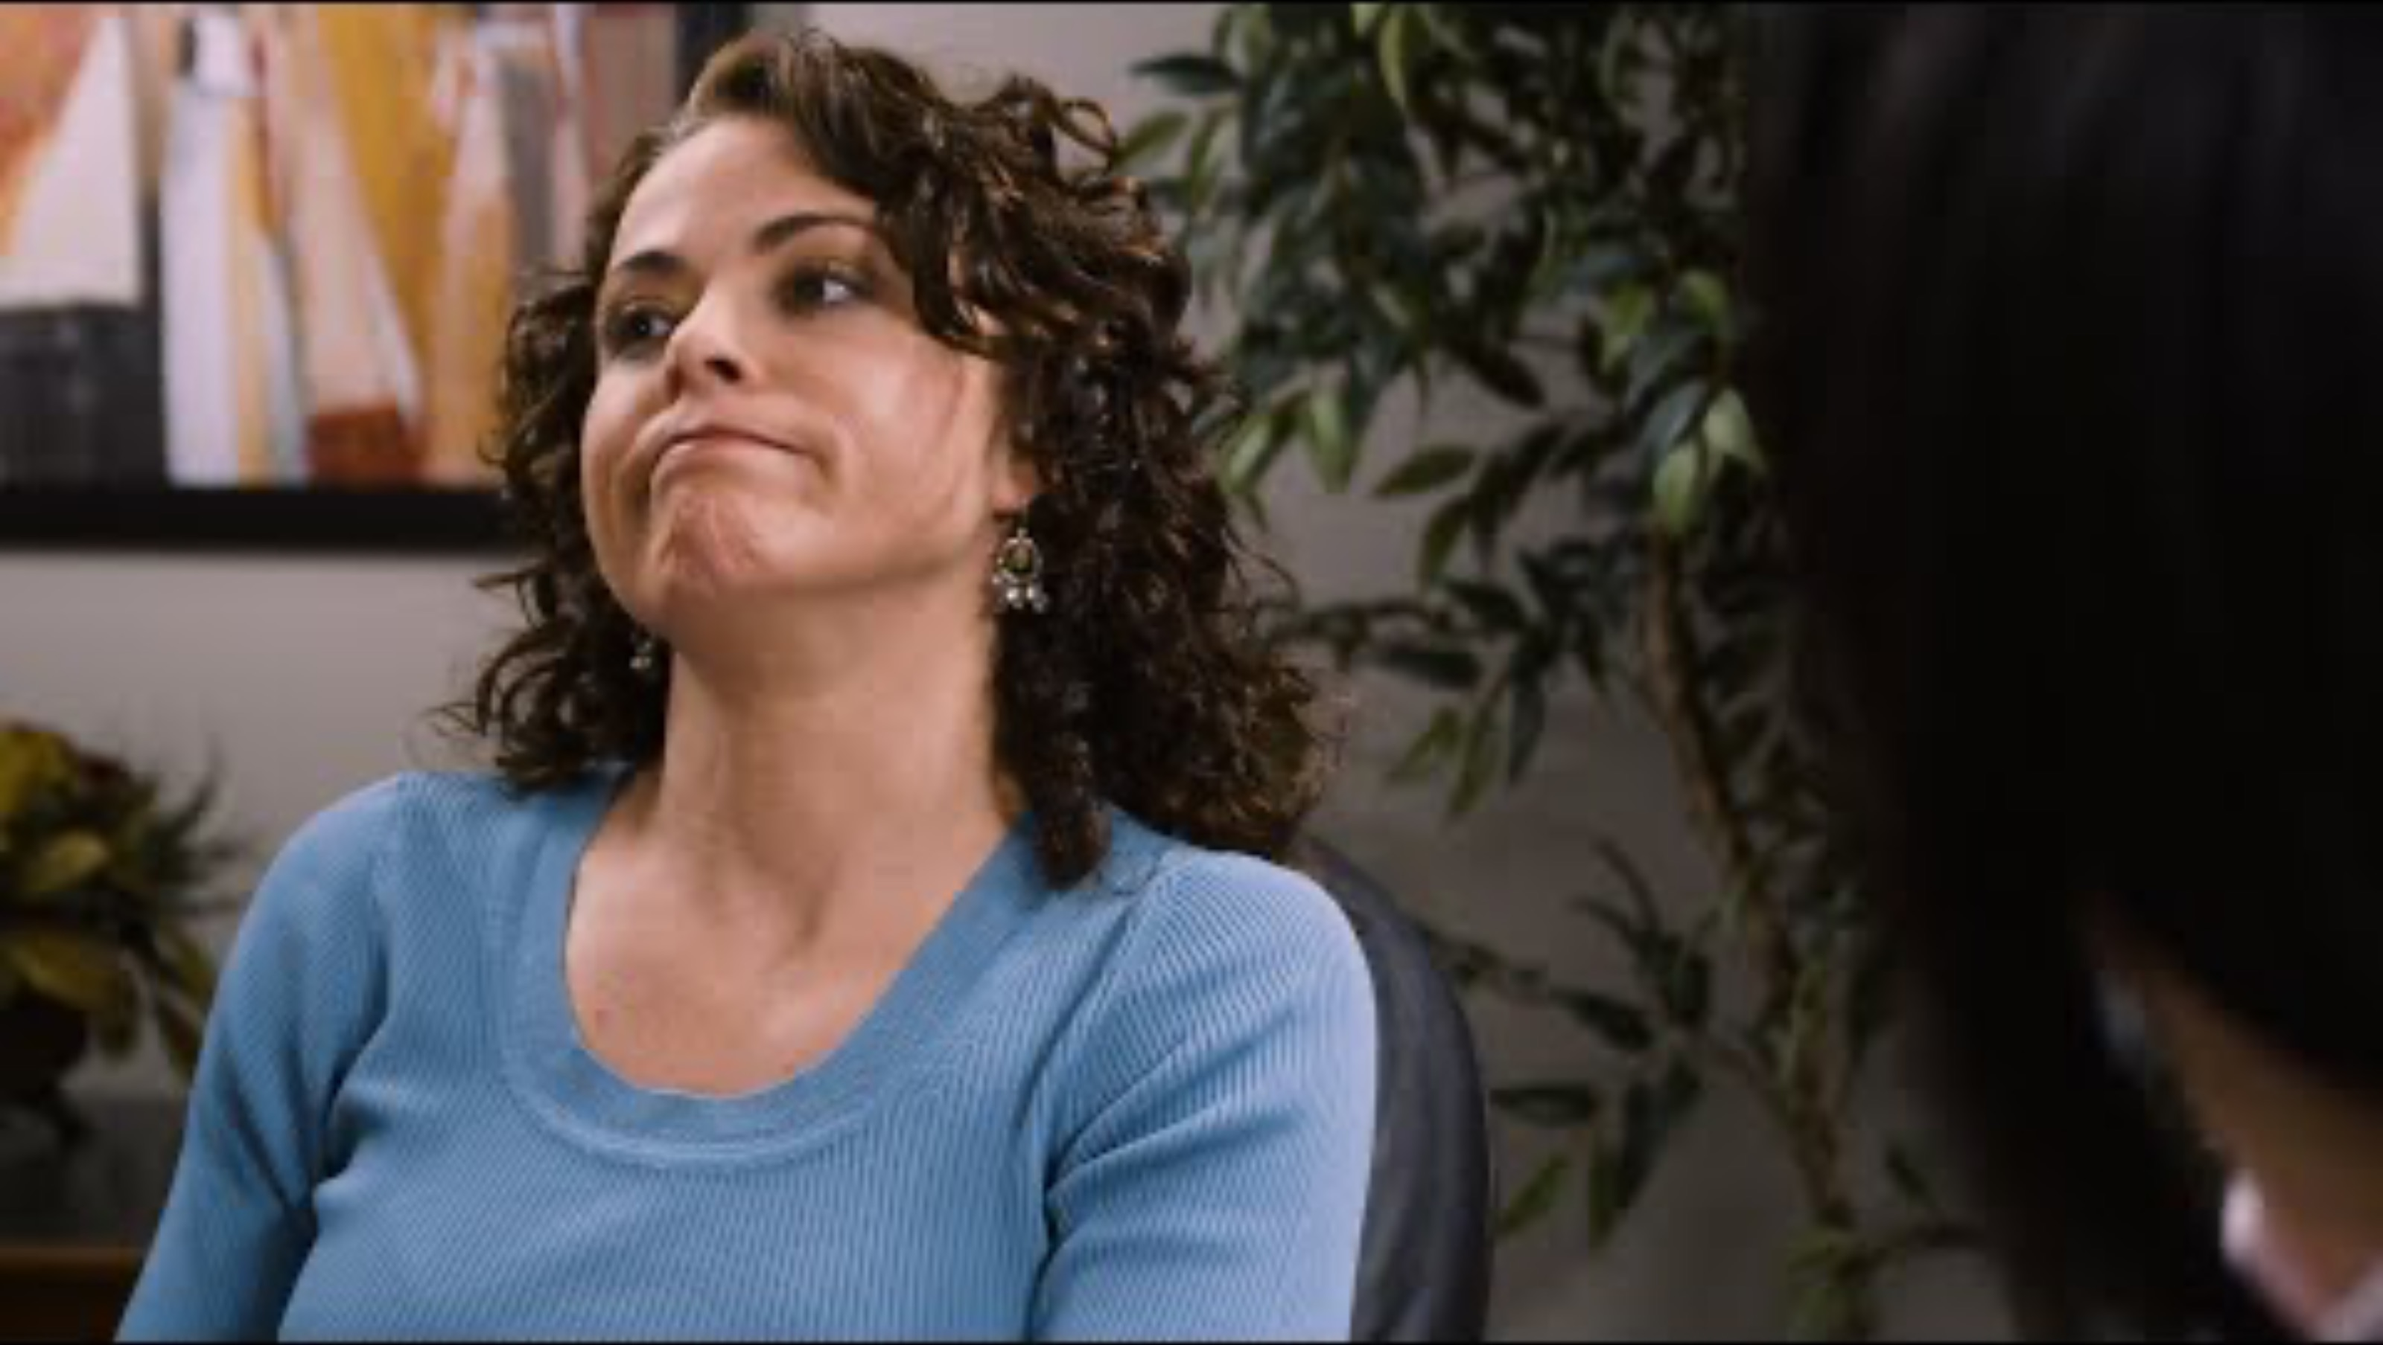
Being uncomfortable is part of being human.
Notes:
You can run away form it. Perpetuates the discomfot or breaks the relationship. Lien into the tension.
And sometimes you have failed those conversations and still kills the relationship.

Slide 8
Communication is the most difficult aspect of managing talent from different generations.

Slide 9
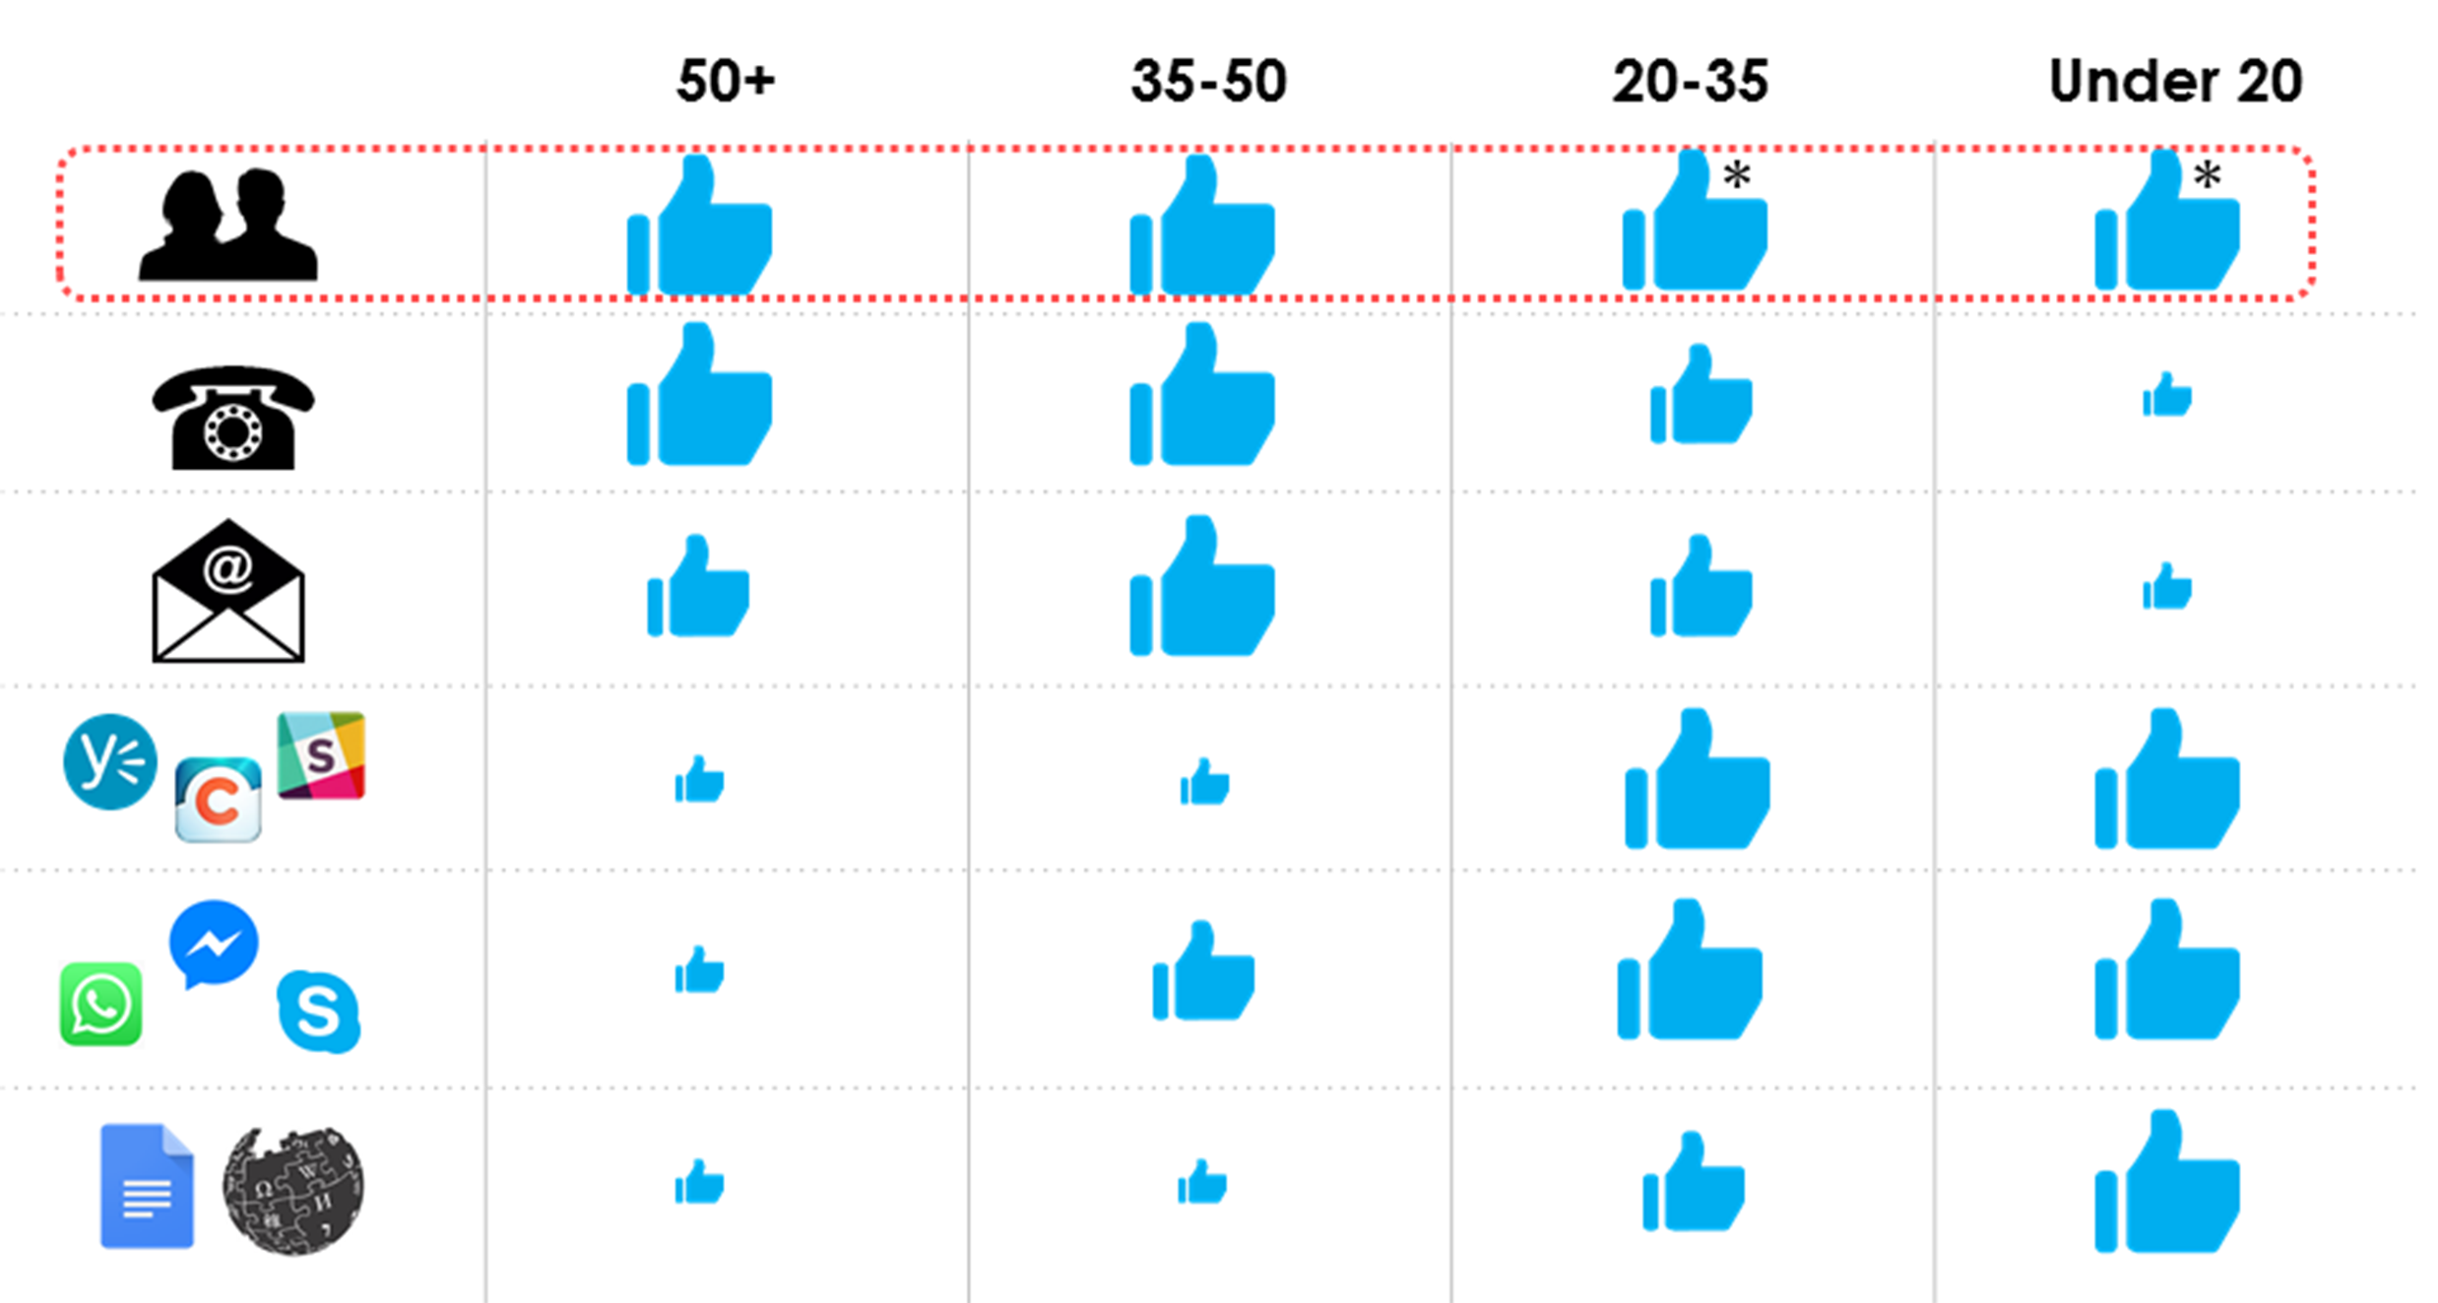
Preferred Comm Channels

Slide 10
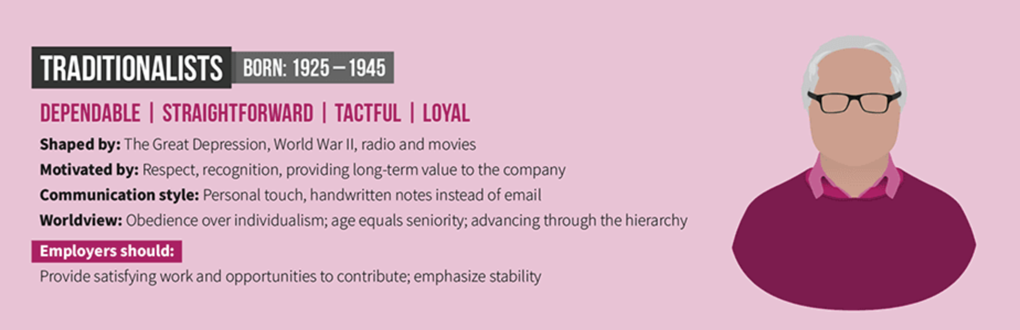

Slide 11
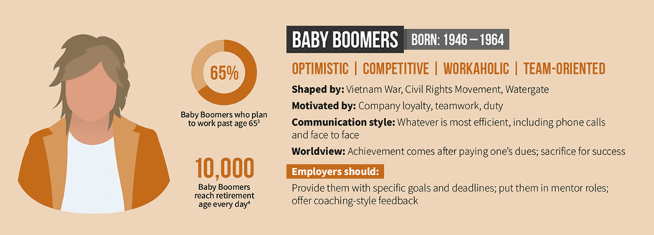

Slide 12
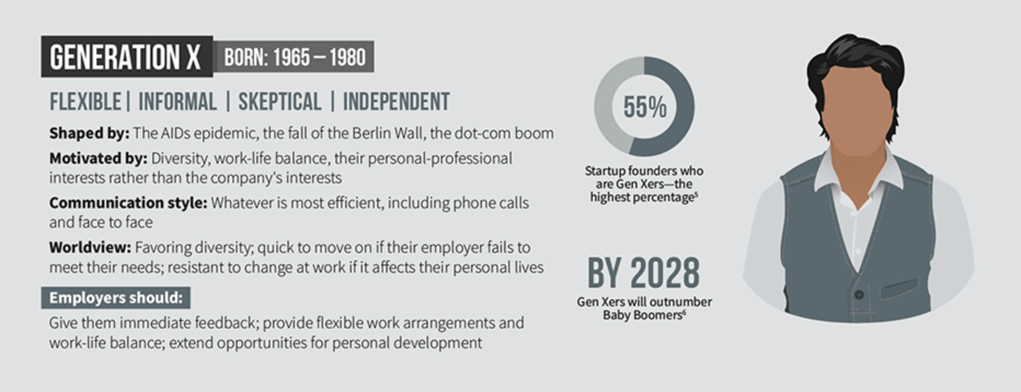

Slide 13
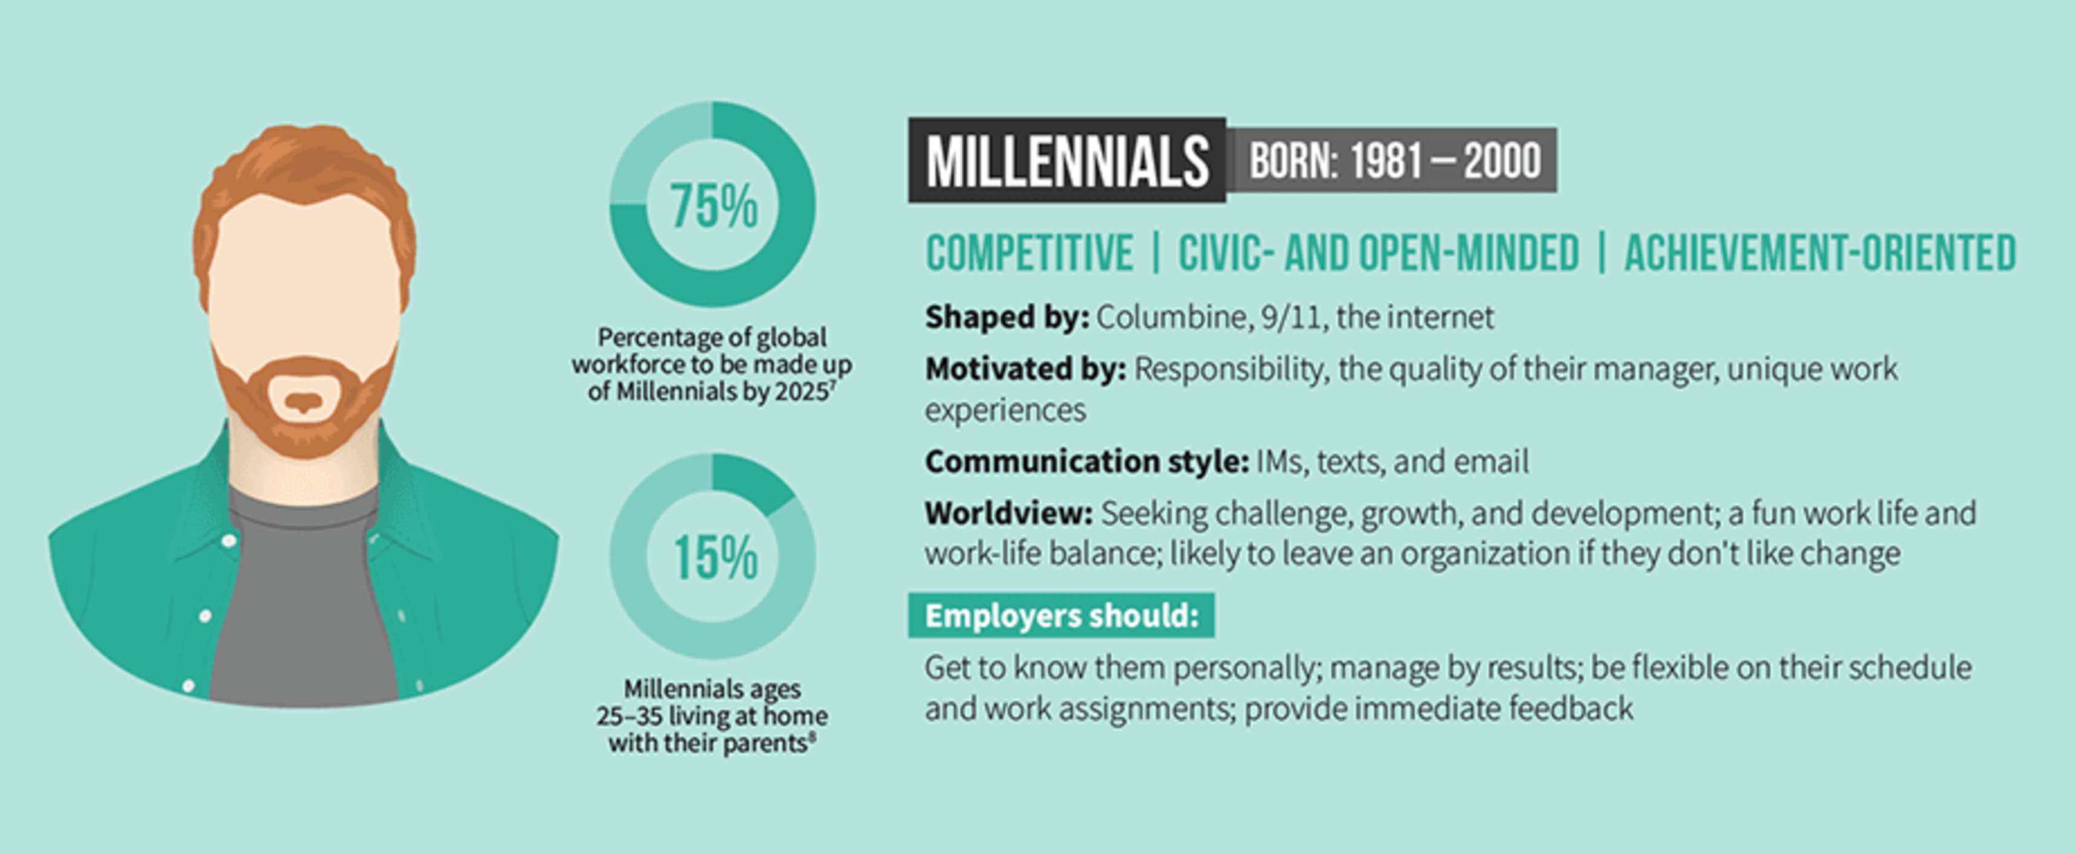

Slide 14
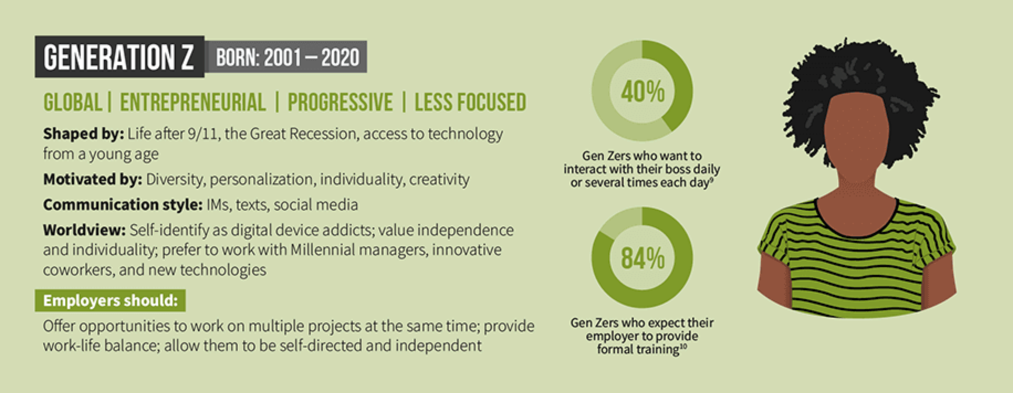

Slide 15


Slide 16
Difficult
Conversations

Slide 17


Slide 18
Difficult conversations are those that involve high stakes, strong emotions, and opposing opinions.

Slide 19
Some Guiding Principles
You don’t know anything
  -Ask & Listen
  -Hear it from them
Move toward the conflict – otherwise frustration sets in
-Conflict can be opportunity
Keep quiet & don’t panic
-They see you jumpy, they lose confidence

Slide 20
Choose the Right Time & Place
Choose a location that is conducive to having a productive conversation, and a time when both parties are likely to be focused and alert.

Slide 21

Use Active Listening
Open mind
Pay attention
Be silent
Ask questions
Comprehend
Retain
Respond
Notes:
Active listening is the practice of preparing to listen, observing what verbal and non-verbal messages are being sent, and then providing appropriate feedback for the sake of showing attentiveness to the message being presented.

Slide 22
Scenarios

Slide 23
Missed Partnership Due to Business Development Gaps
One of your direct reports is a strong performer and respected within the firm. They’re up for partner consideration, but you know they won’t be selected this year due to insufficient business generation. You’re choosing to address this proactively — before they hear it from someone else or feel blindsided
Notes:
Why It’s Critical:
This is a chance to reinforce trust and show that leadership cares about their growth.
If mishandled, the individual may feel blindsided, undervalued, or demoralized — potentially triggering disengagement or attrition.
How to Navigate It:
Start with affirmation:
“You’ve made a tremendous impact here — your leadership, technical skill, and client service are all at a partner level.”
Share the truth clearly and early:
“As we reviewed candidates this year, one key area stood out as needing development — consistent business generation.”
Explain without blame:
“This isn’t about a single year’s performance but a longer view of building and sustaining a book of business. I want to talk about how we can work on that together.”
Coach and co-create a plan:
“Let’s build a path forward so that the next time you’re up, this won’t be a barrier. I’ll support you with strategy, visibility, and opportunities to lead new engagements.”
Let silence do the heavy lifting:
Pause and give them space to react. Be fully present and let the conversation breathe.

Slide 24
Be Respectful
Stay respectful and professional, even if the other person becomes upset or confrontational.

Slide 25
Addressing a Personal Hygiene Issue
You have a high-performing direct report whose personal hygiene has become an issue in the office. Several colleagues have discreetly mentioned concerns about odor and professionalism. You must address it privately and constructively.
Notes:
Why It’s Important:
This conversation tests your ability to be respectful and human while ensuring a productive and comfortable work environment for all.
Avoiding the issue can lead to resentment among team members or reputational harm for the employee.
How to Navigate It:
Be direct, but kind:
“I’d like to speak with you about something that’s a bit awkward, but I’m coming from a place of care and support.”
Name the issue with tact:
“There have been a few comments about noticeable body odor. I understand this can be related to a number of things — health, stress, lifestyle — and I’m not here to judge.”
Offer support:
“I wanted to bring it to your attention privately so you have the opportunity to address it. If there’s anything going on that I can support you with — personally or professionally — please don’t hesitate to let me know.”
Protect their dignity:
“This conversation stays between us. I appreciate your professionalism in handling it.”

Slide 26
Pushing Back Against a Senior Partner's Unreasonable Request
A senior partner has assigned you a client project last minute before the deadline, which you don’t have the bandwidth to handle. You need to push back without appearing uncommitted.
Notes:
Principles: Tackle your toughest challenge today | Come out from behind yourself
Why It Highlights Respect:
Standing up to authority requires careful wording to avoid sounding dismissive or confrontational.
The goal is to communicate the issue without making the partner feel undermined or criticized.
How to Be Respectful:
Acknowledge their good intentions first:
“I really appreciate your guidance and the time you put into ensuring our work is high quality.”
Frame your request as a way to improve efficiency:
❌ "You're checking in too much, and it's slowing me down."
✅ "I want to make sure I'm meeting expectations and working efficiently. Would it be helpful if we set up a regular check-in instead of frequent updates?"
Use “we” language to foster collaboration:
“I’d love to find a balance that keeps you informed while also giving me the space to focus on my work.”

Slide 27
Be Empathetic
Try to understand the other person’s perspective and feelings.
Show empathy and understanding.

Slide 28
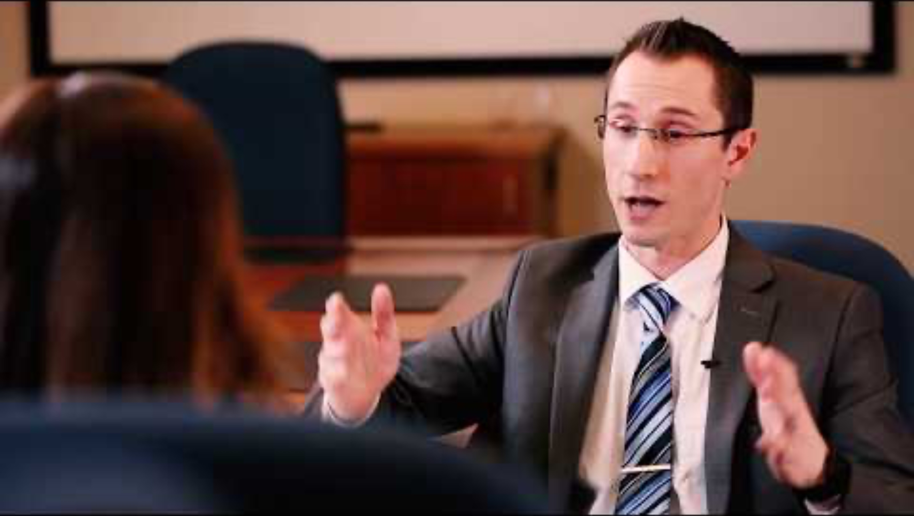

Slide 29
Delivering Difficult News to a Client
Your client’s expectation on the engagement is not going well, and you must deliver bad news while keeping their confidence in you and your firm.
Notes:
Principles: Be here, prepared to be nowhere else | Take responsibility for your emotional wake
Why It Highlights Empathy:
You must deliver disappointing news while ensuring the client feels heard and supported.
The client may be upset, frustrated, or in denial, requiring active listening and an emotionally intelligent response.
The goal is to communicate the legal reality while also showing understanding for their situation.
How to Emphasize Empathy:
Acknowledge their feelings: “I know this is not the outcome you were hoping for, and I can understand how frustrating this must be.”
Be fully present and avoid rushing through the conversation.

Slide 30
Avoid Blame
Instead of attributing blame or pointing fingers,
focus on resolving the issue and finding a solution.

Slide 31
Giving Honest Feedback to a Colleague
You have a colleague who consistently misses deadlines, affecting your ability to work effectively. You must address the issue without damaging your working relationship.

Slide 32
Fee Pressure from a Partner
A partner asks you to discount fees to ‘keep the relationship’ even though the client is already unprofitable and not ideal for the firm.
Notes:
Why It Highlights Accountability + Respect:
This is a chance to reinforce firm strategy and financial discipline without disrespecting a partner’s perspective.
How to Navigate It:
Acknowledge the partner’s concern: “I know you care about maintaining strong client relationships — that’s why you’re so successful.”
Interrogate reality: “This client has consistently received deep discounts, and we’re seeing negative margins. That puts stress on our team and our ability to serve others well.”
Offer alternatives: “What if we revisited the scope or explored value-based pricing to preserve the relationship without compromising our standards?”
Be here, prepared to be nowhere else: anticipate pushback and stand firm with facts and empathy.

Slide 33
Disengaged Remote Team Member
One of your high-potential employees is disengaged since going remote. You sense they’re considering leaving. You’re initiating a difficult, honest conversation.
Notes:
Why It Highlights Empathy + Courage:
It’s a vulnerable moment for both sides. Being direct while showing care can reignite trust and clarity.
How to Navigate It:
Be honest and vulnerable: “I want to check in — I’ve noticed a shift in your engagement, and I care enough to ask what’s going on.”
Create safety: “There’s no judgment here — just a genuine desire to understand and support you.”
Listen deeply: Let silence draw out their truth. Don’t rush to fix.
Explore options together: “What would help you feel more connected or supported in your role?”
Take responsibility for your emotional wake: how you show up in this conversation will stick.

Slide 34

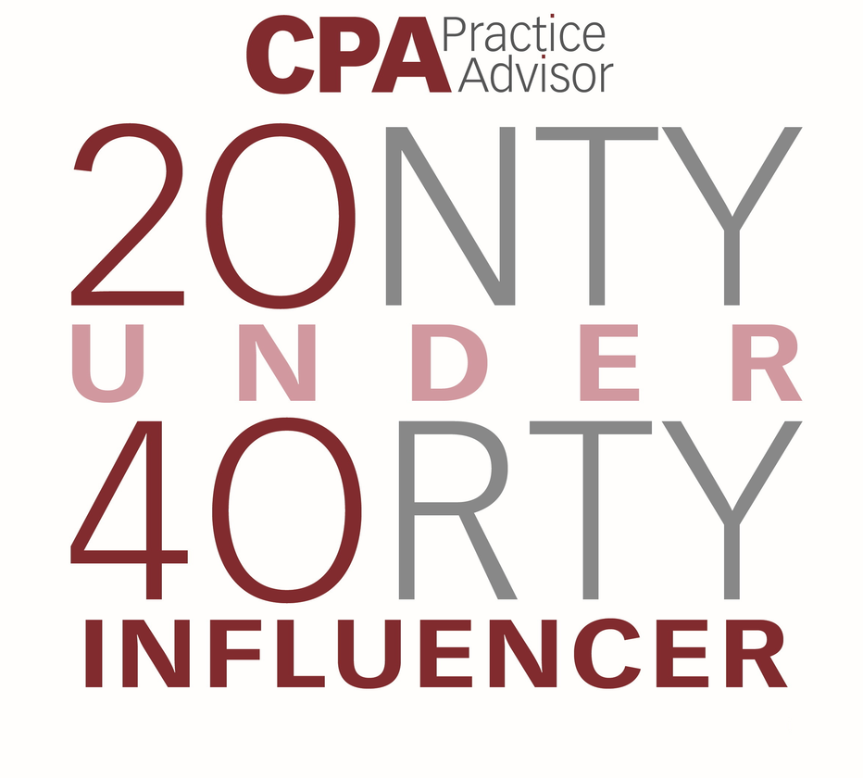
Thank You
CONTACT
Dtoth@WindingRiverConsulting.com
p: 440.723.3653
f: 440.723.3654
SKILLS
Leader, Speaker, Influencer
Change Agent

