Slide 1


Staying Independent
May, 2026
Gary S. Shamis, M. Acc

Slide 2

Choices
Stay Independent
Merge Up
Private Equity

Slide 3
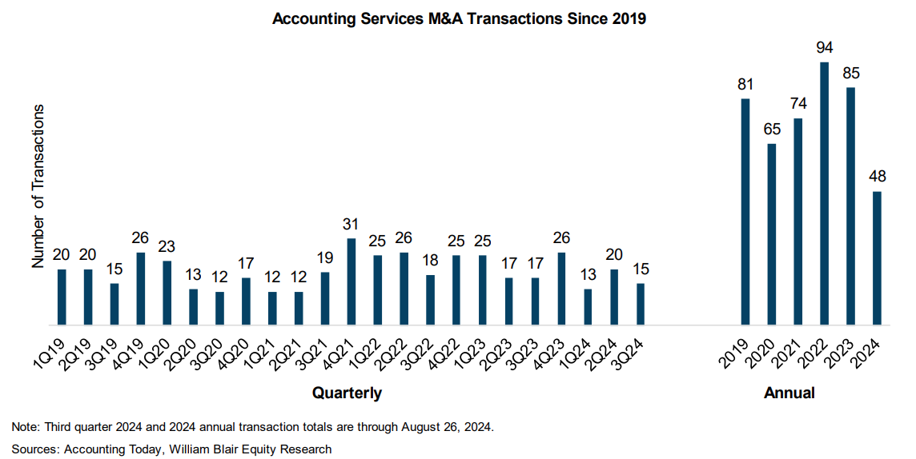

Slide 4
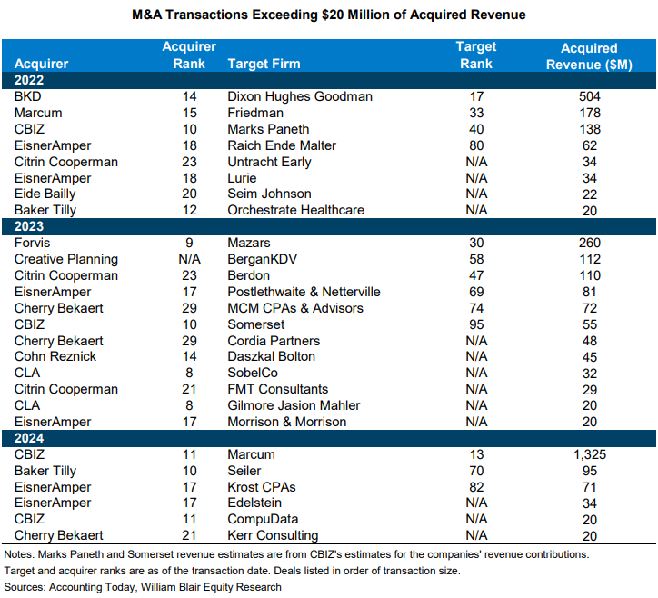

Slide 5
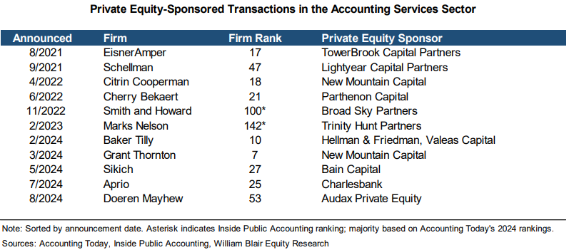

Slide 6
Table Stakes
Want to get in the game, you have to have a minimum.
Here is the minimum:

Slide 7
Partner Alignment
Communication
Temperature
Alignment Exercise

Slide 8
Leadership
NEVER MORE IMPORANT

Slide 9
Succession
Internal
Achievable
Scorecard Exercise

Slide 10

Recalibration of Deferred Compensation

Slide 11
Strategy & Execution
Leadership
Change Management
Execution is the key
Strategy is easy

Slide 12
Winning Strategies
for the Independent firm

Slide 13

Growth
M&A
Digital
Traditional

Slide 14
ABC LLP Financial Services
A&A
Tax
Consulting
Cyber
Tech
Payroll
WM
Industry Specific

Slide 15
ABC LLP CPAs & Advisors
A&A
Tax
Consulting

Slide 16
Brand
Culture
Hiring & Retention
Client Acceptance

Slide 17
What is a Millennial Workplace?
Flexible hours
High degree of trust
Challenging work
Timely and useful feedback
Clear course of advancement
A learning environment
Cool office space
Fair compensation
Attention to work/life balance
Virtual when appropriate
No dress code

Slide 18
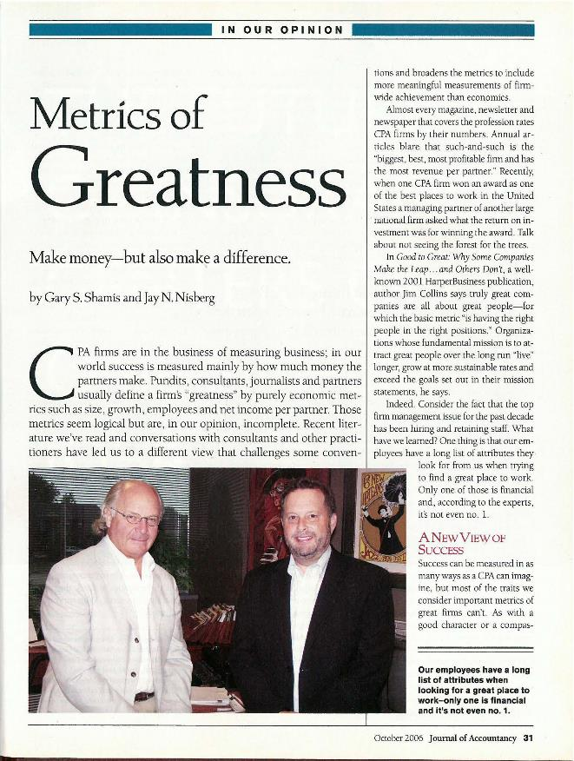
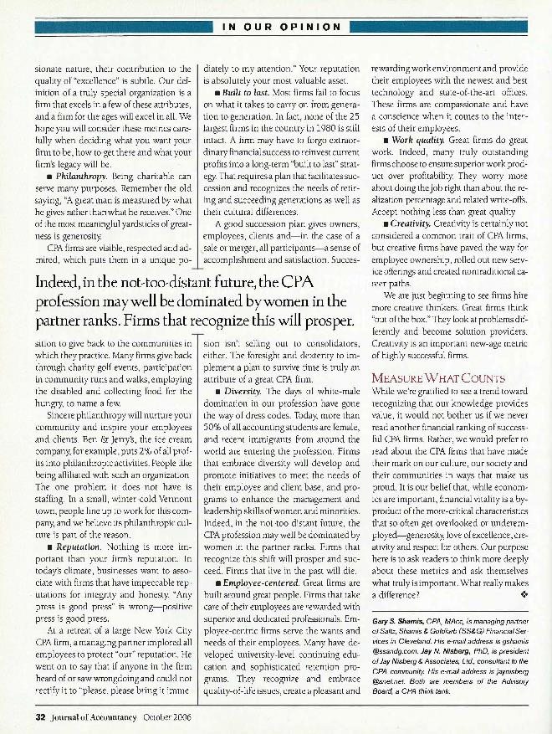
Firm/Partner Goals

Slide 19
Capacity Strategy

Slide 20
Change Management

Slide 21

Reinvestment
Ties to performance
NO place for greedy

Slide 22
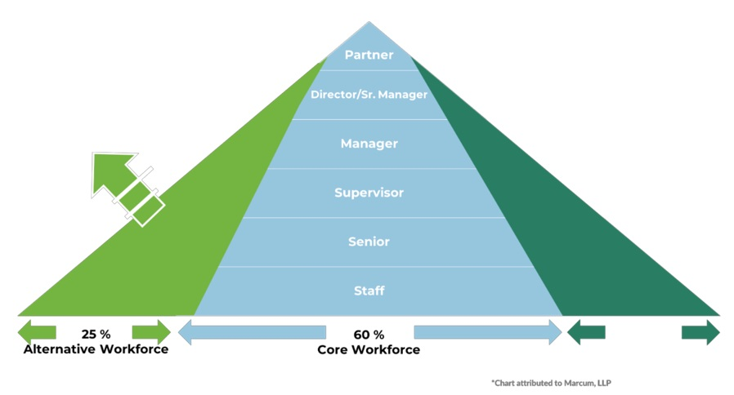
Human Capital Model
Stay-at-home parents
Retirees
People who just want to work part time
15 % Technology

Slide 23

Thank You
CONTACT
GShamis@WindingRiverConsulting.com
p: 440.723.3653
f: 440.723.3654
SKILLS
Leader, Speaker, Author,
Change Agent

