Slide 1



Designing Culture
May, 2026
Trisha Daho

Slide 2
Agenda
What An Intentional Culture Does For You
What Happens When Your Culture Is Not Intentional
What Matters and What Sticks
Values-Based Behaviors Exercise

Slide 3

Exercise!
In Your Mind, What Does a Thriving Culture Look Like?
Merlin Methodology
1 yr, 3 yrs, 5 yrs

Slide 4
Important Philosophical Mindsets
Intention does not equal impact
The Assume Nothing Principle
Little intentional actions move change forward as long as you measure them
This is never one size fits all
Deploy, measure, evolve, deploy, measure…
ACCOUNTABILITY at the granular level!

Slide 5
Awareness to Action
THE CULTURE CONTINUUM
Assessment Phase
Awareness Building
Strategy and Paradigm Shifts
Measure & Monitor
Where are We Now?
What are the Issues?
How do We Change?
When Have We
Succeeded?
Business case
HR Data
360 Feedback
Culture & DEI Surveys
People metrics: retention, hiring, rankings, promotions, etc.
Listening Sessions
Unconscious Bias Sessions/Cultural IQ
Emotional Intelligence
Mental Health
Values Building
Leader Conversations
Strategy
Talent Acquisition
Pay/Opportunities
KPIs
Education/Coaching
Leader Development
Onboarding
Promotion
Retention
Policy Changes
Pipeline Management
Career Trajectory Analysis
Power Mapping
Review
Leader Expectations
What do Metrics tell us?
Accountability

Slide 6
Assessing Your Current State
Demographic Significance
Measures PERCEPTIONS and PERSONAL EXPERIENCES/OBSERVATIONS
At One Point in Time
Straightforward Execution
Gives GREAT Insights in to FOCUS
In conjunction with data, give you a roadmap for strategy, education, and communication
Surveys, focus groups, interviews, forums
You cannot assess your own culture effectively

Slide 7
Survey Data
What did you see culturally as a whole?
Environment
Performance
Communication/Transparency
Commitment/Belonging
What did you see as variances among demographic groups?
What context must be further explored to see the entire picture?
Does it square with any HR Data you have analyzed?

Slide 8
HR Data Analysis & The Employee Lifecycle

Slide 9
Values Based Behaviors:
The How To of Culture Building

Slide 10
First Breakout:
What has been the greatest team experience you’ve ever had?
Tell us what that dynamic was like.

Slide 11
Second Breakout:
What characteristics did your best team have that made it great for YOU? What values were present?

Slide 12
What Do You Value?
What do you value?
What unspoken values have contributed to our success to date?
What do successful employees share in common?
What values should govern the way we interact with each other and with our audience?

Slide 13
What does a great team have that makes them great? How does that translate to the individual?
Beliefs
Behaviors
Traits
Skills
Actions
Habits
Culture is simply the result of the interaction amongst the employees working for a considerable period of time in the organization.

Slide 14
Culture Accountability Map
ID cultural behaviors and who reinforces them.
Choose 3 core cultural behaviors;
Who models it? Where is it breaking down? What can reinforce it?
Assign partners to sponsor each behavior in firm

Slide 15
Create Accountability Threads
What’s Next?

Slide 16
Questions?

Slide 17
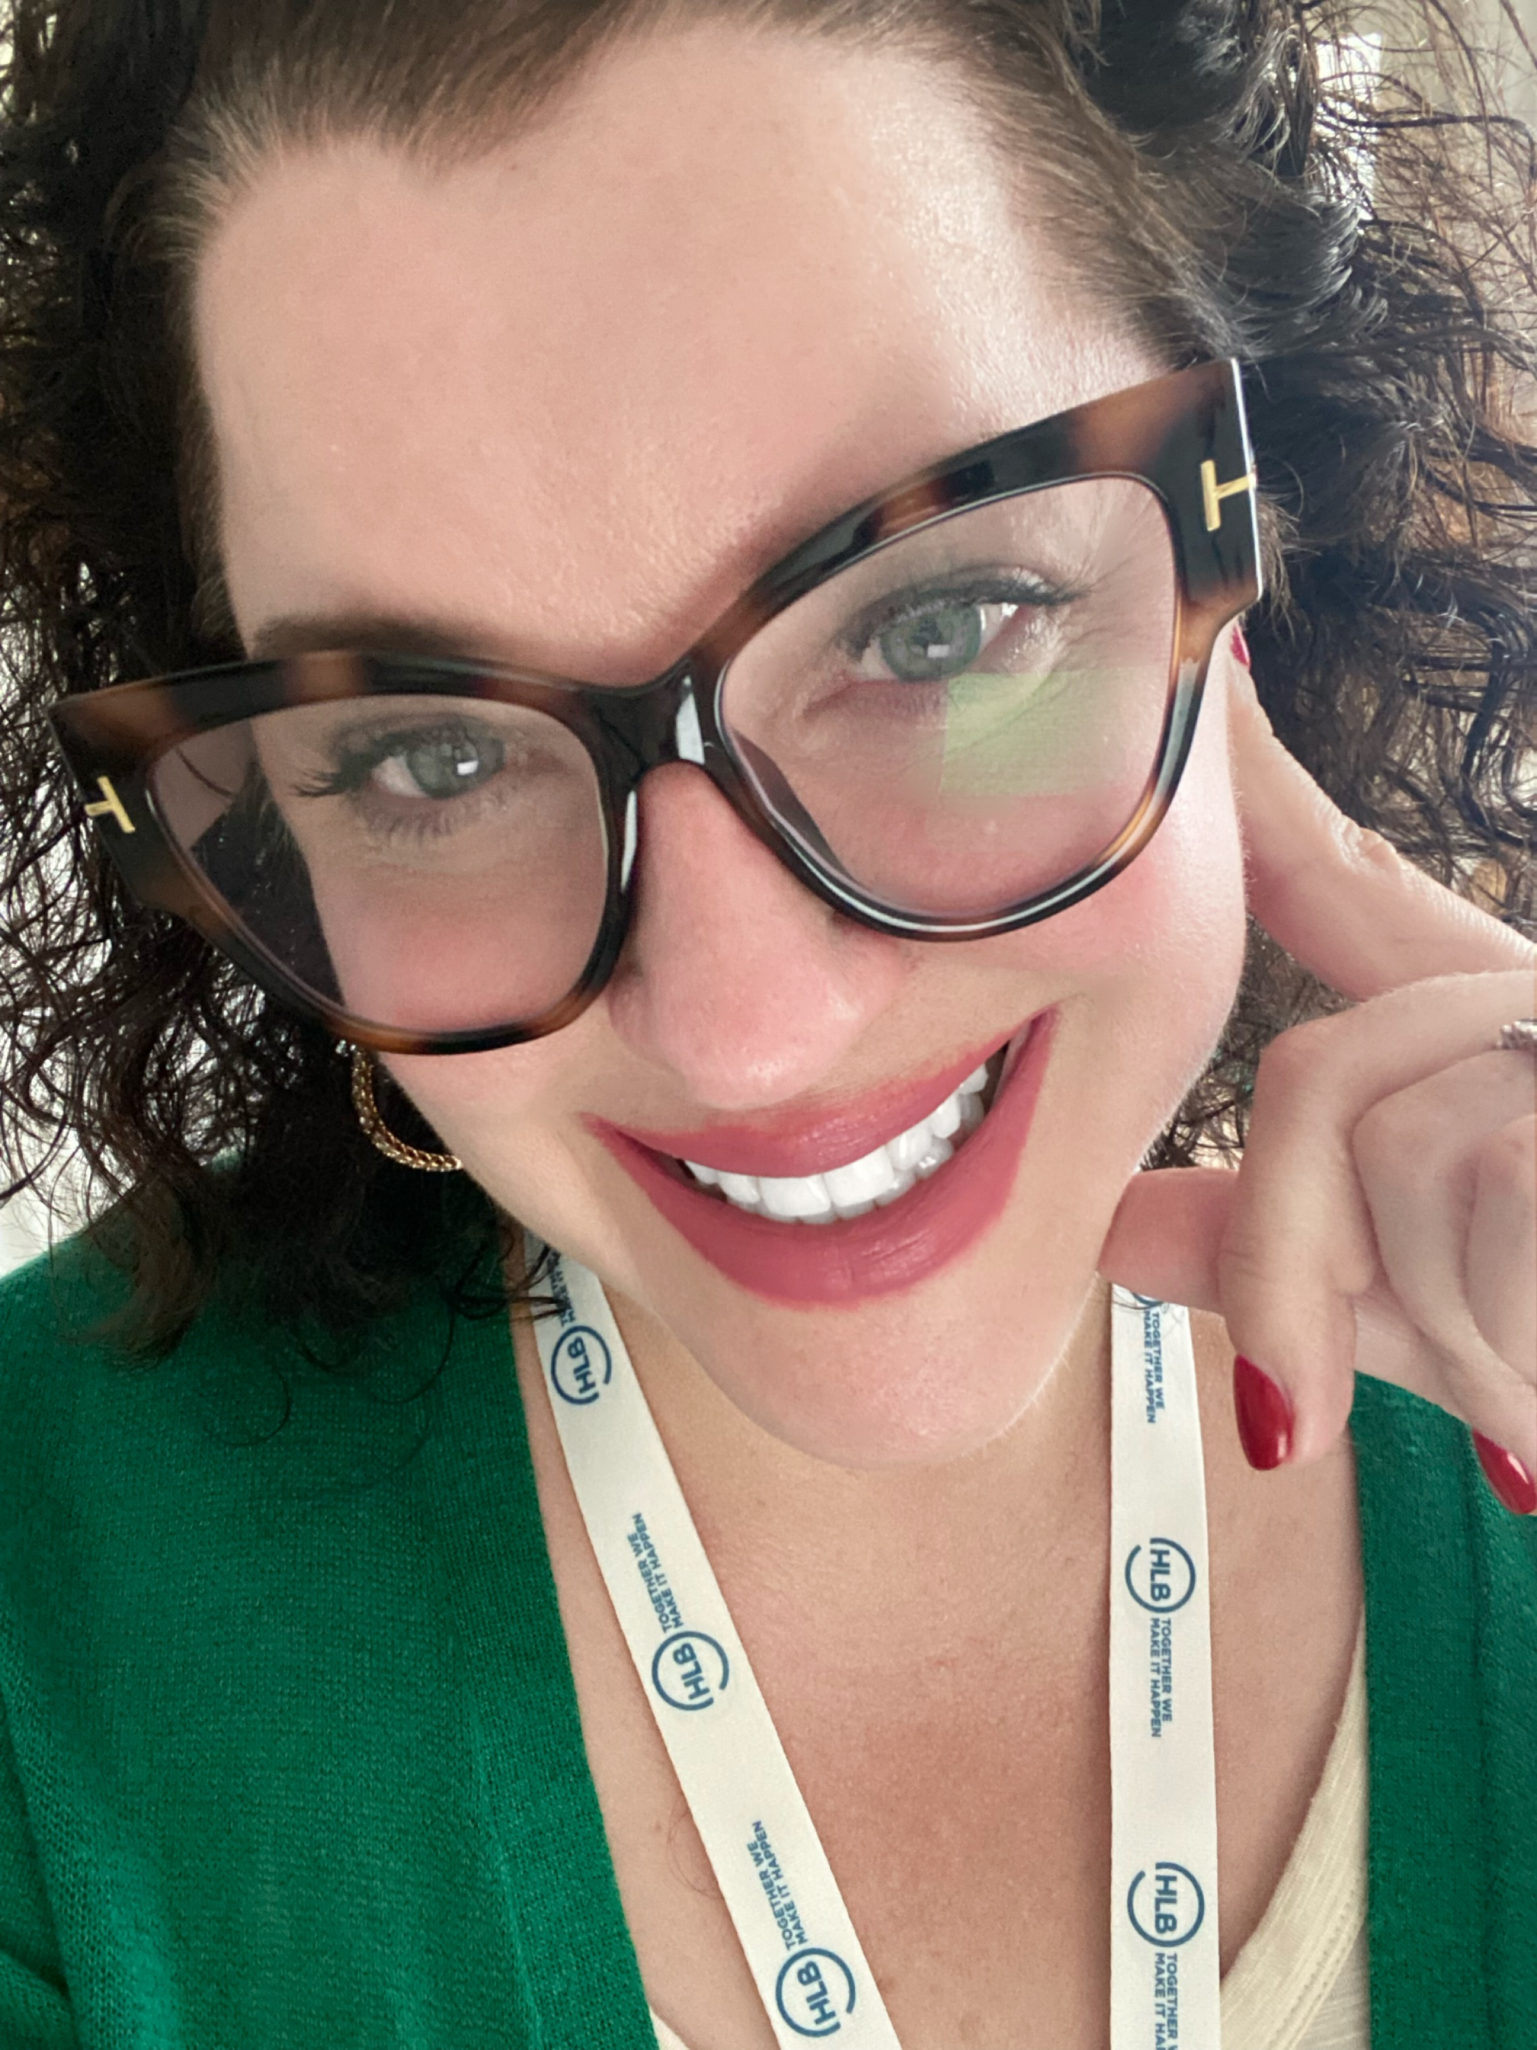
Thank you!
Contact Info:
Trisha Daho
trisha@empoweredlc.com
+33 0744765430
Skills:
Fractional Chief People/Culture Officer
International Keynote Speaker
AI Culture Transformation
Leader Development

