Slide 1



Presenting: The Most Important Business Communication Skill
October, 2026
Ilana Isakov Katz

Slide 2
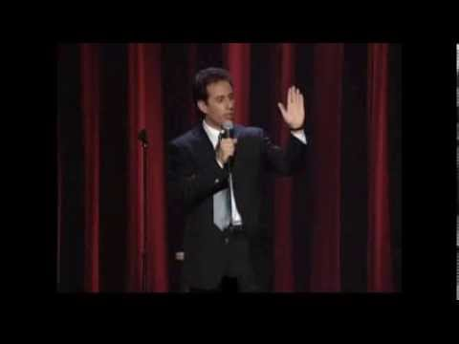

Slide 3
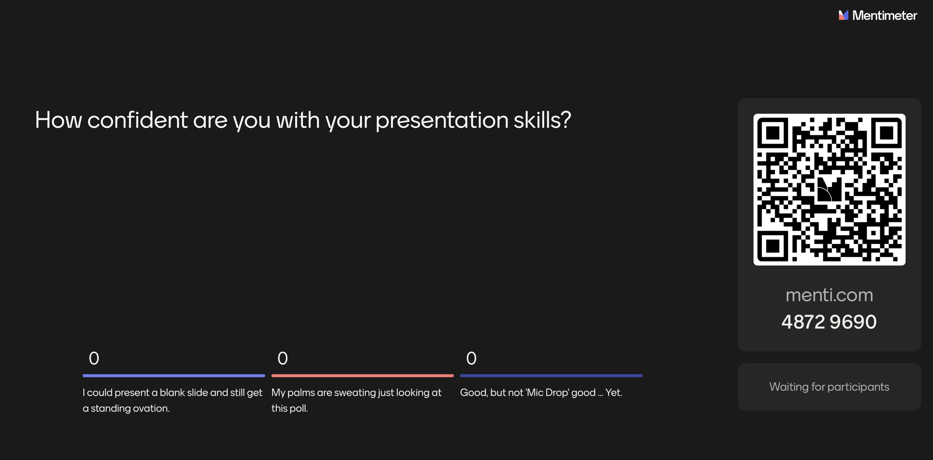

Slide 4
Warren Buffet
All-time best investment
Mastering the art of public speaking is the single greatest skill to boost your career.
​
Whatever you do, good communication skills are incredibly important and something that almost anybody can improve upon, both in writing and speaking.

Slide 5
It’s not you, it’s me.
No, really.

Slide 6
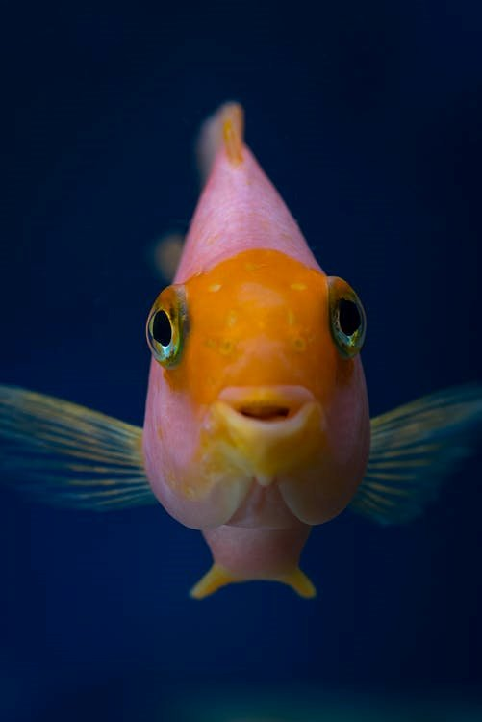

Slide 7

Lead Life Well

Slide 8
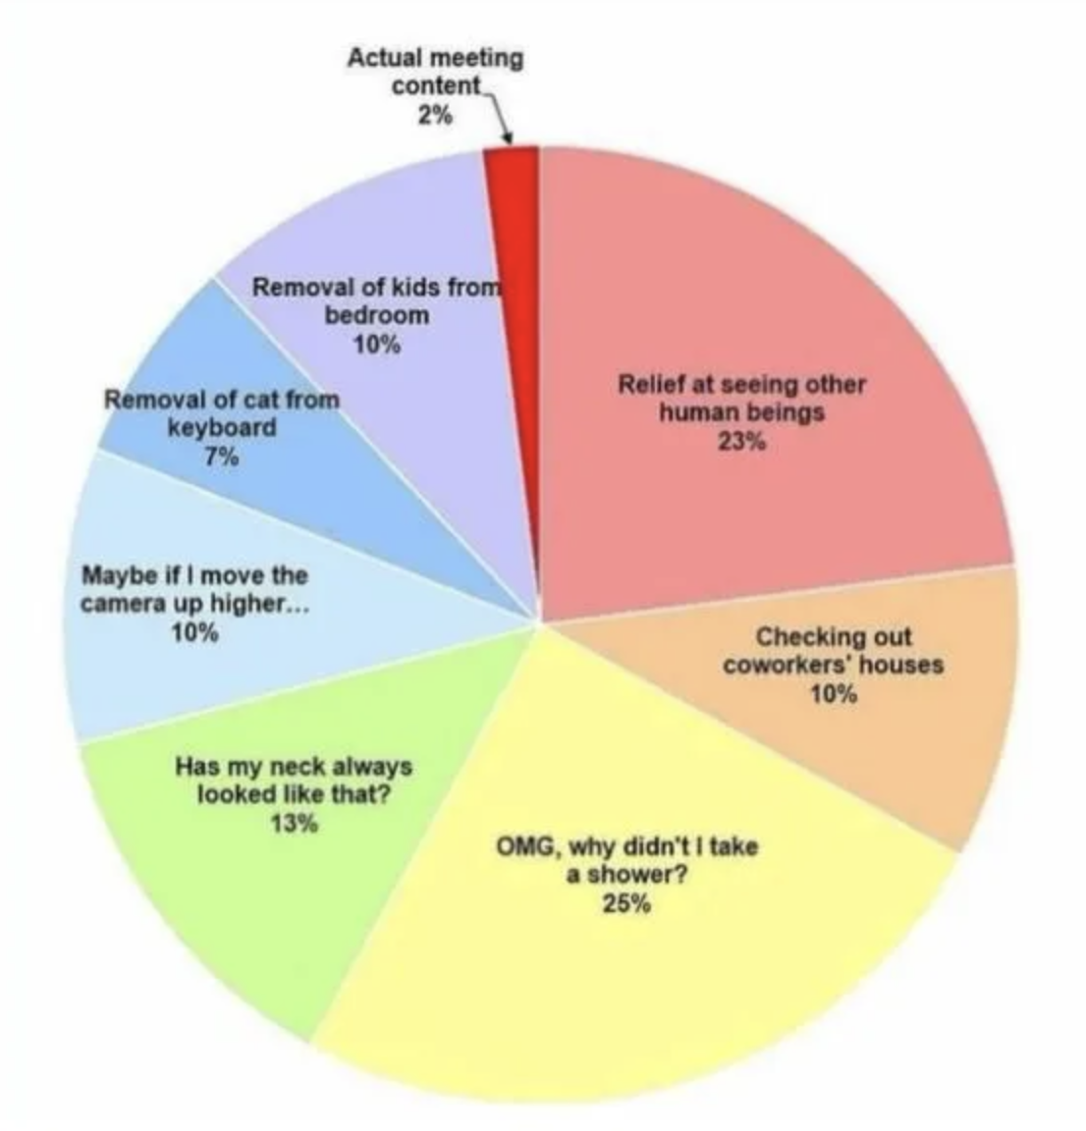

Slide 9
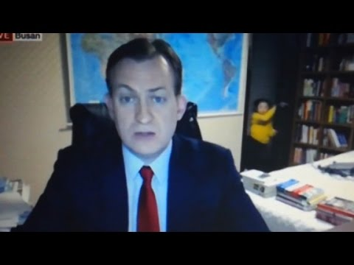

Slide 10







Slide 11
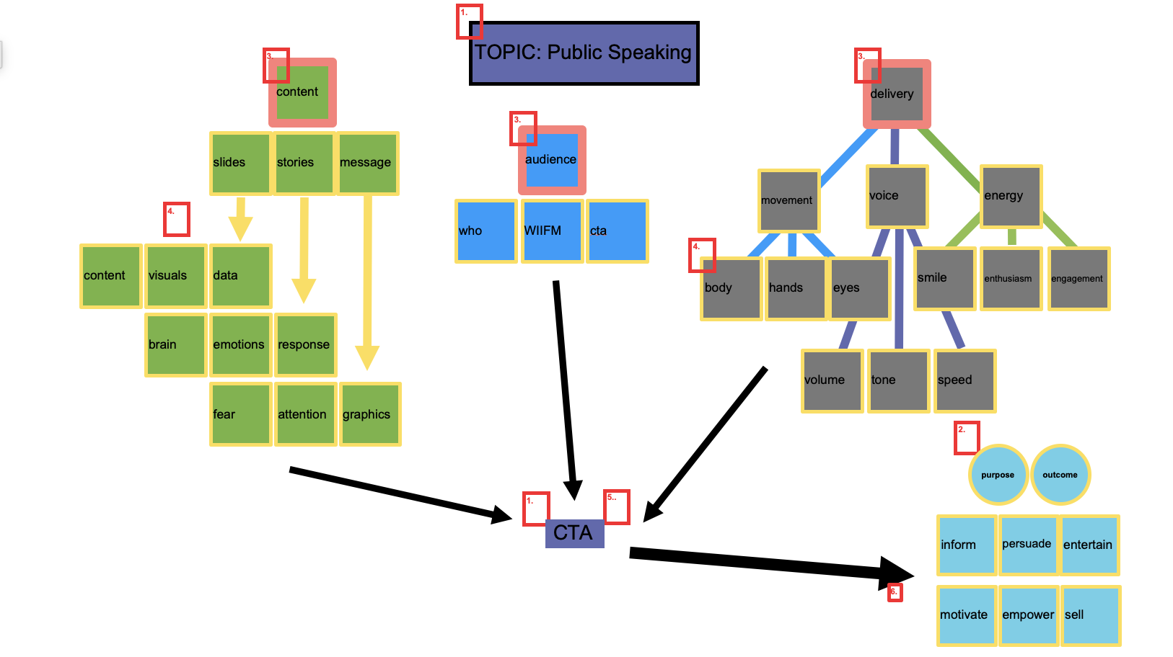

Slide 12
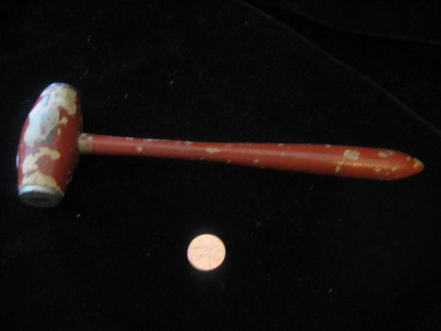
On September 16th, 2031 at 2:35 am, a temporal rift – a “tear” in the very fabric of time and space – will appear 16.5 meters above the area currently occupied by Jeffrey’s Bistro, 123 E Ivinson Ave, Laramie, WY. Only the person wielding this mallet will be able to enter the rift unscathed. If this person then completes the 8 Labors of Worthiness, he or she will become the supreme ruler of the universe.​
Significant Objects & Colson Whitehead

Slide 13


Slide 14


Slide 15


Slide 16


Slide 17
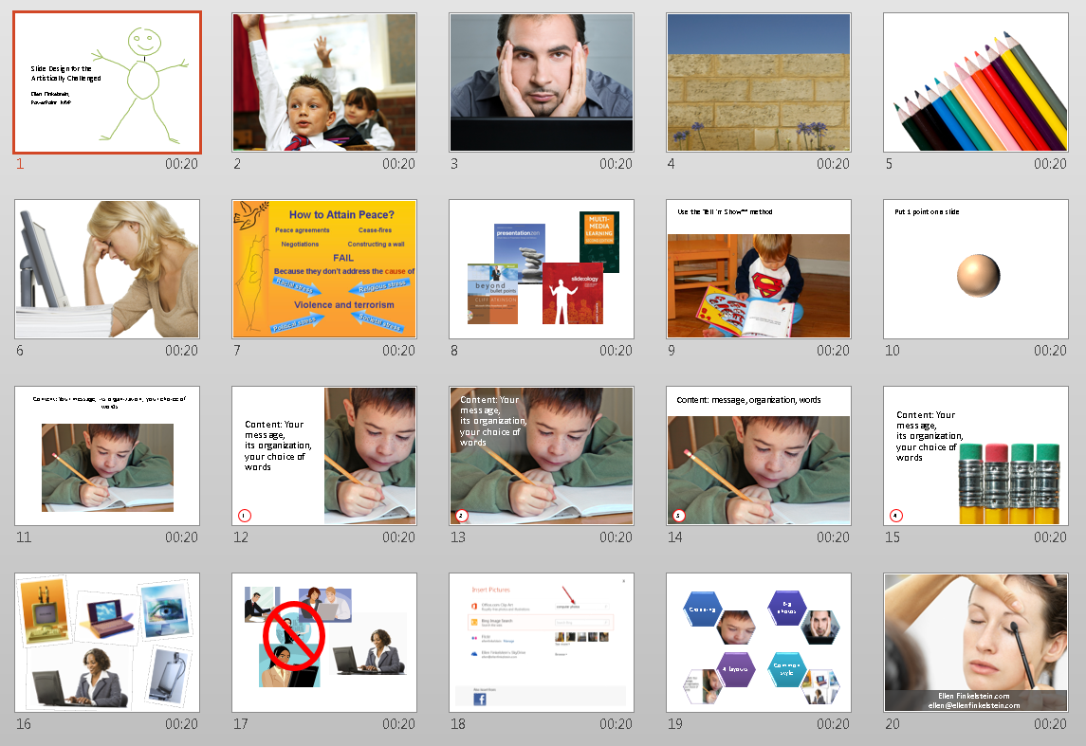
Slide Design for the Artistically Challenged / Ellen Finkelstein

Slide 18


Slide 19
Paul Arden
The more strikingly visual your presentation is, the more people will remember it. And more importantly, they will remember you.

Slide 20
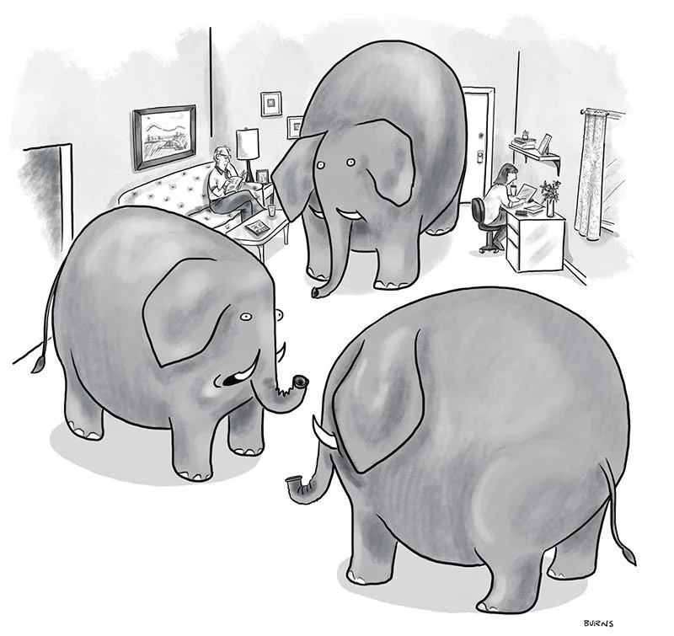

Slide 21
Take Aways
The most powerful tool in a leader’s arsenal.
The fear is real.
Attention spans are short, so the brain needs constant stimulation to it keep from getting bored.
An organized presentation is as much your road map as it is your audiences’.
Storytelling has been a part of the human experience since the beginning of time. Science confirms: Our brains are hardwired for stories.
Practice, practice, practice!
Engage your audience - dialog, break outs, exercises, questions, etc.
Provide a purpose - a ‘call to action’, next steps, and/or take aways.
Remember: Life happens.

Slide 22

Thank You
Contact
ikatz@windingriverconsulting.com
216.548.4770
Skills
Marketing Communications, Branding, Internal Comms, Advertising, PR

Slide 23
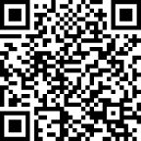

SCAN HERE
Scan the QR Code
To complete our survey
and receive CPE credits

