Slide 1



Contemporary Issues in People and Culture
October, 2026
Trisha Daho

Slide 2
Level Setting

Slide 3
Agenda
Understanding the Current Landscape
The Efficacy of Current Tools
Cohesive Strategies to Be the Employer of Choice
A Self-Reflective Look at What You Need to Consider Now

Slide 4
What Matters Now?
50% / 75%
We need to know WHY now!
Emotional Index
Cultural Index
Contemplation of Career Path
AI
PE
L&D
Partner Tracking
Generational Challenges

Slide 5
External Factors
Remote Work Possibilities
Expansion of Opportunities
Money
Benefits
Cultural & Societal Changes
Loss of Reliable Childcare
Change in Perspectives
Slow Down in Professional Development and Promotions
Craziest Changing Job Market in Decades
AI!
PE!

Slide 6
What is Your AI Plan for People?

Slide 7
Internal Factors:
Lack of Defined Career Paths
Management and Leader Abilities
Rigid Back to Work Requirements
Staffing Too Lean (lower-level work)
Overwork and Stress Levels
Cultures are not defined or accountable
Lack of Innovation
Lack of Diversity
Disconnection to Teams and to Firm as a Whole

Slide 8
Why People Leave an Accounting Firm:
Incorrect Expectations at Hiring
BE HONEST
Include the candidate in the potential future vision
Misalignment of personal vision with firm vision (lack of development)
You don’t provide adequate support for the person to do the job well
Poor Management
Unbalanced workloads
Poor culture (75%!)
They don’t feel they belong long term

Slide 9
Private Equity
Changing the Landscape

Slide 10
AI
Things to Ponder NOW

Slide 11
Performance Management

Slide 12
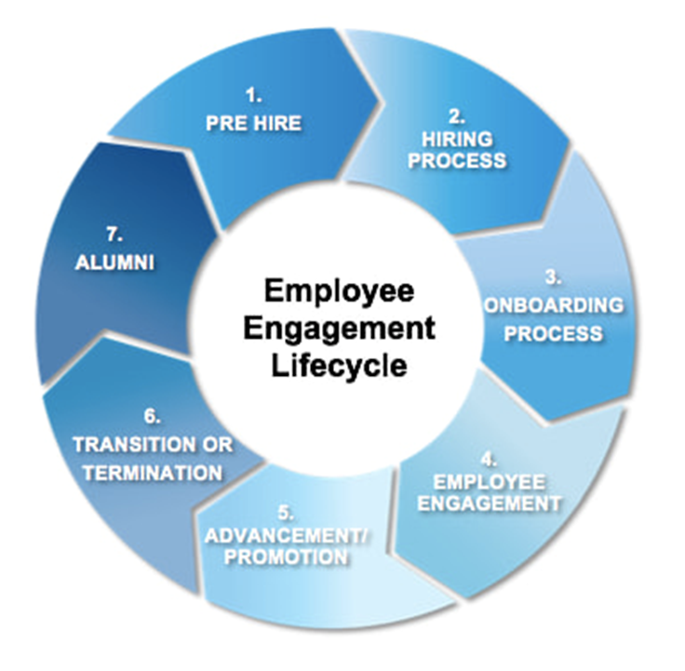

Slide 13
Extra Credit
Mental Health Considerations
Stress and Burnout
Offshoring Culture Challenges
Remote Workers
GenZ

Slide 14
Call to Action:
Where do you stand and where are you going and how are you going to get there?

Slide 15
Q&A

Slide 16

Thank you!
Contact Info:
Trisha Daho
trisha@empoweredlc.com
+33 0744765430
Skills:
Fractional Chief People/Culture Officer
International Keynote Speaker
AI Culture Transformation
Leader Development

Slide 17
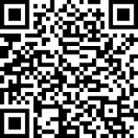

SCAN HERE
Scan the QR Code
To complete our survey
and receive CPE credits

