Slide 1



Growth in 2026
Trends, Strategies & The Future Firm Model
October, 2026
David Toth / Brian Blaha

Slide 2
Today’s Agenda
01
Growth Trends & The New North Star
What WRC is seeing and hearing across the profession.
02
Conversation: Your Growth Reality
Facilitated roundtable.
03
Organic & Inorganic Priorities + AI's Role
The Three Elements of Growth

Slide 3
PART 1
Growth Trends & The New North Star

Slide 4
TRENDS & INSIGHTS
01 Pipeline Is A Problem
02 Pricing Pressure Is Real
03 M&A Is Not Slowing Down
Most firms lack a structured, visible pipeline. BD lives in partners' heads, not systems.
AI commoditization will change pricing philosophy on compliance work. And the criticality of advisory.
Deals at every size. PE-backed platforms are aggressive acquirers. Independence is a strategy — but it requires capital readiness.
04 Digital Can No Longer Be Ignored
05 The Talent-Growth Paradox
06 Enterprise Value Is the New KPI
80% of buyers start their search online. Digital is now primary — not supplemental — to business development.
Firms can't grow what they can't staff. The Talent Stack is changing.
The conversation is shifting from revenue to EBITDA, multiples, and what makes a firm attractive — to buyers, to talent, to clients.

Slide 5
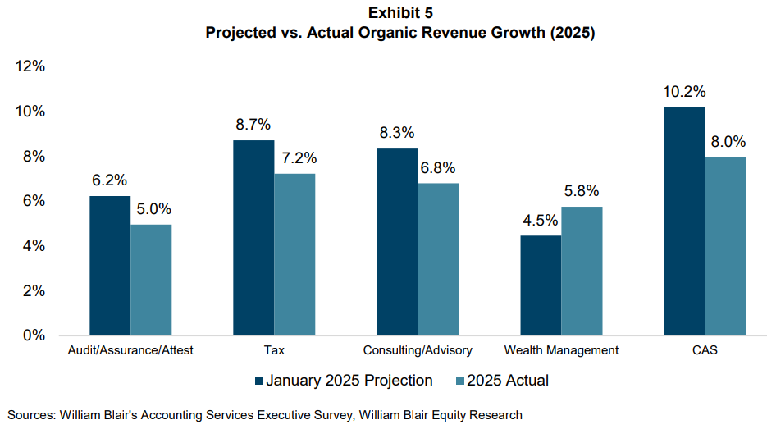
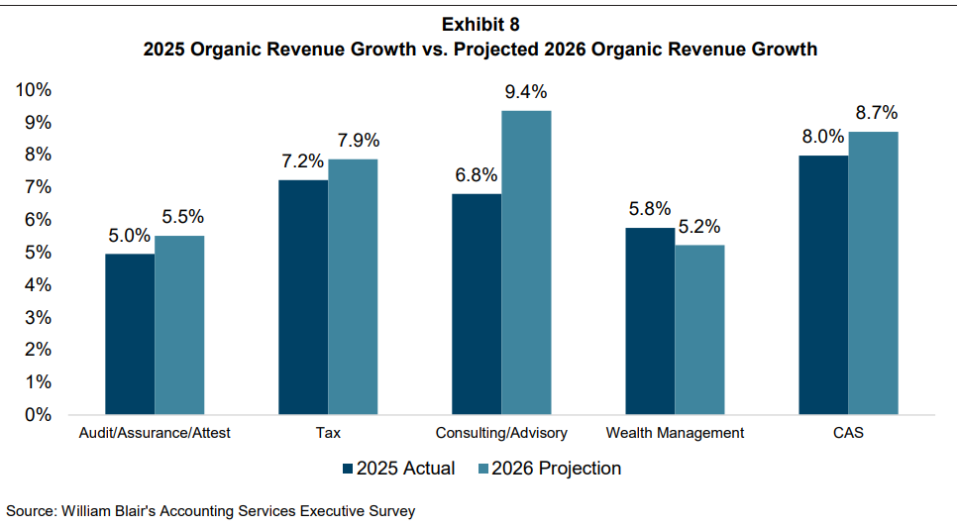
TRENDS & INSIGHTS

Slide 6
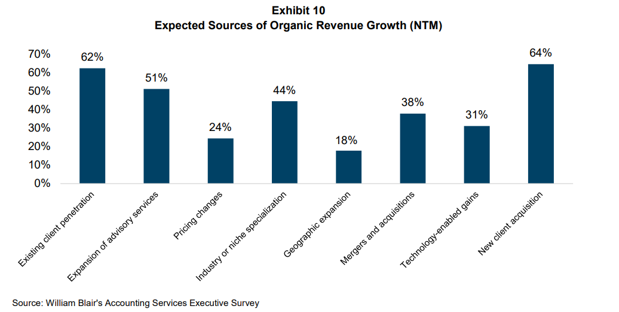
TRENDS & INSIGHTS

Slide 7
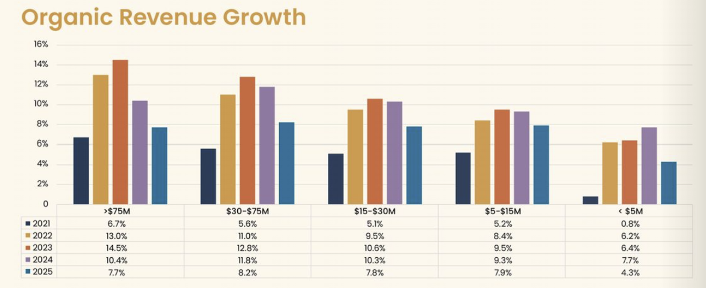
TRENDS & INSIGHTS - ORGANIC

Slide 8
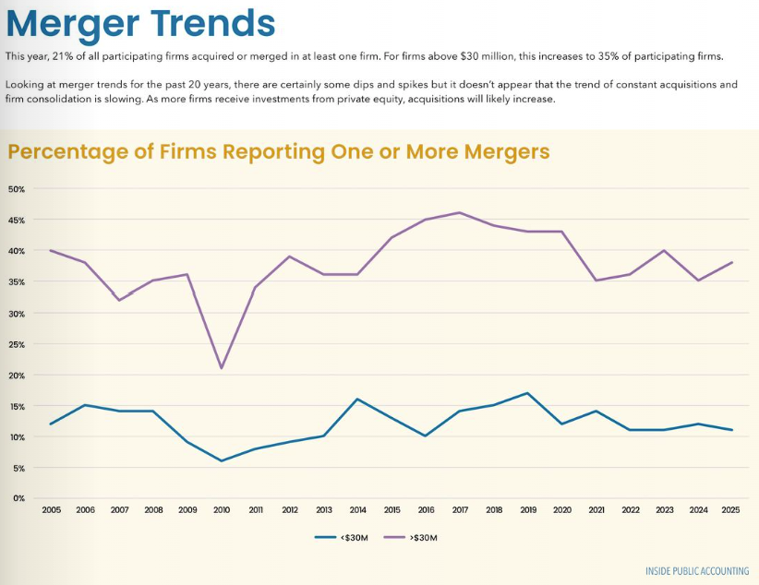
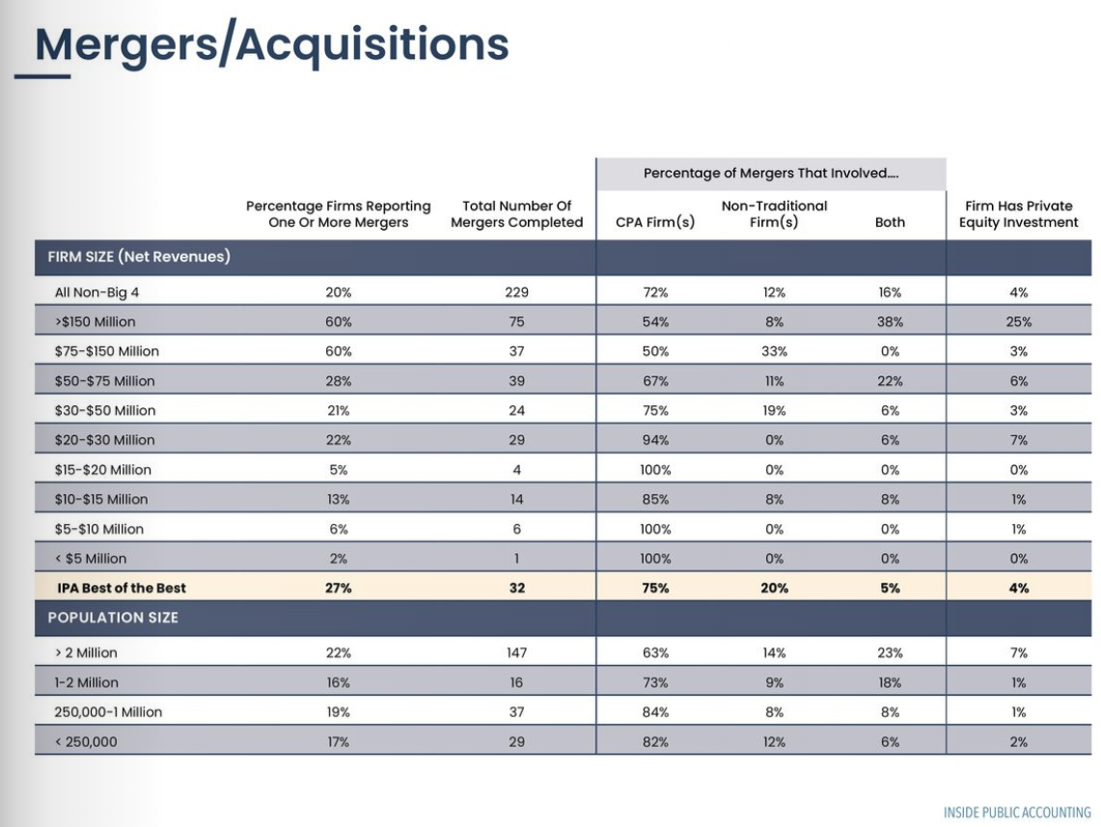
TRENDS & INSIGHTS – M&A

Slide 9
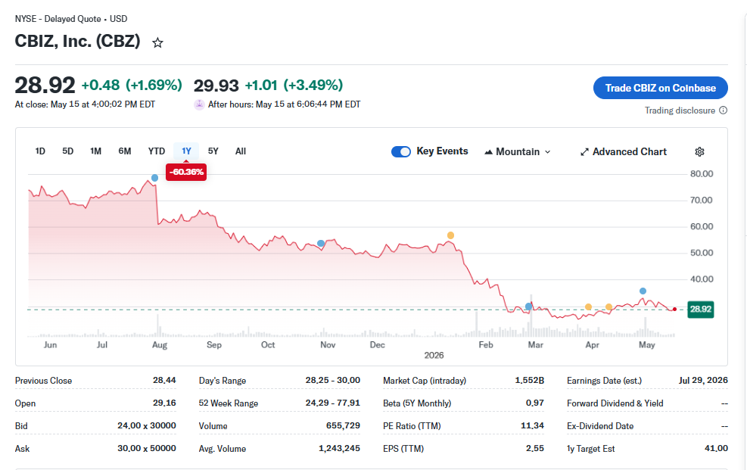
TRENDS & INSIGHTS

Slide 10
THE GROWTH CONVERSATION HAS CHANGED
THEN
NOW
Growth
happened
to firms.
Firms must
design it.
→
Deliberate markets & ideal clients
Collective systems over lone rainmakers
Technology-enabled BD
M&A as a growth lever, not just succession
Reputation, referrals, rainmakers. No system needed.

Slide 11
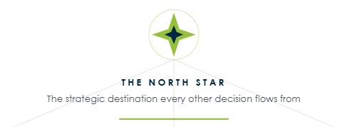

Slide 12
THE NORTH STAR HAS SHIFTED
YESTERDAY'S
NORTH STAR
TODAY'S
NORTH STAR
✕ Revenue Growth
✓ Enterprise Value / EBITDA
✕ New Logos
→
✓ Quality of Revenue (clients, delivery)
✕ Headcount
✓ Advisory Revenue Mix
✕ Billing Rates
✓ Client Retention & Expansion
✕ Market Share
✓ Firm Attractiveness (buyers, talent)

Slide 13
WHAT ENTERPRISE VALUE MEANS TODAY
Enterprise Value = EBITDA × Multiple
GROW THE EBITDA
EXPAND THE MULTIPLE
REDUCE RISK FACTORS
Shift mix from compliance to advisory
Price for value, not hours
Reduce dependency on any one partner or client
Leverage AI to improve realization rates
Build recurring revenue & retainers
Deepen client relationships (services per client)
Develop leadership bench strength
Create institutional, not personal, client ownership
Diversify service lines and industries
Document & systematize delivery
Align culture post-M&A or post-retirement
Invest in technology & infrastructure

Slide 14

Partner Accountability
Enterprise Contribution Framework

Slide 15
PART 2
Your Growth Reality: Roundtable Discussion

Slide 16
ROUNDTABLE: YOUR FIRMS GROWTH
1
What is your firm's #1 growth focus heading into the second half of 2026?
→ Is it organic? M&A? Digital? A specific service line or market?
2
What is the biggest constraint holding your firm back from growing faster?
→ Talent, pipeline, pricing, technology, culture, leadership capacity?
3
How are your partners showing up in the growth conversation?
→ Are they engaged, disengaged, playing to strengths — or stuck in legacy habits?
4
What does 'growth success' look like for your firm 3 years from now?
→ Revenue target? EV multiple? A specific market position? Independence maintained?
WRC

Slide 17
PART 3
Priorities, Urgency & the AI Inflection Point

Slide 18
BUILDING YOUR GROWTH ENGINE
"The future firm isn't defined by its ownership. It's defined by its orchestration."
TRADITIONAL
DIGITAL
M&A READY
Relationship-driven BD, but with structure and accountability. Vertical specialization. Client segmentation. Advisory services expansion.
Digital is the primary discovery channel. AI-assisted BD and content. Data-driven decision making. Scalable marketing without headcount growth.
Capital readiness even if staying independent. Clear value story. Talent development. Enterprise value lens on every major decision.
The orchestration advantage: firms that master all three — Traditional + Digital + M&A — will define the next decade.
WRC

Slide 19
ORGANIC GROWTH
1
Define & Activate Your ICP
2
Build Services-Per-Client as a KPI
Know exactly who you serve — and who you don't. Refine from Total Addressable Market to a Specific Addressable Market your team can execute against.
Client expansion is your highest-ROI growth lever. Track services per client. Identify white space. Create structured cross-service pathways.
3
Vertical Specialization
4
Role-Driven Growth Accountability
Generalists are losing. Specialists win trust faster, command premium pricing, and generate the referral flywheels that sustain growth.
Not every partner is a rainmaker — nor should they be. Define roles: Rainmaker, Advisor, Relationship Builder, Technical Specialist. Align expectations.
5
Visibility by Design
6
Digital as a Revenue Channel
Show up consistently in defined ecosystems — industry events, thought leadership, digital channels. Track it. Measure it. Old model: show up everywhere. New model: show up where it matters.
80% of buyers start online. Firms with niche-specific digital presence are generating larger average client sizes and faster sales cycles.
© Winding River Consulting 2025
13

Slide 20
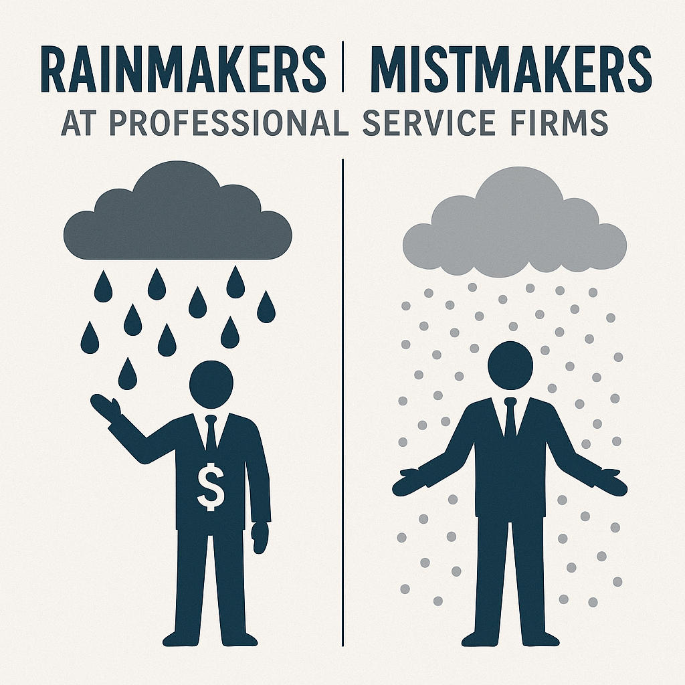
TRADITIONAL
What’s happening:
Most firms growing 6–8%
Referral-driven, compliance-heavy growth
Increasing pressure on capacity and margins
Why it’s stalling:
Talent shortages
Pricing resistance
Undifferentiated market positioning
PE-backed competitors out-executing

Slide 21
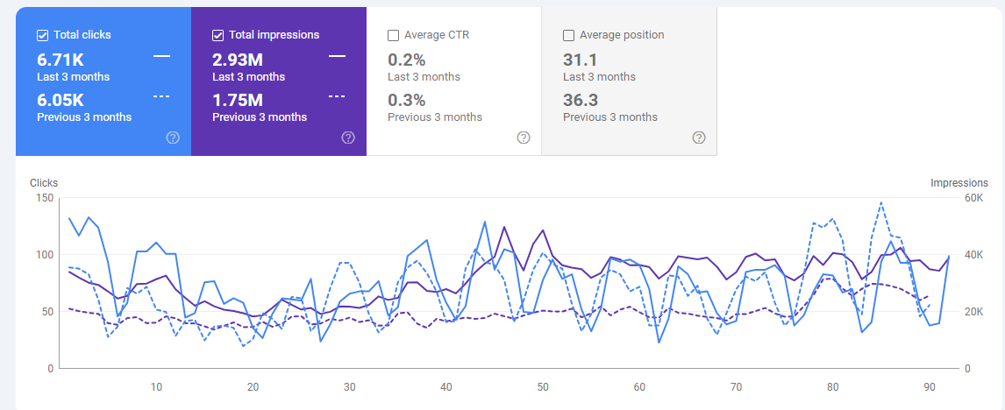
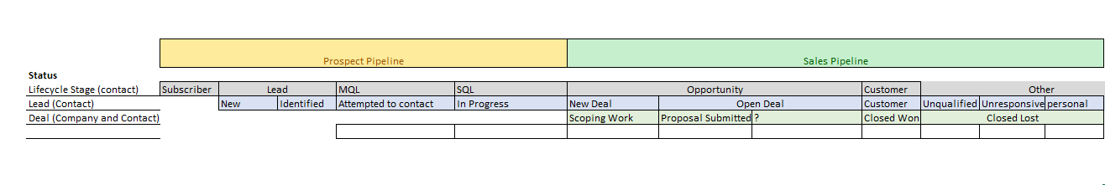
TRADITIONAL
What’s different:
Growth driven by client complexity, not volume
Advisory creates stickier, higher-value relationships
Digital enables scale—not just leads
Data informs decisions, not just reporting

Slide 22
CLIENT SEGMENTATION
Stable Performers
Strategic Accounts
Low Fit / Legacy Accounts
Growth Opportunities
Maintain Satisfaction
Improve Efficiency
Protect
Deepen
Cross-serve
Evaluate for transition or automation
Activate relationships
Expand services per client
Design growth around potential, not history
High potential clients often sit below your visibility line.
Use Services per Client as a leading indicator
Client expansion correlates with # of Services
  Helps determine which clients have room for deeper advisory relationships
Establish growth playbooks to:
  Protect Strategic Accounts
  Expand Growth Opportunities
  Streaming or Sustain Stable Performances
  Transition low-fit clients

Slide 23
DIGITAL GROWTH TRENDS
The buyer journey is digital-first (even when the lead is a referral)
Search is becoming an answer engine (SEO → AEO / AI Overviews)
Clicks are declining — visibility + trust matter more than traffic
Your website is now a growth asset (proof, credibility, conversion)
Industry niche pages win (generic positioning gets ignored)
CRM must become a GTM operating system (pipeline, accountability, insights)
Data integrity is the new growth bottleneck (bad data = bad decisions)
Partner + leader personal brands drive demand (firm → individual → firm)
AI is being embedded into marketing + sales workflows (speed + leverage)
GTM ownership is becoming non-optional (CGO / revenue leader + cadence)

Slide 24
MEASURING PERFORMANCE
LEADING INDICATORS
Signals that measure momentum, engagement, and future pipeline health:
Organic search visibility, including impressions and priority keyword rankings
Growth in qualified website traffic
Email engagement performance, including open and click-through rates
Net-new contacts sourced from digital channels
Development of active, engaged niche communities
Expansion of internal marketing capabilities and channel sophistication
REVENUE INDICATORS
Measures that connect digital activity directly to business outcomes:
Inbound leads attributed to digital channels
Proposal requests originating from digital touchpoints
Closed-won revenue generated from digital-sourced pipeline
Cross-sell and expansion opportunities identified through digital engagement
“Clicks are down across the board. The winners will be the firms that can prove pipeline impact.”

Slide 25
AI’S IMPACT ON GROWTH, PRICING & E.V.
AI WILL COMPRESS
COMPLIANCE MARGINS
AI CREATES NEW
GROWTH LEVERS
AI RESHAPES THE
VALUE CONVERSATION
Commoditized services — tax prep, bookkeeping, basic audit — are becoming automated. Pricing power lives in judgment, relationships, and advisory depth. Firms that don't shift their mix will see EBITDA erode.
Firms deploying AI in business development, content marketing, and client segmentation are outpacing competitors. Digital + AI = scalable BD that doesn't require adding headcount.
Clients will expect faster, cheaper transactional work. The premium goes to trusted advisors who can interpret, counsel, and navigate complexity. Your pricing model must reflect this shift.

Slide 26
INORGANIC GROWTH – M&A
Traditional Partnership
Minority Capital
Majority PE
ESOP
Public / Platform
← Independence ───────────────────────────────────────────────────── Scale / Capital →
Buy-Side Priorities
Sell-Side Priorities
Critical Success Factors
Industry depth & advisory capability
Geographic expansion
Leadership pipeline acquisition
Technology & infrastructure
Platform for scale
Succession planning with capital upside
Investment in technology & transformation
Liquidity and partner optionality
Access to larger firm infrastructure
Alignment with a growth-oriented culture
Alignment > Structure (culture must fit)
Know your value story before the process starts
Integration planning starts Day 1
People/Purpose/Performance triangle
Enterprise value readiness — even if staying independent
WRC

Slide 27
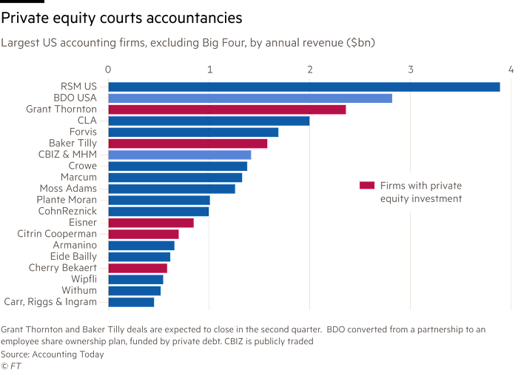
PRIVATE EQUITY

Slide 28
PRIORITIES FOR 2026
DO NOW
PLAN THIS YEAR
AVOID THESE TRAPS
Highest urgency, highest impact
Strategic bets for sustainable scale
Common mistakes killing growth
› Define or refresh your Ideal Client Profile
› Develop 2–3 vertical specialization plays
› Waiting for the market to come to you
› Analyze services per client — find white space
› Launch or rebuild your digital lead engine
› Relying on one rainmaker for all new business
› Stand up a growth dashboard with role-based KPIs
› Build M&A readiness: financials, culture, story
› Treating compliance revenue as growth
› Assess your digital presence vs. competitors
› Implement structured pipeline tracking (CRM)
› Underinvesting in mid-level leader development
› Know your enterprise value story
› Design AI adoption roadmap for BD + delivery
› Ignoring enterprise value until it's too late
© Winding River Consulting 2025
WRC
17

Slide 29
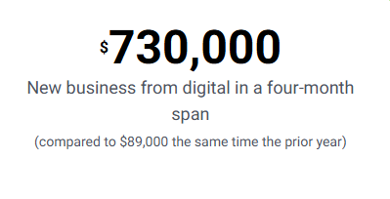
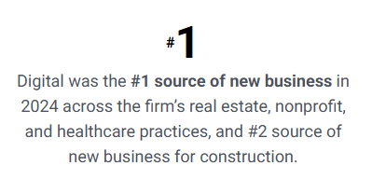
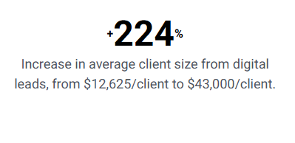
GROWTH IN ACTION – CONTENT AT SCALE
Expand upon JMCOs digital culture to build out tailored niche strategies identified by the firms leadership as growth priorities including construction, HR, higher education, government and healthcare.
Strategic Goals:
Our challenge was to deliver improvement across several key areas:
  Strengthen each practice’s digital presence
  Grow visibility for the practices and their leaders among their target audiences
  Generate inbound leads
  Drive new revenue directly attributable to digital

Slide 30
GROWTH IN ACTION – DATA DRIVEN TECH
To transform CRM from a data repository into a strategic growth enabler — a unified platform that drives collaboration, accountability, and insight across all service lines.
Strategic Goals:
Reimagine the sales process: Move from inconsistent, reactive data entry to a standardized, guided process that reflects FIRM’s modern GTM motion.
Strengthen data integrity: Establish data governance, ownership, and accuracy as the foundation for adoption and decision-making.
Enable smarter GTM approaches: Use CRM insights to understand client lifecycle, cross-sell opportunities, and profitability.
Integrate core technologies: Ensure seamless connections to HubSpot, Intacct, Practice MGT, Clay, and future platforms.
Drive adoption and accountability: CRM success begins with leadership modeling and cascades through every level.
Prioritize change management: Manage behavioral and cultural shifts intentionally through training and communication.

Slide 31


SCAN HERE
Scan the QR Code
To complete our survey
and receive CPE credits

