Slide 1


WELCOME BACK!
(Hope You’re Not Too Sore)
MPB | Leadership Accelerated
May 2025
Cohort 19

Slide 2
Self-care &
Energy Management
MPB | Leadership Accelerated
May 2025
Matt Terlop

Slide 3
Health in the workplace
70%
Of Americans 20 and older are overweight
38%
are obese
Average number of daily calories people consume has increased dramatically

Slide 4



Health in the workplace
Much of this added intake comes at work, where perpetual grazing and hours of sedentary activity are the norm.
Obesity is associated with increased absenteeism and reduced productivity.
Obesity results in $1,429 higher annual health premium per the CDC.

Slide 5





Benefits of Wellness & Nutrition for You
Higher productivity
Set example
Improved sense of wellbeing
Improved health
Increased stamina and longevity

Slide 6


Benefits of Wellness & Nutrition for
Your Employees
Higher productivity
Higher Engagement
Improved health
Greater Loyalty

Slide 7
Employee Nutrition is Important
Healthy employees provide companies with a wide array of benefits. They tend to be…
More productive
Less stressed
Take fewer sick days
A key factor in employee health is nutrition- which is why you your employees to eat well.

Slide 8

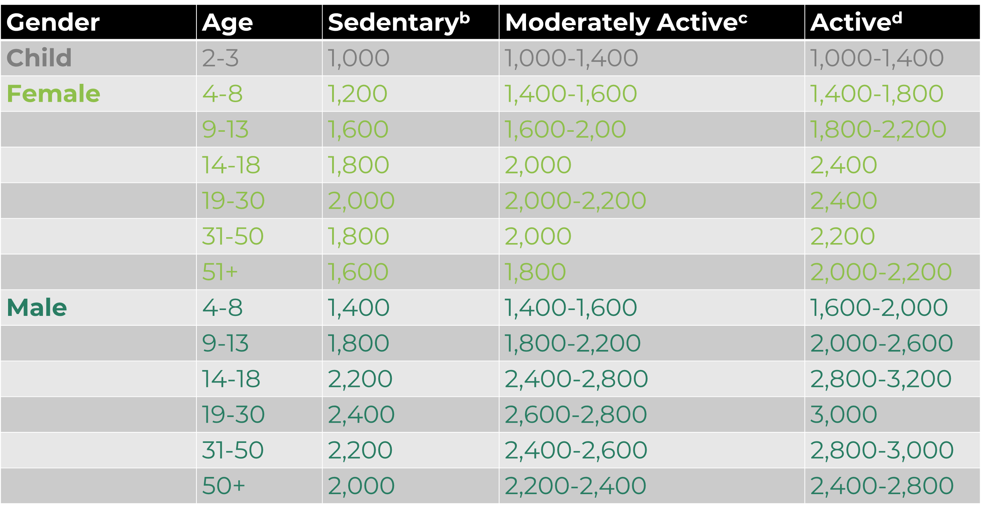
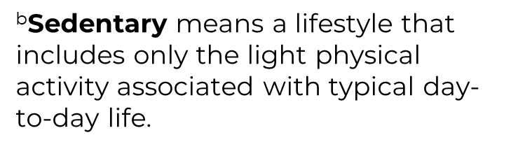
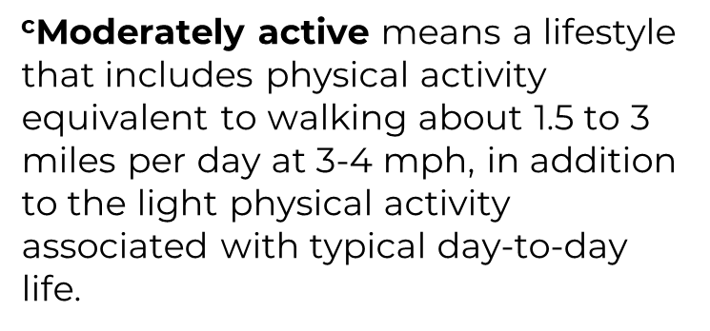
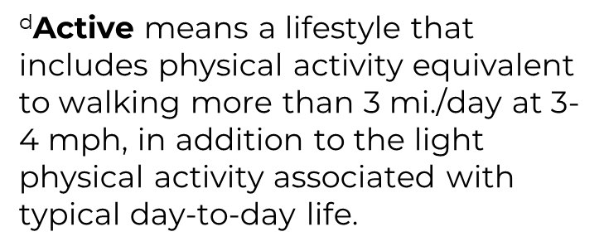
Nutrition and Calorie Intake
^{b}Sedentary means a lifestyle that includes only the light physical activity associated with typical day-to-day life.
^{c}Moderately active means a lifestyle that includes physical activity equivalent to walking about 1.5 to 3 miles per day at 3-4 mph, in addition to the light physical activity associated with typical day-to-day life.
^{d}Active means a lifestyle that includes physical activity equivalent to walking more than 3 mi./day at 3-4 mph, in addition to the light physical activity associated with typical day-to-day life.
WindingRiverConsulting.com

Slide 9
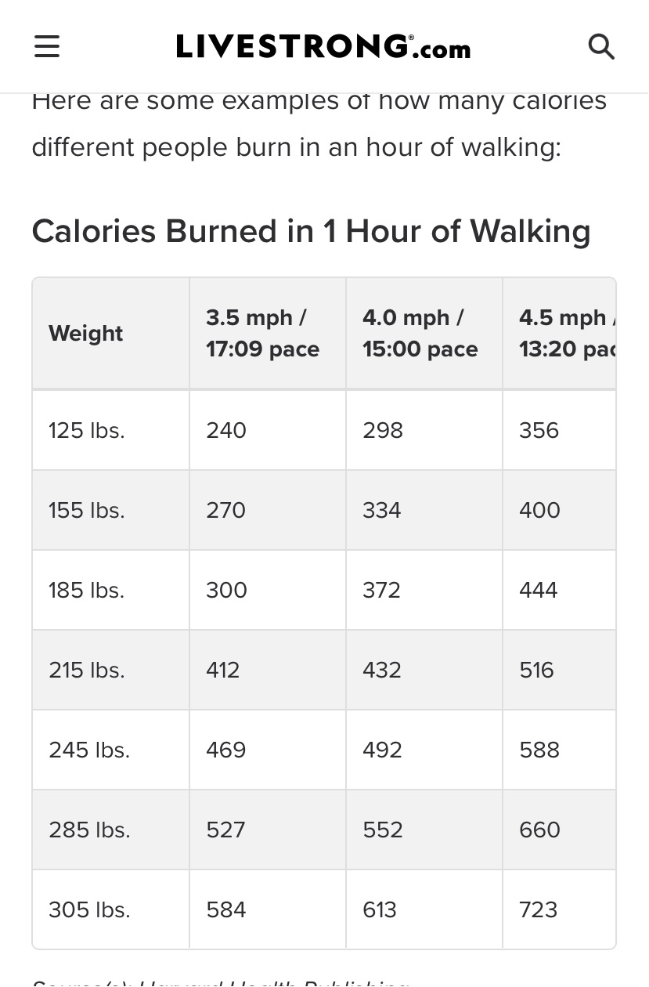
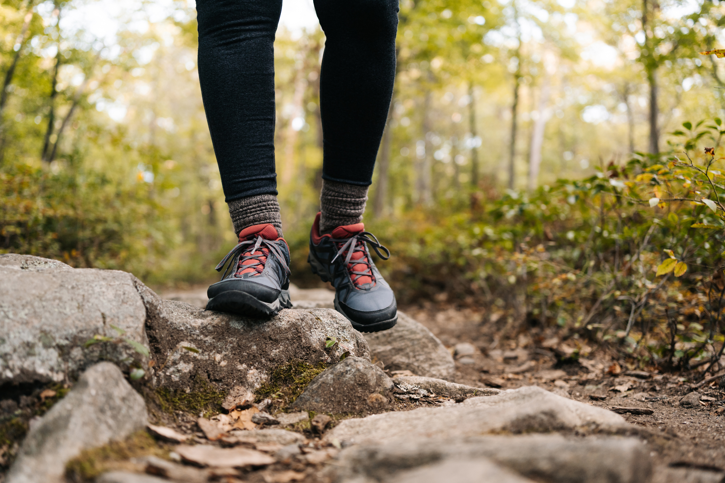

Slide 10
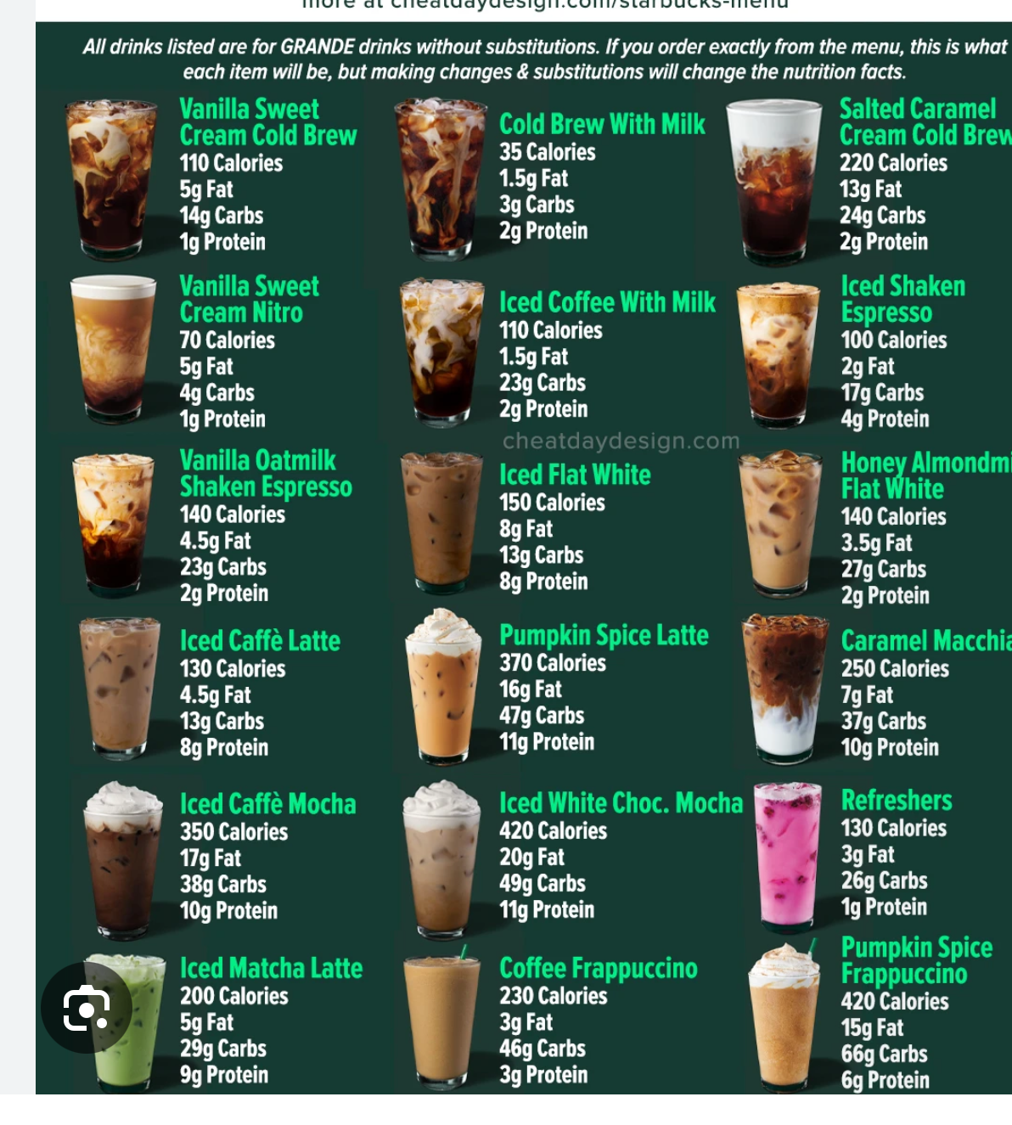

Slide 11
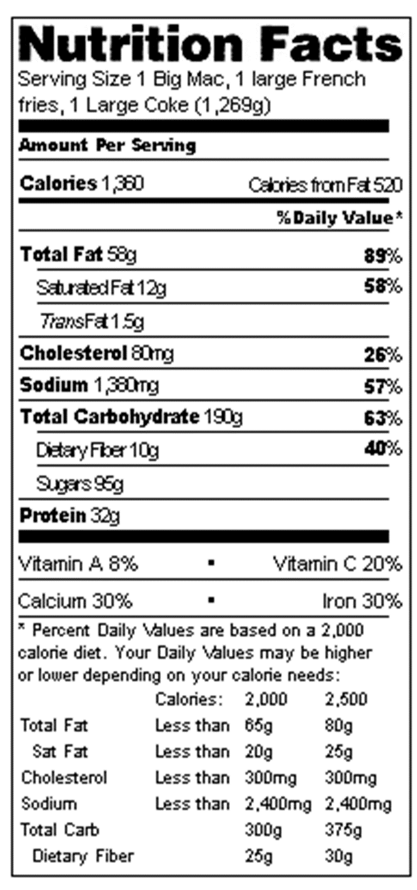
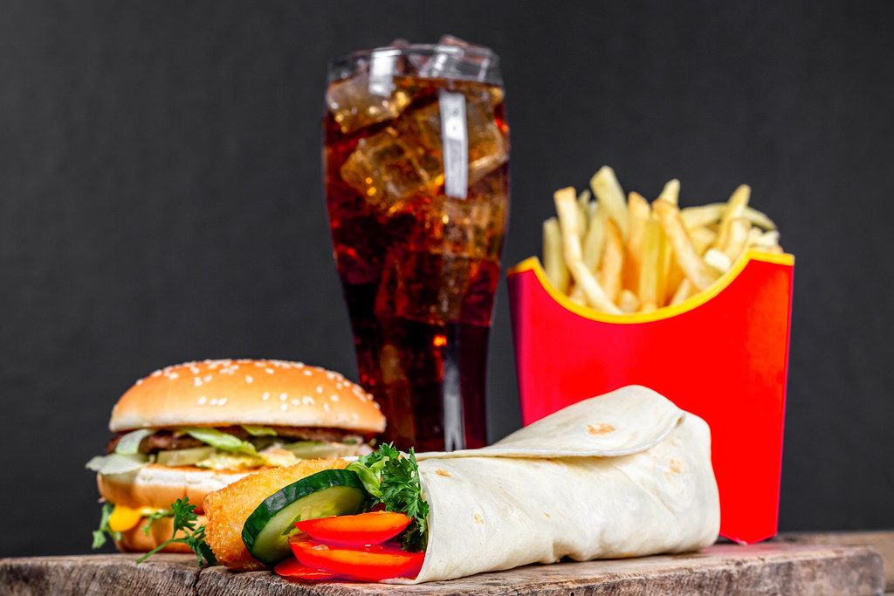
Nutrition: Calories in a Big Mac, Large Fry, and Large Coke
This Photo by Unknown Author is licensed under CC BY

Slide 12
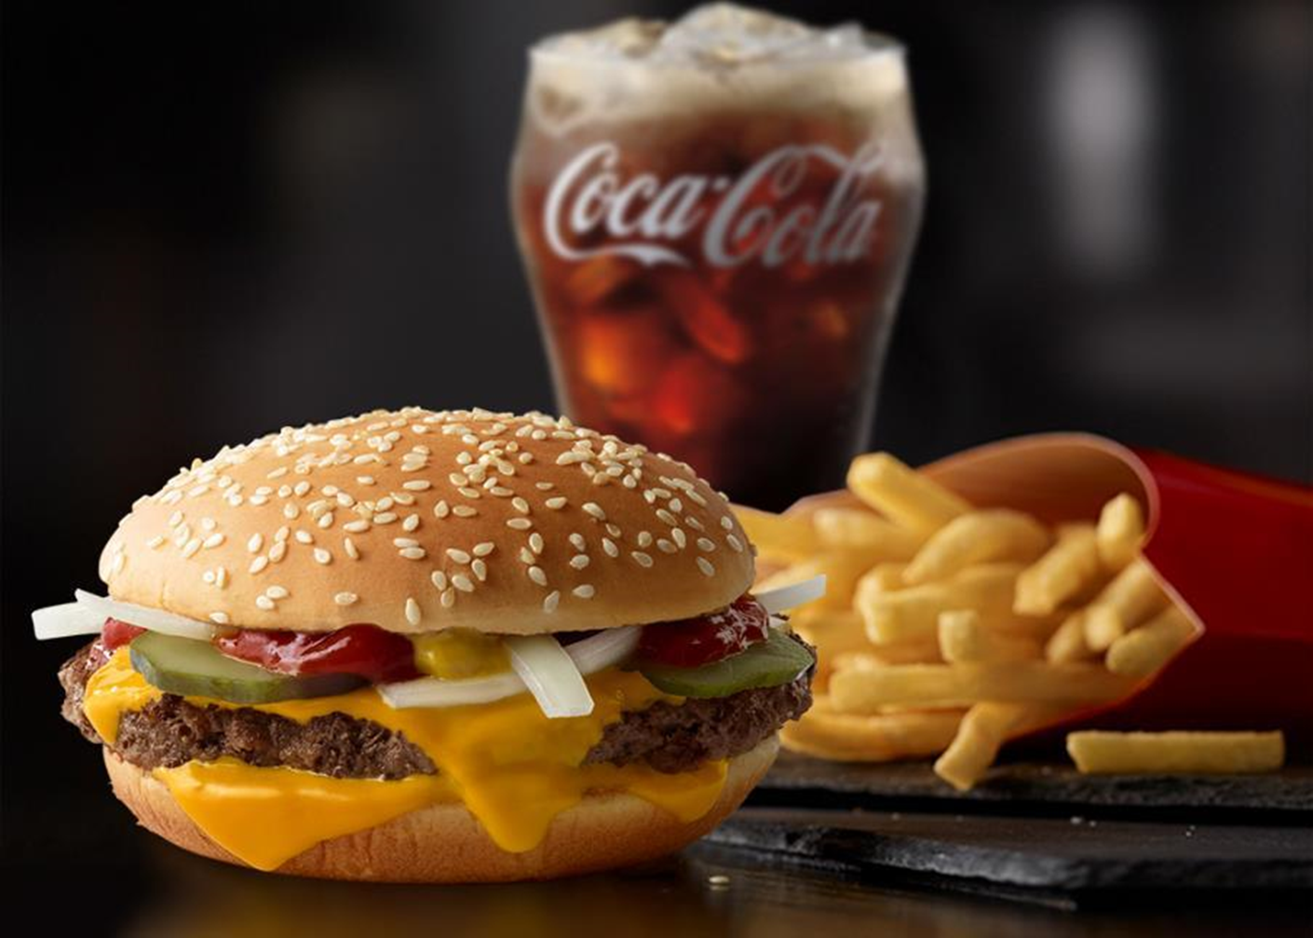
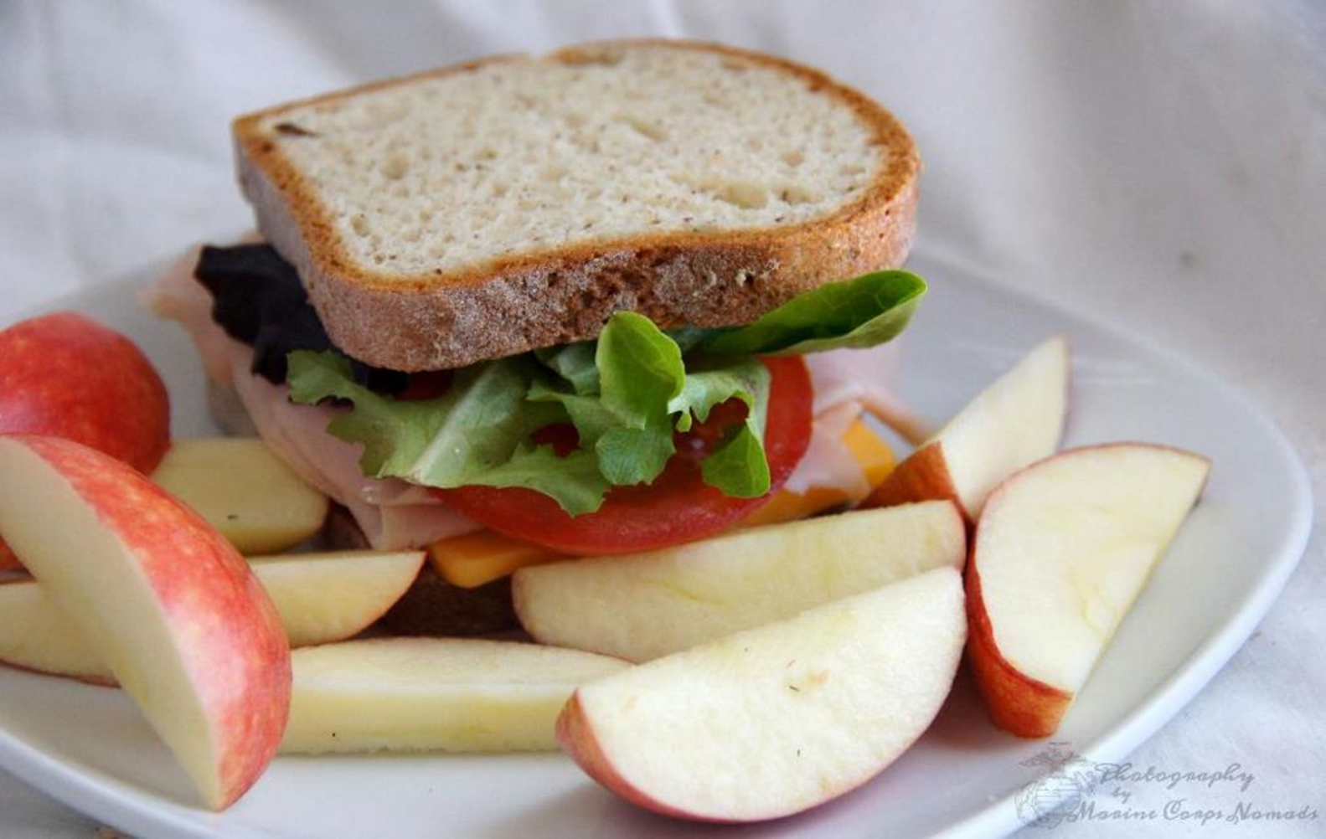
Making good choices will result in weight loss and healthier habits
Diet & Nutrition
Quarter Pounder, Large Fries, Coke 1320 Calories
Turkey sandwich, 2 apples, & Water 510 Calories

Slide 13
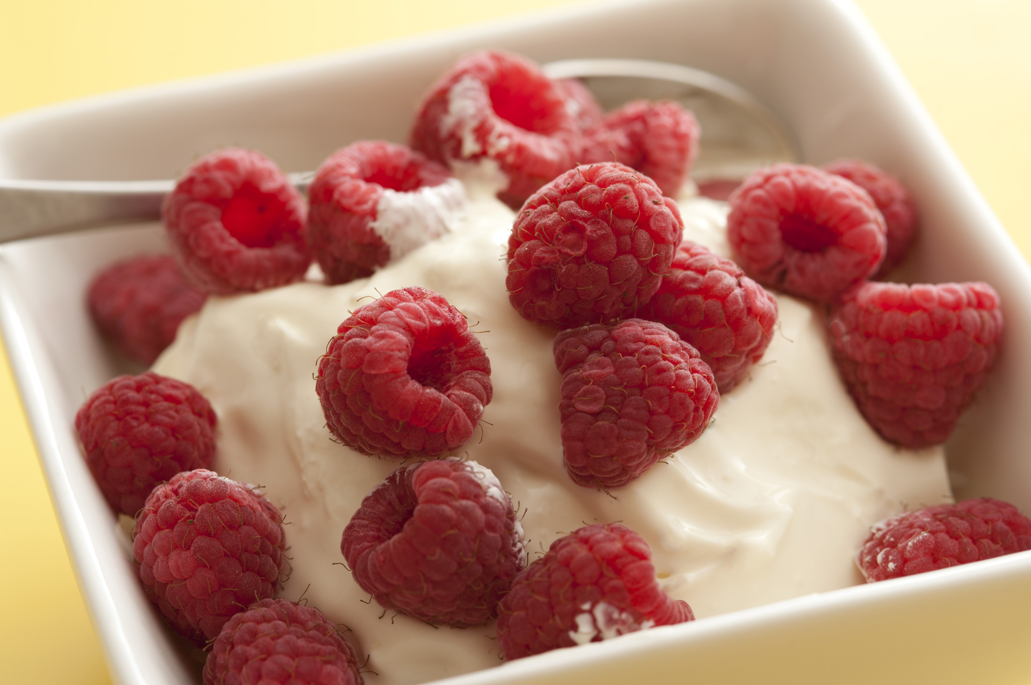
Nutrition: Positive Options
Unsalted mixed nuts
Greek yogurt and berries
Apple slices with peanut butter
Cottage cheese with berries
Cucumber with hummus
A piece of fruit
Hard boiled eggs
Carrots with fat free ranch
Protein shake
Lean meats; chicken, beef, fish, turkey
Consider using a meal service during busy season
This Photo by Unknown Author is licensed under CC BY

Slide 14
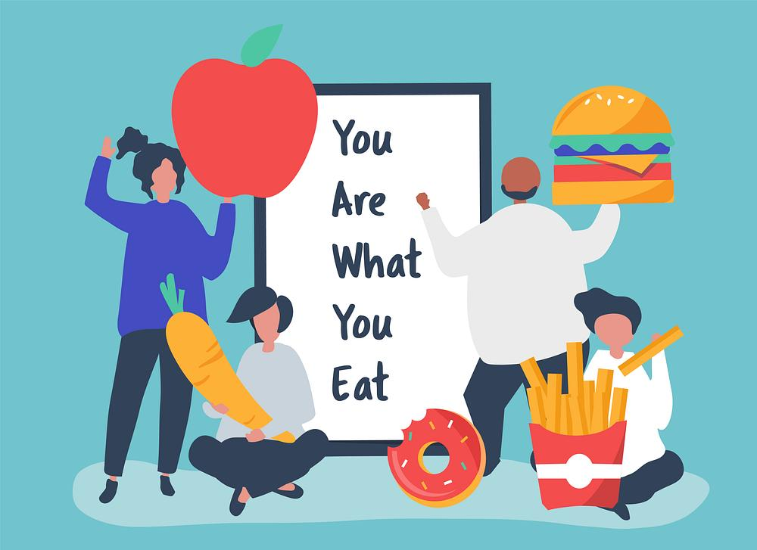
Nutrition: Popular Snacks with High Calorie Count
Soda
Ice cream
Pizza
Cookies and doughnuts
French fries
Potato chips
Candy

Slide 15

Nutrition: Fast-Food Resturants that Serve Healthy Foods
1
Healthy options: grilled chicken nuggets, grilled market salad, and multi-grain breakfast oatmeal.

Slide 16

Nutrition: Fast-Food Resturants that Serve Healthy Foods
2
Healthy options: Several healthy salads made with chicken, vegetables and fruit

Slide 17

Nutrition: Fast-Food Resturants that Serve Healthy Foods
3
Healthy options: Steak, fish, seafood, salads, various appetizers

Slide 18

Nutrition: Fast-Food Resturants that Serve Healthy Foods
4
Healthy options: Whole-grain bread, plus plenty of vegetables

Slide 19

Nutrition: Fast-Food Resturants that Serve Healthy Foods
5
Healthy options: Variety of healthy soups and salads

Slide 20
Diet & Nutrition
Everyone knows what the right choices are…
…cultivate the discipline to make those choices.

Slide 21





Nutrition: The Bottom Line
People gain weight because they eat more calories than they burn.
It should be noted that no single food on this list will make you fat if you enjoy it occasionally as part of a balanced diet. However regular and excessive consumption of these foods will likely make you gain weight over time

Slide 22
Nutrition Tips to Help You Lose Weight
Don’t Skip Breakfast
Eat regular meals
Eat plenty of fruits and Vegetables
Get more active
Drink plenty of water
Eat high fiber foods
Read food Labels
Use a smaller plate
Do not ban foods
Do not stock junk foods
Cut down on alcohol
Plan your meals

Slide 23


Exercise Methods
Aerobic
Anaerobic

Slide 24




Exercise Styles
The best training offers a combination of the BIG 3 major components:
Cardio
Strength
Flexibility

Slide 25
Exercise Styles
Yoga
Running
Weight Training
Spinning
Boot Camp
CrossFit
All offer great things, but many are short sighted

Slide 26
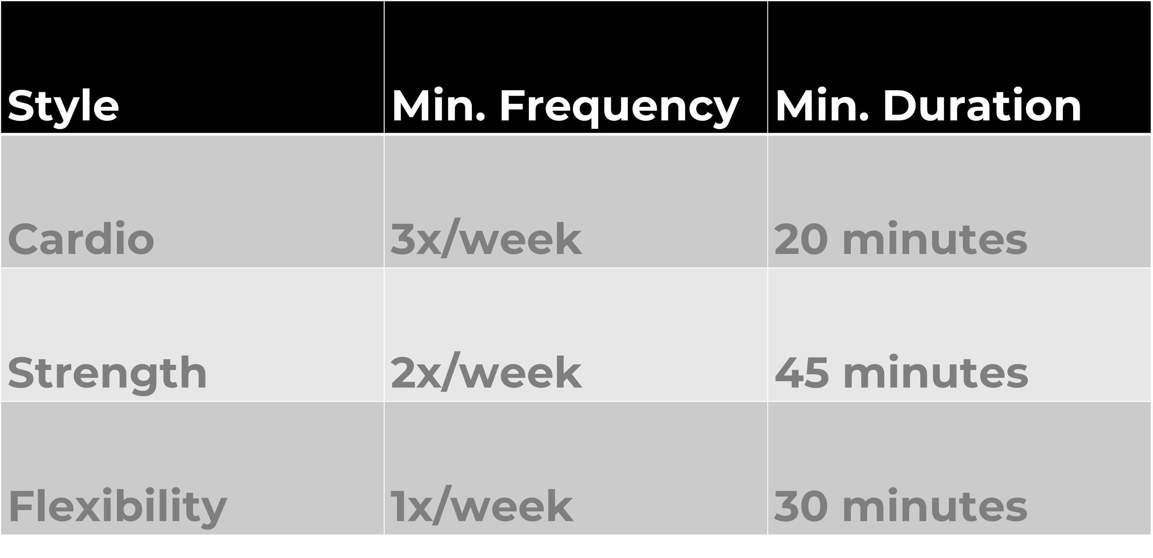



Exercise Frequency

Slide 27

Mindfulness
Mindfulness creates a space within, a quiet shift in focus and attention that helps the mind and body rest and reset. This allows us to respond to ourselves and our lives rather than reacting instantly, which in turn soothes the entire range of unpleasant anxiety symptoms.

Slide 28
Benefits of Mindfulness in the Workplace
A reduction in job stress
Decreased feelings of anxiety and depression
Increased focus and ability to drown out distraction
Increased self-awareness and regulation of emotions
Improved body satisfaction
Mindfulness really does promote physical, emotional and mental wellbeing, allowing for increased productivity.

Slide 29



Having a Mindful Approach on Social Media
70% of adults and 81% of teens use social media
Short bursts of dopamine boost a temporary sense of self esteem as people post and read content with the hopes of receiving likes and comments
The unpredictable outcomes make people keep checking back over and over again creating addictive tendencies, it's been compared to gambling on a slot machine
FOMO or fear of missing out also creates the addiction to social media and other people’s platforms by comparing themselves to the other person
All of this is unproductive in the workplace/life and creates a hole slew of negative side effects:
Low self esteem
Depression/anxiety
Misinformation/delusion
Online predators/ bully's

Slide 30
Internal Wellness/Stress Reduction
Most misunderstood part of wellness
Involves the greatest amount of patience
Contradictory to Western Culture and corporate beliefs
Cannot process the same way as business
No left brain (logic, strategic thinking) involved
All right brain (creative, instinctual, feeling)
*Goes against the very grain of how we are taught to think and process information

Slide 31

“Doing nothing is everything”
Internal Wellness/Stress Reduction
What does that mean?

Slide 32
Internal Wellness/Stress Reduction
Importance of breath…
Deeply and slowly
Returns us to the “energy of life”
Finding our center
Discovering balance
Finding clarity and internal order
Total stress reduction and anxiety management

Slide 33






How to Practice Mindfulness
Take a seat. Find a place that feels calm and quiet.
Set a time limit 5-10 min works to begin.
Notice your body
Feel your breath
Notice when your mind has wandered
Be kind to your wandering mind

Slide 34

How to Practice Mindfulness

Slide 35

Thank You
CONTACT
Motiv8matt@aol.com
P: 216.401.0276

