Slide 1


Executive Presence
Personal Branding & LinkedIn
MPB | Leadership Accelerated
May, 2025
David M. Toth

Slide 2
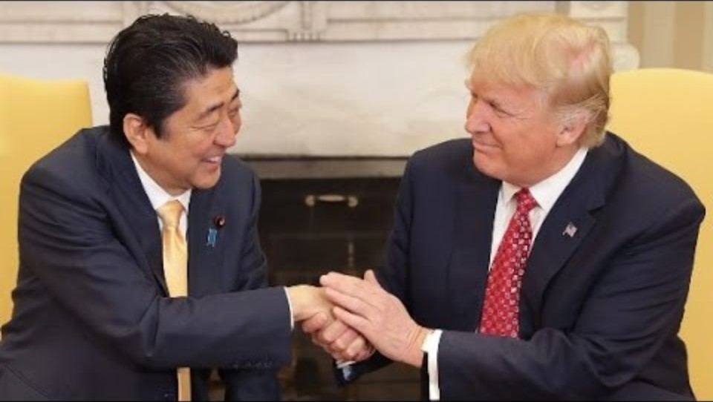
The Handshake
Notes:
Japanese Prime Minister Shinzo Abe

Slide 3
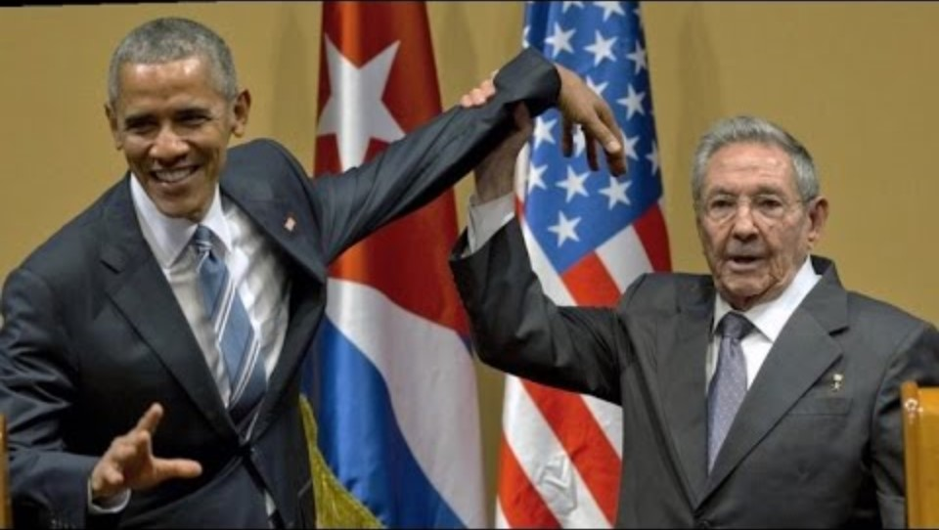
The Handshake
Notes:
Raul Castro

Slide 4
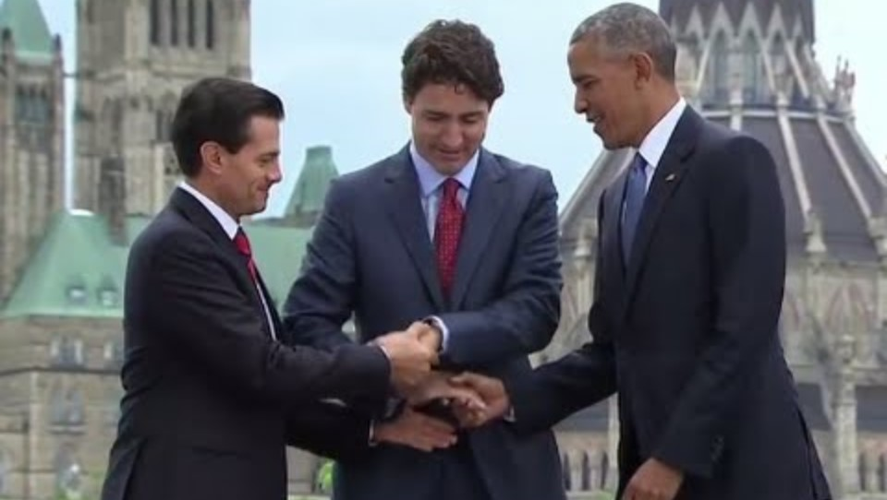
The Handshake
Notes:
Canadian prime minister Justin Trudeau
Mexican President Enrique Pena Nieto

Slide 5
Who has the most memorable handshake?

Slide 6

“The research I’ve been doing for years now joins a large body of inquiry into a quality I call presence. Presence stems from believing in and trusting yourself—your real, honest feelings, values, and abilities. That’s important, because if you don’t trust yourself, how can others trust you? Whether we are talking in front of two people or five thousand, interviewing for a job, negotiating for a raise, or pitching a business idea to potential investors, speaking up for ourselves or speaking up for someone else, we all face daunting moments that must be met with poise if we want to feel good about ourselves and make progress in our lives. Presence gives us the power to rise to these moments."

Slide 7
Presence is a quality that…
Commands respect and inspires others
Speaks with poise and clarity
Becomes genuinely relatable to others
Develops an inner sense of confidence that helps us feel good about ourselves and make progress in our lives

Slide 8
Your posture is evidence of how you feel about yourself, and by improving it, even right now, you will become more self-confident.

Slide 9

Your Body Language May Shape Who You Are

Slide 10
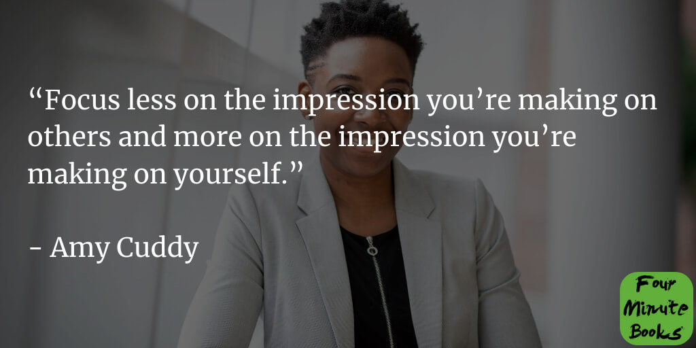

Slide 11
Executive Presence

Slide 12

Executive Presence
Easy to recognize, hard to define
Appearance
Communication
Gravitas
(4.) Character
Notes:
Inspire Confidence

Slide 13
Executive presence is about your ability to inspire confidence:
Inspiring confidence in your subordinates that you’re the leader they want to follow
Inspiring confidence among peers that you’re capable and reliable
Inspiring confidence among senior leaders that you have the potential for great achievements.

Slide 14
Your Executive Presence
How would you characterize your own Presence?
I’m good!
Not bad, could be better.
Oh, boy!
Huh?

Slide 15
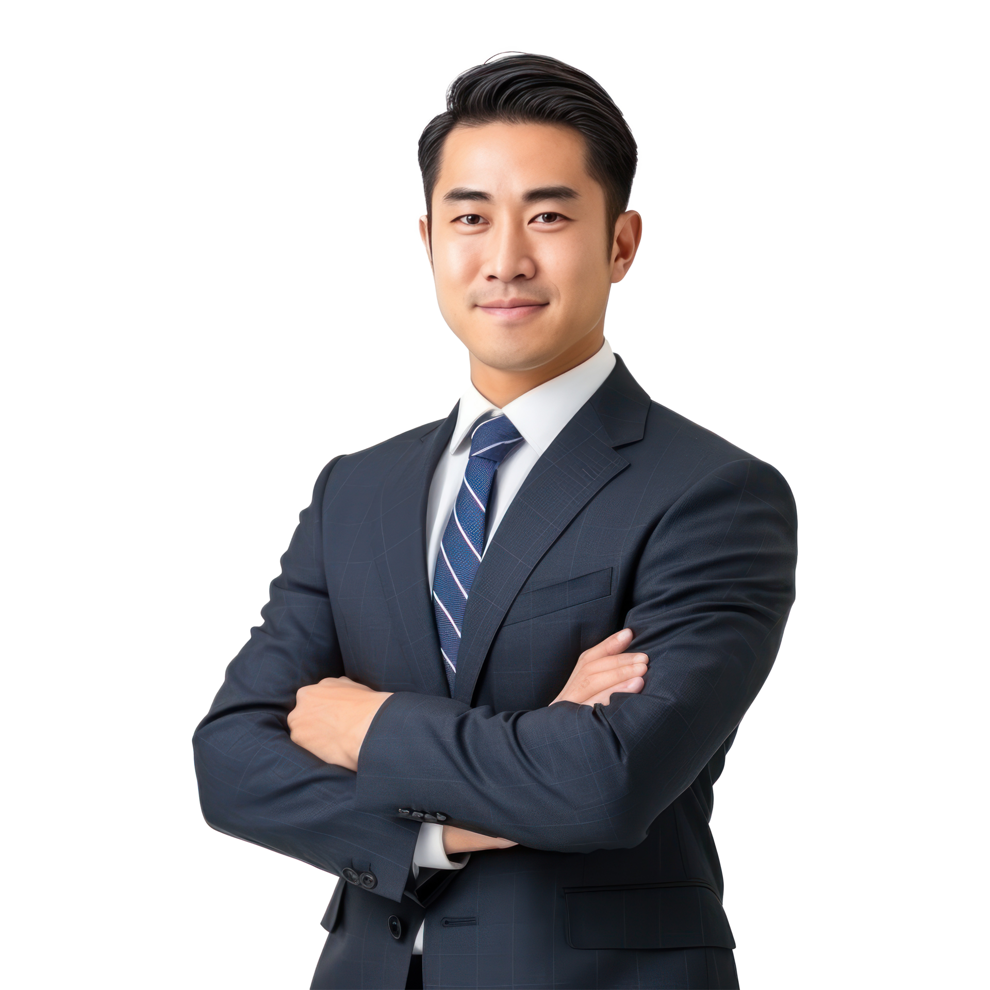
1: Appearance
The way you show up.
Appropriate attire - style, wrinkles, rips, stains
Hygiene - dental, too much cologne (not enough)
Grooming - hair, nails, make up, jewelry
How you act - composed, calm
Organized
Posture - confident
Body language/Demeanor - eye contact, hand gestures
Facial expressions
Symmetry
Stillness

Slide 16
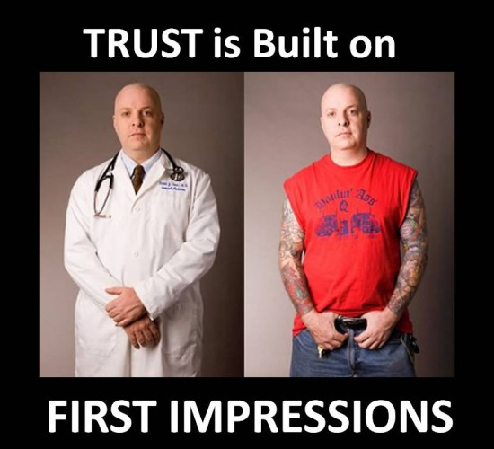
First Impressions

Slide 17

2: Communication
The way you speak and listen.
Voice - tone, pitch, pace
Word choices
Apologetic
Overusing tired clichés
Substituting a question for a sentence
Fillers - ummmmmm
Present - body language, distractions
Focused, open, curious, listening, and energetic
Self-aware
Silence

Slide 18
Communication: Listening
Be focused hearing what is being said instead of planning what to say in response
Paying close attention to YOUR words and body language
  Voice not emotional; open, calm gestures; eye contact
  Be respectful; no distractions; focus and do not interrupt
  Breathe
Pay attention to THEIR words and body language
  Noticing (and using) non-verbal cues
  Paraphrasing and reflecting back what has been said
  Inquire for clarity

Slide 19

3: Gravitas
The way you behave. A sum of the weight of your personality and confidence.
A carefully cultivated skill
Self (quiet) confidence
Charm/Charisma - warm, engaging
Positive energy/Optimism
Calm and consistent
Engaging

Slide 20


Slide 21
4: Character
If you want more courage and the ability to handle stress better, find and write about your top core value.
The way you express your core values.
Integrity
Approachable
Believable
Consistent
Dependable
Humble
Empathic
Authentic
Genuine
Vulnerable
Respectful
Supportive
Collaborative
Appreciative
Prepared
How you show up
Doesn’t gossip or talk ill of others
Comfortable learning from others
Willing to admit when they were wrong
Invests in self - physically, mentally, emotionally

Slide 22
Let’s Get Personal
Your Brand

Slide 23
A Brand
Notes:
A brand is a product, service or concept that is publicly distinguished from other products, services or concepts so that it can be easily communicated and usually marketed.

Slide 24


Slide 25
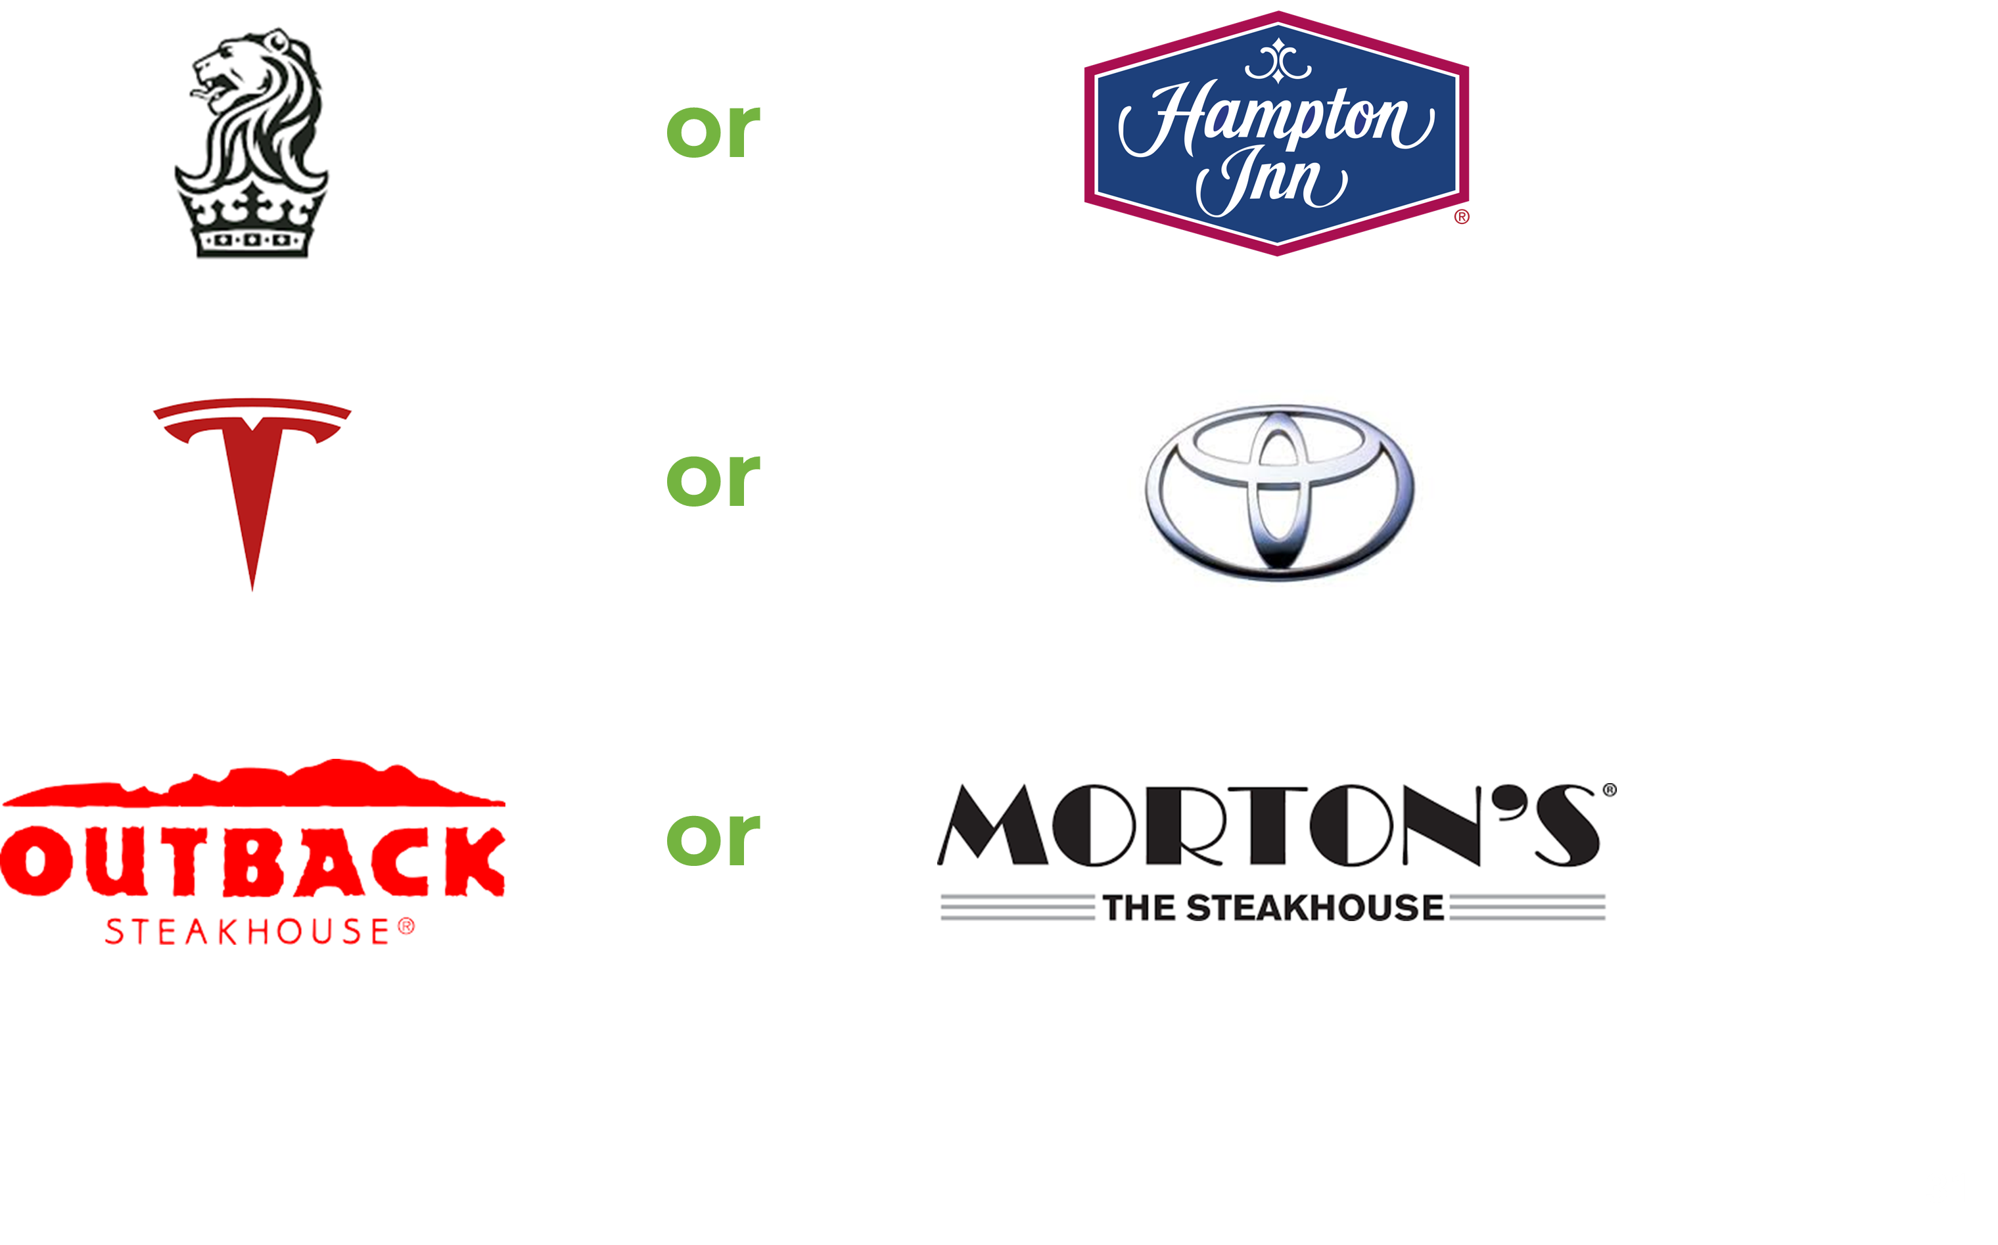

Slide 26
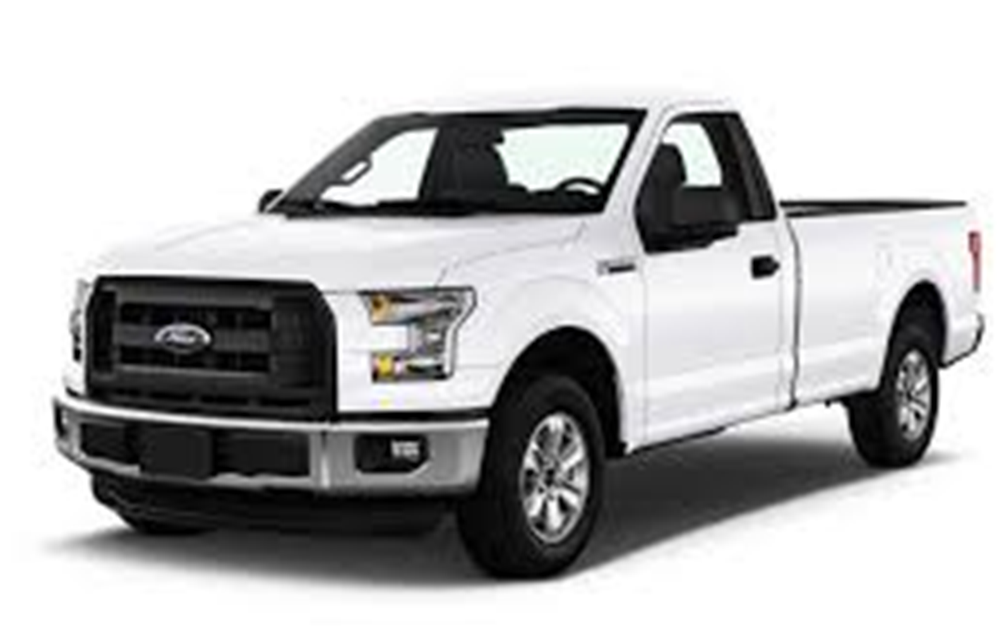

Slide 27

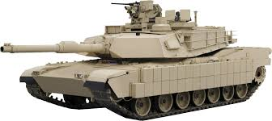

Slide 28


Slide 29
YOUR Brand
Notes:
Personal branding is becoming less of a competitive edge and more of a requirement for anyone looking to grow their business; get that dream job; or take their career to the next level.

Slide 30
What others say about you when you’re not in the room.

Slide 31
Personal (Business) Brand
Your brand is how people perceive you compared to others in like roles.
Who are you?
What do you do?
What’s most important to you?
What do you stand for?
What value do you bring?
Why do people like you?
Why do people trust you?
What is a non-negotiable?
How and where do you communicate it?
How would people describe you?

Slide 32
A Personal Page
Overlap*
You
Your Profile
Firm
Company Profile
*Articles, announcements, events, deadlines, industry changes/updates, new hires, etc.

Slide 33

Your DIGITAL (Personal) Brand

Slide 34
80%

Slide 35
40% of monthly active users visit LinkedIn daily.
4 out of 5 people on LinkedIn “drive business decisions”
Americans aged 30 to 49 used LinkedIn the most
LinkedIn posts with images see 2x higher comment rates
82% of B2B marketers see success on LinkedIn

Slide 36
Social Selling
Establish your professional brand - Complete your profile with the customer in mind. Become a thought-leader by publishing meaningful posts.
Find the right people - Identify better prospects in less time using efficient search and research tools
Engage with insights - Discover and share conversation-worthy updates to create and grow relationships.
Build relationships - Strengthen your network by connecting and establishing trust with decision makers

Slide 37
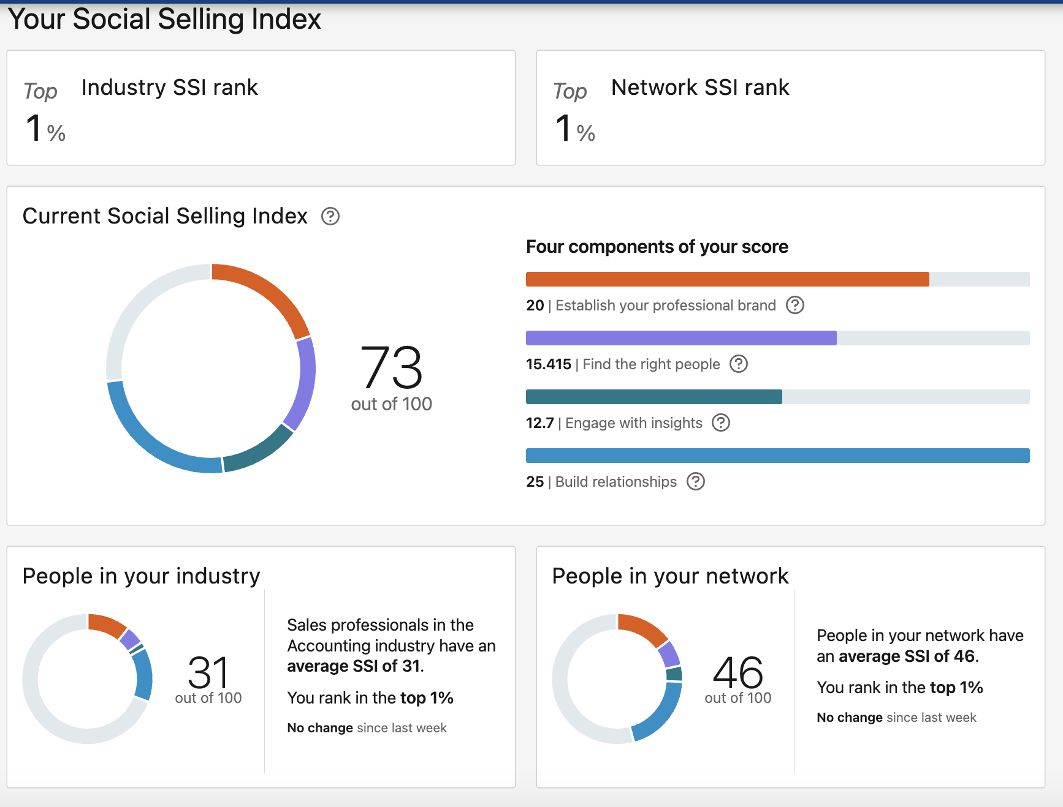
Social Selling Index Score
The Social Selling Index (SSI) | LinkedIn Sales Solutions

Slide 38
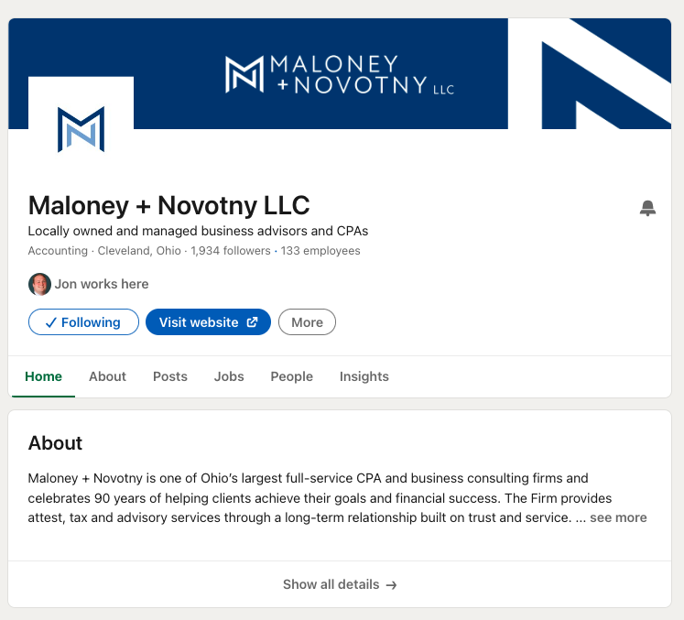
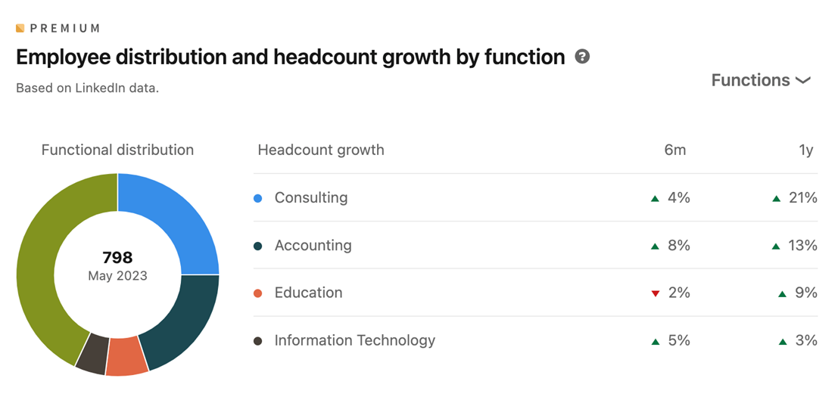
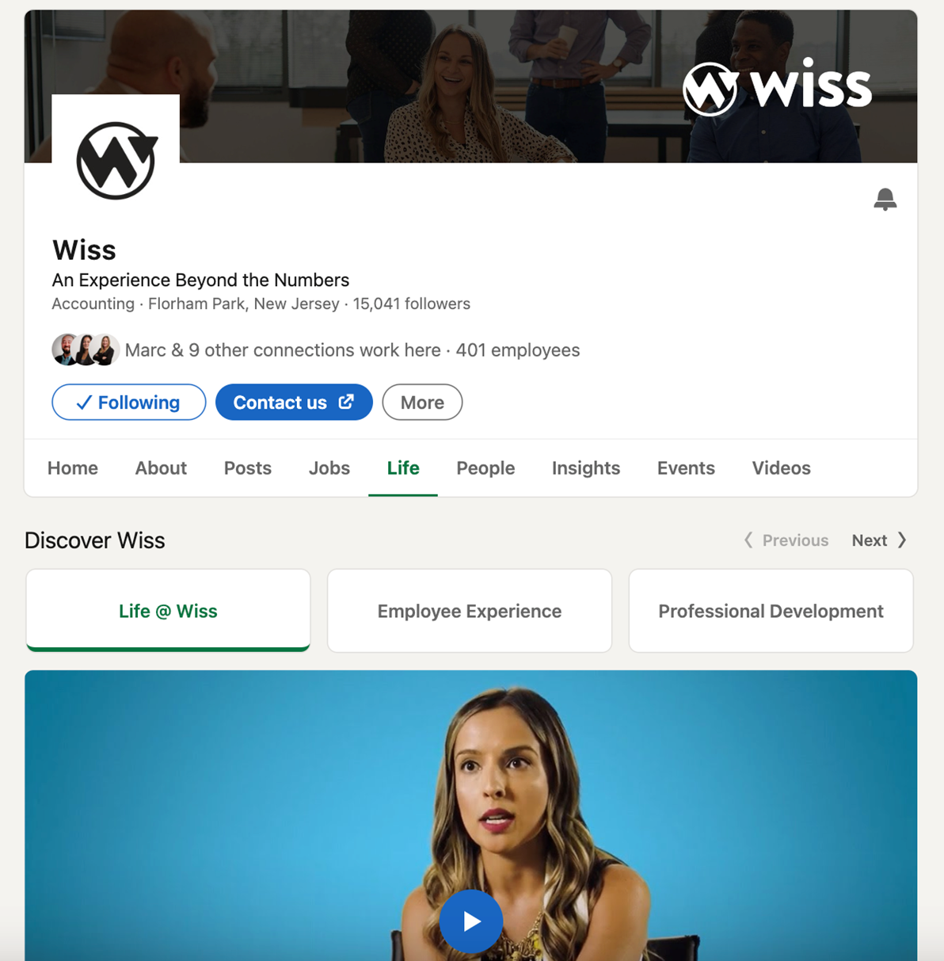
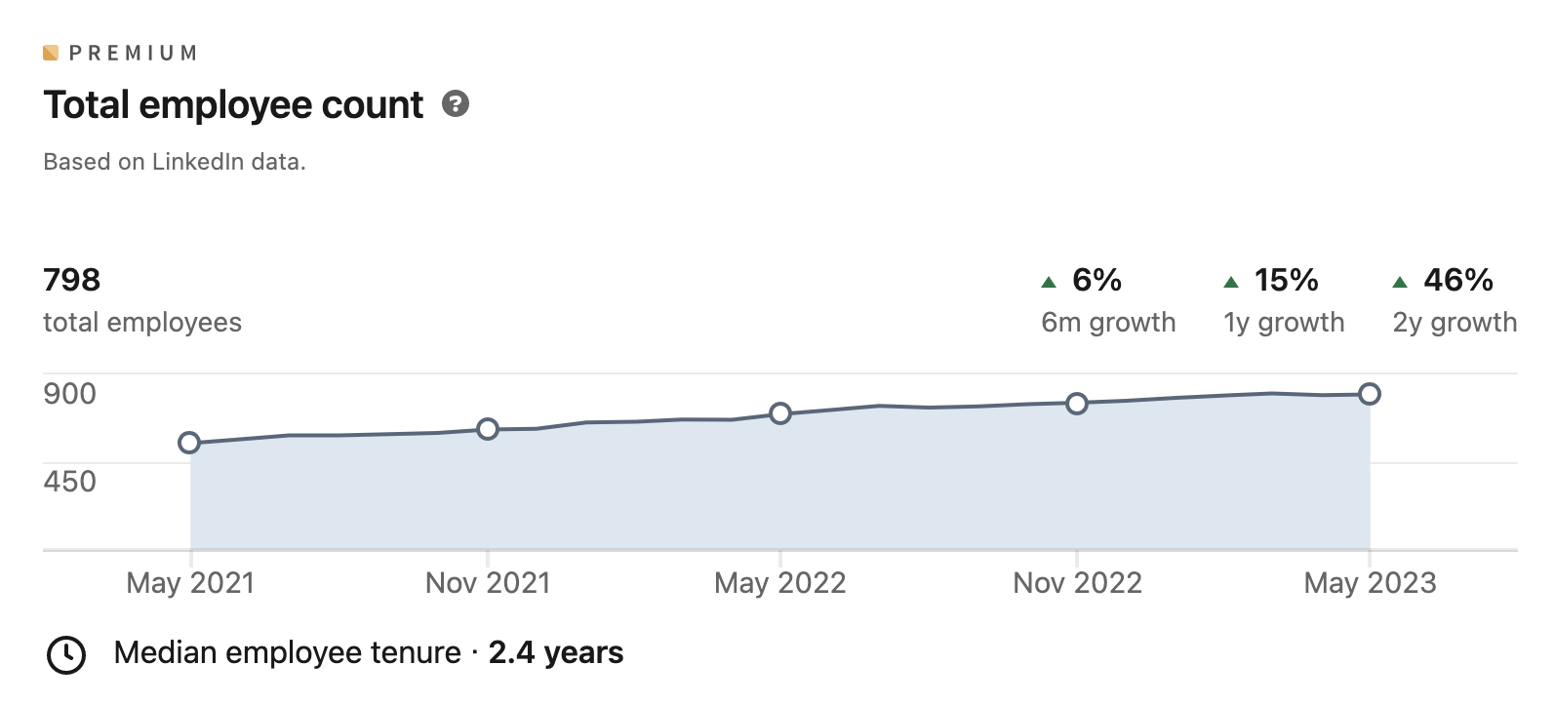
A Business Page

Slide 39
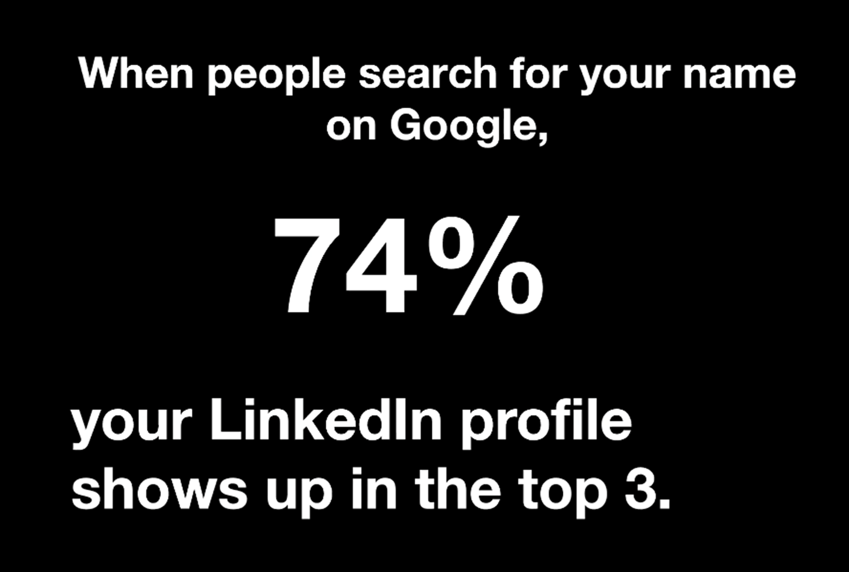
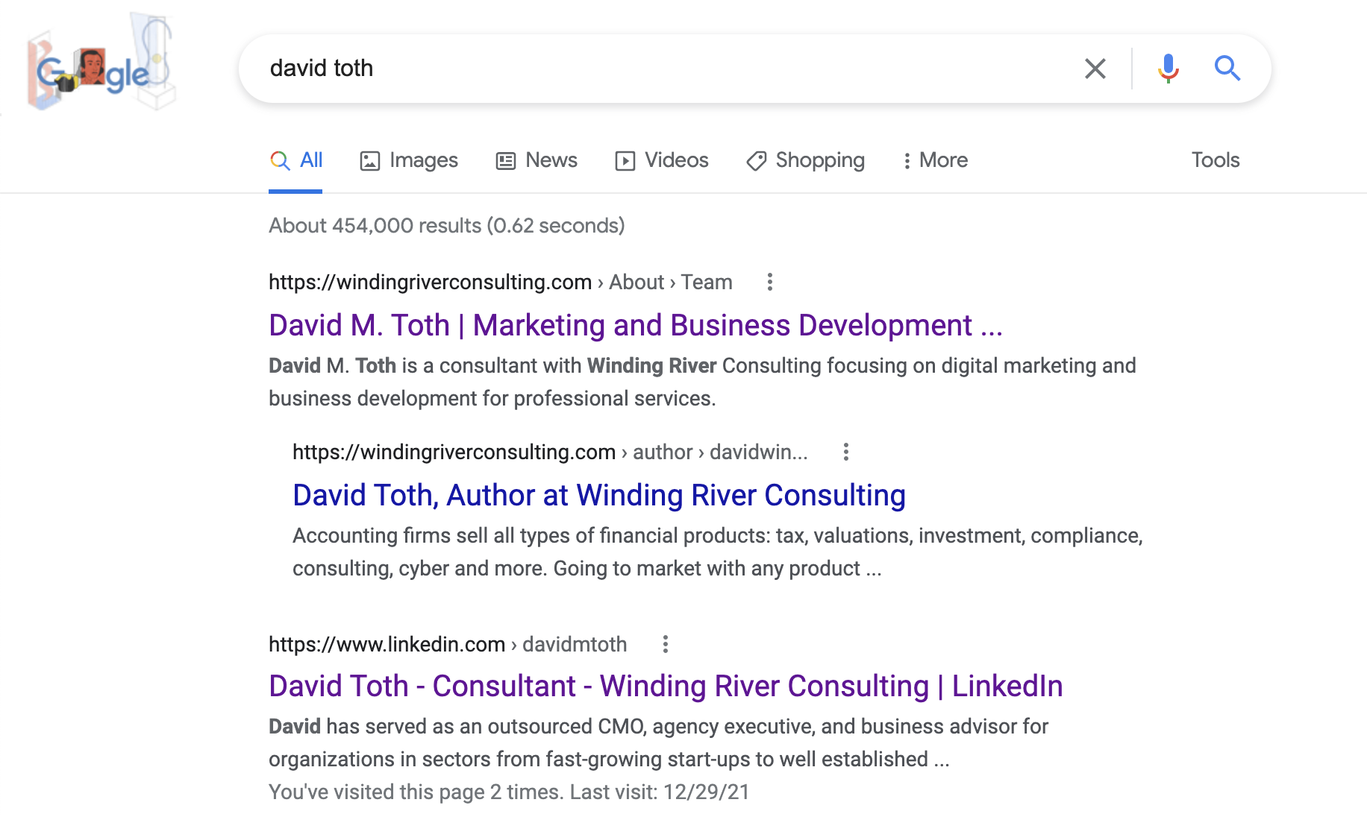

Slide 40
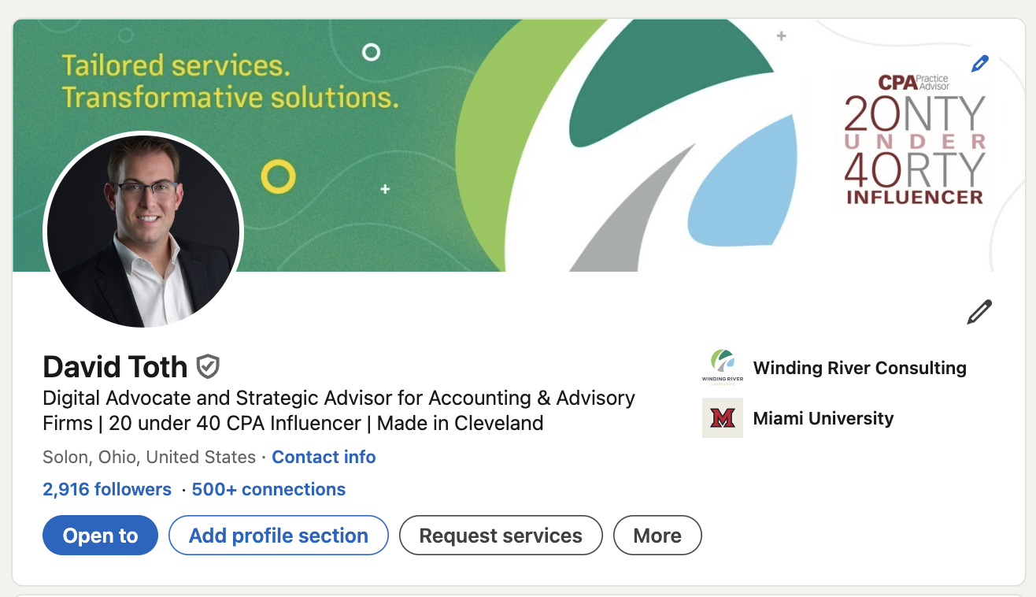
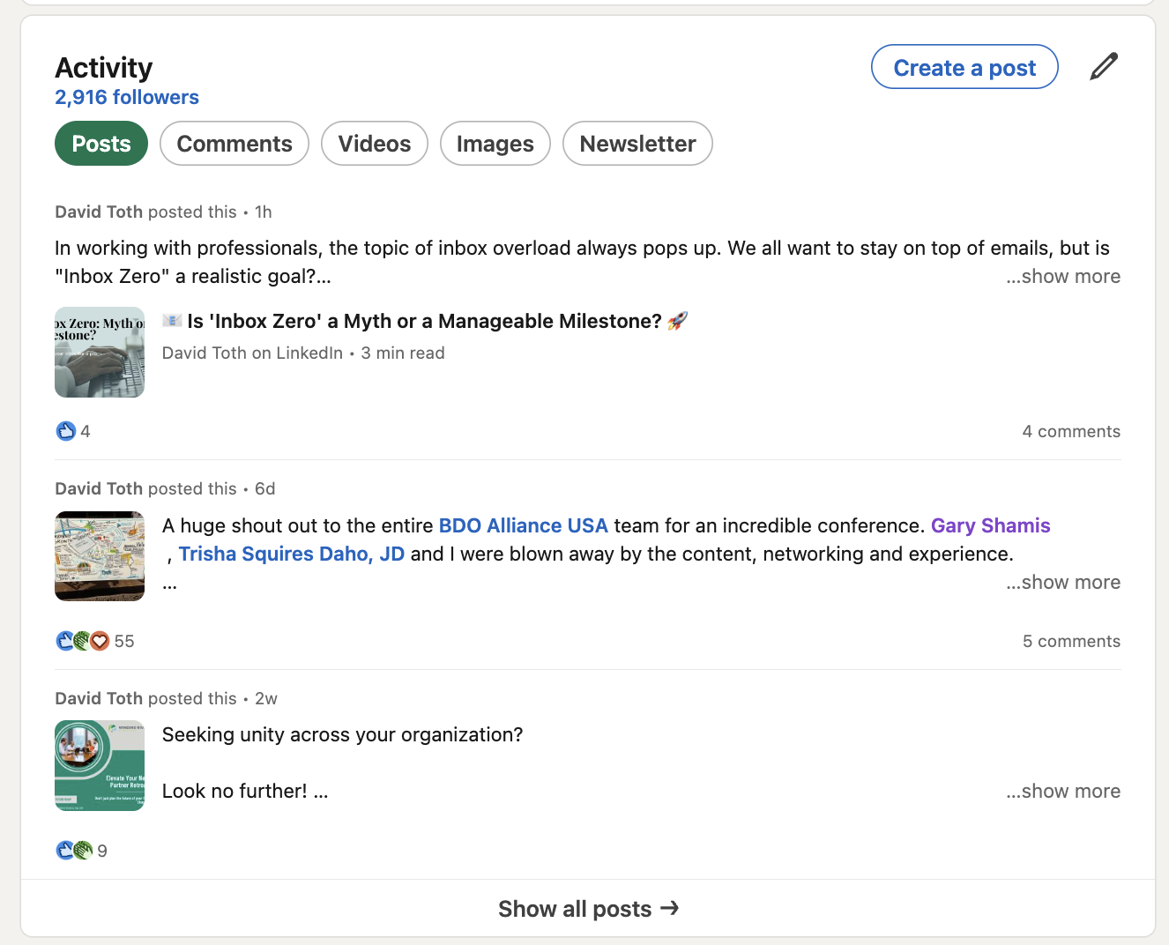
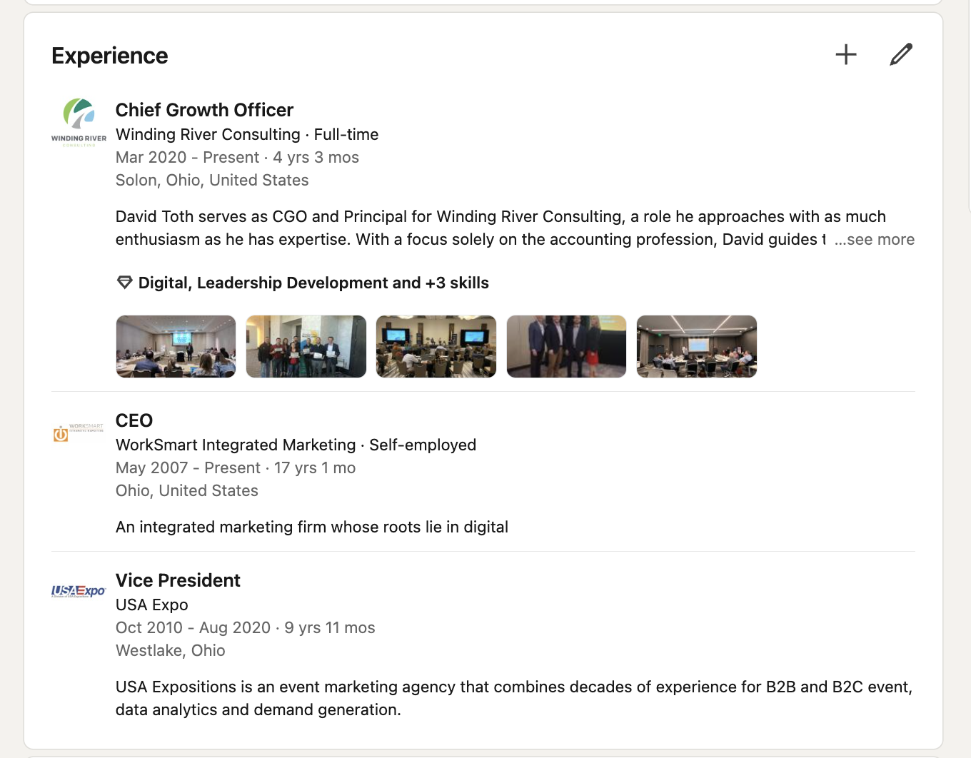
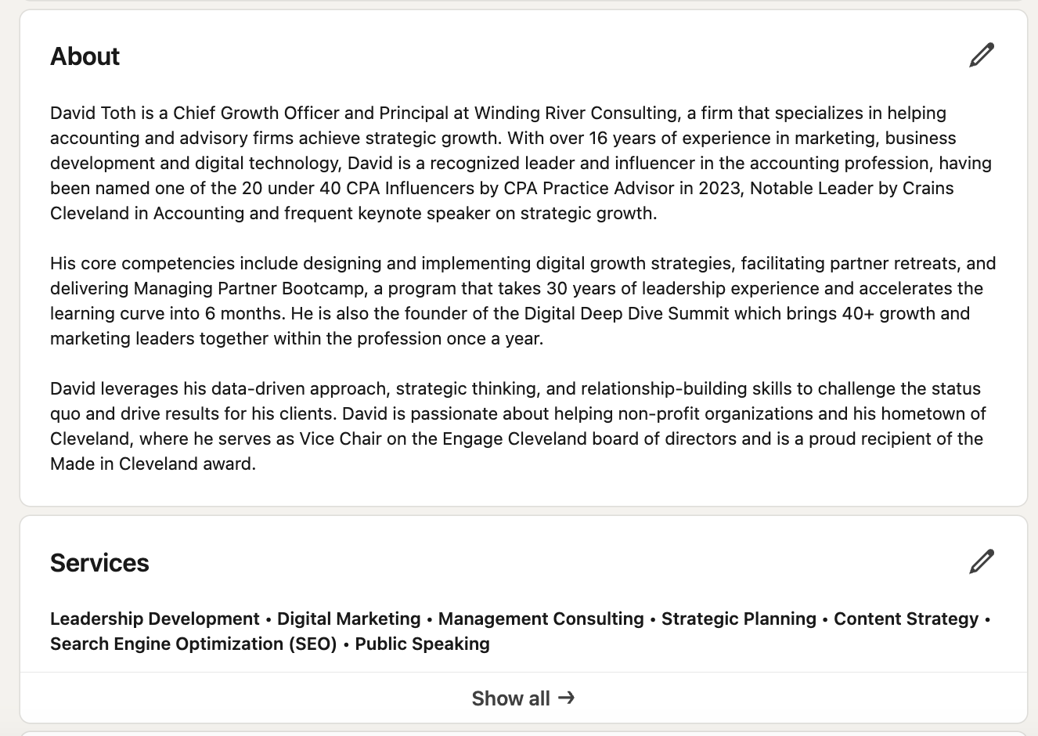
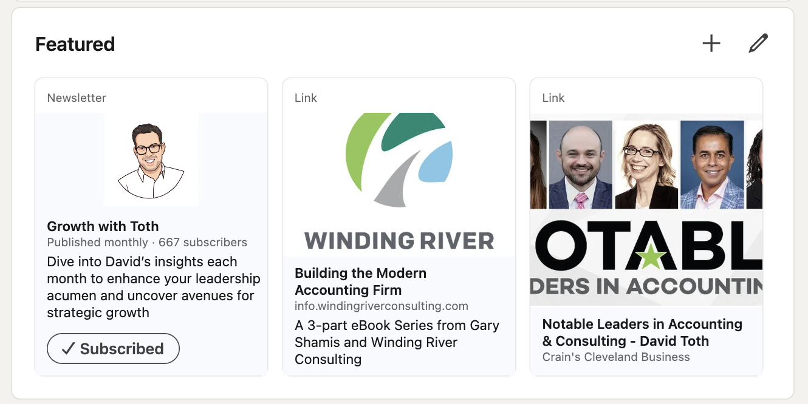
A Personal Page

Slide 41
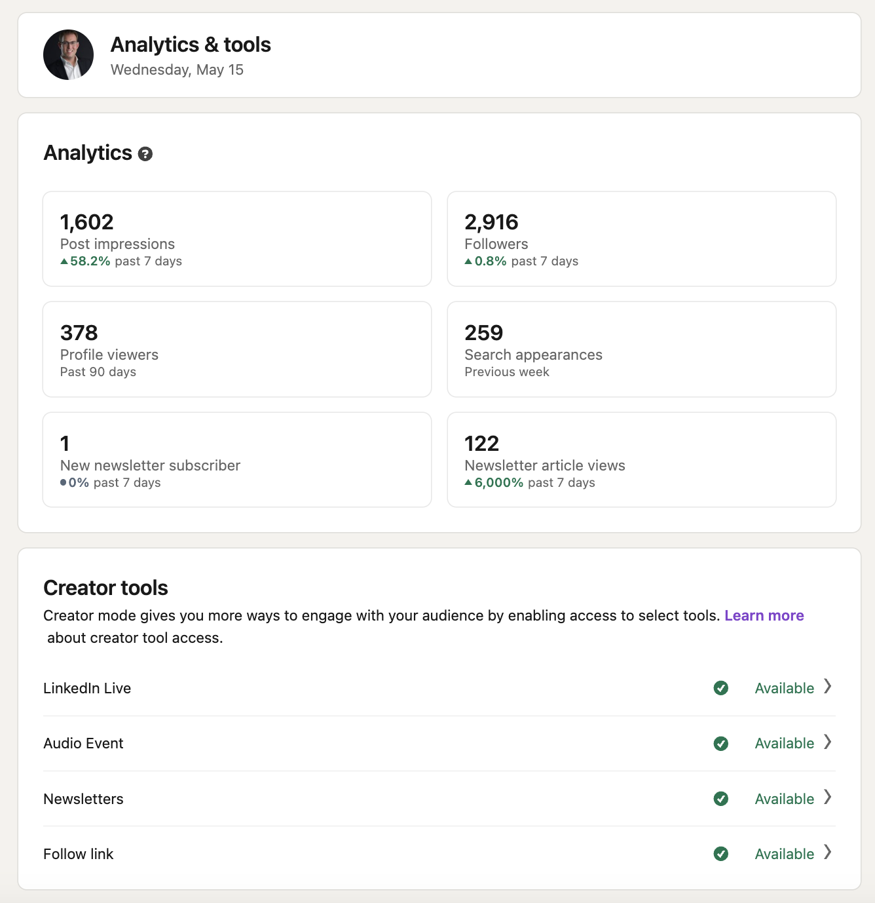
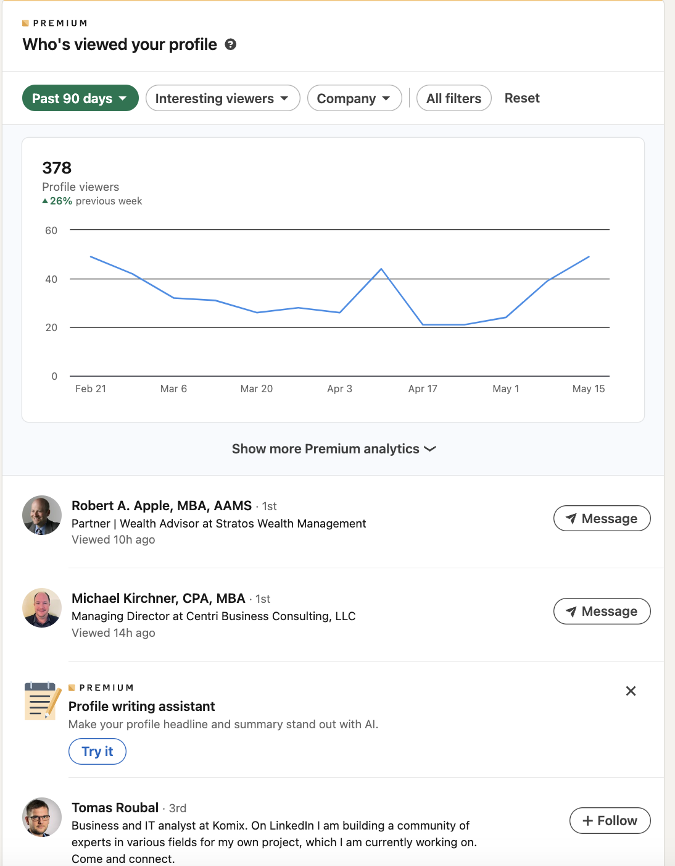
A Personal Page

Slide 42
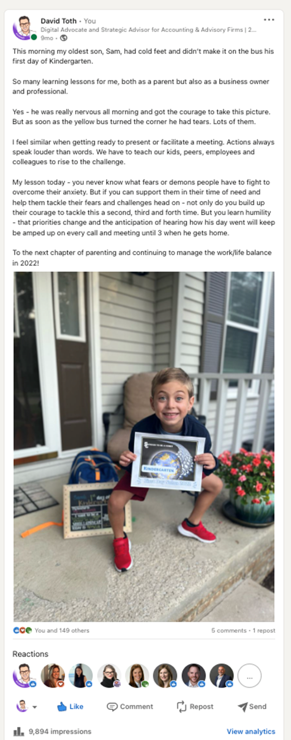
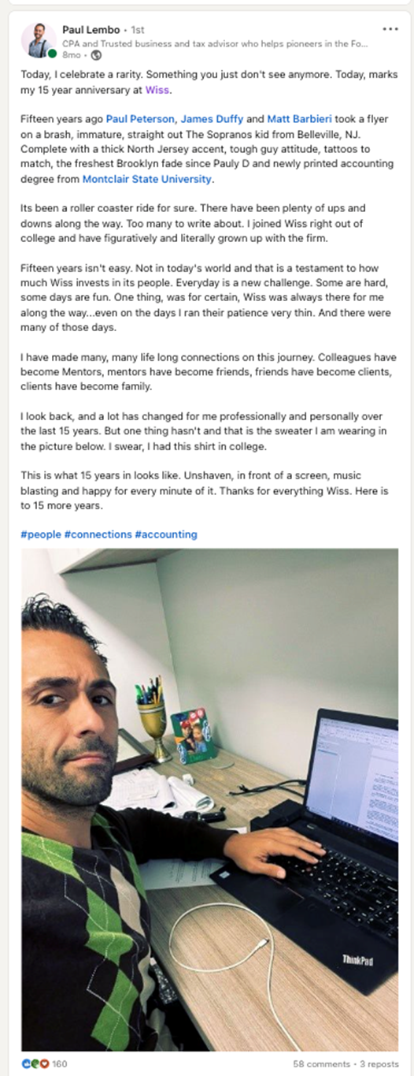
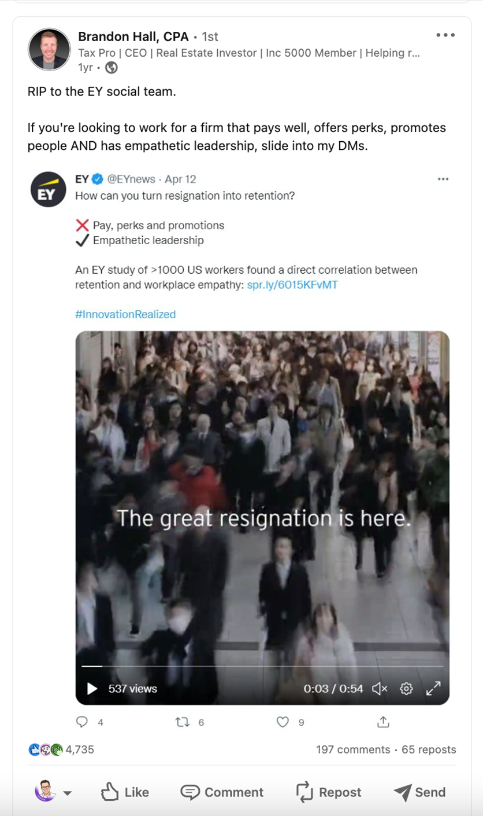
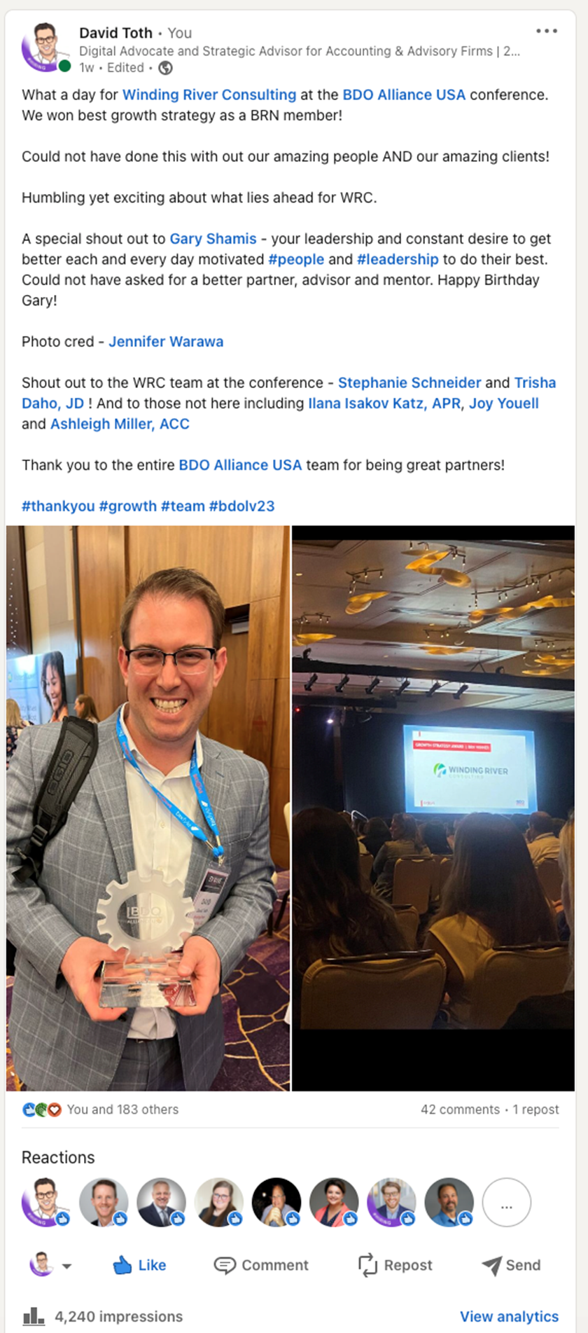
A Personal Page

Slide 43
Personal vs Business
 | Personal Page | Business Page
Purpose | Showcase individual skills and experience | Promote a company, its brand, and culture
Who it represents | Individuals | Organizations
Focus | Your career journey, achievements, and qualifications | Company information, products, services, and news
Connections | Build a network of professional contacts | Grow brand awareness and attract followers
Engagement | High (through comments, likes, and shares) | Lower (organic reach can be limited)
Content | A mix of professional and personal content (articles, updates, discussions) | Company updates, job postings, industry news, and thought leadership content
Activity | Can actively connect with others, join groups, participate in discussions | Limited activity options
Advertising | Limited paid advertising options | Access to a wider range of paid advertising features
Analytics | Provides insights into your profile views and engagement | Provides insights into page views, follower demographics, and content performance

Slide 44
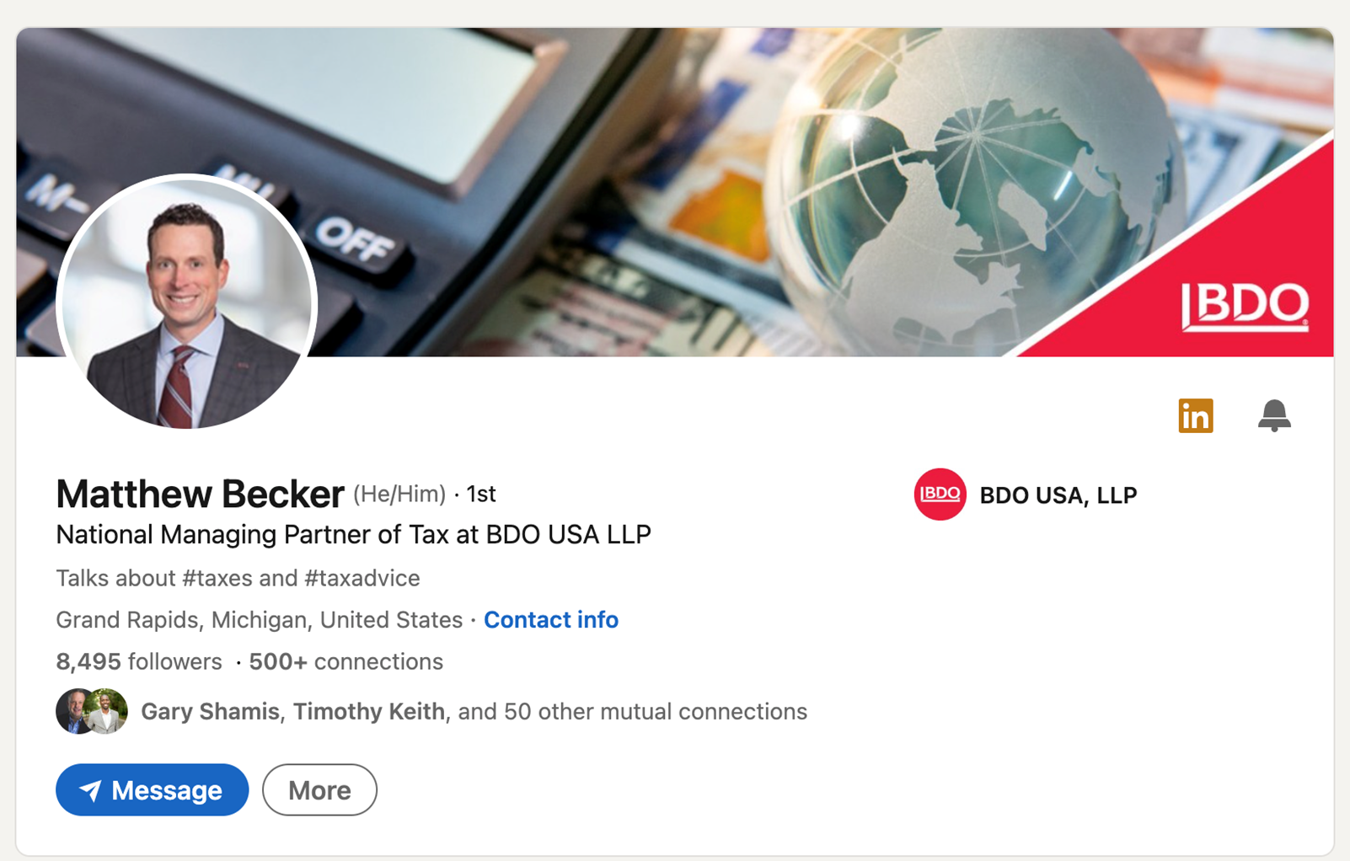
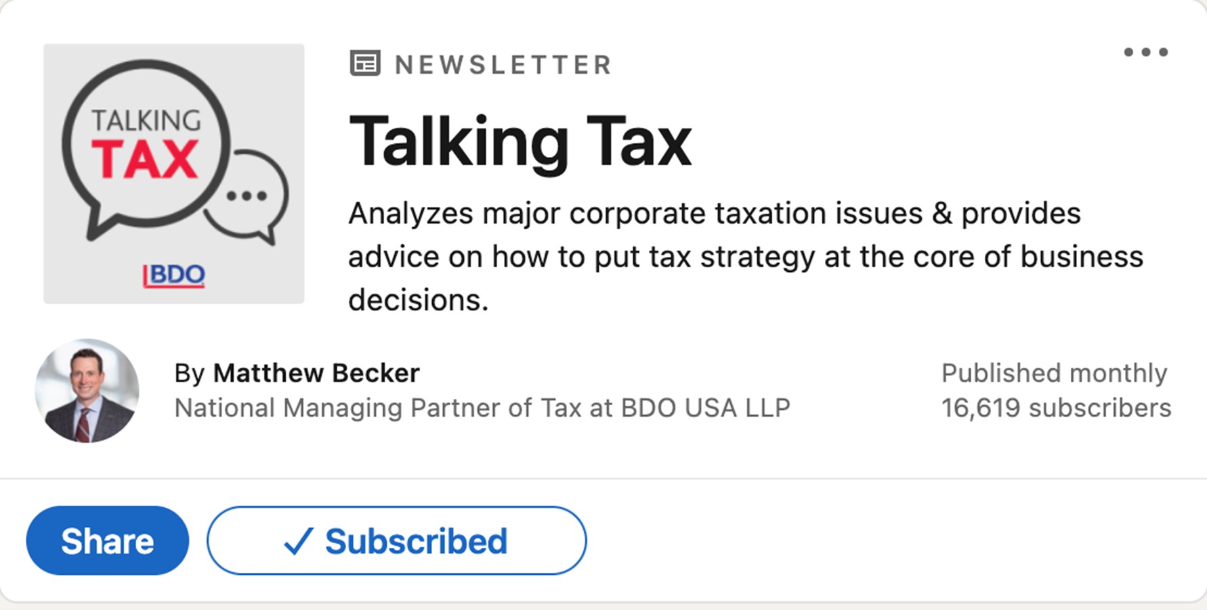
Personal + Business

Slide 45
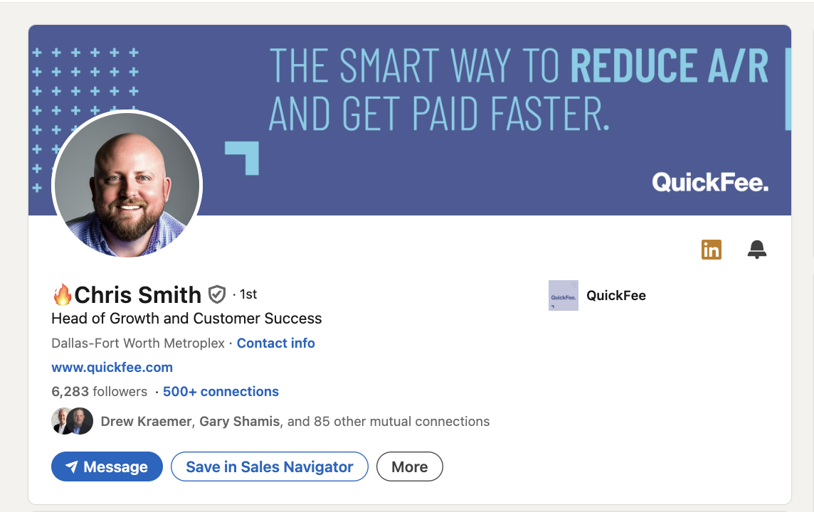
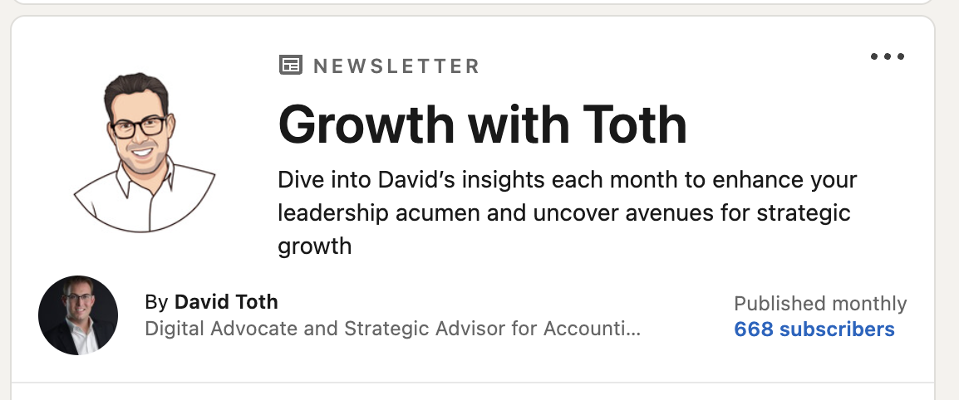
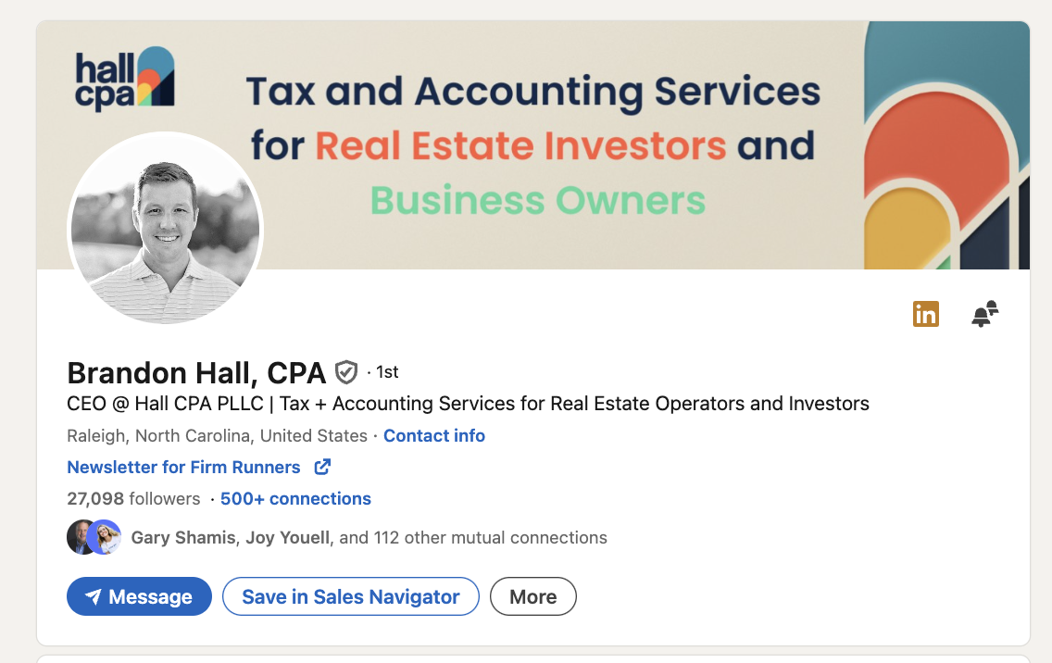
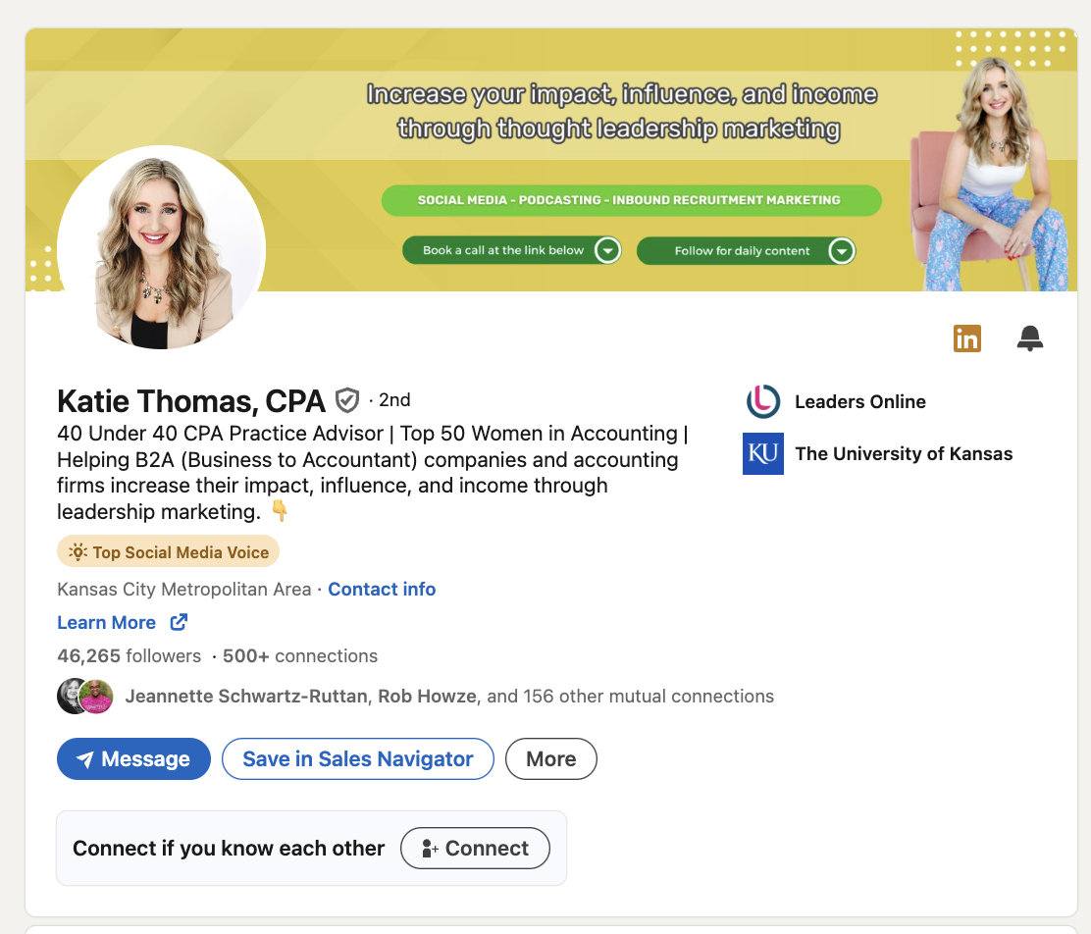
Personal + Business

Slide 46
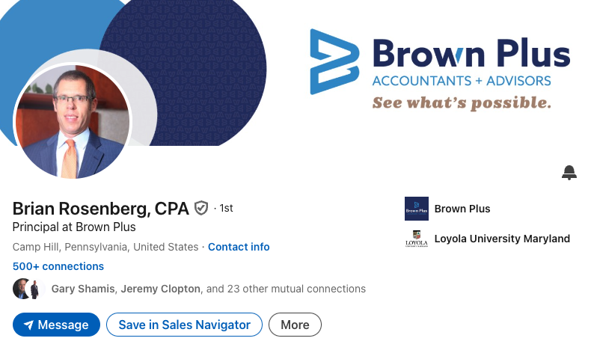
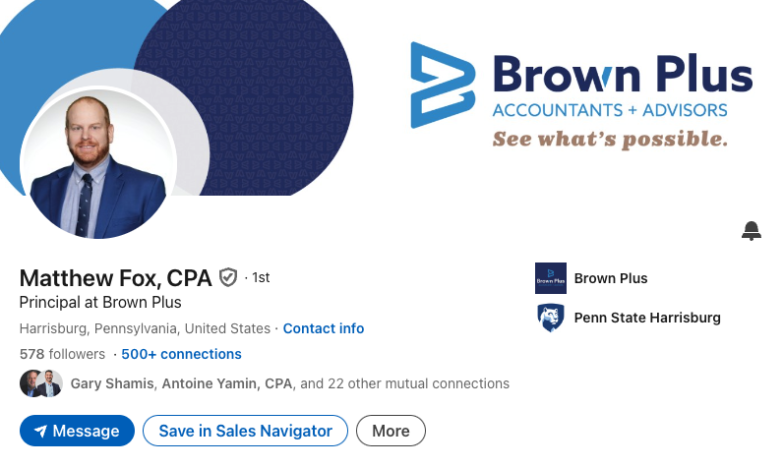
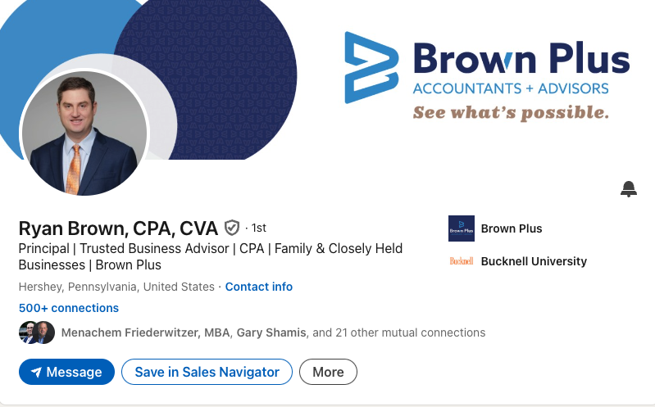
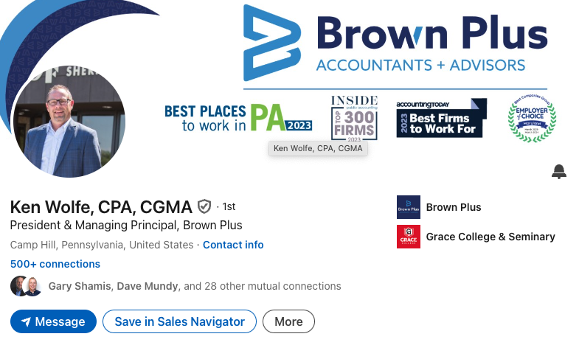
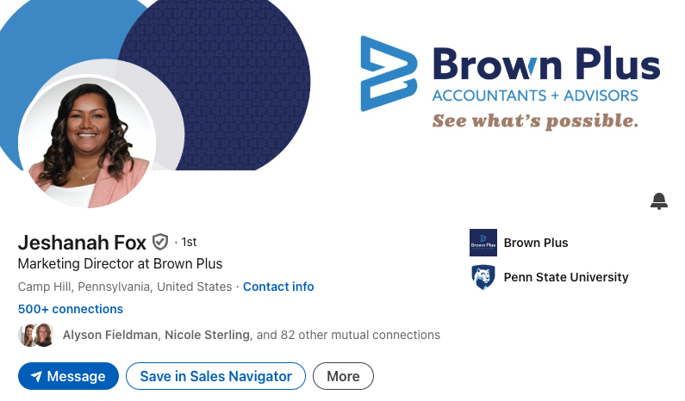

Slide 47
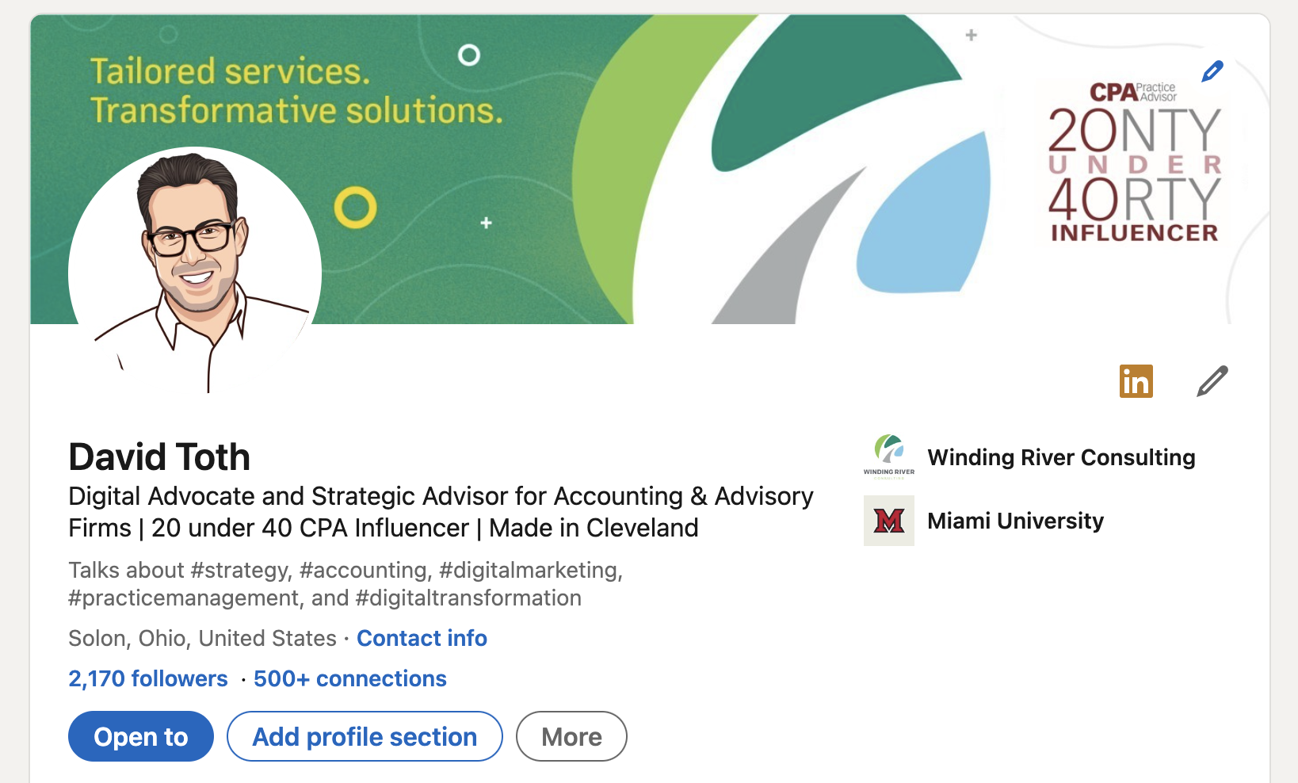
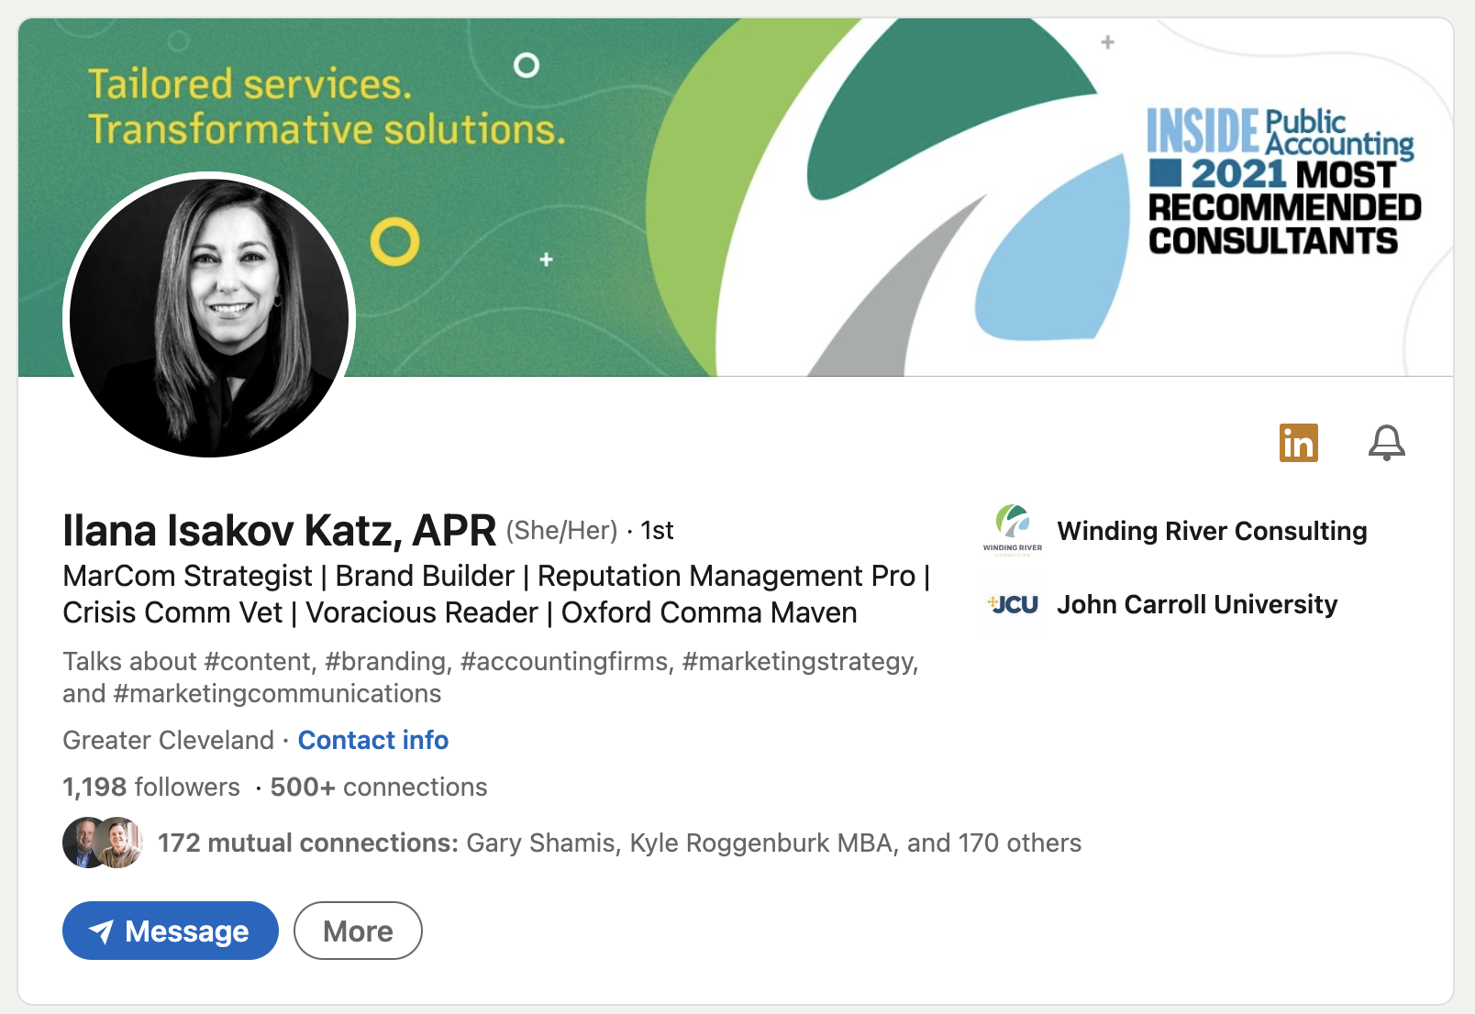
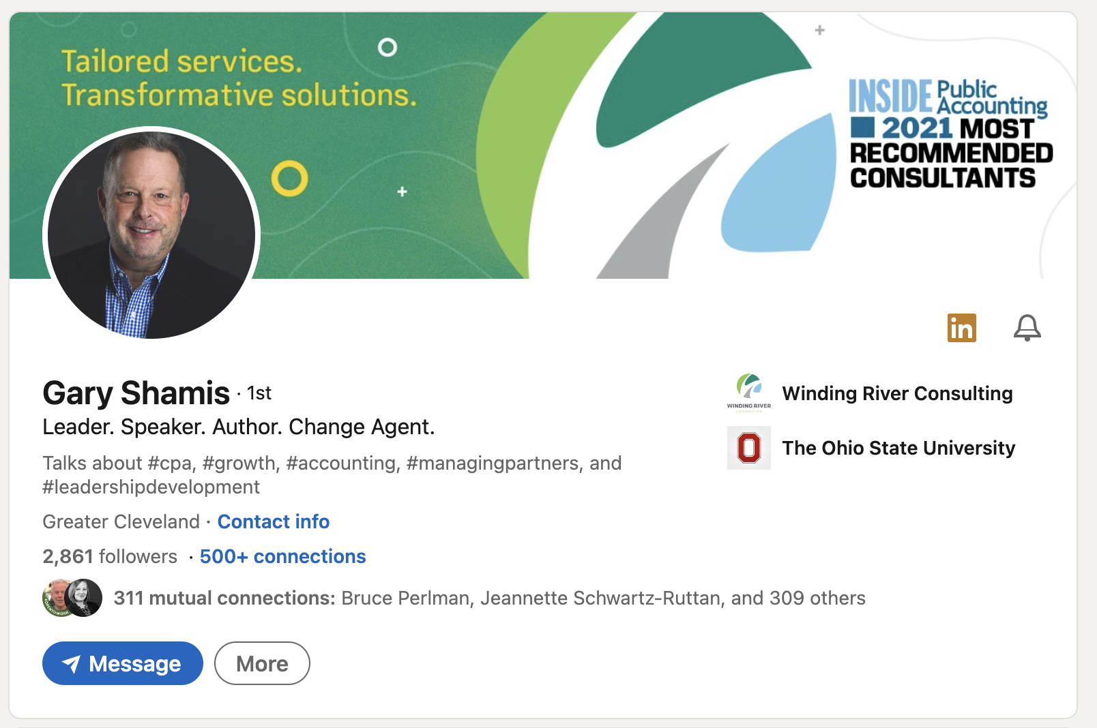

Slide 48
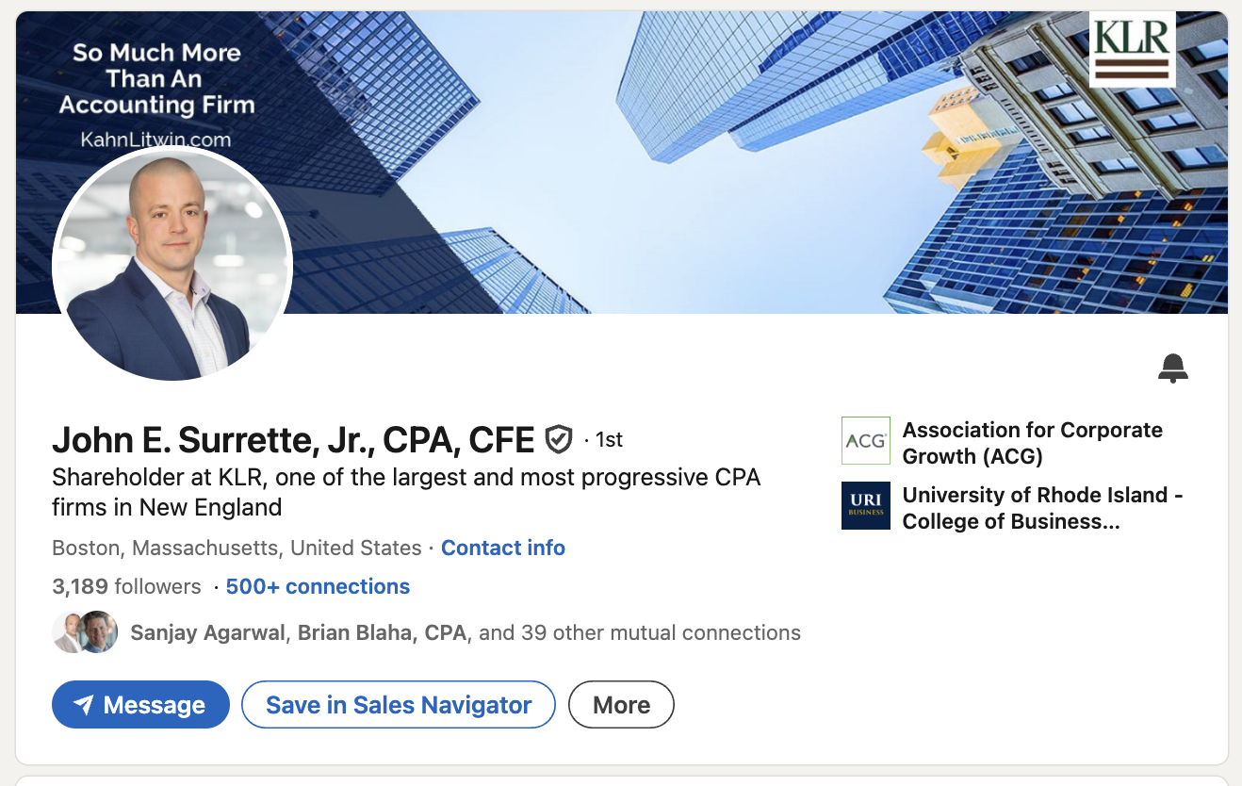
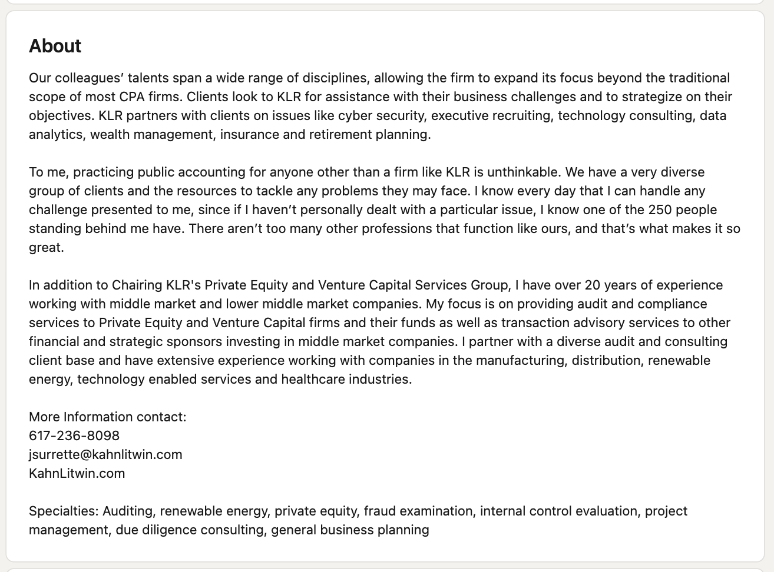
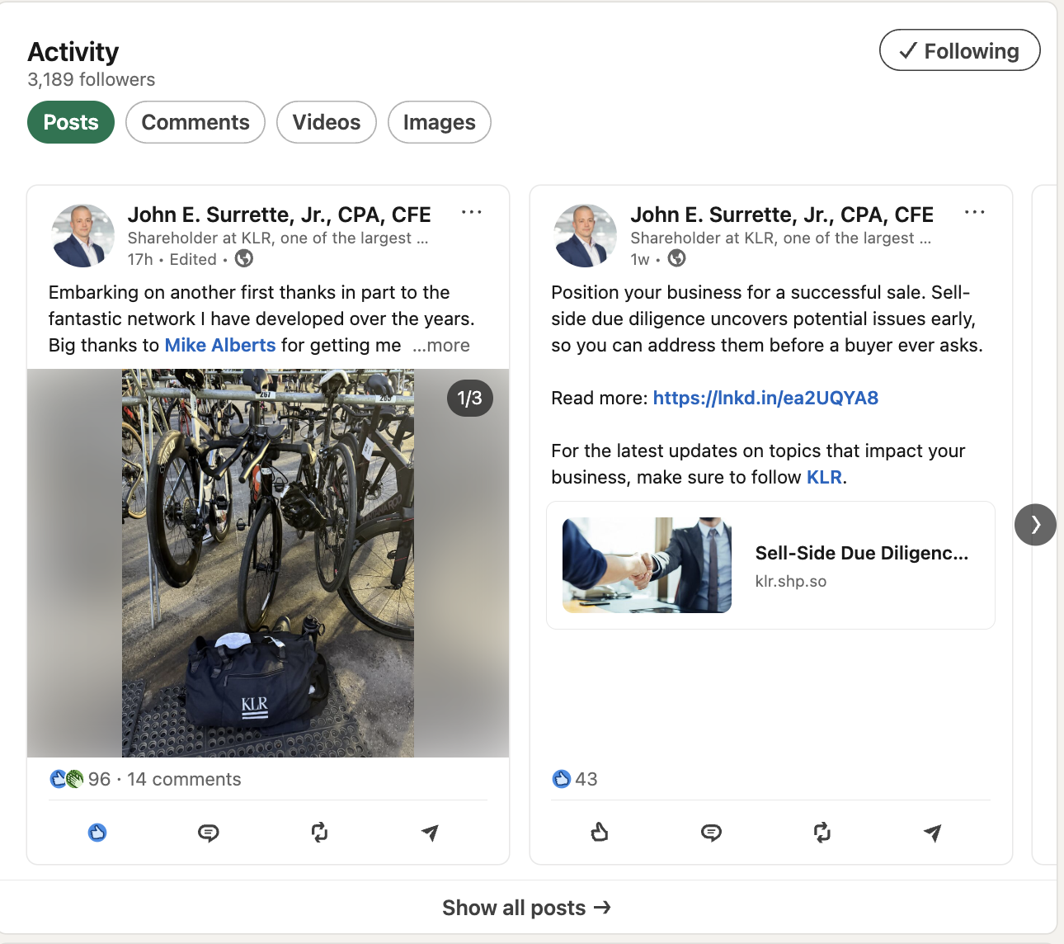
Notes:
(8) Courtney Bach, CPA | LinkedIn

Slide 49
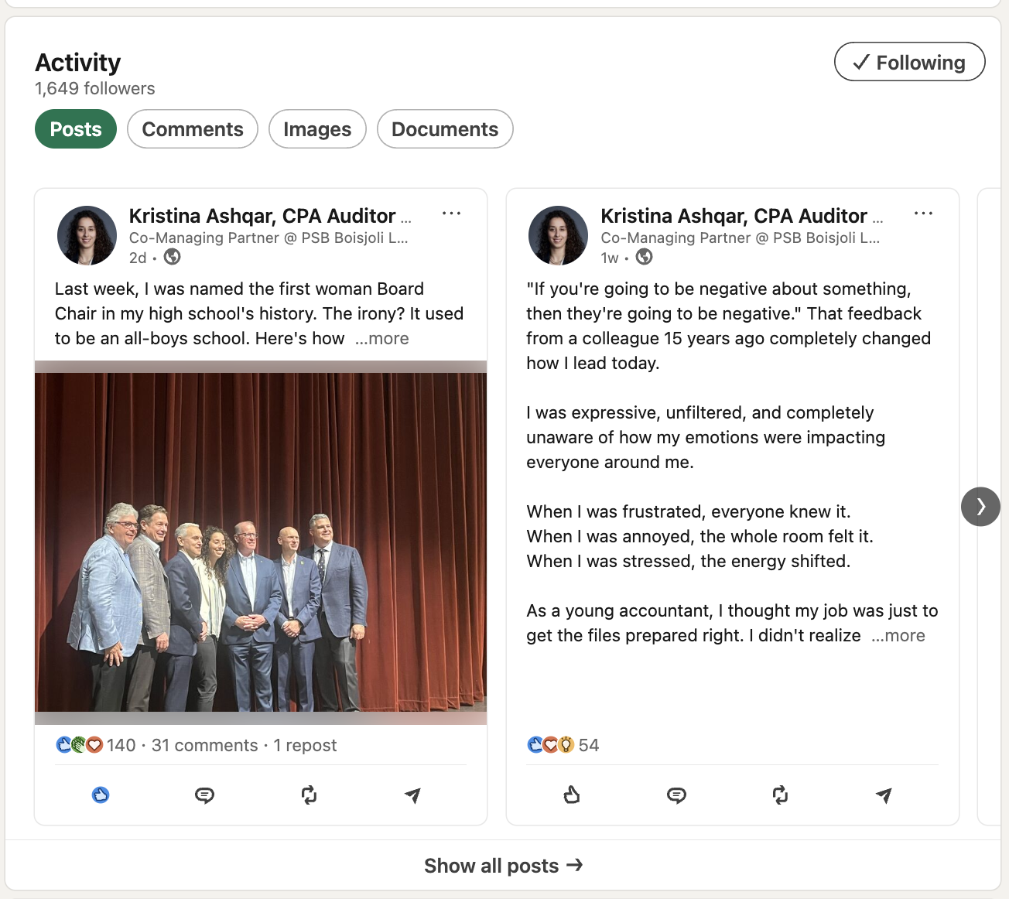
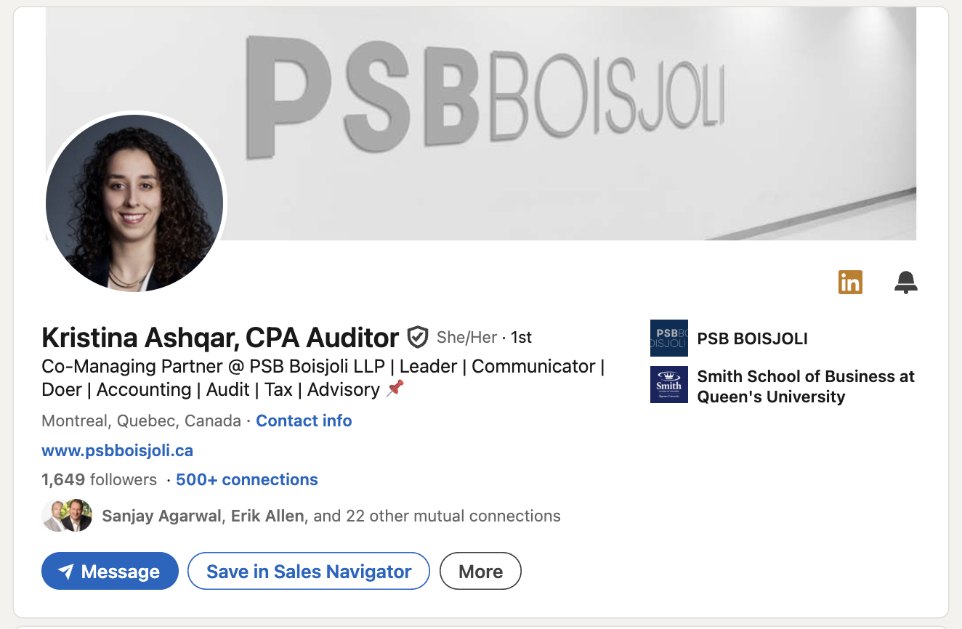
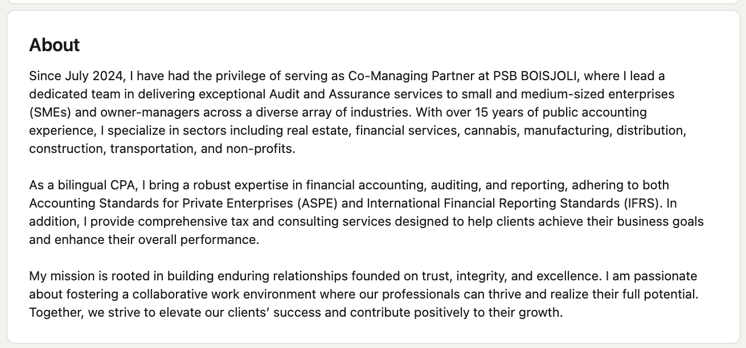
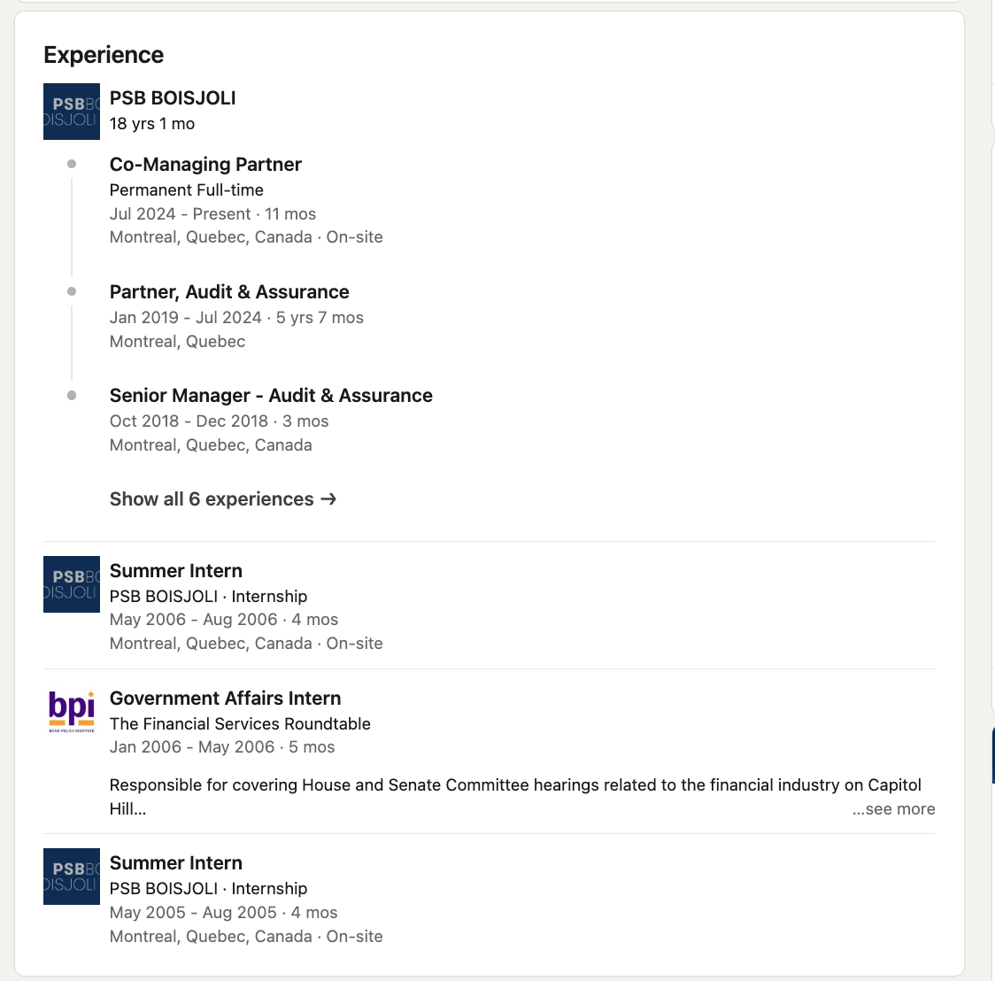
Notes:
(8) Courtney Bach, CPA | LinkedIn

Slide 50
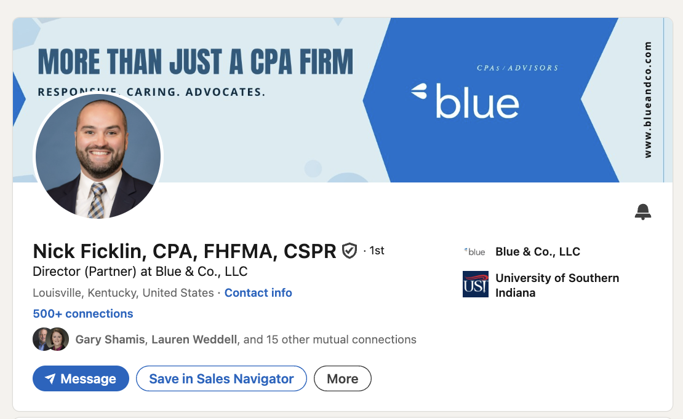
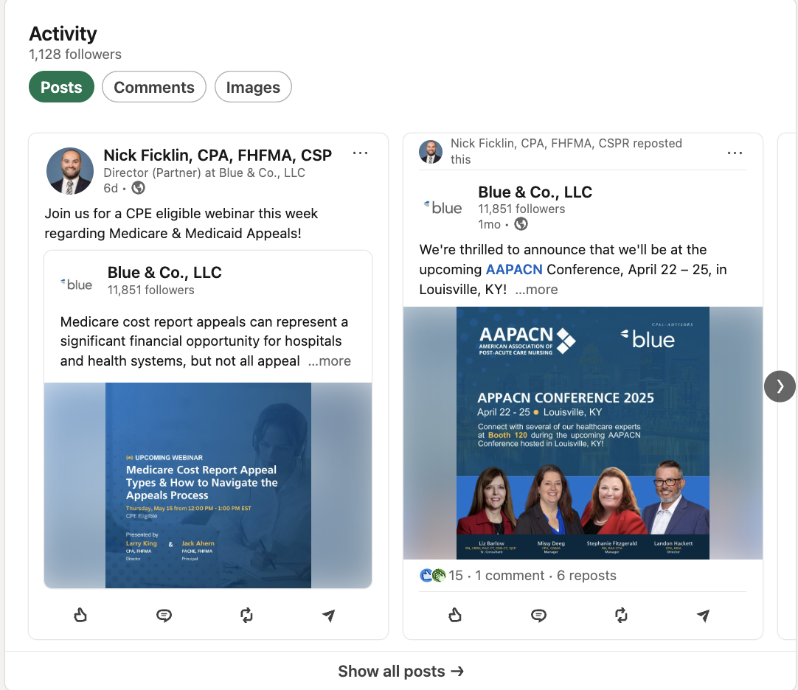


Notes:
(8) Courtney Bach, CPA | LinkedIn

Slide 51




Notes:
(8) Courtney Bach, CPA | LinkedIn

Slide 52



Notes:
(8) Courtney Bach, CPA | LinkedIn

Slide 53



Notes:
(8) Courtney Bach, CPA | LinkedIn

Slide 54



Notes:
(8) Courtney Bach, CPA | LinkedIn

Slide 55
Ways to Engage Personally
Follow your firm’s company page to ensure you receive notifications
Login to LinkedIn 3-5 times per week to check your feed and make new connections
Respond to comments and like or react to posts from industry leaders, authoritative pages, colleagues, and/or friends
Share content from authoritative sources on your feed (industry journals, Tier 1 news publications, accounting experts) – be sure to add commentary
Like, react, share your firm’s posts (you will be notified when the company page has a new post)
Join accounting and/or industry specific LinkedIn groups and regularly engage
Create your own new content with the goal of posting once a week
Tag firm, or tag individuals (using “@”) in work-related posts

Slide 56
LinkedIn Features

Slide 57

The Bell

Slide 58


Service Page

Slide 59

Tools

Slide 60




Who’s Viewed Your Profile

Slide 61



Newsletter

Slide 62


Video

Slide 63




Search Filters

Slide 64


Thank You
CONTACT
Dtoth@WindingRiverConsulting.com
p: 440.723.3653
f: 440.723.3654
SKILLS
Leader, Speaker, Influencer
Change Agent

