Slide 1


Executive Presence Personal Branding & LinkedIn
MPB | Leadership Accelerated
October, 2025
David M. Toth

Slide 2
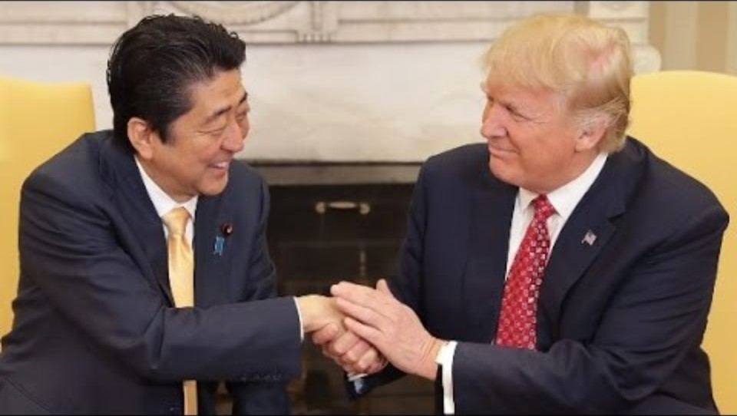
The Handshake
Notes:
Japanese Prime Minister Shinzo Abe

Slide 3
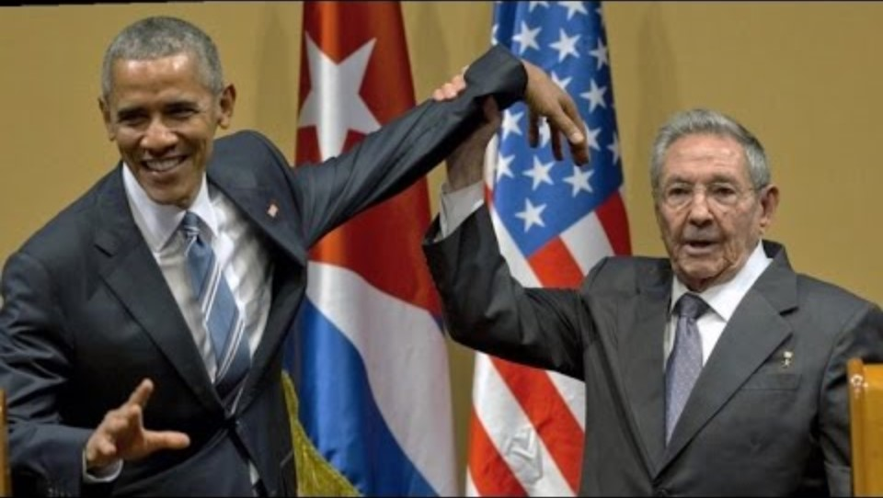
The Handshake
Notes:
Raul Castro

Slide 4
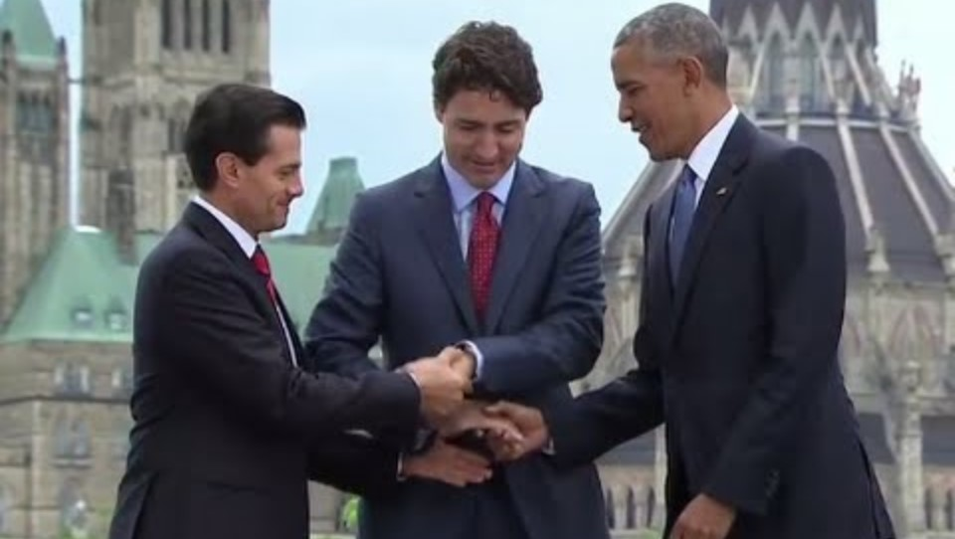
The Handshake
Notes:
Canadian prime minister Justin Trudeau
Mexican President Enrique Pena Nieto

Slide 5
Who has the most memorable handshake?

Slide 6
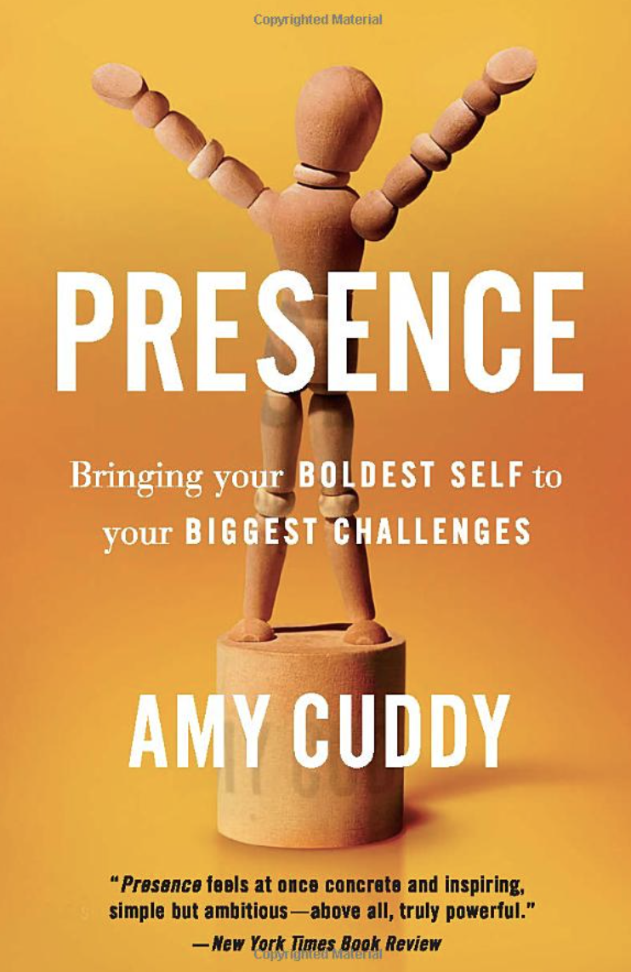
“The research I’ve been doing for years now joins a large body of inquiry into a quality I call presence. Presence stems from believing in and trusting yourself—your real, honest feelings, values, and abilities. That’s important, because if you don’t trust yourself, how can others trust you? Whether we are talking in front of two people or five thousand, interviewing for a job, negotiating for a raise, or pitching a business idea to potential investors, speaking up for ourselves or speaking up for someone else, we all face daunting moments that must be met with poise if we want to feel good about ourselves and make progress in our lives. Presence gives us the power to rise to these moments."

Slide 7
Your posture is evidence of how you feel about yourself, and by improving it, even right now, you will become more self-confident.

Slide 8
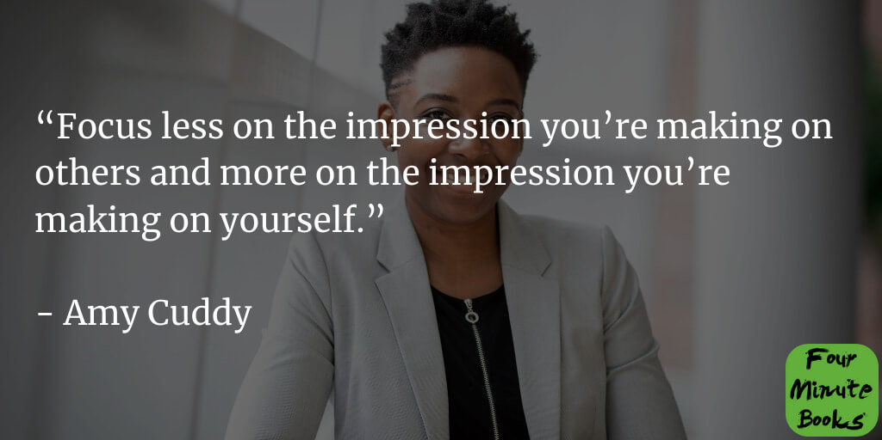

Slide 9
Executive Presence

Slide 10
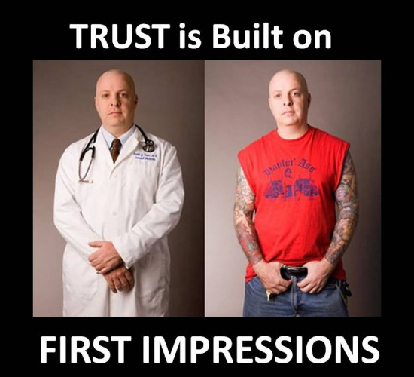
First Impressions

Slide 11

Executive Presence
Easy to recognize, hard to define
Appearance
Communication
Gravitas
Notes:
Inspire Confidence

Slide 12
Executive presence is about your ability to inspire confidence:
Inspiring confidence in your subordinates that you’re the leader they want to follow
Inspiring confidence among peers that you’re capable and reliable
Inspiring confidence among senior leaders that you have the potential for great achievements.

Slide 13
Your Executive Presence
How would you characterize your own Presence?
I’m good!
Not bad, could be better.
Oh, boy!
Huh?

Slide 14

1: Appearance
The way you show up.
Appropriate attire - style, wrinkles, rips, stains
Hygiene - dental, too much cologne (not enough)
Grooming - hair, nails, make up, jewelry
How you act - composed, calm
Organized
Posture - confident
Body language/Demeanor - eye contact, hand gestures
Facial expressions
Symmetry
Stillness

Slide 15

2: Communication
The way you speak and listen.
Voice - tone, pitch, pace
Word choices
Apologetic
Overusing tired clichés
Substituting a question for a sentence
Fillers - ummmmmm
Present - body language, distractions
Focused, open, curious, listening, and energetic
Self-aware
Silence

Slide 16

3: Gravitas
The way you behave. A sum of the weight of your personality and confidence.
A carefully cultivated skill
Self (quiet) confidence
Charm/Charisma - warm, engaging
Positive energy/Optimism
Calm and consistent
Engaging

Slide 17
Let’s Get Personal Your Brand

Slide 18
A Brand…
is more than just a name, logo, or product.
It's the overall perception and emotional connection a customer has with a company, product, or service.
It encompasses the public's feeling, opinions, and experiences, influencing how they perceive its value, quality, and overall identity.
A brand is what people think it is, not just what the company says it is.

Slide 19
What others say about you when you’re not in the room.

Slide 20
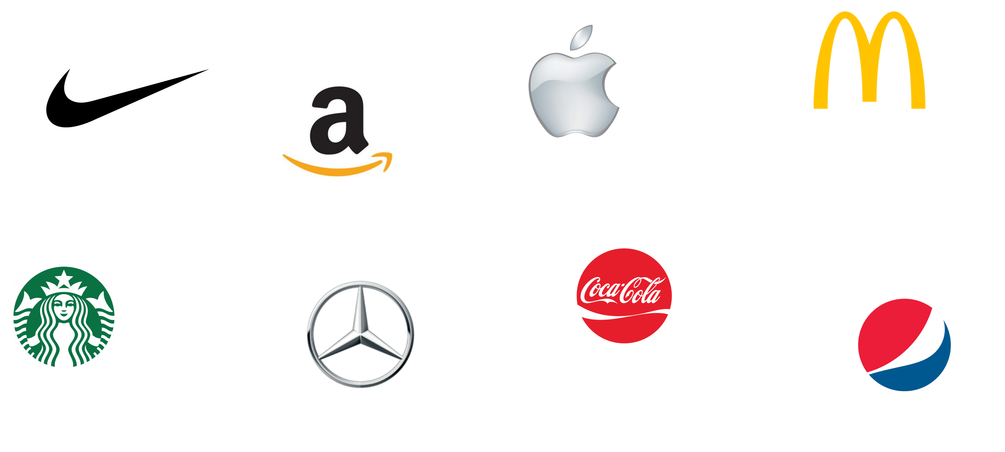
Notes:
A strong brand builds positive associations in people's minds, while a logo serves as a visual cue to trigger those associations.
Pause on recognition
“Take a second and look at these logos. Without me saying anything, you already have feelings and assumptions about each.”
Highlight immediacy
“Notice how fast that happened. That’s the power of a brand — it bypasses facts and goes straight to perception.”
Make it personal
“Now think about this: when people hear your name in a closed-door meeting — what comes to mind that quickly? That’s your personal brand at work.”
Perception > Product. Most people haven’t even used every one of these brands personally, but they believe something about them (luxury, reliability, value, innovation) because of brand narrative.
Your brand works the same way. Colleagues, clients, and future partners form opinions about you — often before they’ve worked deeply with you — based on signals, reputation, and word of mouth.

Slide 21
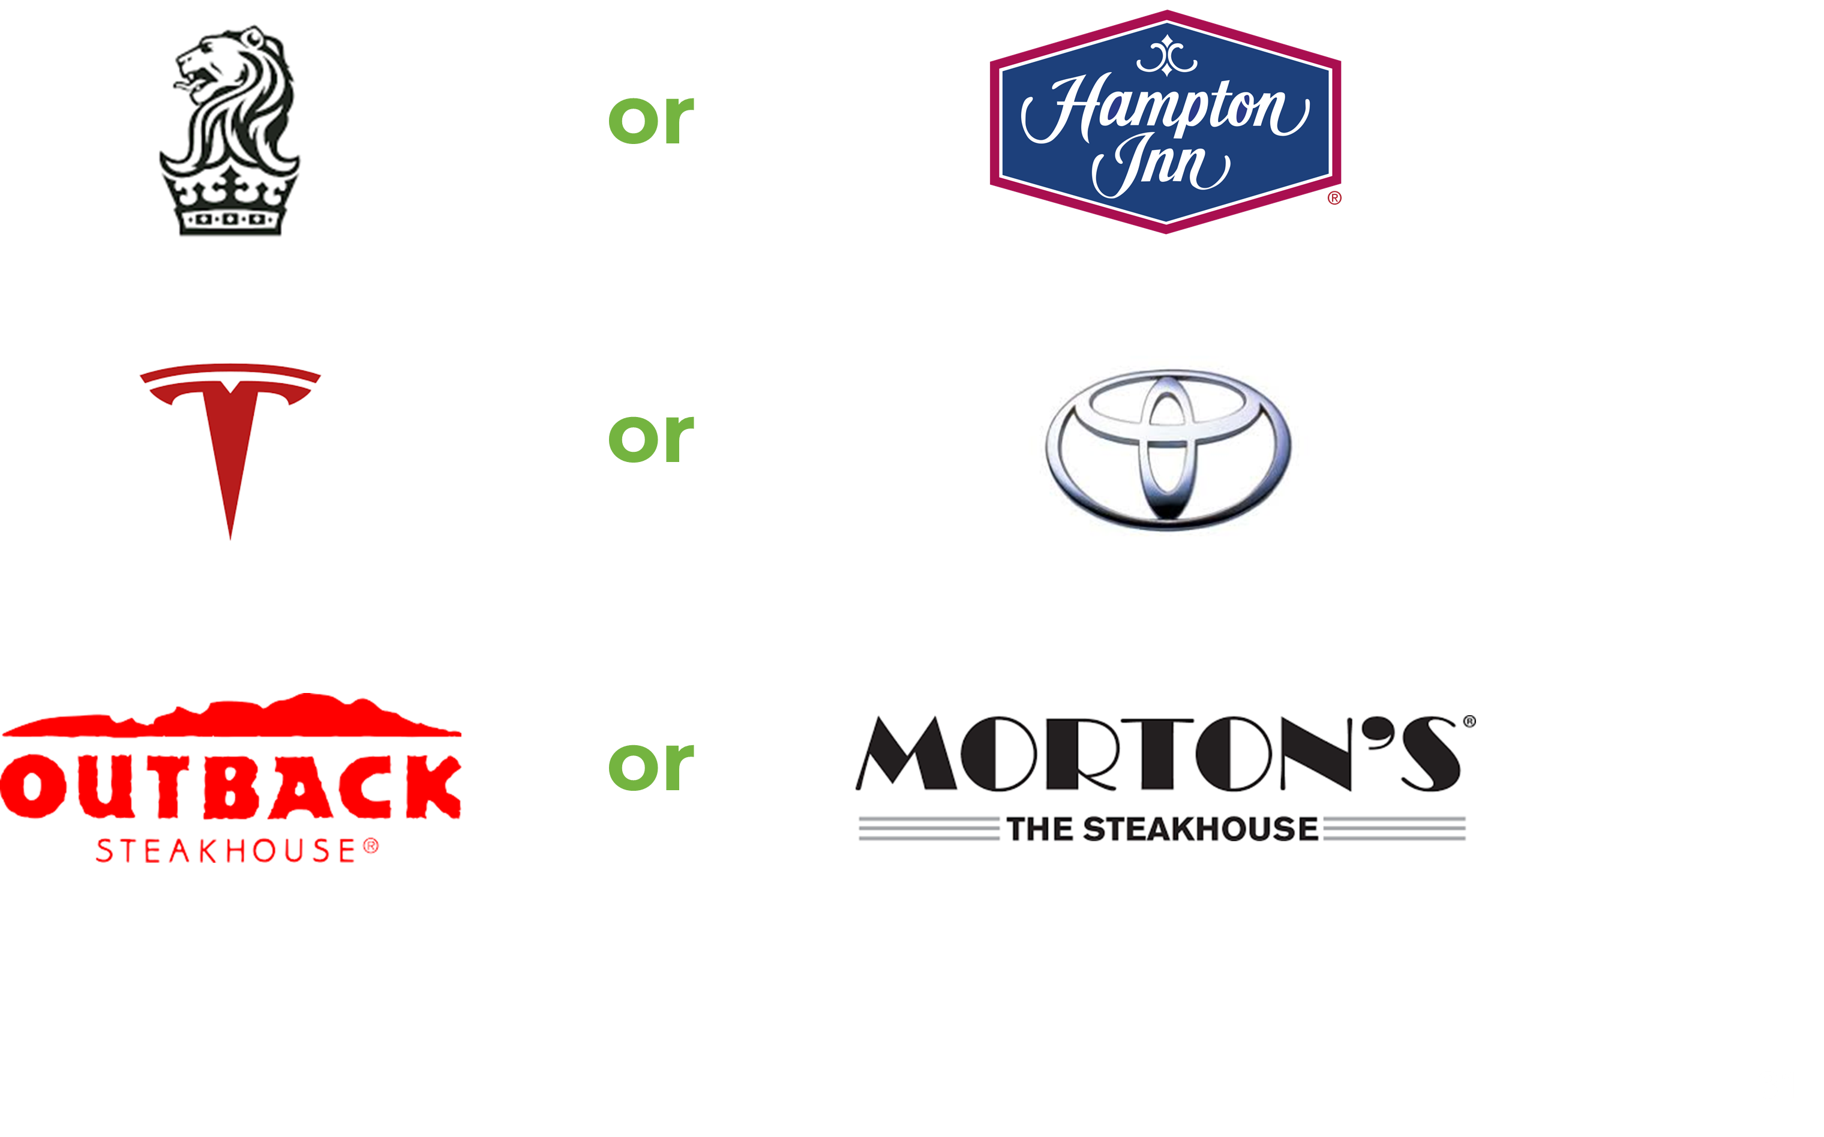
Notes:
Why Ritz vs. Hampton Works
Both sell the same core product: a place to sleep.
Hampton Inn = clean, consistent, predictable, affordable. It gets the job done.
Ritz-Carlton = luxury, status, “ladies and gentlemen serving ladies and gentlemen.” It isn’t about the bed — it’s about the experience, prestige, and emotional memory.
Price premium: Hampton Inn ~$150/night. Ritz-Carlton ~$700/night. Not because of better mattresses, but because of the brand promise.
Why Tesla vs. Toyota Works
Both make cars. Toyota builds ~6x more cars, but Tesla owns the conversation. (11million vs 1.8)
Toyota = scale, reliability, consistency. When someone says “Toyota,” you think dependable, practical, proven, safe bet.
Tesla = innovation, boldness, future-facing. “Tesla” evokes status, disruption, cutting-edge tech, visionary leadership.
Valuation gap. Despite Toyota’s scale, Tesla has often been valued higher on Wall Street because of perception of future potential, not current production.
Outback vs Mortons
Same product category, very different positioning → both serve steak, but the perception gap is huge.
Price anchor → Morton’s commands a 3–4x premium not because of raw materials, but because of brand promise.
Experience cue → Outback signals casual, accessible, family-friendly. Morton’s signals exclusivity, refinement, business dinners.
Emotional shorthand → When someone says “let’s go to Morton’s,” you instantly imagine a high-stakes dinner, not just a meal.

Slide 22
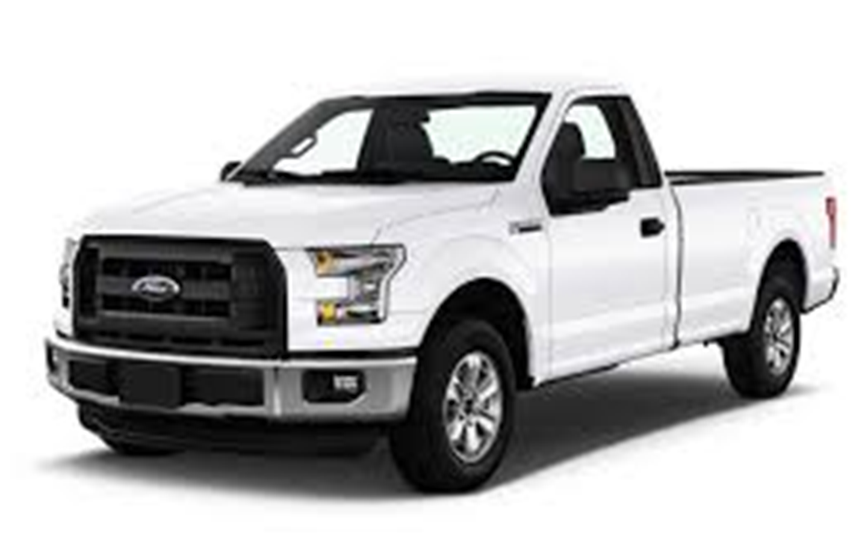
Notes:
he 2024 J.D. Power U.S. Automotive Brand Loyalty Study shows 65.1% of Ford truck owners (predominantly F‑Series buyers) repurchased within the brand—leading the pack.

Slide 23
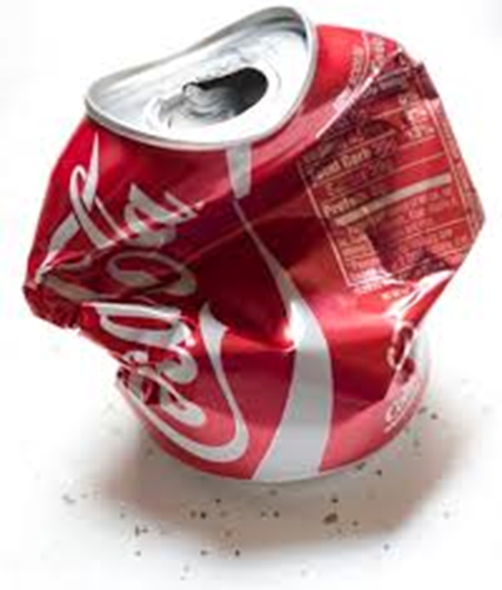
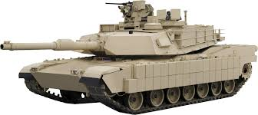
Notes:
Aluminum is a commodity. So how do you differentiate?
Leverages authority
Reality: The material isn’t magical—it’s aluminum. It has pros (lighter weight, corrosion resistance) and cons (more expensive repairs, different dent characteristics).
Perception: The truck now feels futuristic, high-tech, and rugged. The story neutralized skeptics and gave Ford a talking point that competitors struggled to counter.
Net result: They reframed a potential liability (using aluminum instead of steel) into a brand strength—and loyalty numbers show it stuck.
Coke cans and tanks share aluminum, but Ford turned “commodity metal” into a differentiator through brilliant brand framing. They sold the story more than the substance—and the market rewarded them.

Slide 24
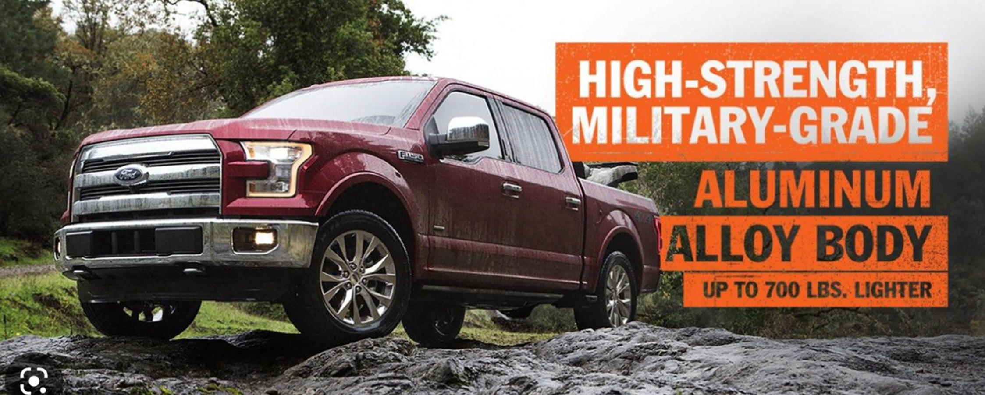

Slide 25
YOUR Brand
Notes:
Personal branding is becoming less of a competitive edge and more of a requirement for anyone looking to grow their business; get that dream job; or take their career to the next level.

Slide 26
Personal (Business) Brand
Your brand is how people perceive you compared to others in like roles.
Who are you?
What do you do?
What’s most important to you?
What do you stand for?
What value do you bring?
Why do people like you?
Why do people trust you?
What is a non-negotiable?
How and where do you communicate it?
How would people describe you?

Slide 27
Overlap*
You
Your Profile
Firm
Company Profile
*Articles, announcements, events, deadlines, industry changes/updates, new hires, etc.

Slide 28
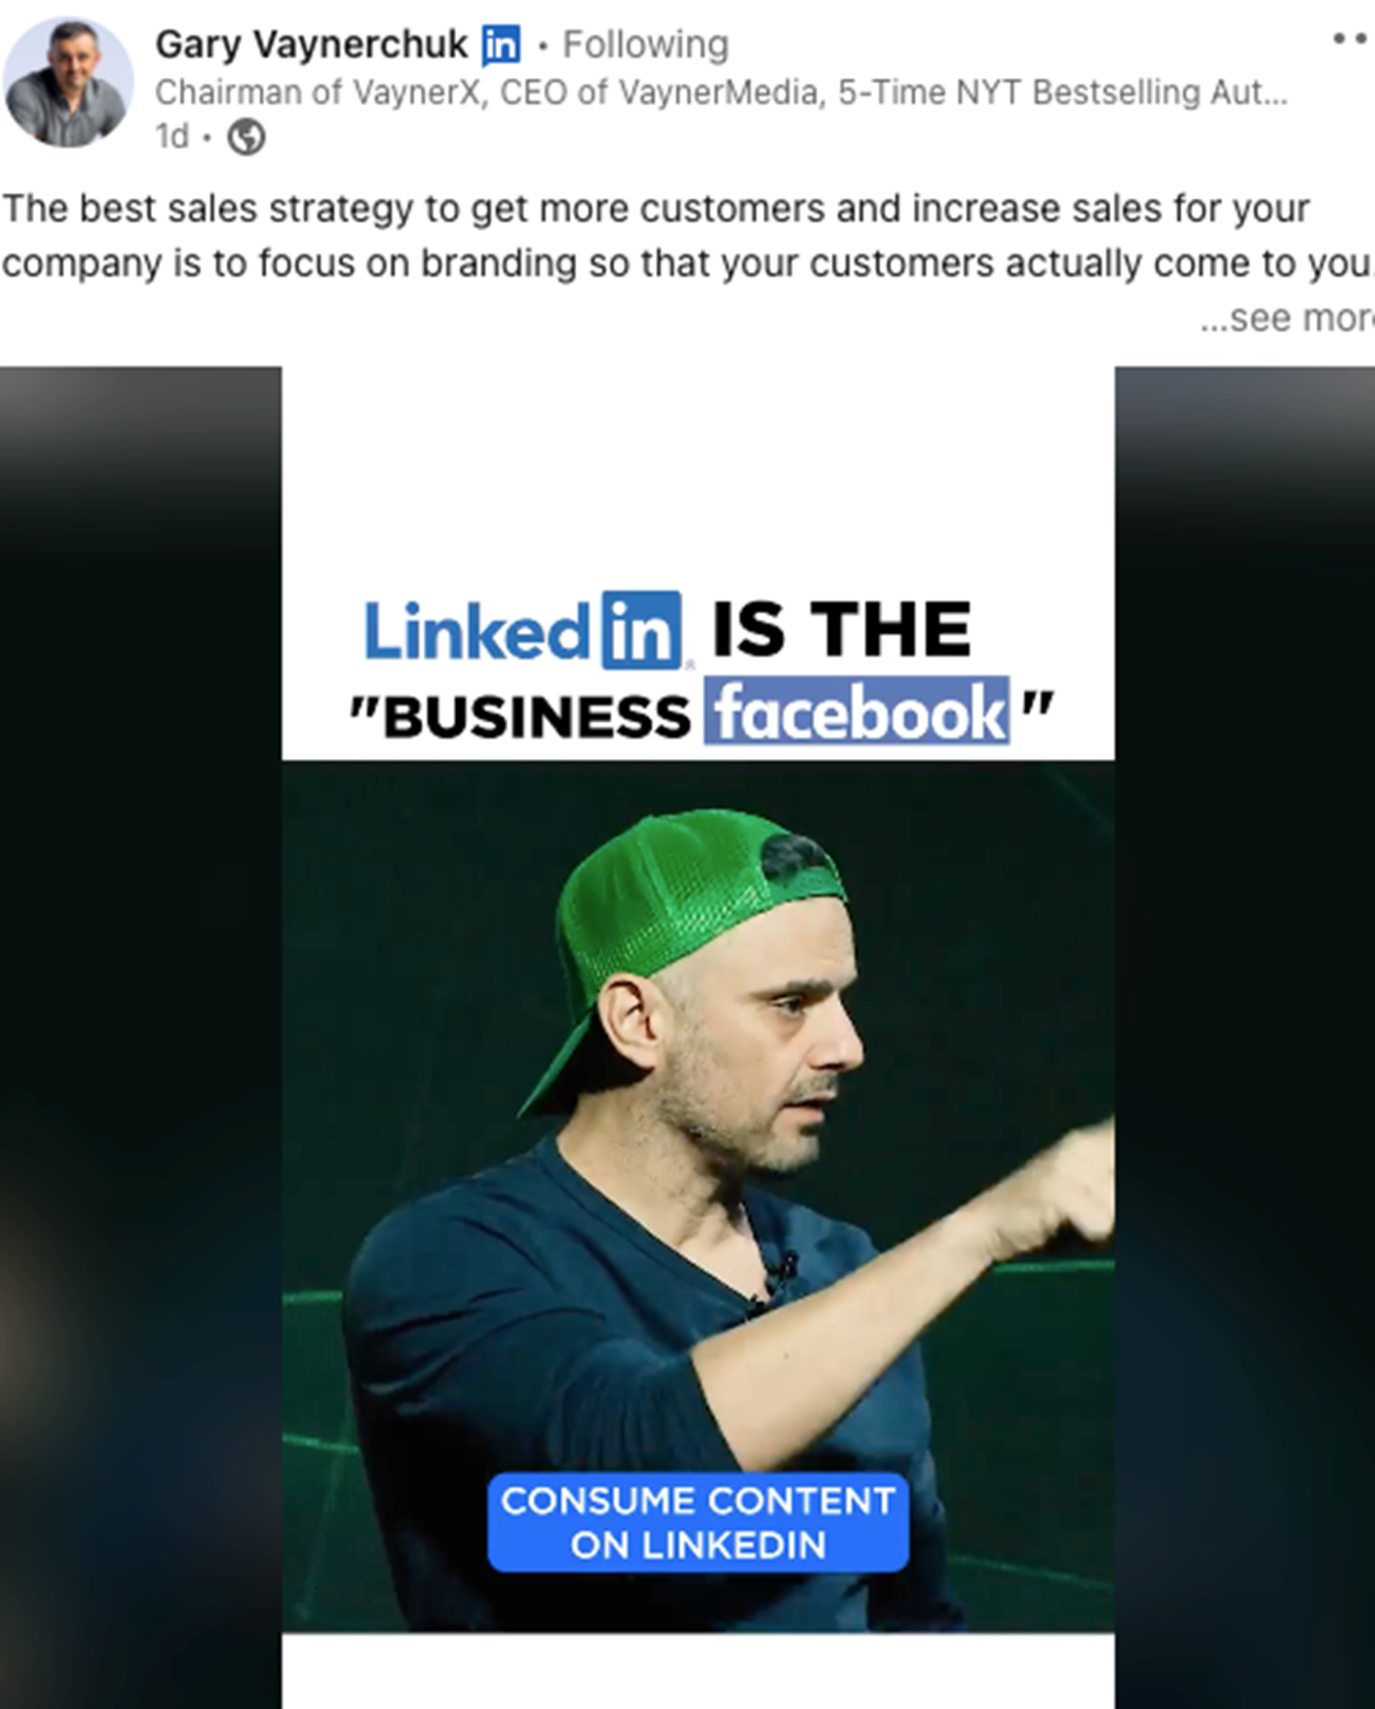
Your DIGITAL (Personal) Brand

Slide 29
80%

Slide 30
40% of monthly active users visit LinkedIn daily.
4 out of 5 people on LinkedIn “drive business decisions”
Americans aged 30 to 49 used LinkedIn the most
LinkedIn posts with images see 2x higher comment rates
82% of B2B marketers see success on LinkedIn

Slide 31
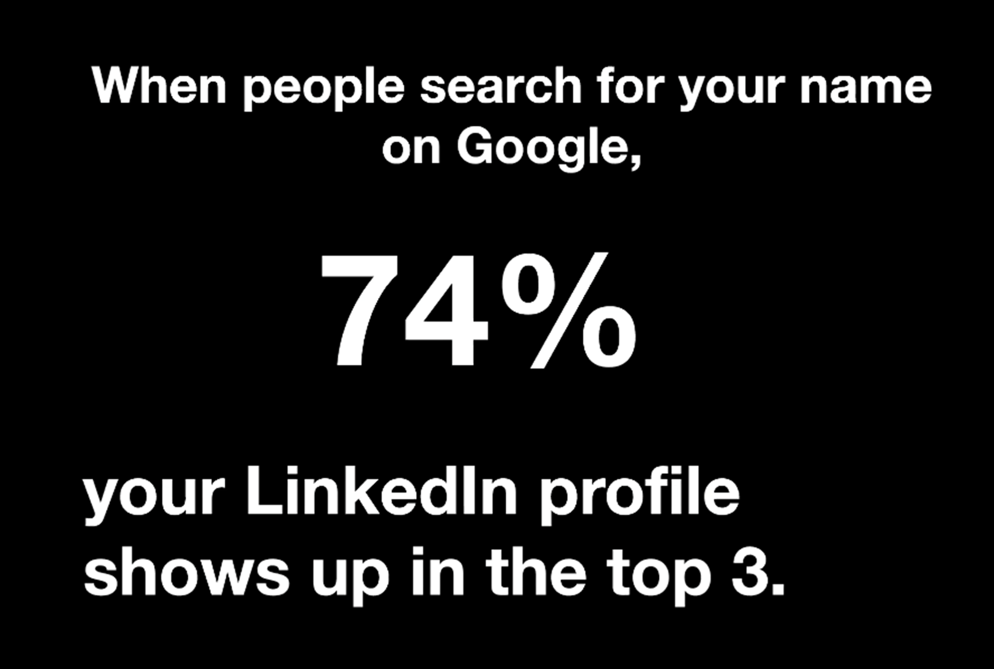
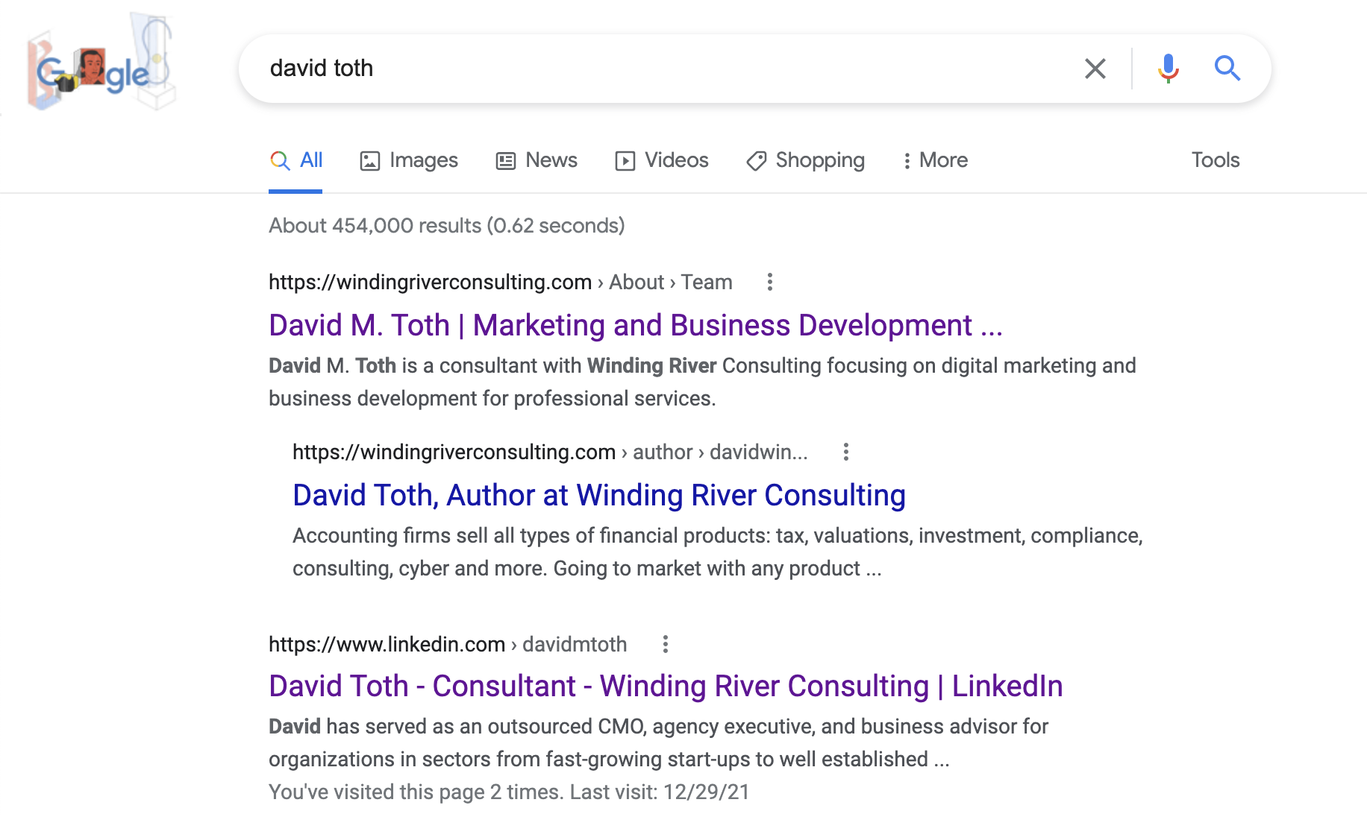

Slide 32
Social Selling
Establish your professional brand - Complete your profile with the customer in mind. Become a thought-leader by publishing meaningful posts.
Find the right people - Identify better prospects in less time using efficient search and research tools
Engage with insights - Discover and share conversation-worthy updates to create and grow relationships.
Build relationships - Strengthen your network by connecting and establishing trust with decision makers

Slide 33
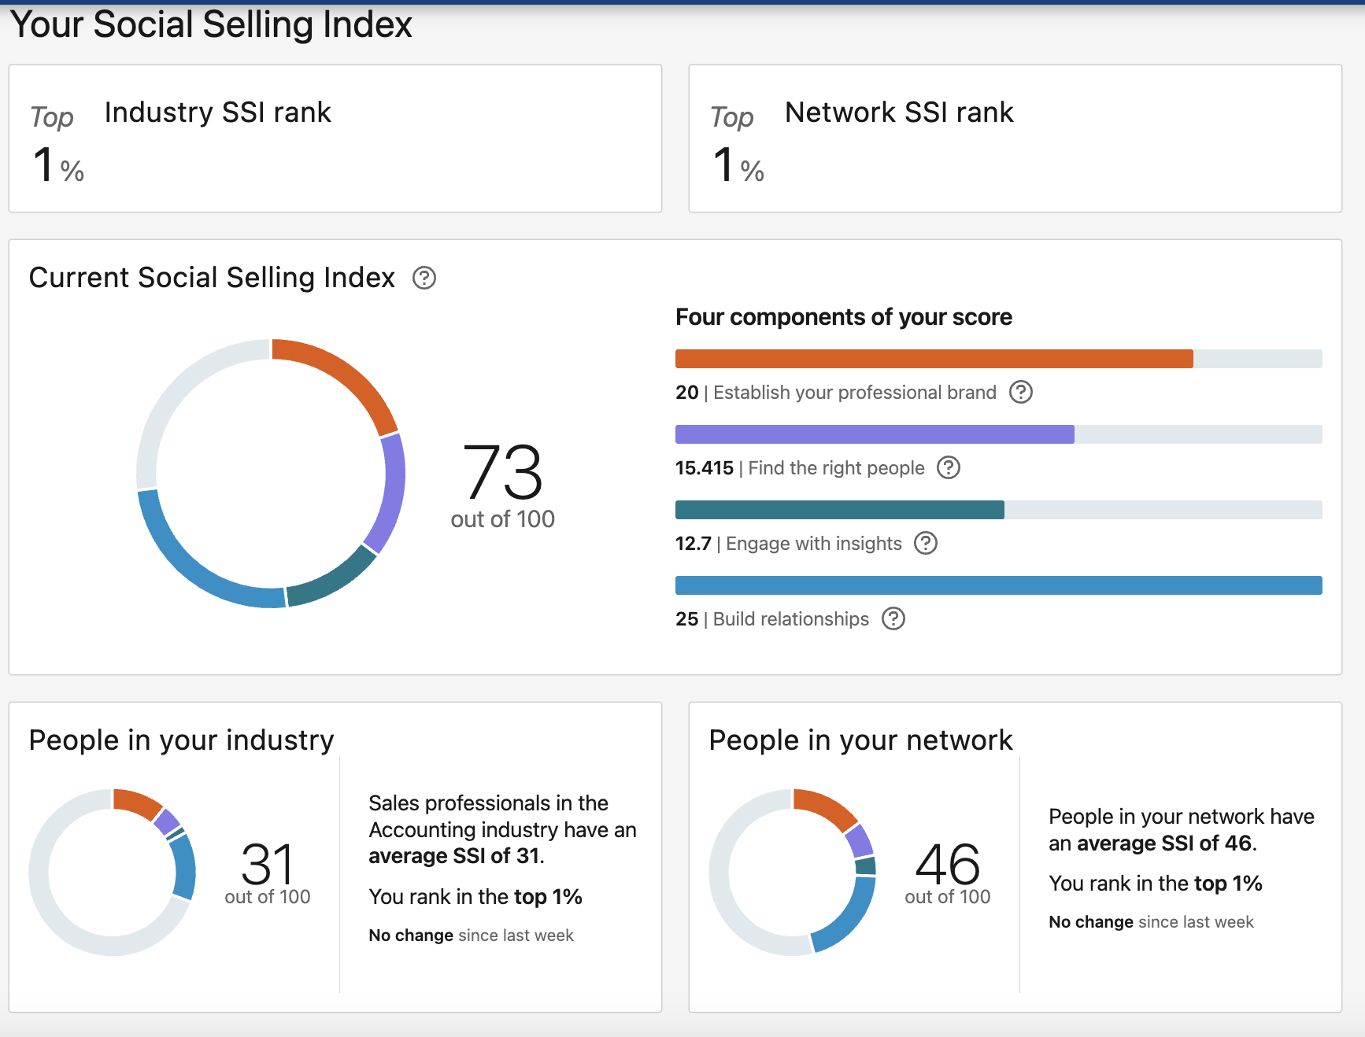
Social Selling Index Score
The Social Selling Index (SSI) | LinkedIn Sales Solutions

Slide 34
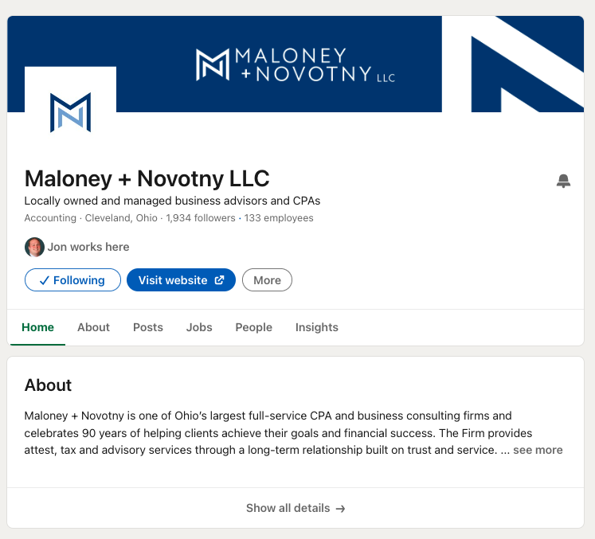
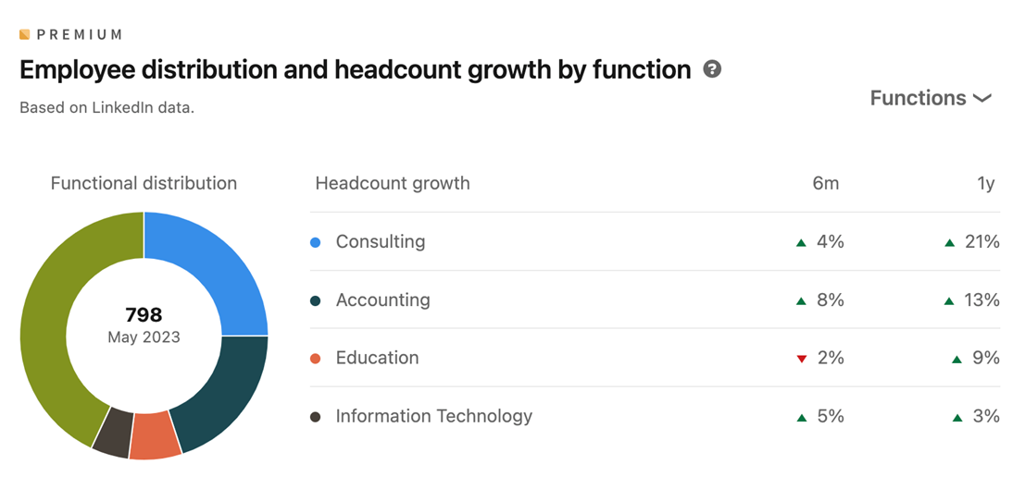
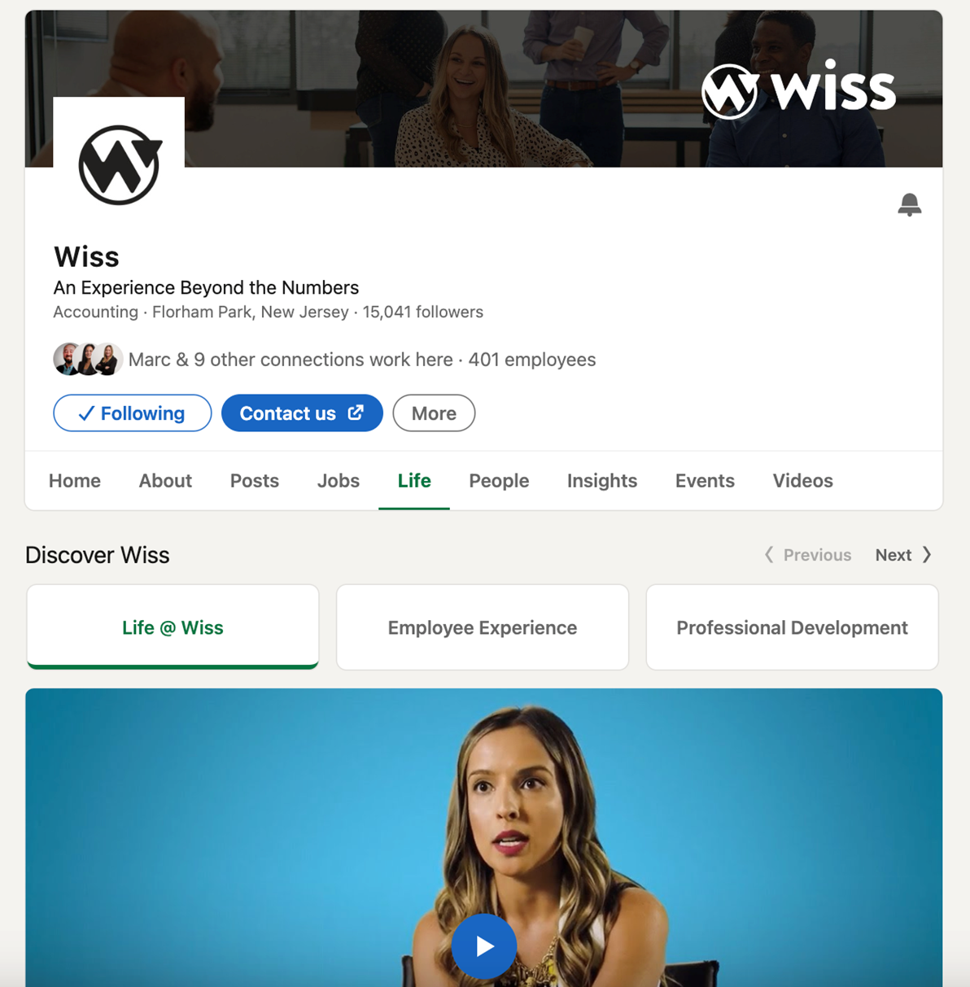
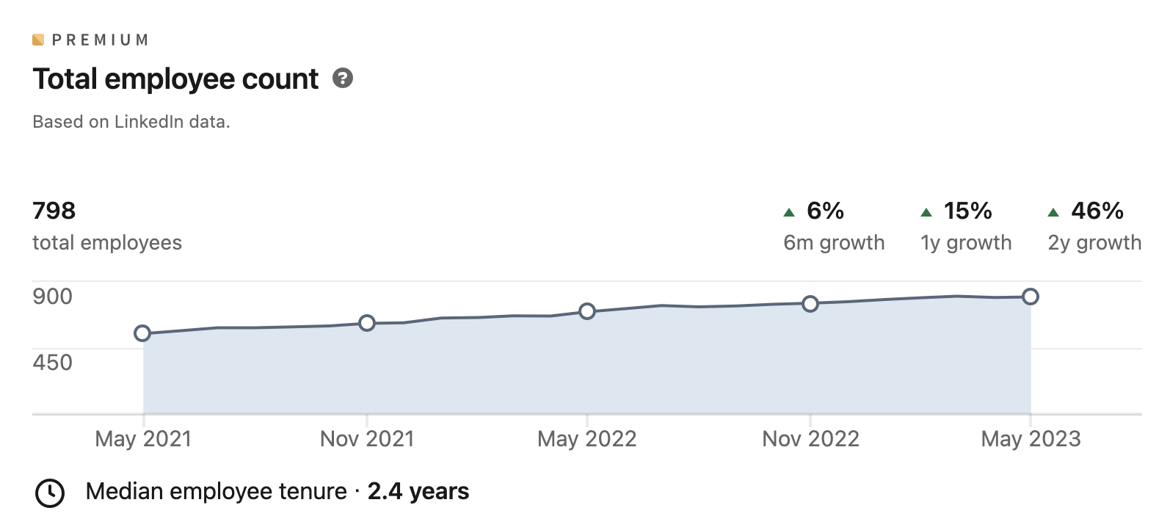
A Business Page

Slide 35
Personal vs Business
 | Personal Page | Business Page
Purpose | Showcase individual skills and experience | Promote a company, its brand, and culture
Who it represents | Individuals | Organizations
Focus | Your career journey, achievements, and qualifications | Company information, products, services, and news
Connections | Build a network of professional contacts | Grow brand awareness and attract followers
Engagement | High (through comments, likes, and shares) | Lower (organic reach can be limited)
Content | A mix of professional and personal content (articles, updates, discussions) | Company updates, job postings, industry news, and thought leadership content
Activity | Can actively connect with others, join groups, participate in discussions | Limited activity options
Advertising | Limited paid advertising options | Access to a wider range of paid advertising features
Analytics | Provides insights into your profile views and engagement | Provides insights into page views, follower demographics, and content performance

Slide 36
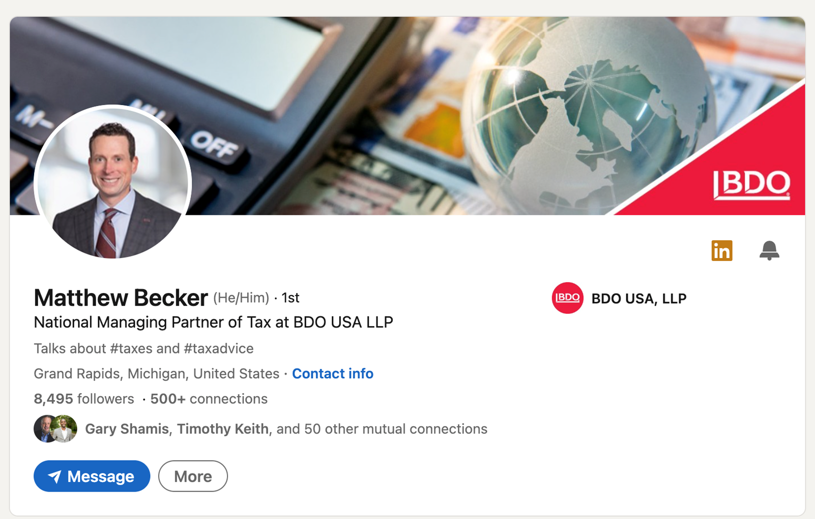
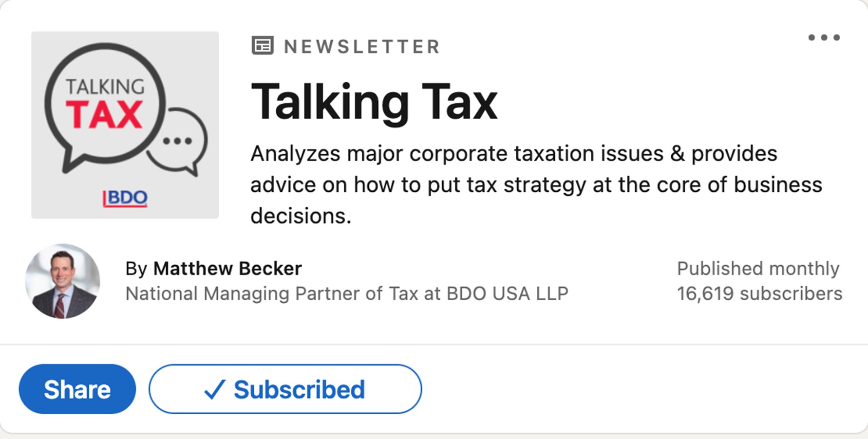
Personal + Business

Slide 37
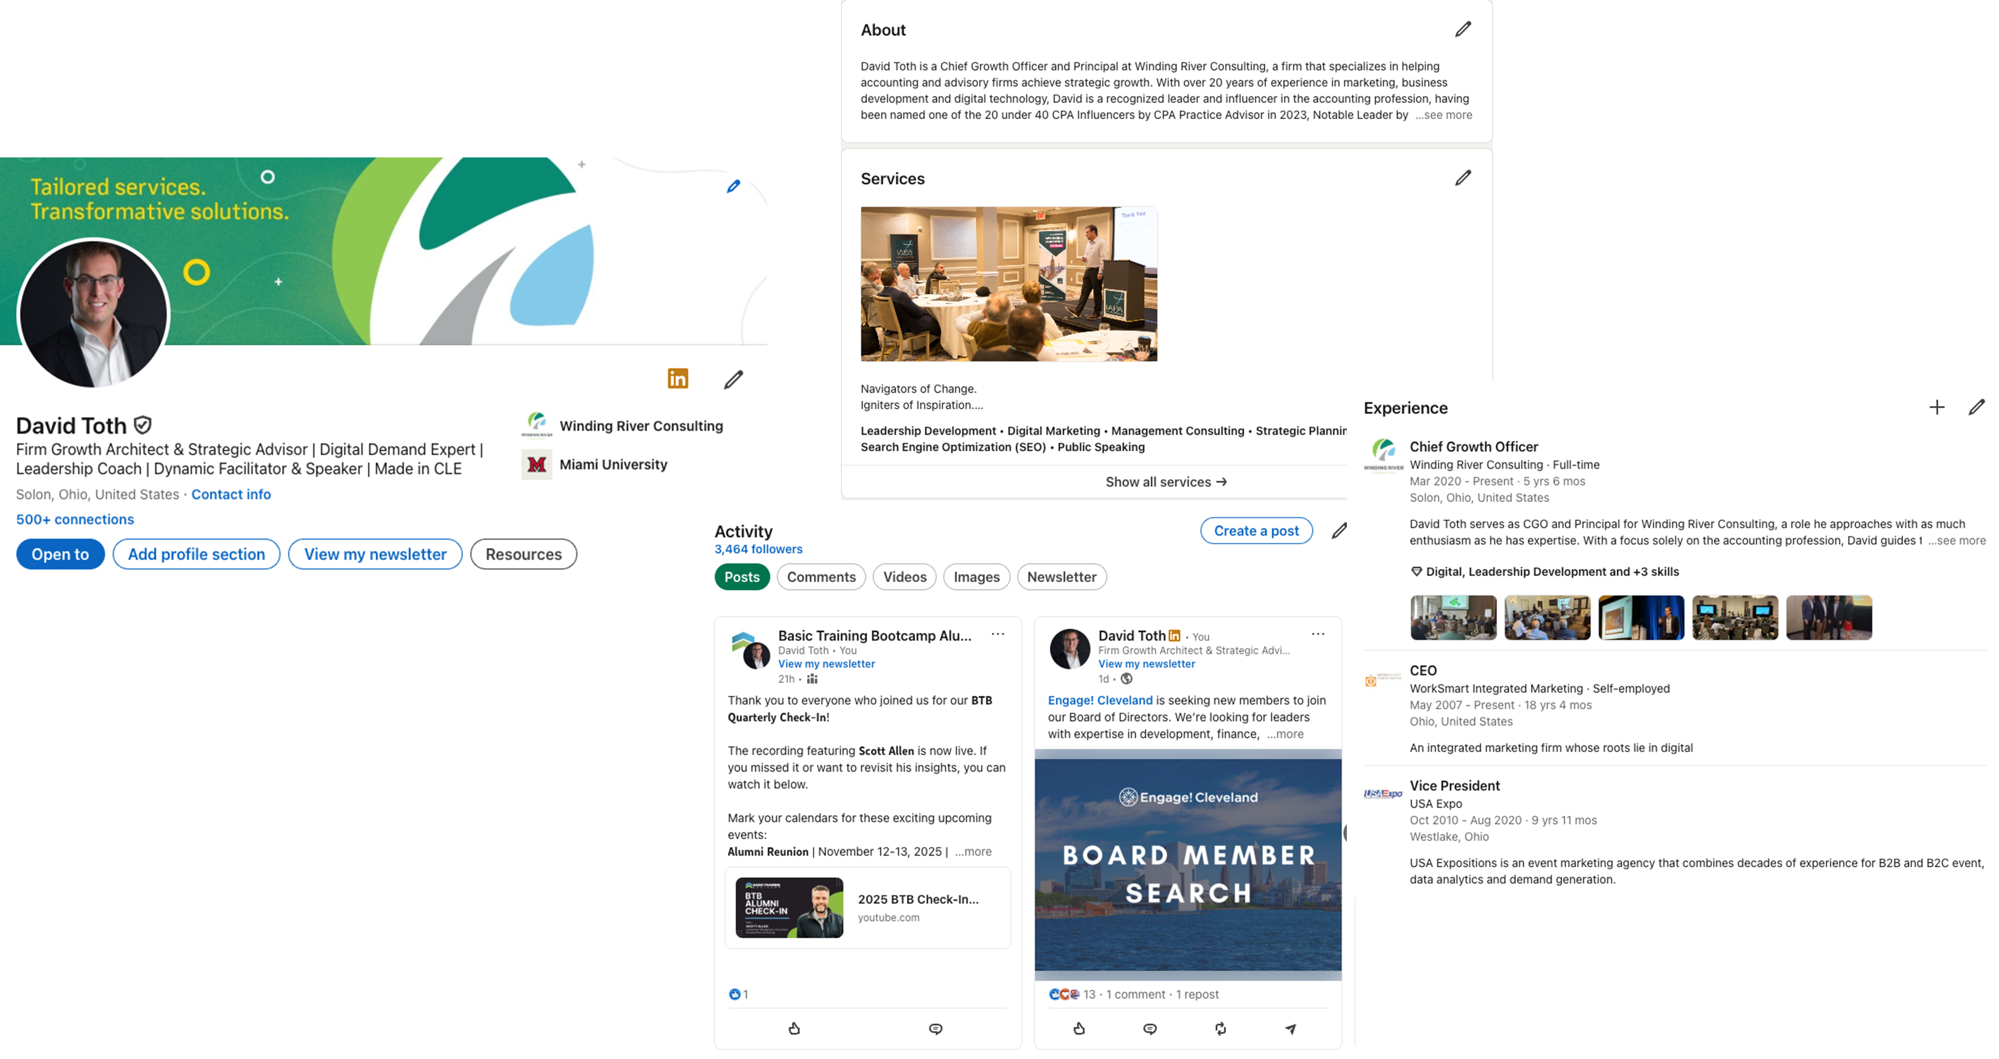
A Personal Page

Slide 38
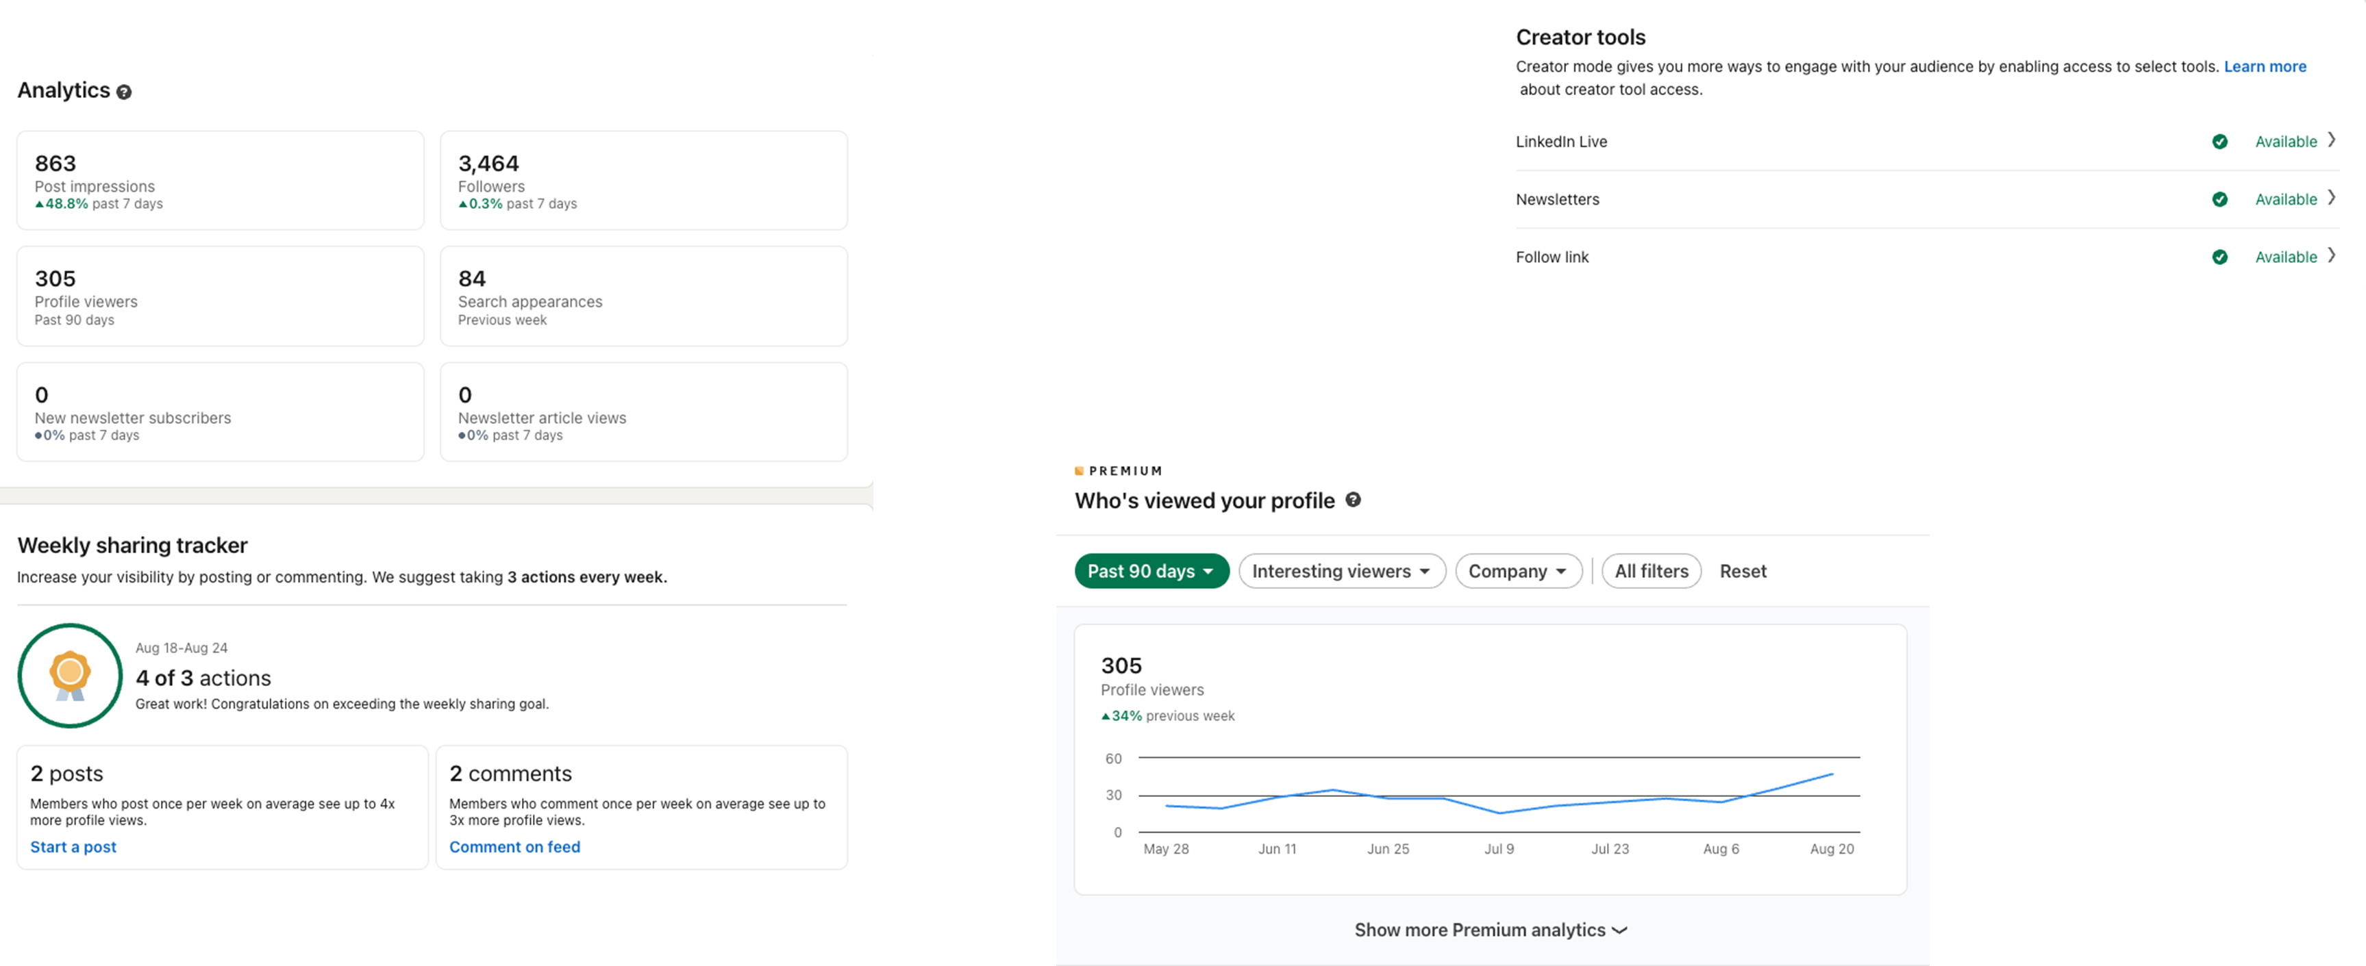
A Personal Page

Slide 39
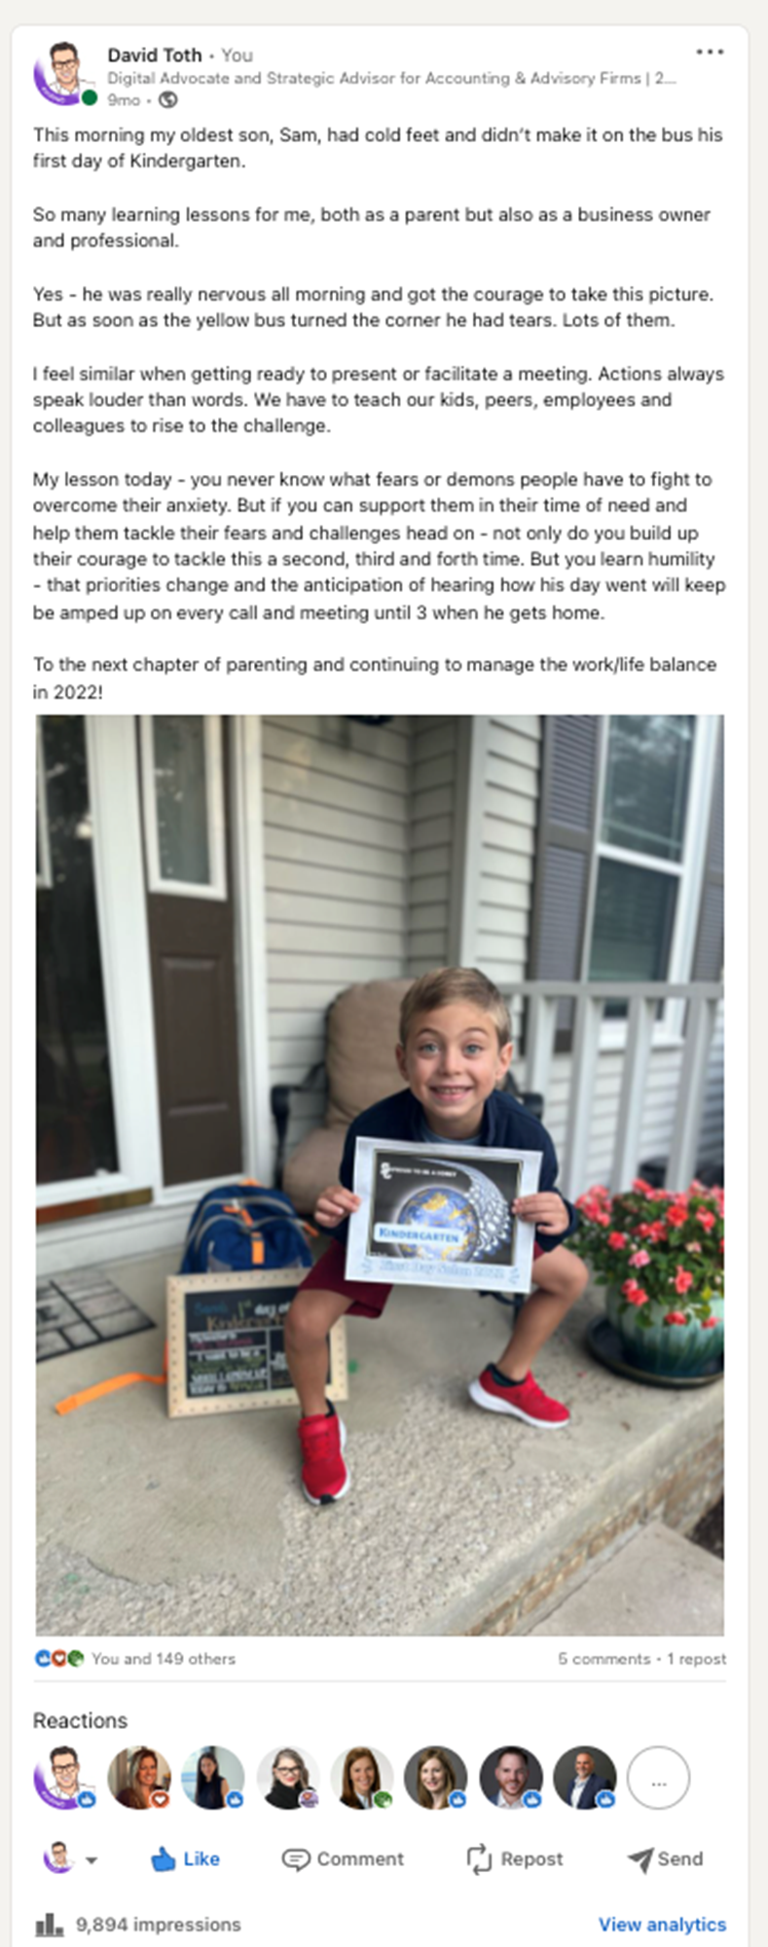
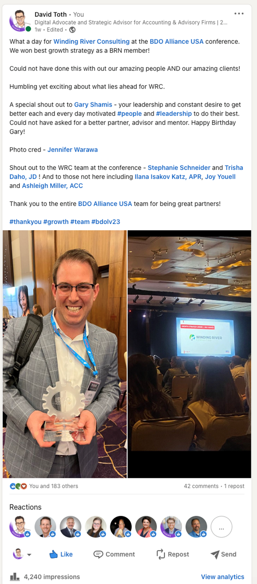
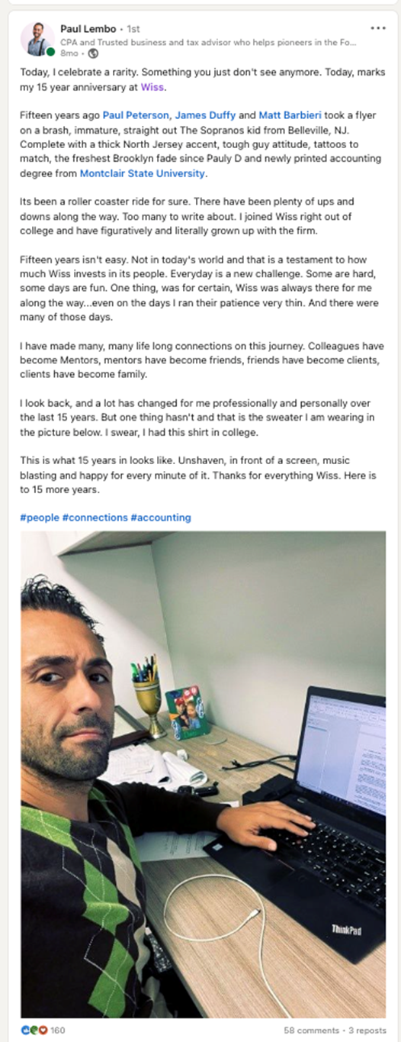
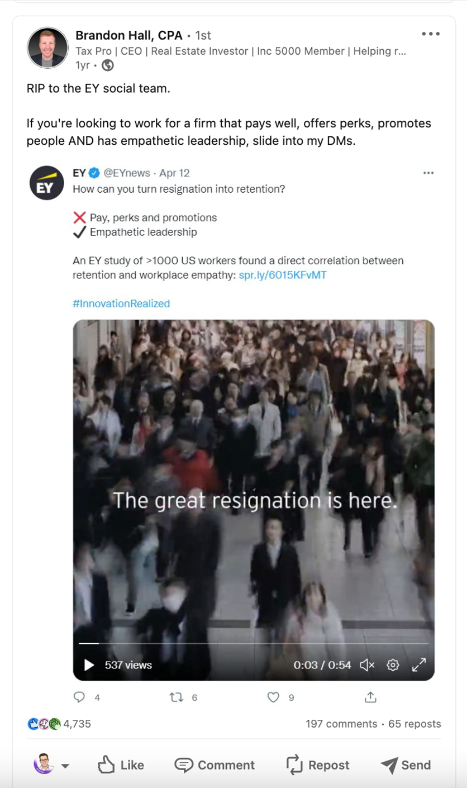
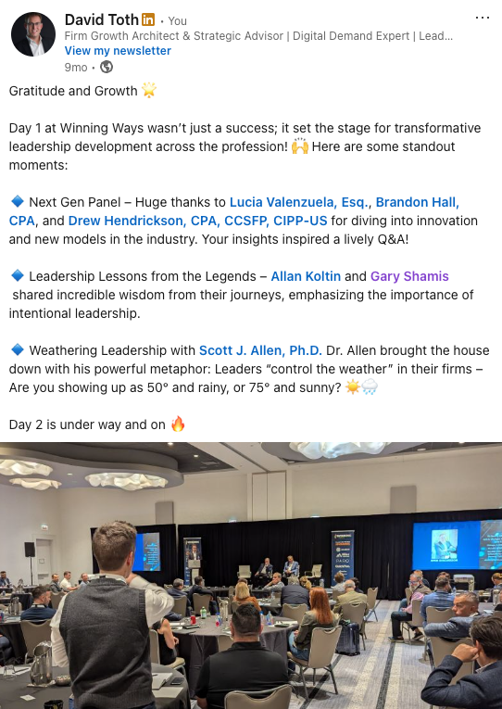
A Personal Page

Slide 40
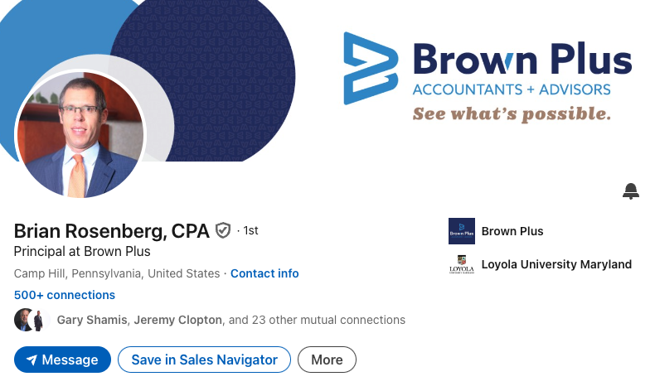
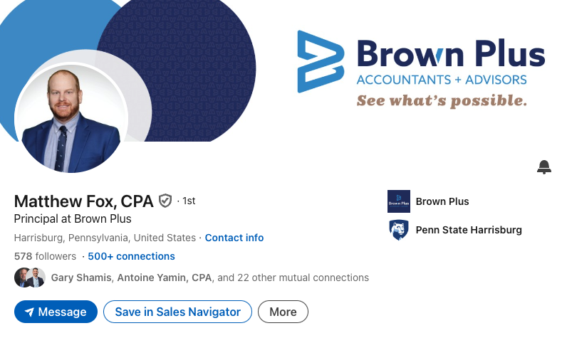
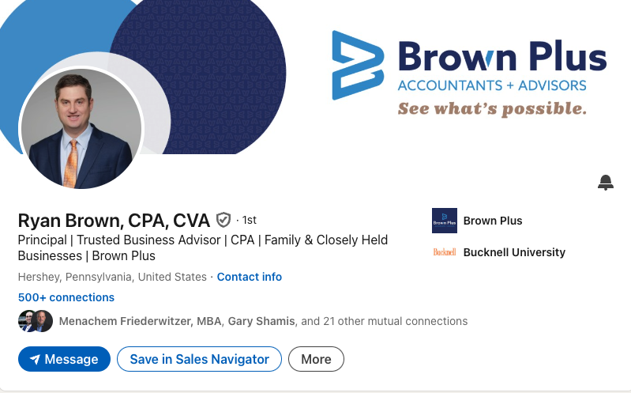
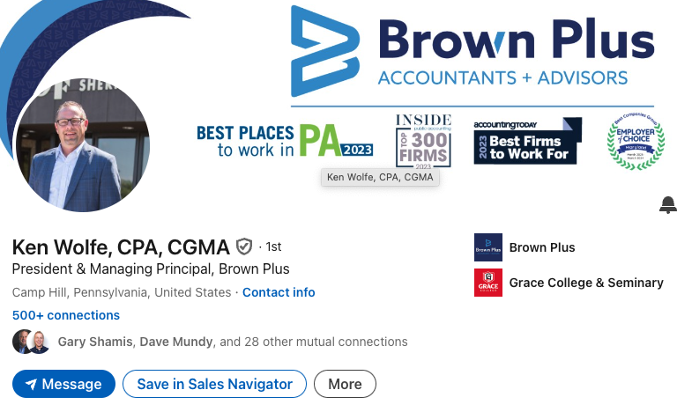
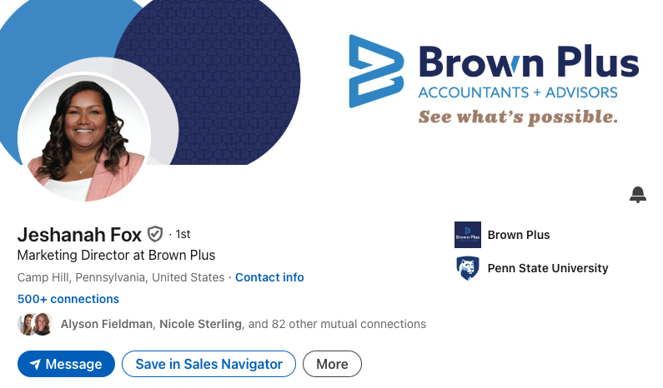

Slide 41
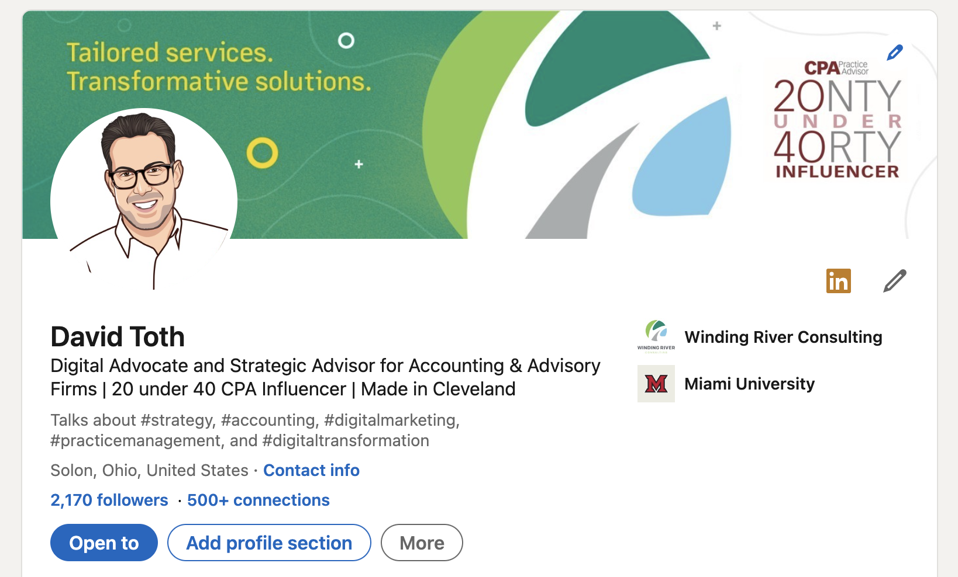
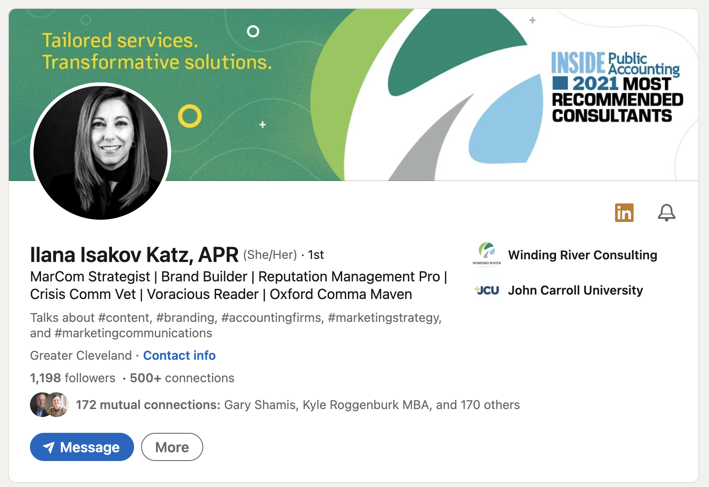
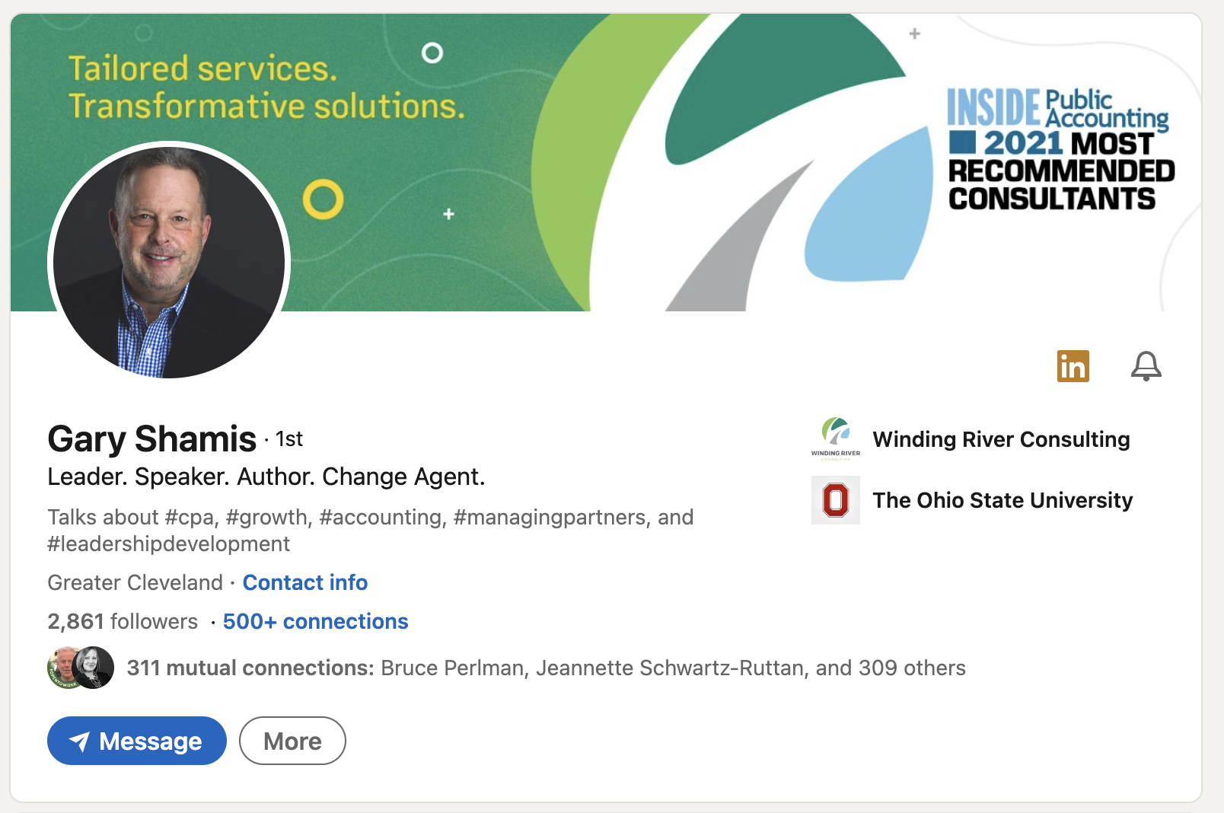

Slide 42
Your Profiles

Slide 43
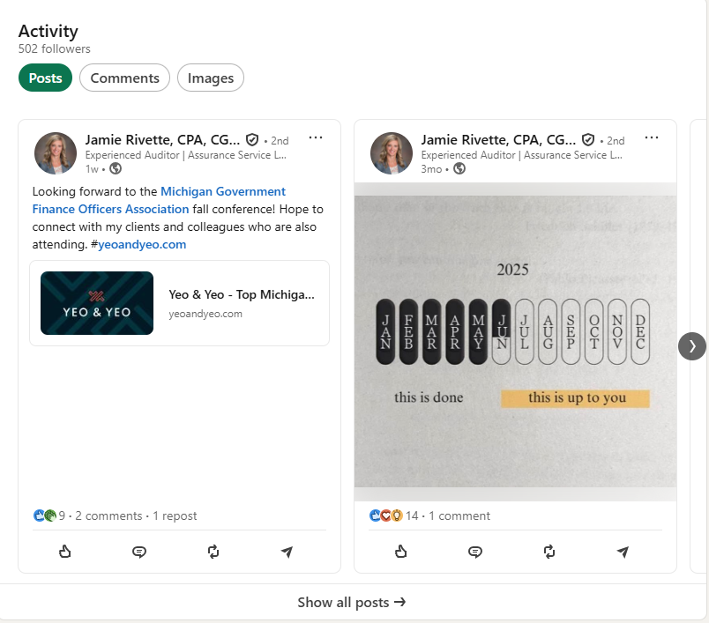
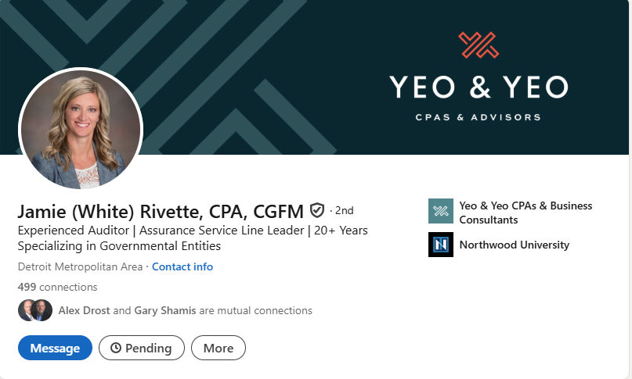
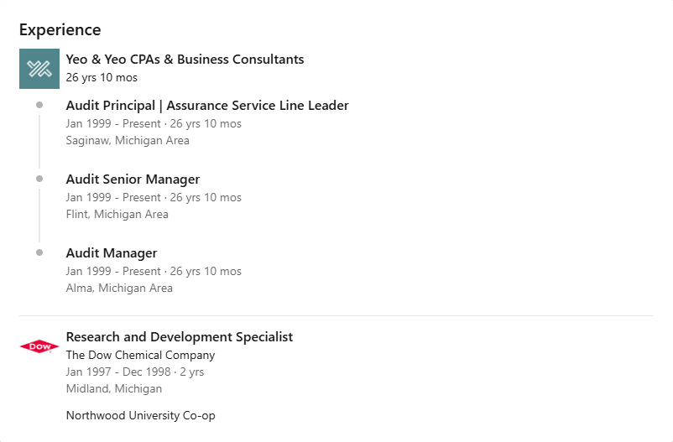
Notes:
(21) Jamie Rivette, CPA, CGFM | LinkedIn

Slide 44
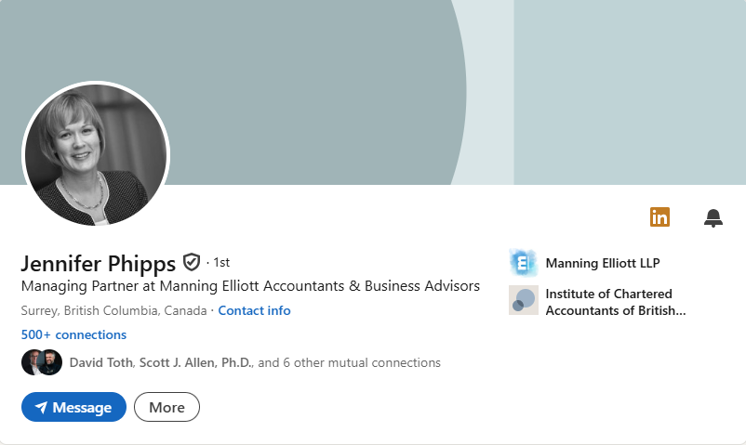
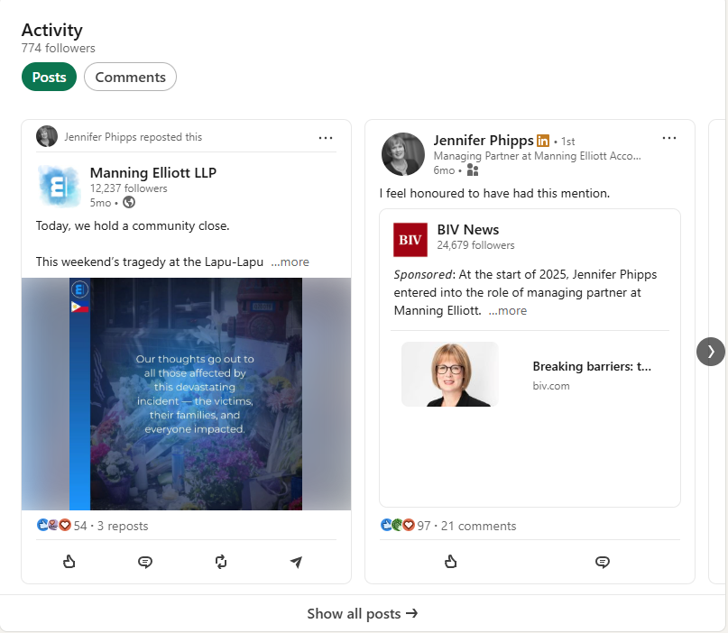
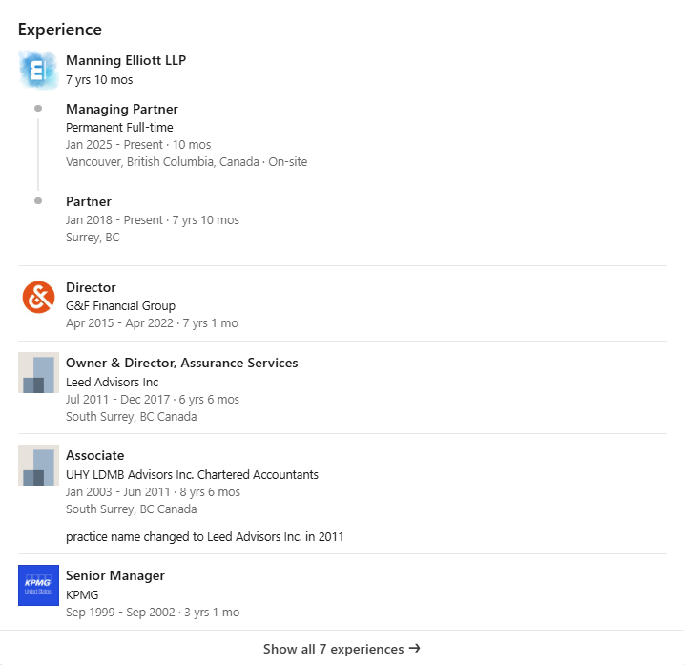
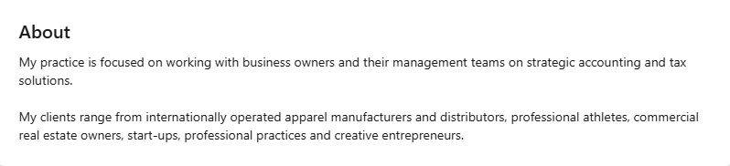
Notes:
(21) Jennifer Phipps | LinkedIn

Slide 45
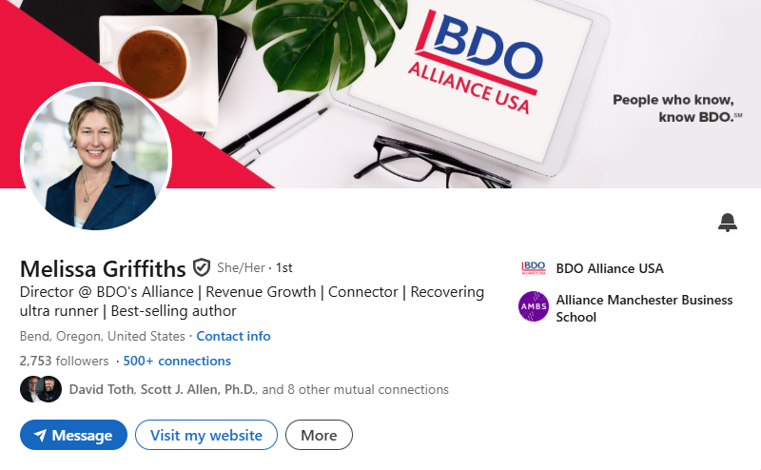
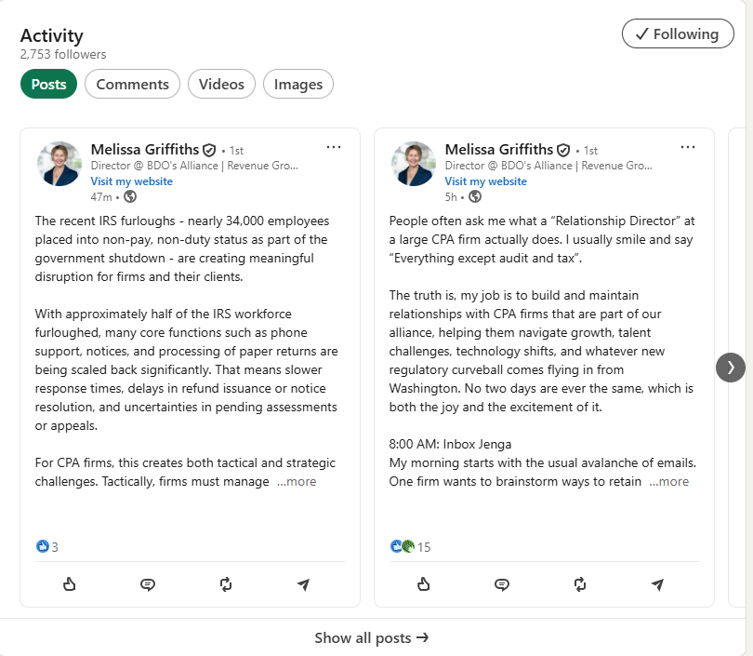
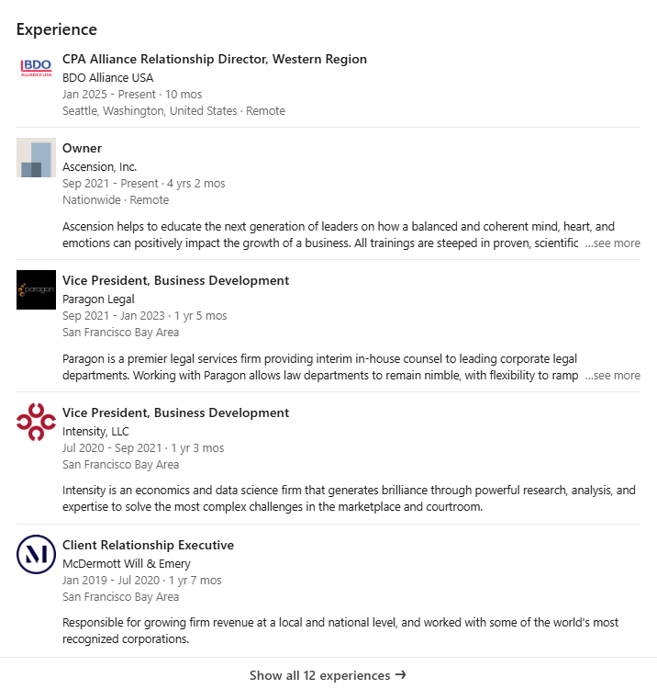
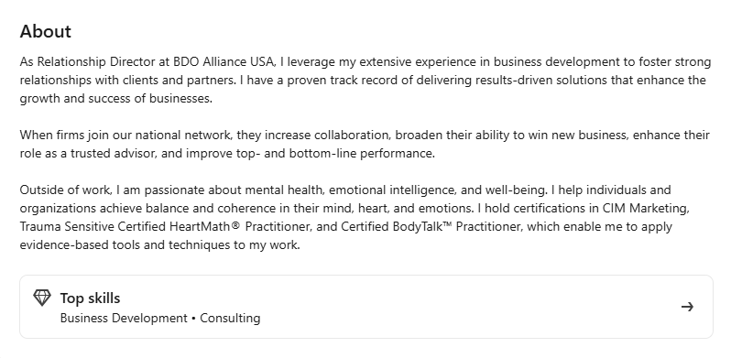
Notes:
(25) Melissa Griffiths | LinkedIn

Slide 46
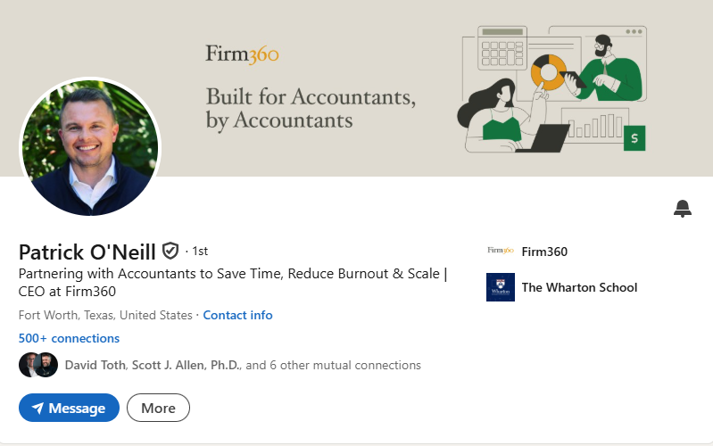
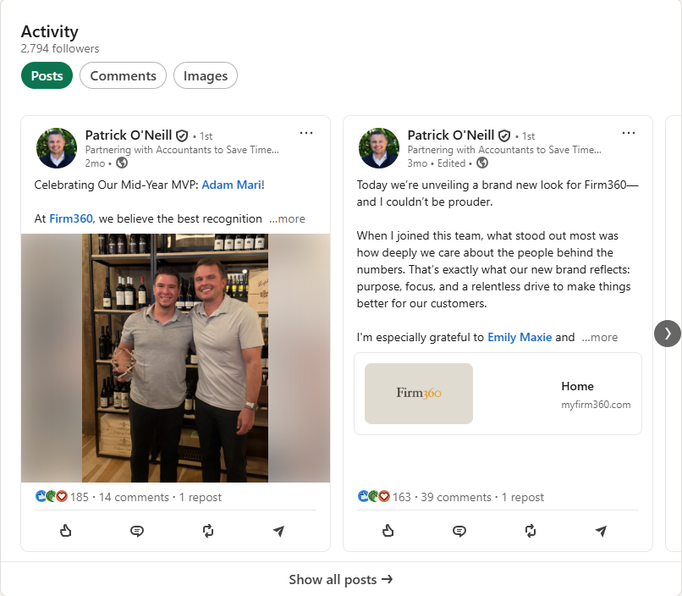


Notes:
(25) Patrick O'Neill | LinkedIn

Slide 47




Notes:
(23) Jon Cohen | LinkedIn

Slide 48




Notes:
(23) Alex Drost | LinkedIn

Slide 49




Notes:
(23) Todd Resnick | LinkedIn

Slide 50





Notes:
(22) Michael Jamison, CPA, CGMA | LinkedIn

Slide 51




Notes:
LinkedIn

Slide 52
Ways to Engage Personally
Follow your firm’s company page to ensure you receive notifications
Login to LinkedIn 3-5 times per week to check your feed and make new connections
Respond to comments and like or react to posts from industry leaders, authoritative pages, colleagues, and/or friends
Share content from authoritative sources on your feed (industry journals, Tier 1 news publications, accounting experts) – be sure to add commentary
Like, react, share your firm’s posts (you will be notified when the company page has a new post)
Join accounting and/or industry specific LinkedIn groups and regularly engage
Create your own new content with the goal of posting once a week
Tag firm, or tag individuals (using “@”) in work-related posts

Slide 53
LinkedIn Features

Slide 54

The Bell

Slide 55


Service Page

Slide 56




Tools

Slide 57




Who’s Viewed Your Profile

Slide 58



Newsletter

Slide 59

Video
Videos get shared 20 times more than any other content format on LinkedIn.

Slide 60




Search Filters

Slide 61


Thank You
CONTACT
Dtoth@WindingRiverConsulting.com
p: 440.723.3653
f: 440.723.3654
SKILLS
Leader, Speaker, Influencer
Change Agent

