Slide 1


What’s Your Story?
Presentation Skills for the Ambitious Leader
MPB | Leadership Accelerated
May 2025
Ilana Isakov Katz

Slide 2
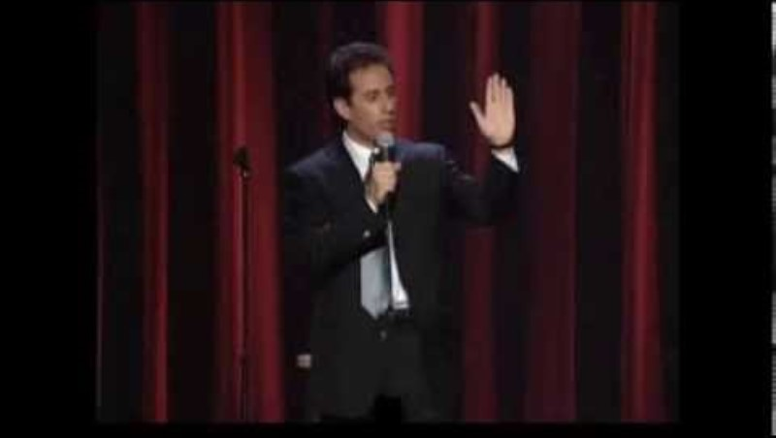

Slide 3

Photo: Getty Images / Inc. Magazine

Slide 4
“All-Time Best Investment”
Mastering the art of public speaking is the single greatest skill to boost your career.
Whatever you do, good communication skills are incredibly important and something that almost anybody can improve upon, both in writing and speaking.
- Warren Buffett

Slide 5
Leader
control
influence
lead
inspire
motivate
teach
empower
comfort
convince
empower
resolve
balance
connect
persuade
lead·​er | \ ˈlē-dər
a powerful person who controls or influences what other people do : a person who leads a group, organization, country, etc. : a person who has commanding authority or influence
Merriam-Webster

Slide 6
“Presentation skills are key”
People who work for you represent your brand. You want them to present themselves — and represent you — in a certain way.
- Marc Benioff

Slide 7

Photo by Алексей Маркин from Pexels

Slide 8
attention
time
McKeachie
Notes:
In Wilbert McKeachie’s book Teaching Tips, he asserts that attention increases from the beginning of a lecture to 10 minutes and decreases sharply after that.
This means, that when we give a presentation, we have to get and hold attention for 10 minutes, and then do it all over again for as long as we are lecturing.
needs to be engaging and reengaging audience multiple times.
FINLAND imposes obligatory 15 min break for 45 min instruction = “brain break”

Slide 9
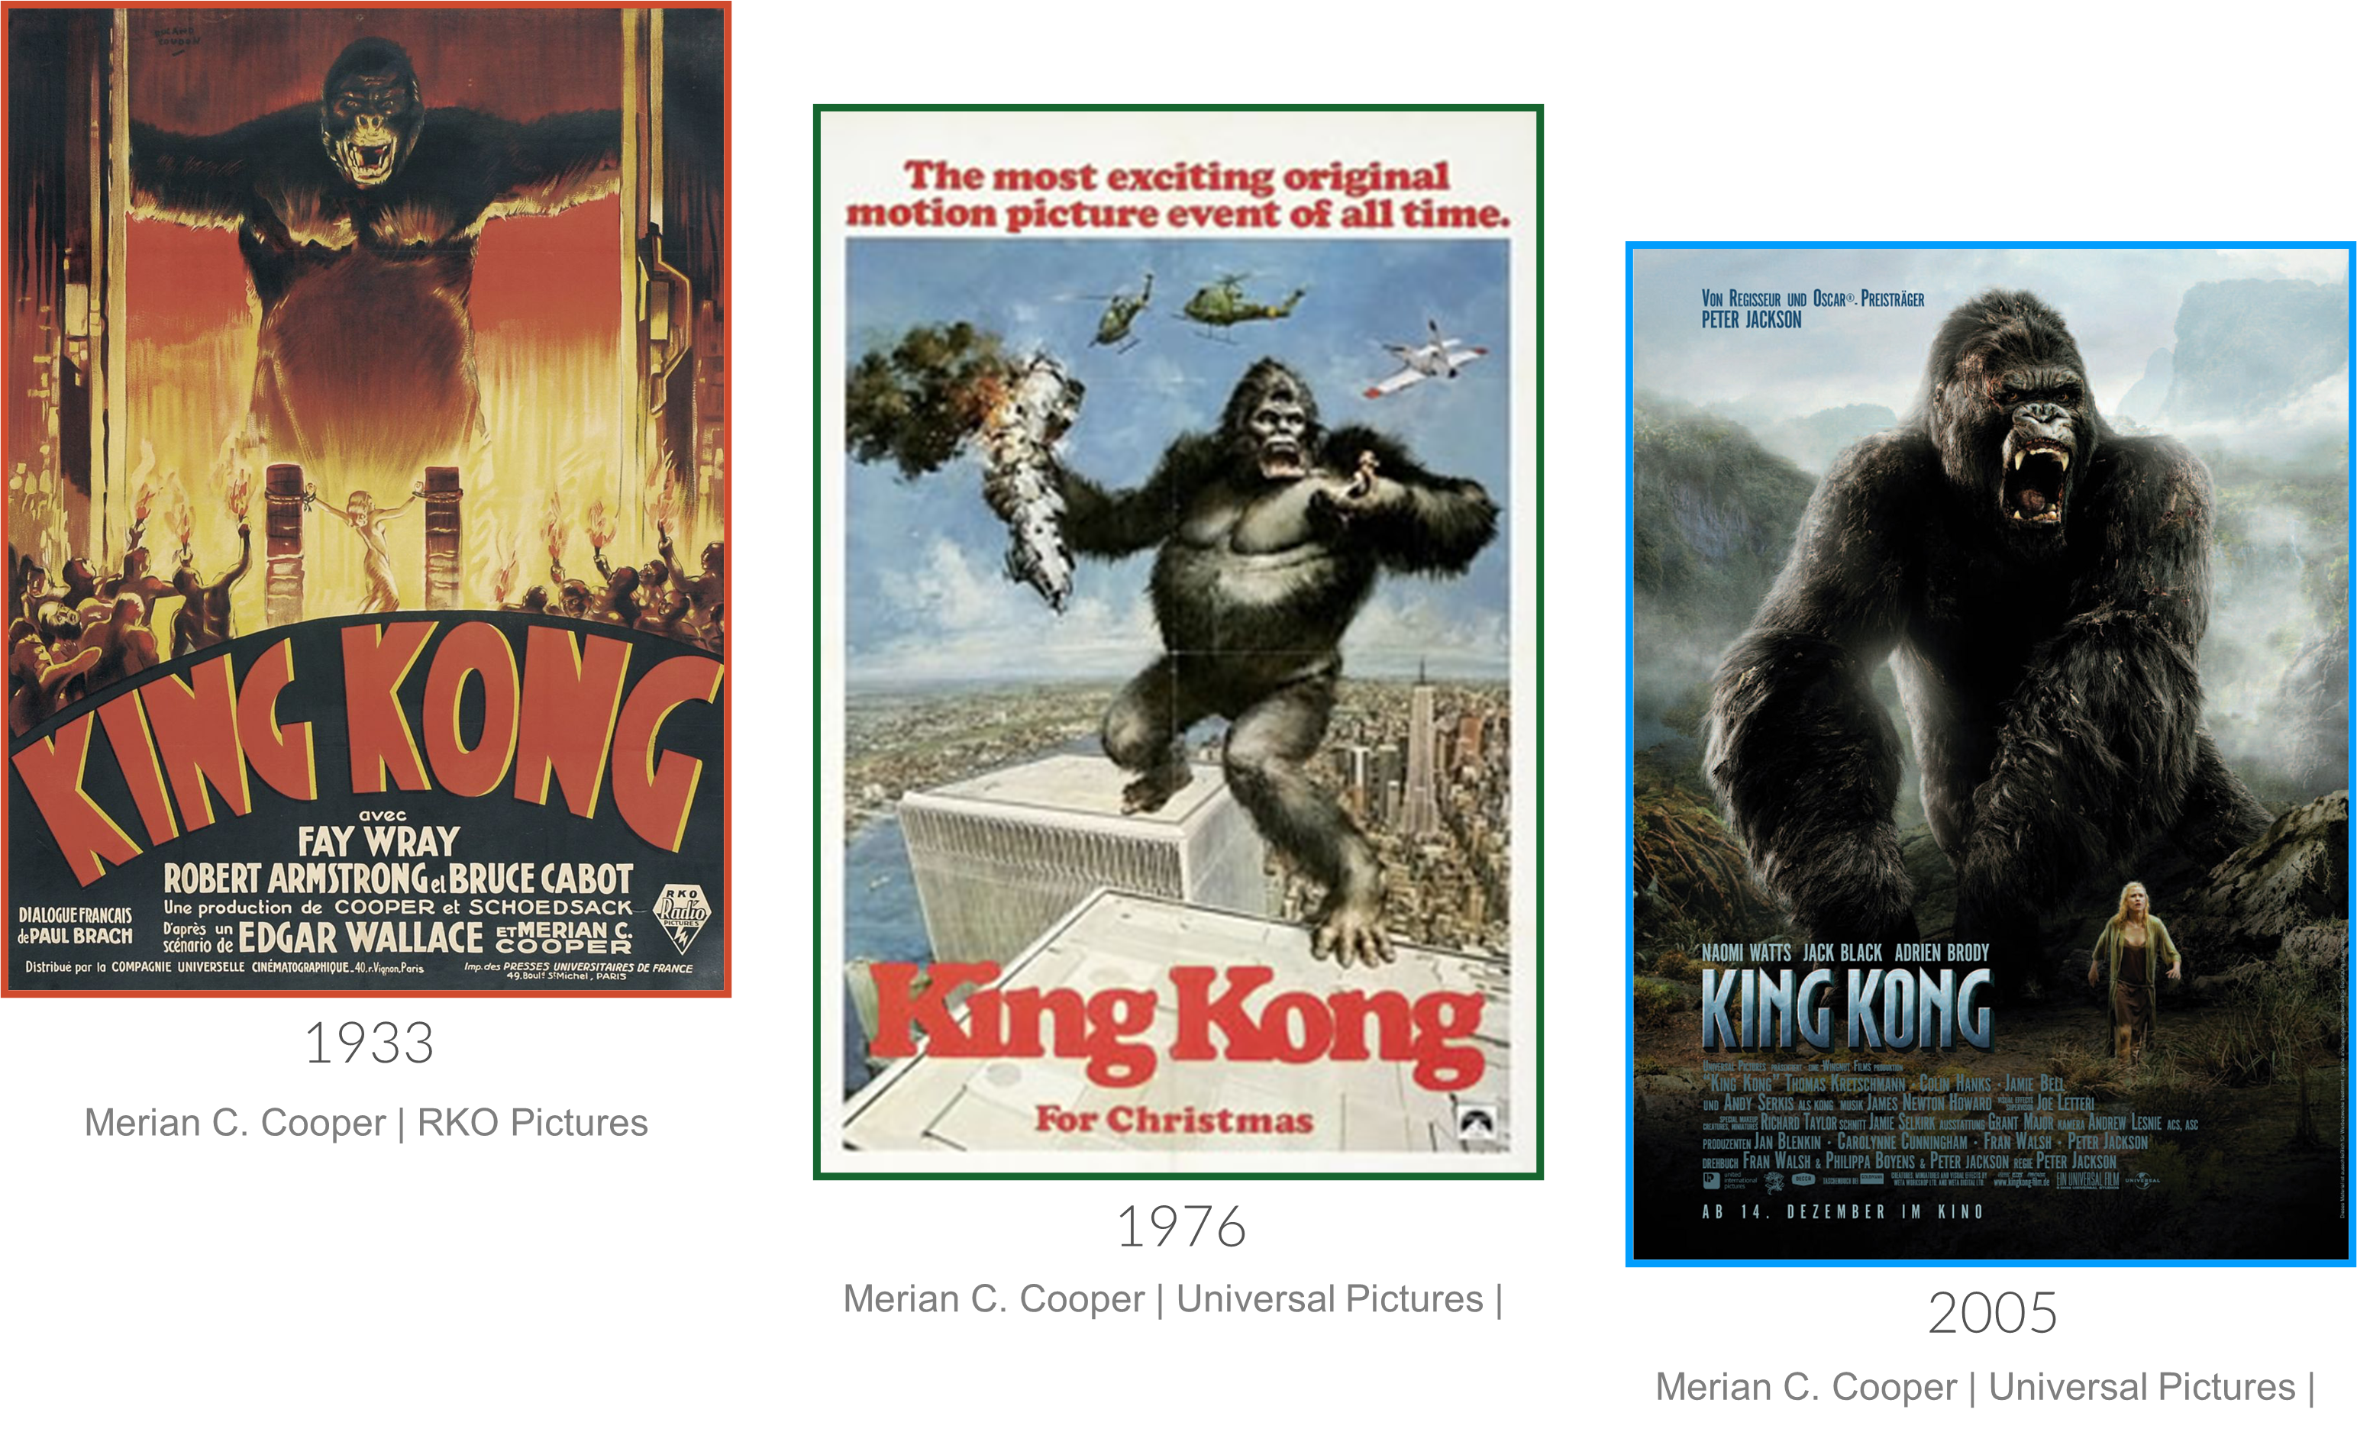

Slide 10

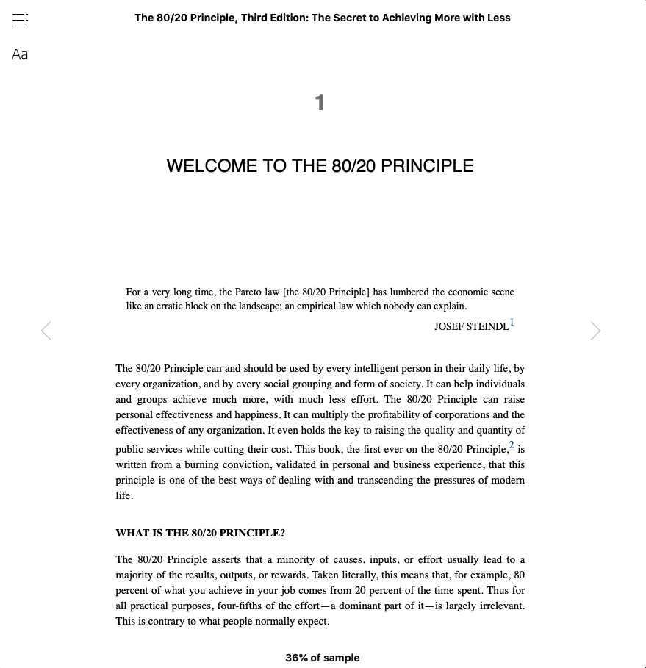
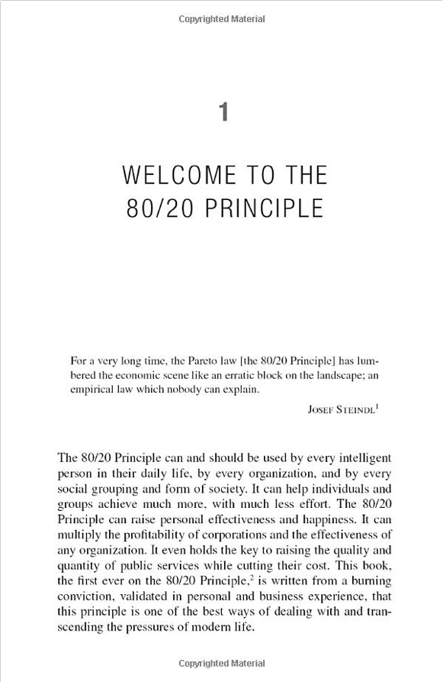
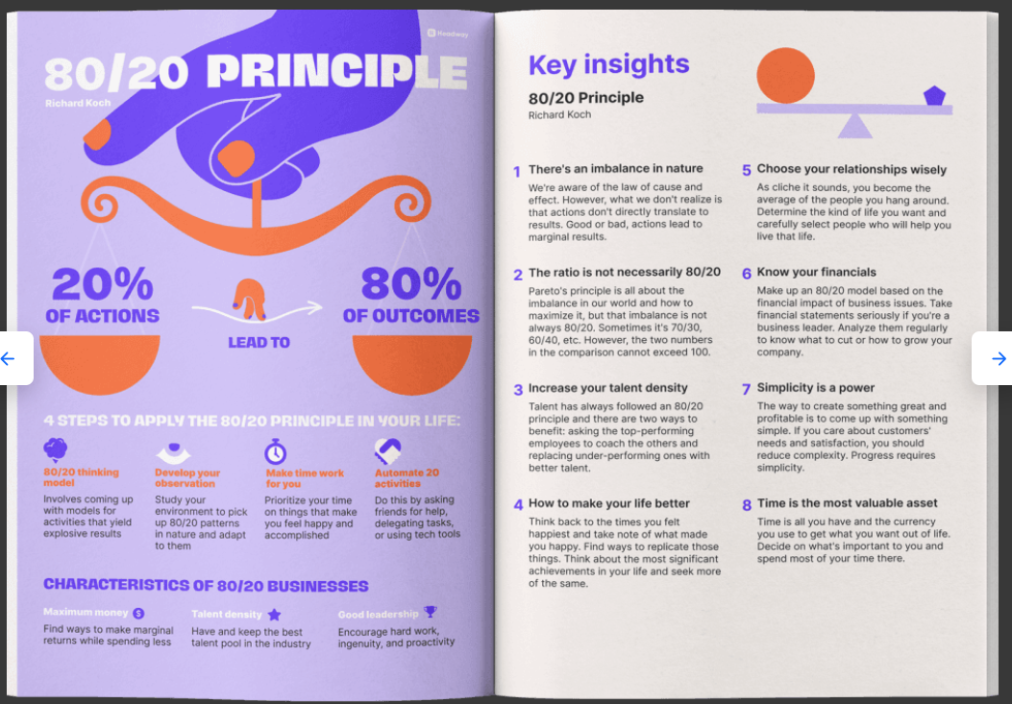

SCHITT’S CREEK™ Not a Real Company Productions Inc. / Amazon / headway.com

Slide 11


Slide 12
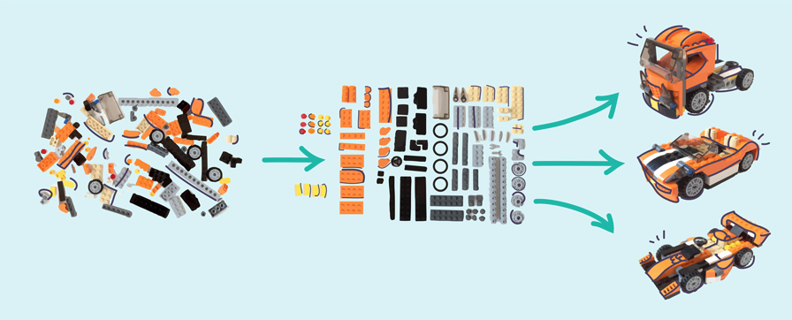
WINDING RIVER CONSULTING
thoughts/ideas
organized
presentation
Visme

Slide 13
1.
3.
TOPIC: Public Speaking
3.
content
delivery
3.
    slides
stories
message
audience
movement
voice
energy
4.
who
WIIFM
cta
4.
    content
visuals
data
  body
hands
eyes
  smile
enthusiasm
engagement
    brain
emotions
response
  volume
tone
speed
    fear
attention
graphics
2.
purpose
outcome
1.
5..
CTA
CTA
          inform
  persuade
entertain
6.
motivate
empower
sell

Slide 14
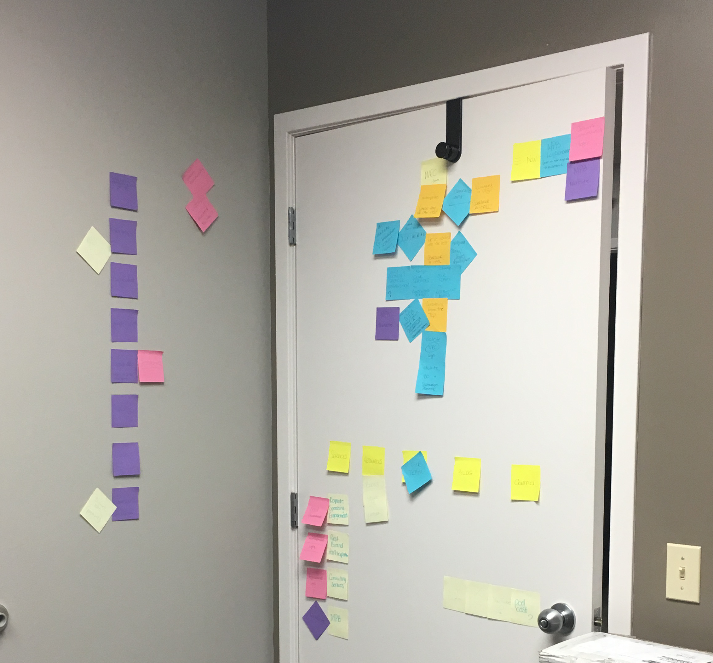
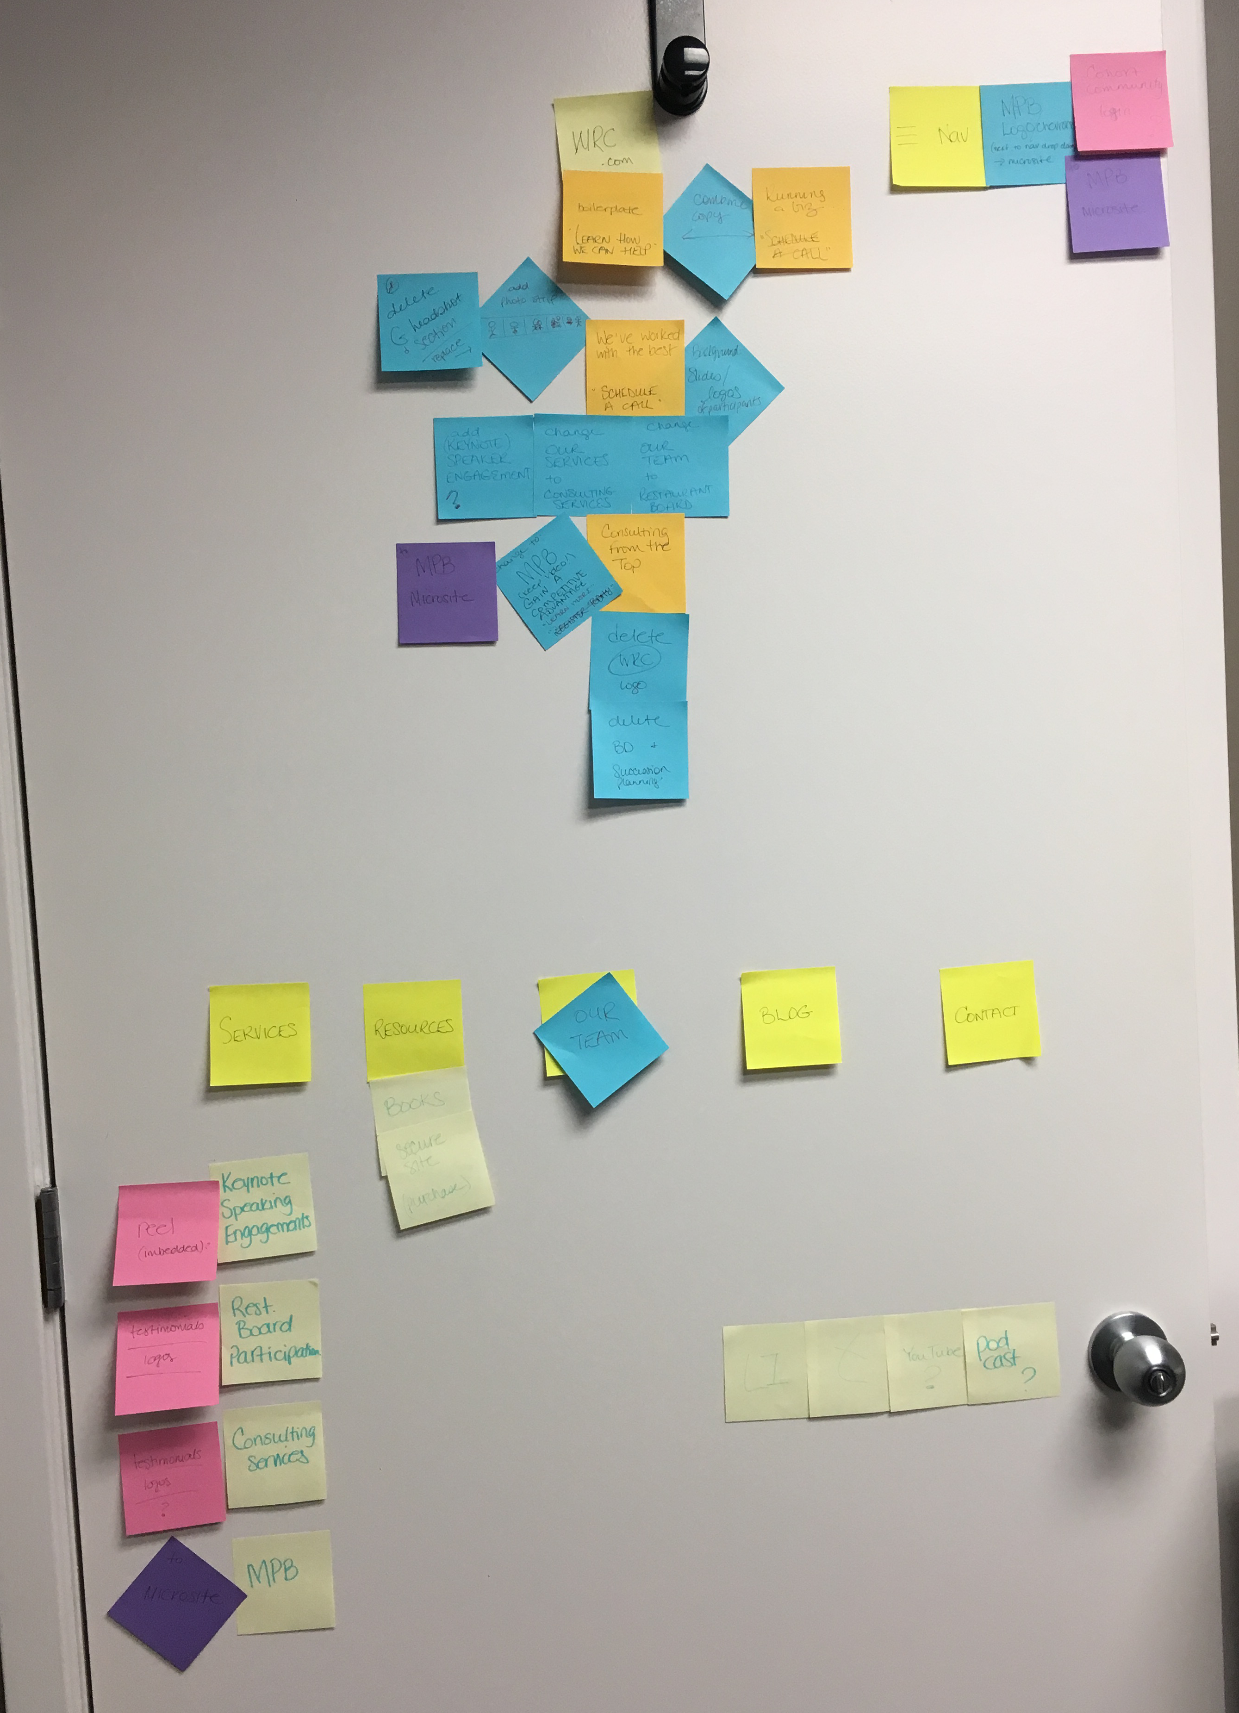

Slide 15


Slide 16
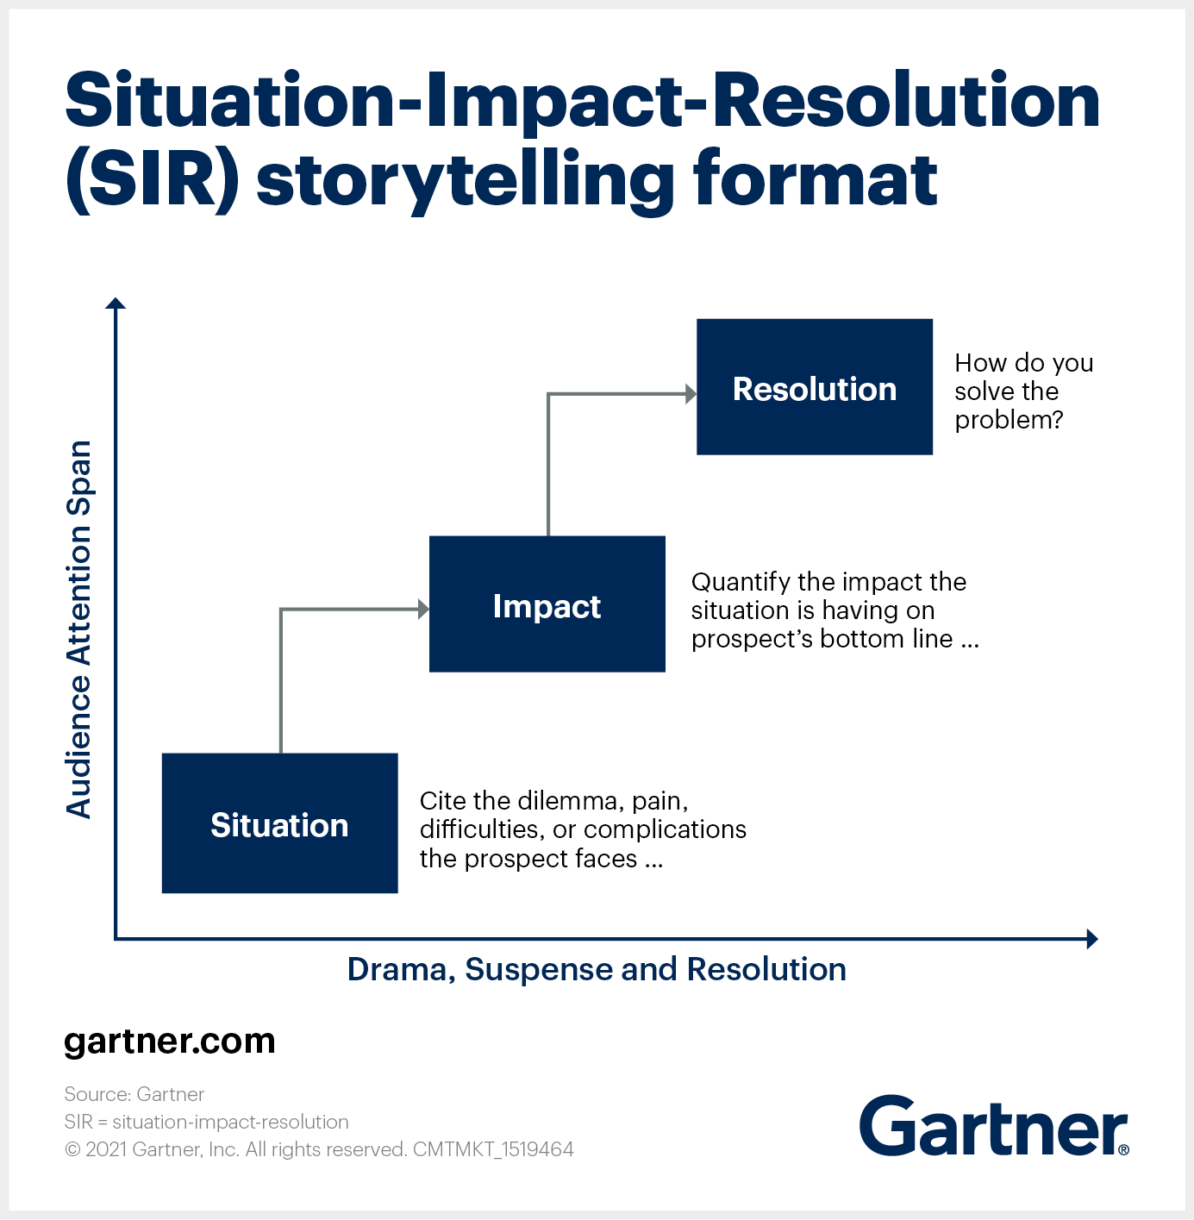

Slide 17
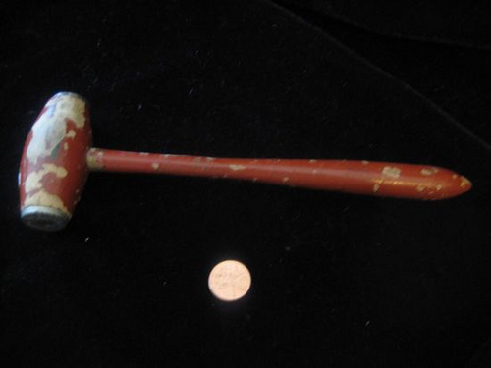
On September 16th, 2031 at 2:35 am, a temporal rift – a “tear” in the very fabric of time and space – will appear 16.5 meters above the area currently occupied by Jeffrey’s Bistro, 123 E Ivinson Ave, Laramie, WY. Only the person wielding this mallet will be able to enter the rift unscathed. If this person then completes the 8 Labors of Worthiness, he or she will become the supreme ruler of the universe.
Significant Objects / Colson Whitehead

Slide 18


Slide 20
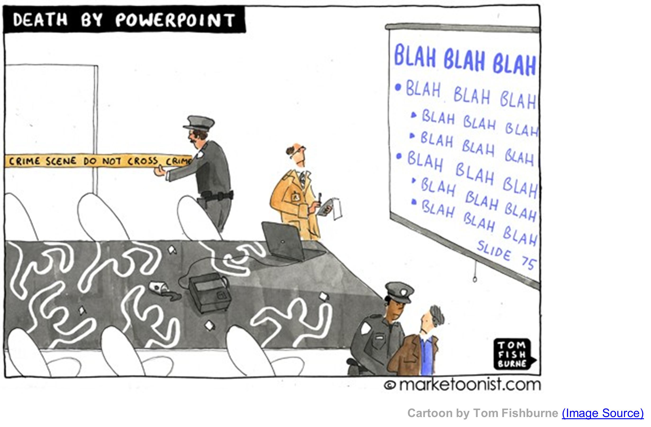

Slide 21
The more strikingly visual your presentation is, the more people will remember it. And more importantly, they will remember you.
- Paul Arden

Slide 22
Client

Slide 23

Photo by Sandeep Ket from Pexels

Slide 24

Photos by Miguel Á. Padriñán for Pexels

Slide 25


Slide 26
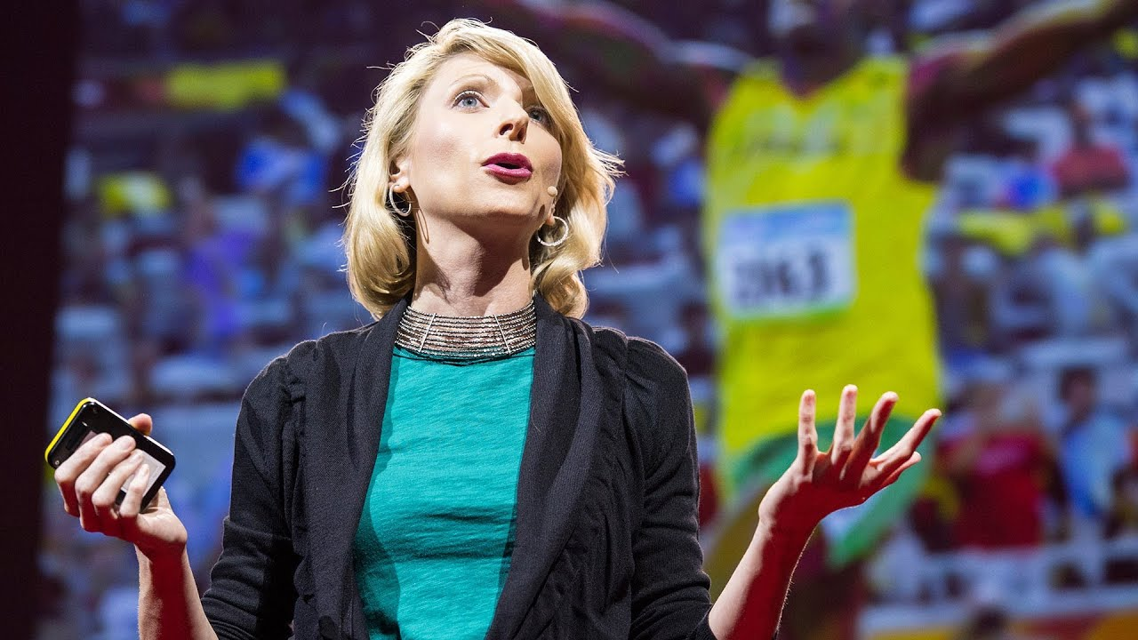
WINDING RIVER CONSULTING
TED

Slide 27

Haiku Deck

Slide 28



Photos by (10) Markus Spiske (20) Magda Ehlers (30) from Pexels

Slide 29
So Cool
mentimeter.com

Slide 30


Slide 31
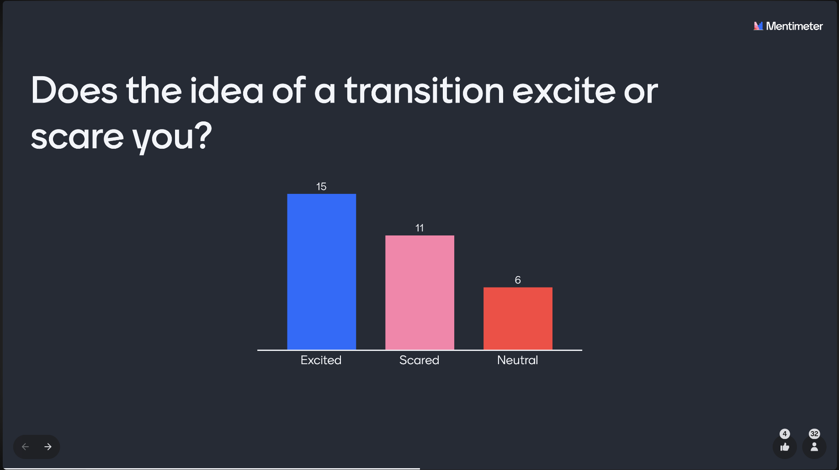
Real Time

Slide 32
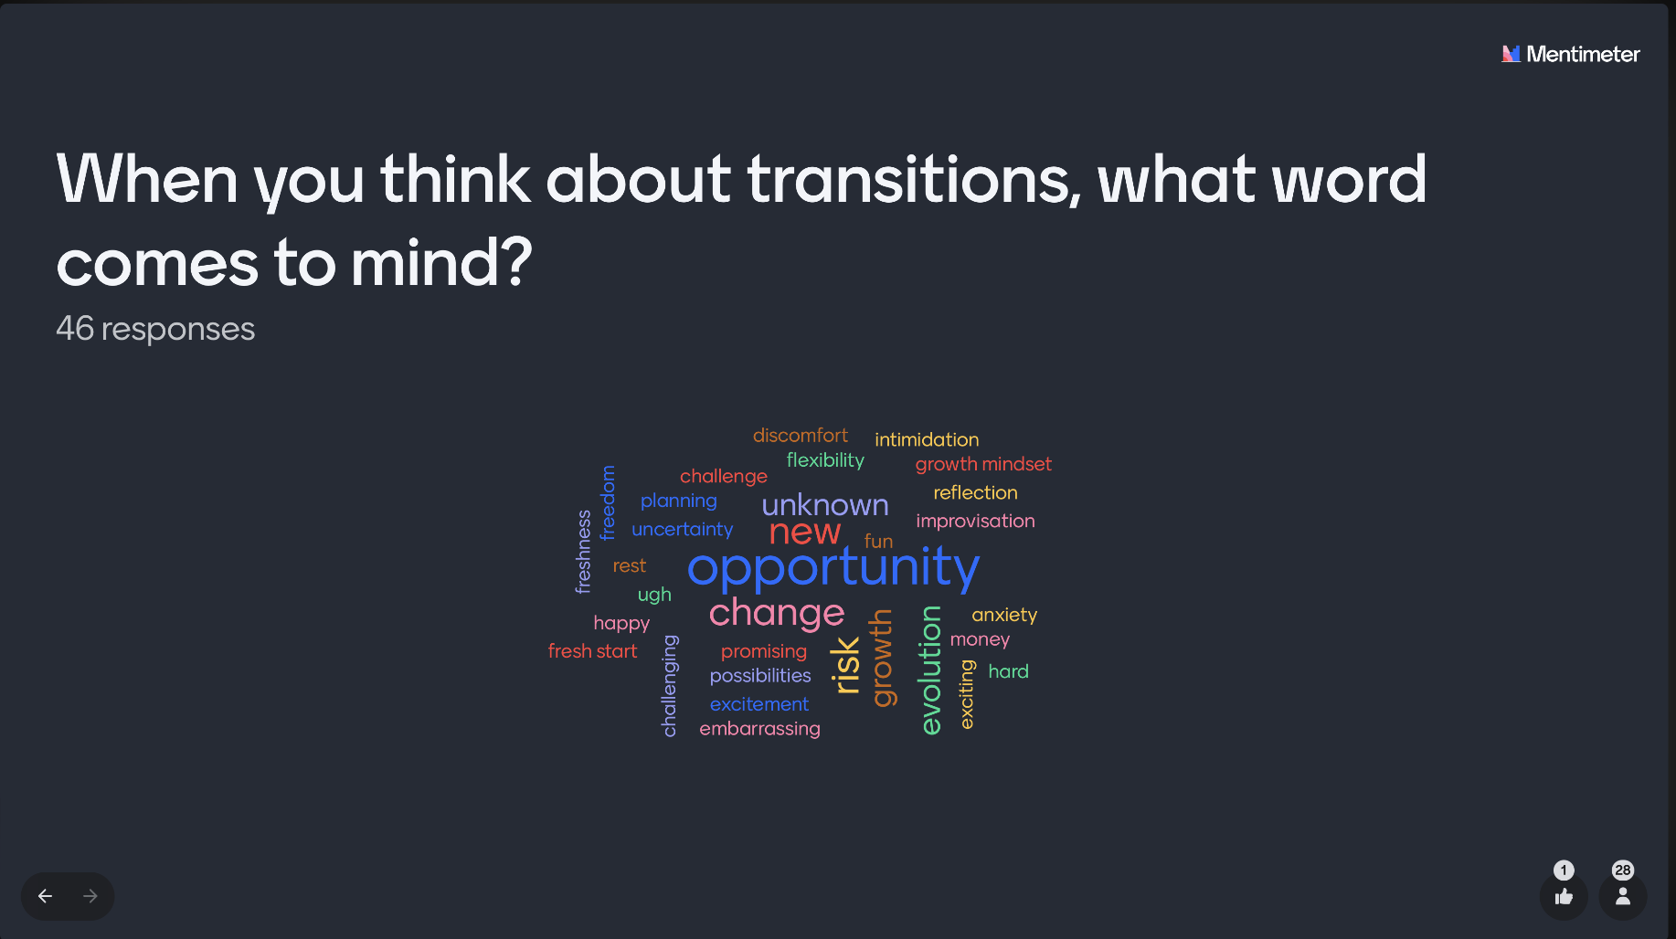
Participation

Slide 33

Evaluation

Slide 34

Photo by CDC from Pexels

Slide 35
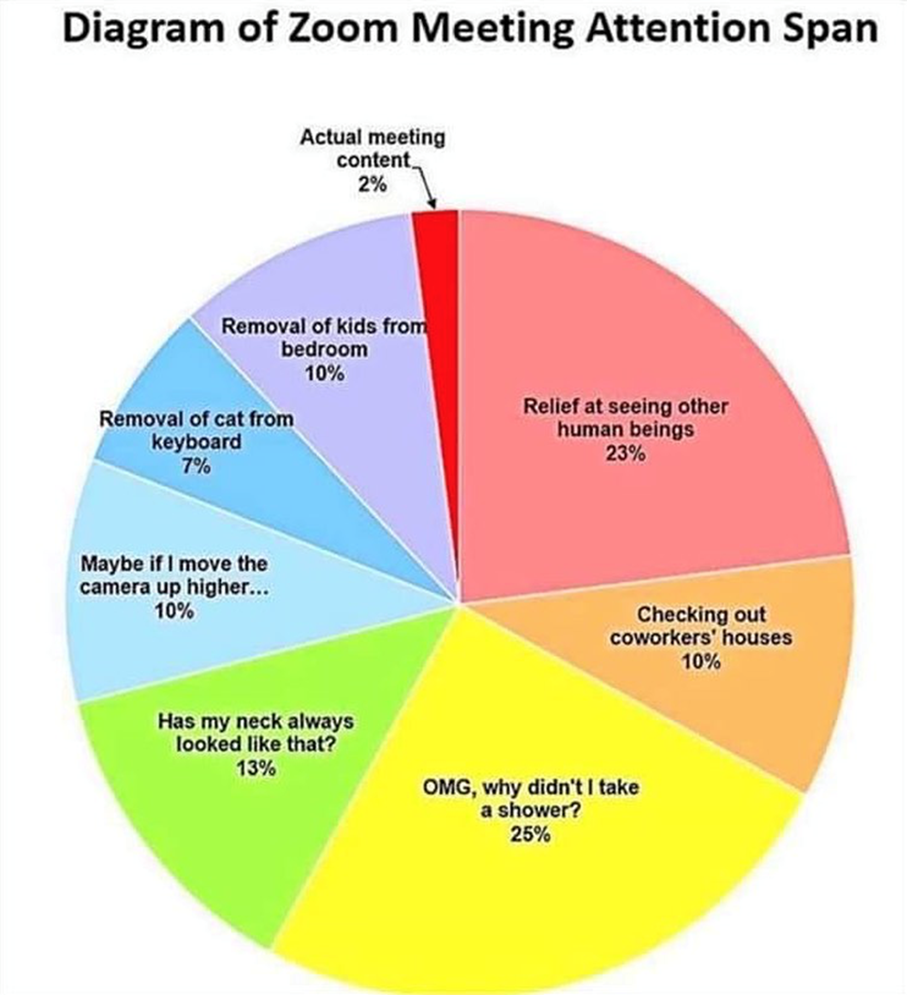
Sarah Woodward

Slide 36
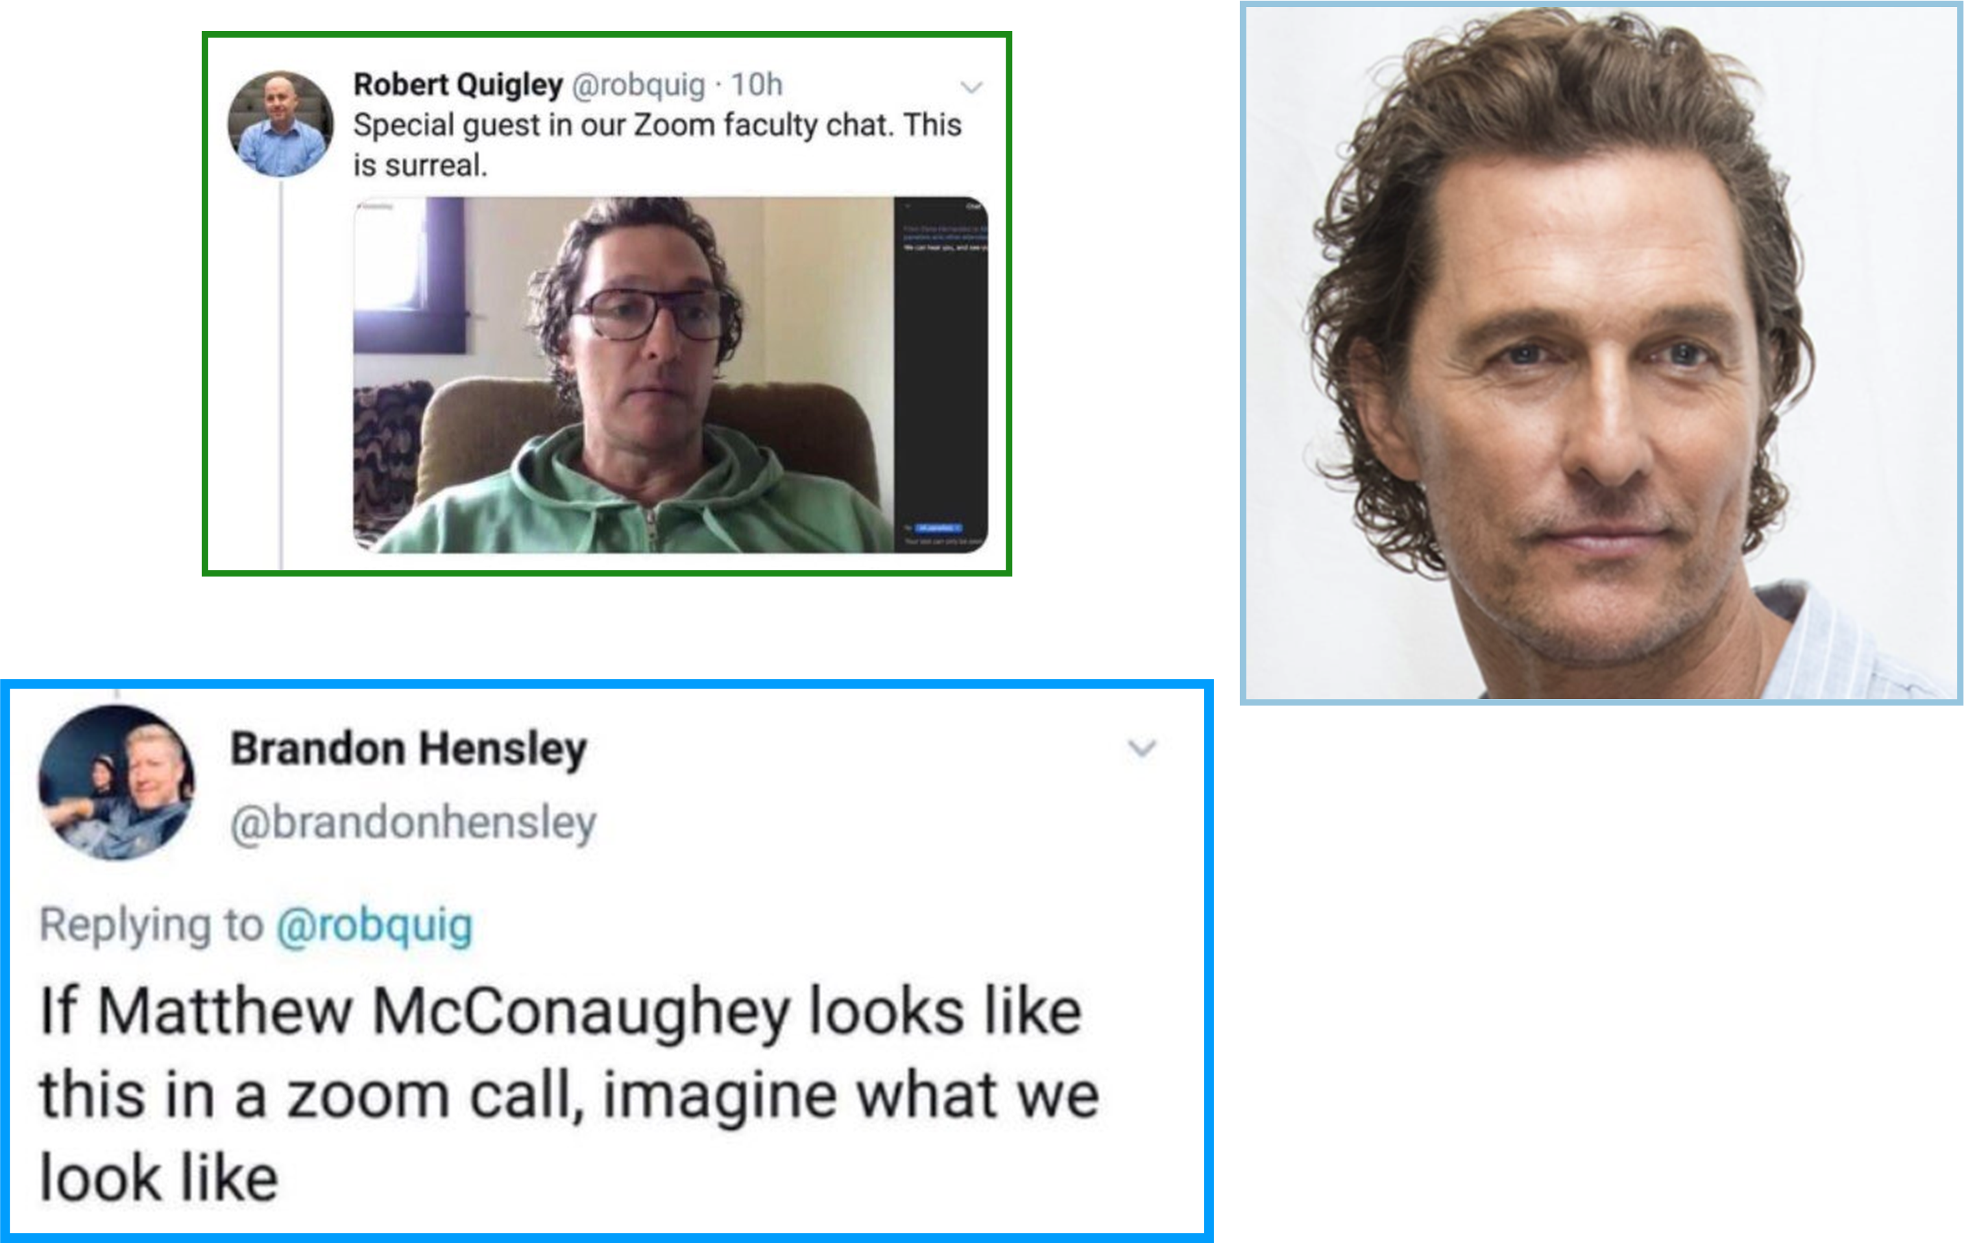

Slide 37
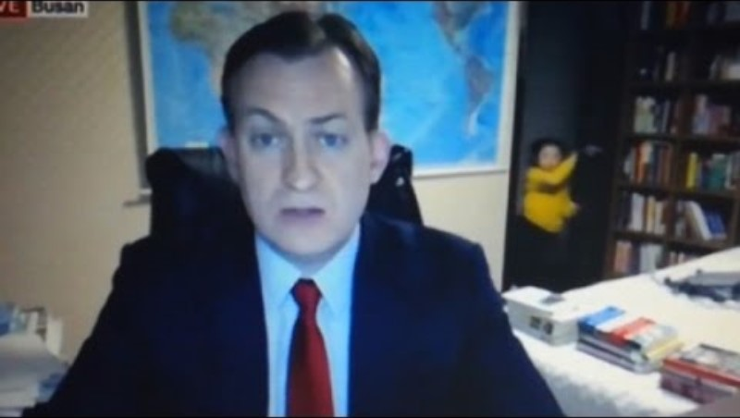
In “The Before”

Slide 38
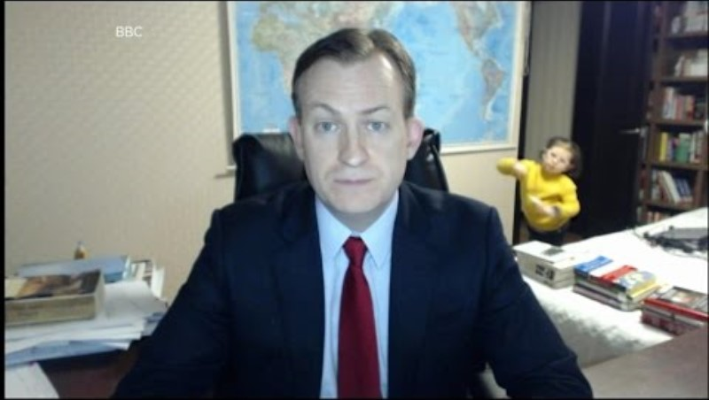
Pandemic

Slide 39
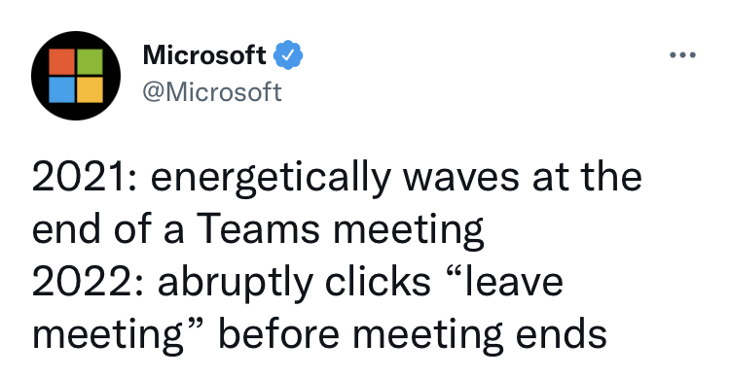

Slide 40
Take Aways
    The fear is real
    Attention spans are short, so the brain needs constant stimulation to it keep from getting bored
    An organized presentation is as much your road map as it is your audiences’
    Storytelling has been a part of the human experience since the beginning of time. Science confirms: Our brains are hardwired for stories
    Practice, practice, practice
    Engage your audience - dialog, break outs, exercises, questions, etc.
    Provide a purpose - a ‘call to action’, next steps, and/or take aways
    Remember: Life happens

Slide 41
get in touch
Ilana Isakov Katz
IKatz@WindingRiverConsulting.com

