Slide 1


Growing from the Inside Out
MPB | Leadership Accelerated
May 2025
David Toth
Notes:
Raise your hand if you feel confident your next generation of leaders will be able to grow the firm through relationships.
What’s one thing your firm is doing to help future leaders become better relationship builders?

Slide 2
Growth Strategy
Traditional
Mergers & Acquisitions / P.E.
Digital

Slide 3
The Original Growth Engine: Relationships
For decades, accounting firms grew through reputation, referrals, and real-world relationships.
Relationships still drive 75%+ of revenue in most traditional firms
The challenge today: relationships take time, trust, and intentionality—and many new partners lack the tools and structure to succeed here.

Slide 4
Business Development ≠ Networking
Networking is about visibility (being seen).
Business Development is about intentionality (being remembered, followed up with, and trusted).
Notes:
BD = identifying opportunities, nurturing them, and converting them over time.
Why it matters: Too many firms assume “they’ll figure it out.”

Slide 5
Skill Gaps
The next generation grew up executing, not originating.
Lack of training, mentorship, and structured BD pathways.
Imposter syndrome and fear of rejection slow progress.
Technology

Slide 6
How Leading Firms Are Investing in Relationships
Formal relationship-building plans for new partners.
Investments in coaching, mentorship, and accountability groups.
Support for board service, industry associations, community leadership roles.
Client experience initiatives that deepen relationships firm-wide.

Slide 7
Some ideas
Create a firmwide dashboard
Assign mentors to emerging partners with a relationship focus.
Host internal BD workshops—focus on storytelling, follow-up, and positioning.
Elevate success stories—celebrate “quiet” wins.

Slide 8
Mar-ket-ing
n. the process or technique of promoting, selling, and distributing a product or service
the activity, set of institutions, and processes for creating, communicating, delivering, and exchanging offerings that have value for customers, clients, partners, and society at large*
all activities a company does to promote and sell products and services to consumers**
Increase brand awareness
Create value through customer experience
*AMA
**investopedia.com
Notes:
mission, vision, values, positioning statement, voice, slogan, elevator pitch, value prop, differentiators
competitor analysis
logo, tag, messages, unique value proposition

Slide 9
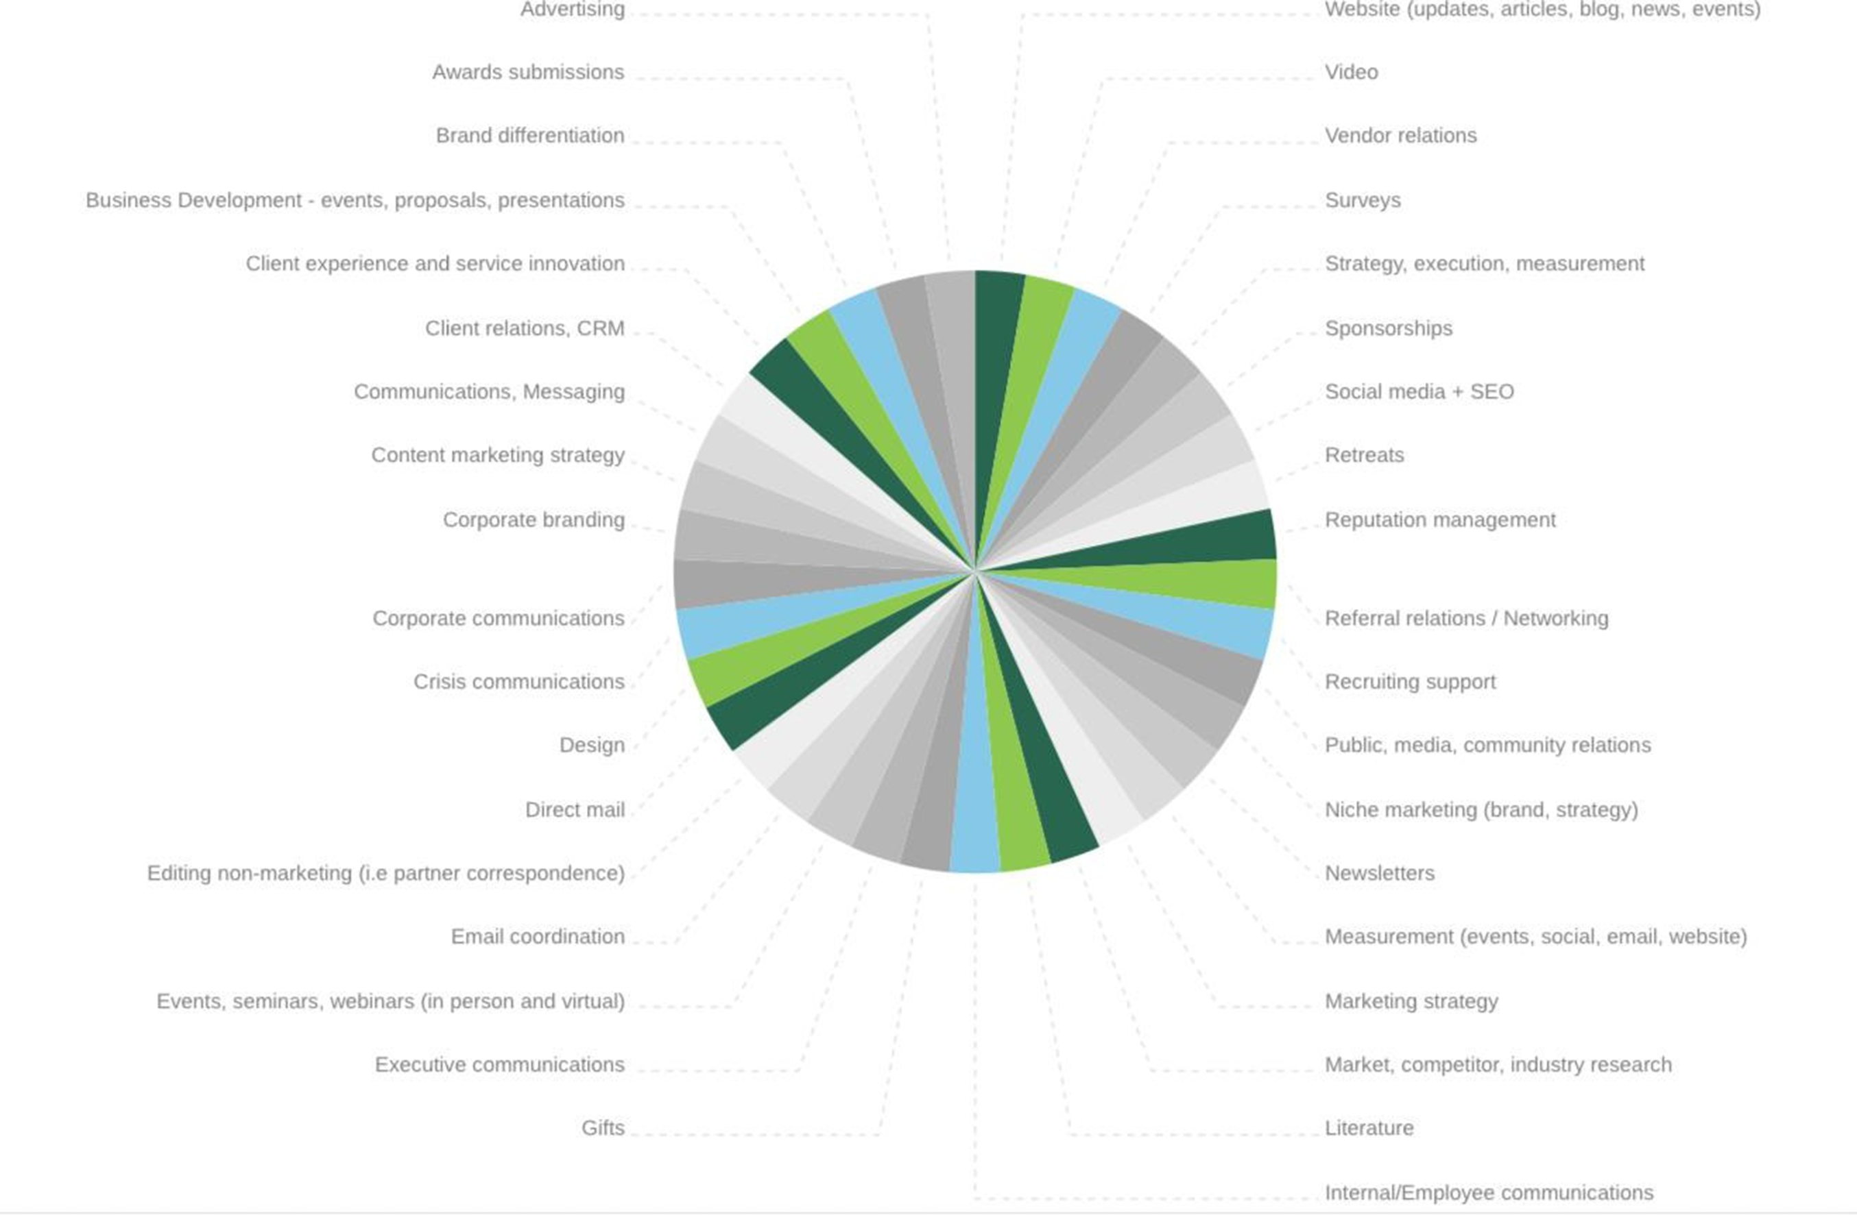
Notes:
12% of revenue
Align with business plan
Objective(s)
Target audience
SWOT
Channels
Go to market strat (personas, journey, KSP/UVP)
Accountability
Budget
Measure performance

Slide 10
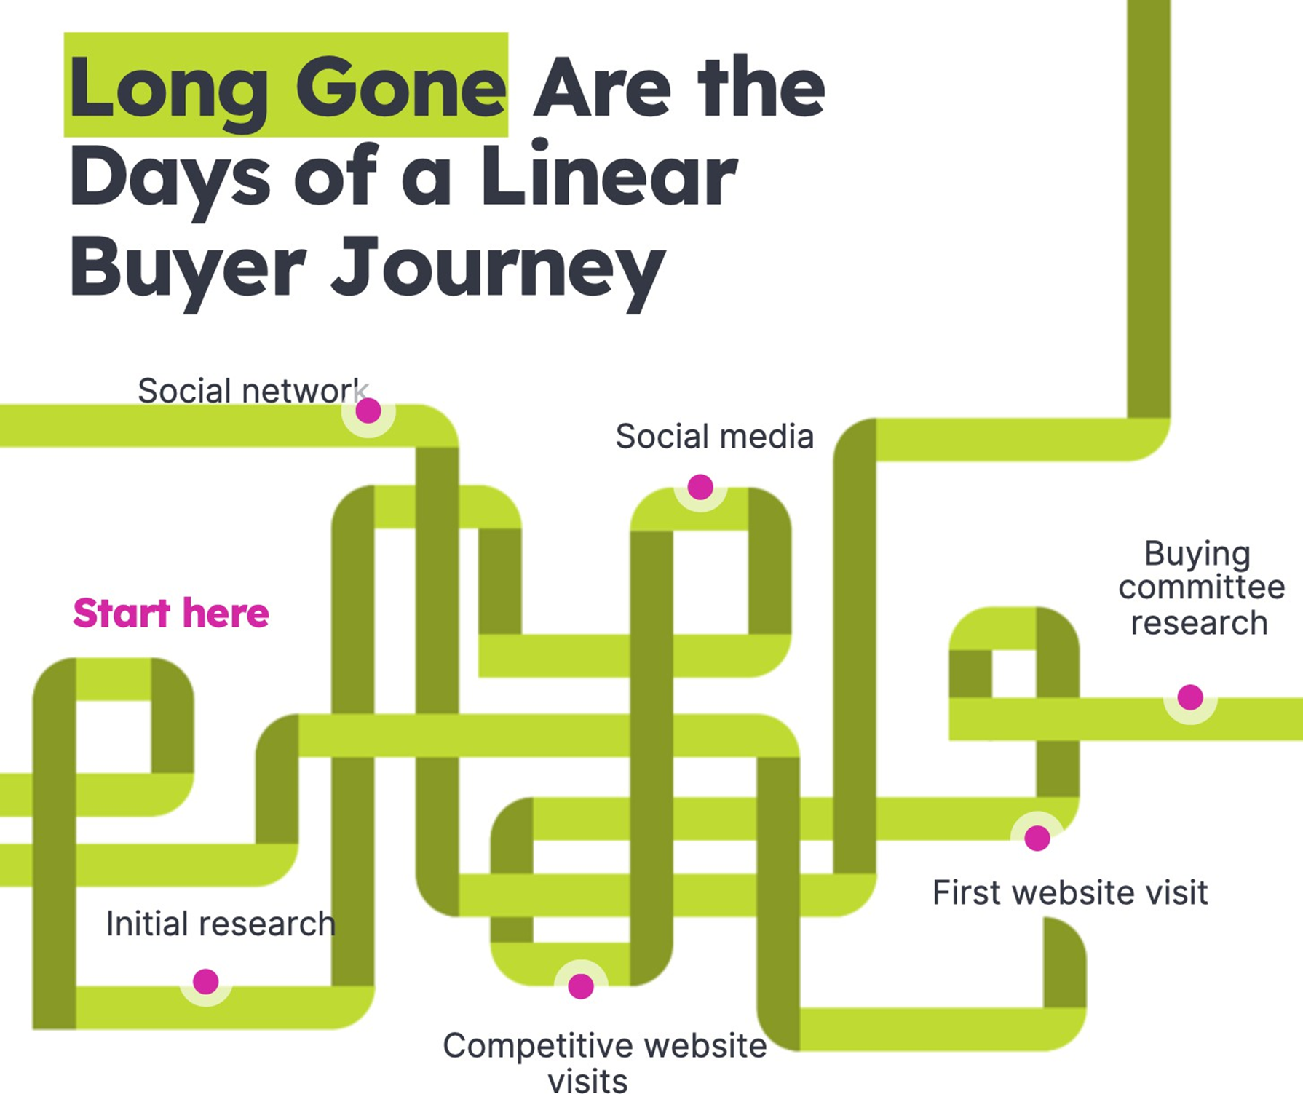
Notes:
marketing messaging by capitalizing on customer experience. So many B2B brands offer amazing resources, on-boarding, training, and/or community for their clients, and these are often ‘hidden benefits’ of working with them.
Measure — SURVEY

Slide 11
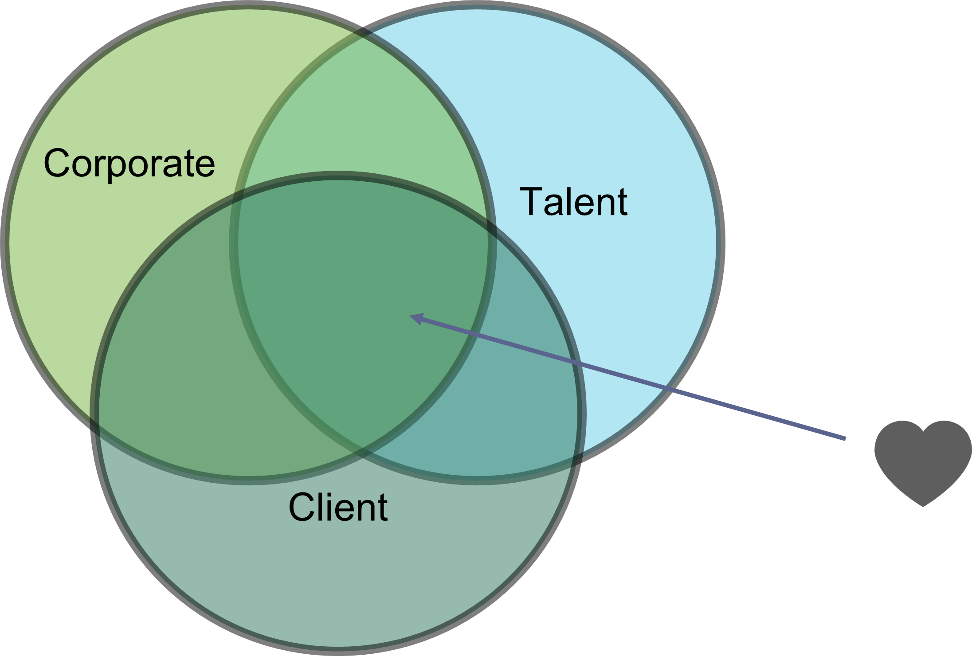
Unified Brand Strategy
Notes:
DNA
who/what you are, what you do, how you do it; your purpose, relevance to its audience. It often includes a general description of the organization, its function, and its objectives
Brand messaging is how you communicate about your business, both internally and externally. You want brand messaging to be consistent and unique, so you can showcase who you are as a business. Learn what brand messaging is, and get six steps to create your own brand messaging framework that elevates your marketing.

Slide 12
The CMO
As chief marketing officers take on more responsibility and ownership of CX, understanding the influence they have on company growth is critical to success in this rapidly evolving role.

Slide 13
“75% of a brand is now built through experience — build the experience to build the brand”
On the Evolving Role of the CMO…
- Suzanne Kounkel, Chief Marketing Officer, Deloitte

Slide 14
“If you lose money for the firm, I will be understanding. If you lose reputation for the firm,
I will be ruthless.”
On Reputation
- Warren Buffett
Notes:
reputation is probably the most important but the least valued by executives. After all, you can’t directly measure it.

Slide 15
External Brand
How your people feel when they talk about you and your team and your services
aka Employer Brand
Notes:
In the B2B market it takes on average 27 “encounters” from the first contact until the sale is closed.
85% of U.S. Consumers would pay more for a superior experience. Price becomes irrelevant.
Customer-centric companies are more profitable
39% of people switched brands after a bad experience. - Deloitte

Slide 16
Internal Branding
“Customers will never love a company until the employees love it first.”
- Simon Sinek

Slide 17

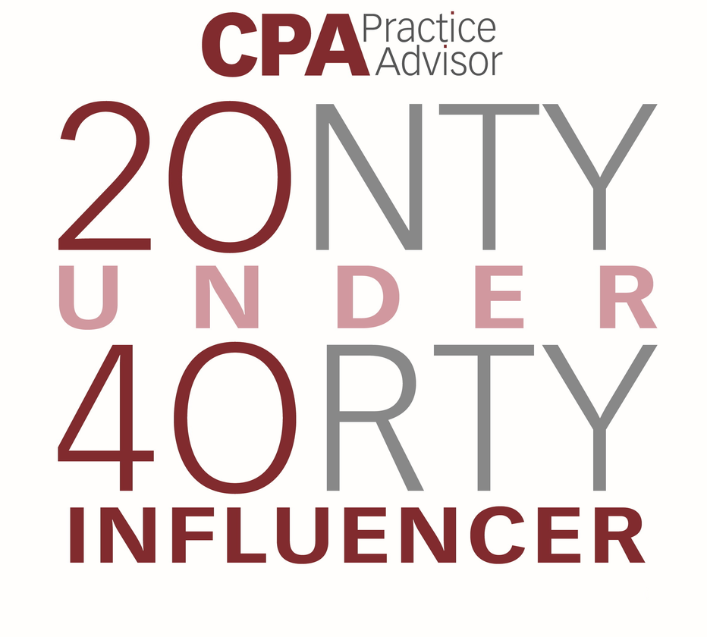
Thank You
CONTACT
Dtoth@WindingRiverConsulting.com
p: 440.723.3653
SKILLS
Leader, Speaker, Influencer, Change Agent

