Slide 1


Current State of M&A
MPB | Leadership Accelerated
May, 2025
Gary S. Shamis, M. Acc

Slide 2
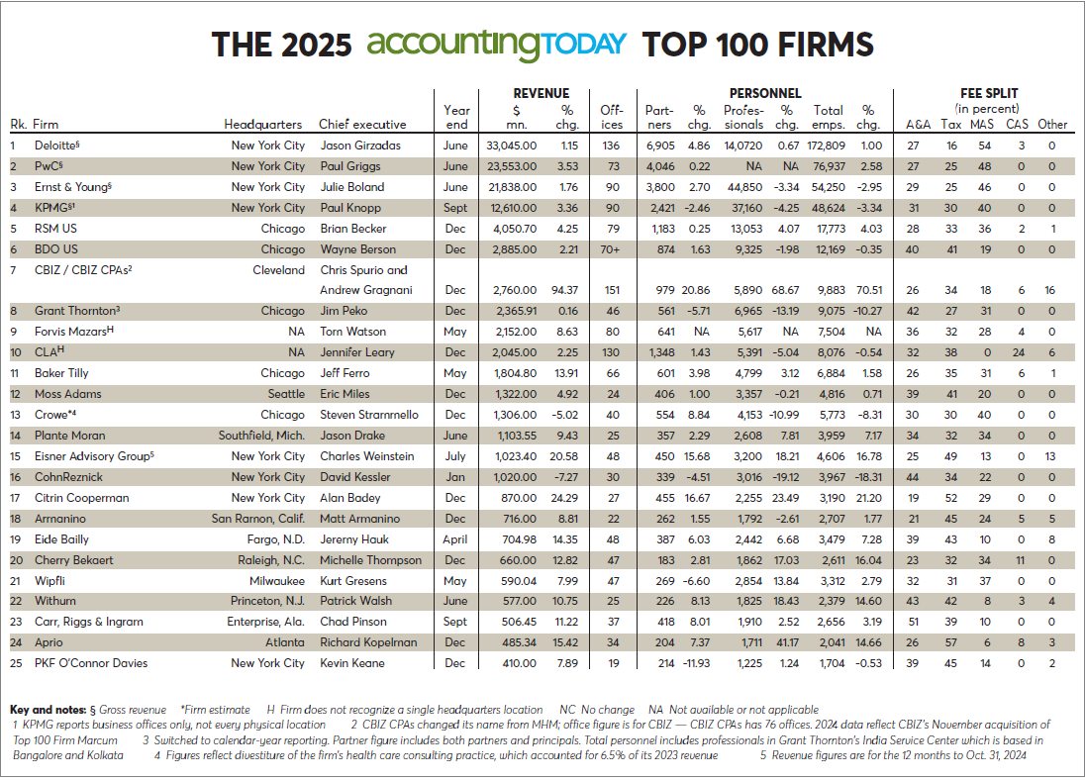

Slide 3
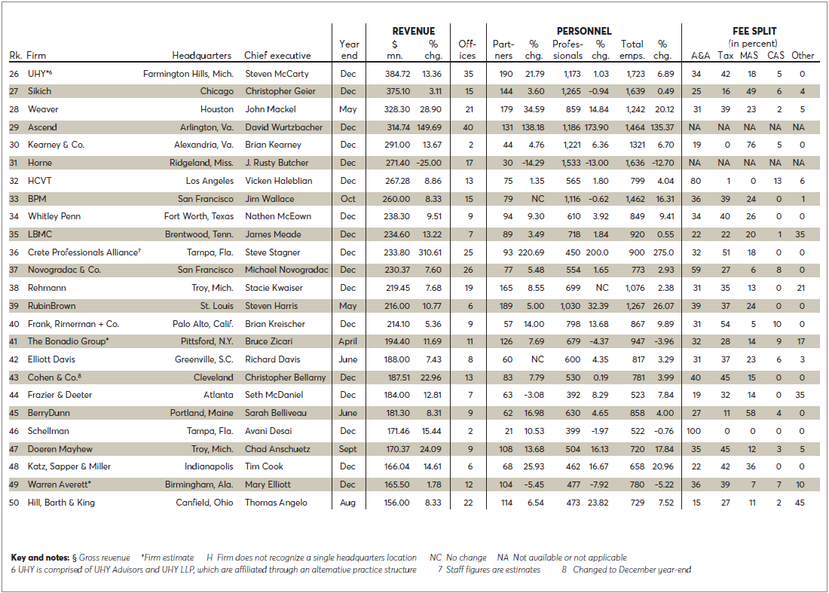
- Accounting Today

Slide 4
Historical Deal Structures
No Cash
Liquidate balance sheet
Acquire covers working capital
All do better
Retirement – yours or theirs

Slide 5
PE Era
PE has one goal
Senior partners cash out
Change in governance / ownership
PE will monetize
Rising partner risk
Capital for growth

Slide 6
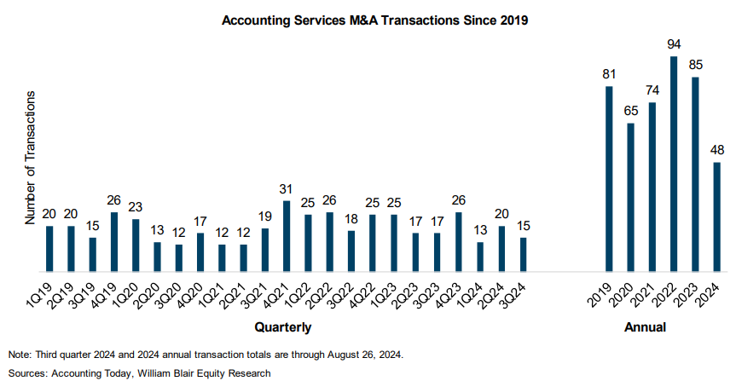

Slide 7
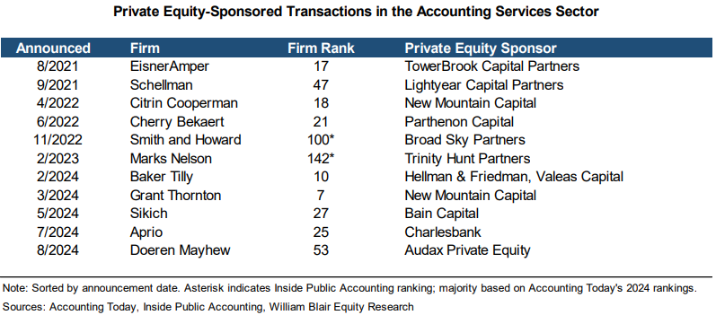

Slide 8
Related Economics
Senior Partners
  Very, very favorable
Rising Partners
  Time will tell
  Minority owners
  Restrictions

Slide 9
PE
Adjusted EBITDA x multiplier
PE - Financial Engineering
PE - Roll Up
PE - Minority

Slide 10

Thank You
CONTACT
GShamis@WindingRiverConsulting.com
p: 440.723.3653
f: 440.723.3654
SKILLS
Leader, Speaker, Author, Change Agent

