Slide 1


BIOS
COHORT 18
MPB | Leadership Accelerated

Slide 2

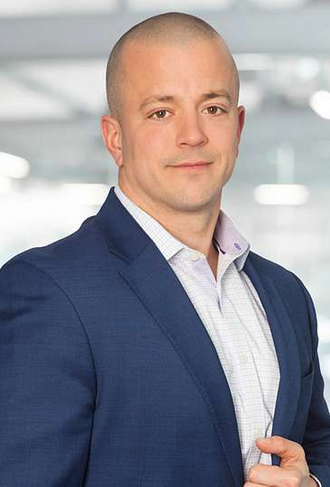
John Surrette
KLR
Partner, Director of Private Equity and Transaction Services Group
Over 20 years of experience in public and private accounting
Chair of the Private Equity and Venture Capital Services Group
Co- Chair of the Renewable Energy Services Group
Member of leadership teams of KLR Outsourcing and KLR Executive Search
Works closely with private equity and venture capital firms in meeting both back office and portfolio company needs
Assists clients looking to obtain debt and equity financing
Experienced in assisting clients in evaluating investment opportunities as well as hands on experience during the pre and post transaction process, including providing buy-side and sell-side due diligence/ quality of earnings services
Audit and consulting experience with clients in a variety of industries including renewable energy, private equity, technology, professional services, construction, casino gaming, auto dealerships, manufacturing, distribution, forensic accounting and employee benefit plans
Assists clients in the evaluation of internal controls, fraud examination and forensic accounting engagements

Slide 3
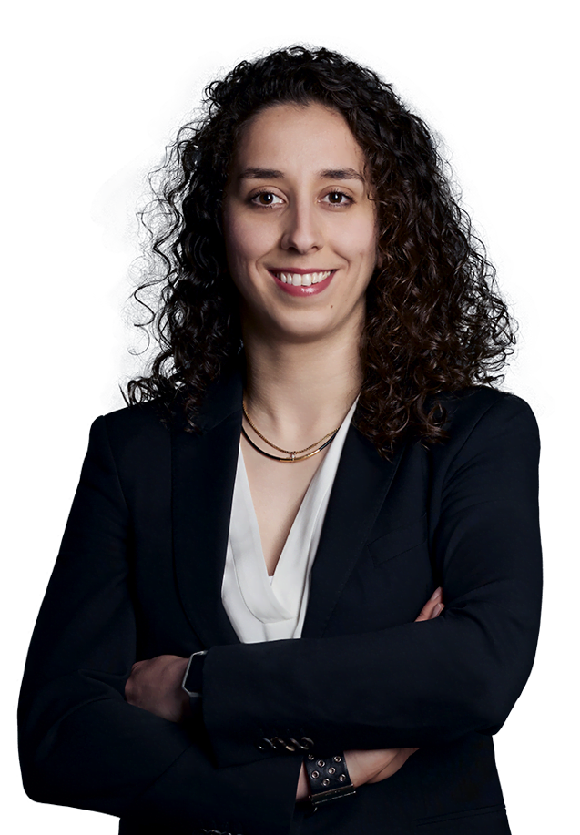

Kristina Ashqar
PSB
CPA Auditor, Co-Managing Partner
Kristina Ashqar joined PSB BOISJOLI as an intern in 2005 and quickly advanced in the firm’s Audit and Assurance Division. She became a Partner in 2019 and, in 2024, was named Co-Managing Partner, the firm's youngest and first female in the role. Kristina manages major client accounts, oversees the audit department, and co-chairs the Executive Committee.
With expertise in audit, assurance, IFRS, and ASPE, she’s recognized for her leadership, innovation, and commitment to fostering a collaborative environment. Kristina also plays a key role in recruitment and is a highly respected figure in the profession.

Slide 4
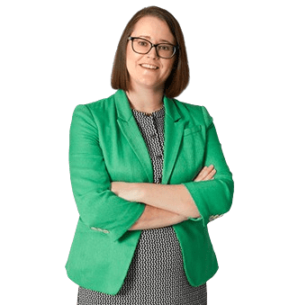

Lauren Weddell
Schneider Downs
Shareholder
Lauren has been with the firm since 2004 and has experience serving a variety of clients in the manufacturing, real estate, not-for-profit, higher education, distribution and professional services sectors, including publicly traded companies. This experience includes a focus in regulatory compliance and complex investment portfolios. Lauren also has significant experience in auditing employee benefit plans, including 11-K filings.
She is responsible for the management and coordination of selected audits, as well as the delivery of the firm’s accounting, assurance, tax and business advisory services to her client base. These responsibilities require an extensive knowledge of financial reporting requirements and operational and organizational concerns of the entities served.

Slide 5
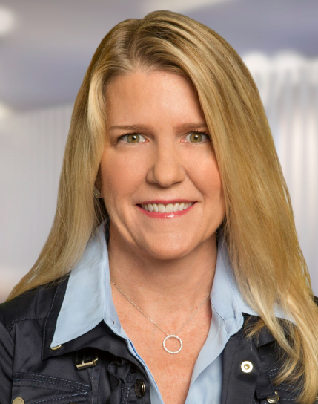

Melanie Fernandez
BDO USA
Alliance Relationship Principal
Melanie, an Alliance Relationship Principal at BDO USA, P.C., connects CPA member firms of the BDO Alliance USA with resources to help them expand services while maintaining independence. With a career at BDO starting in 1987, she co-founded Cross, Fernandez & Riley, LLP, which maintained a BDO alliance before rejoining BDO in 2015.
After 36 years as an assurance partner, Melanie joined the BDO Alliance team in 2023. Her deep understanding of business ownership is a key asset to her clients. Outside of work, Melanie enjoys yoga, biking, swimming, and traveling.

Slide 6
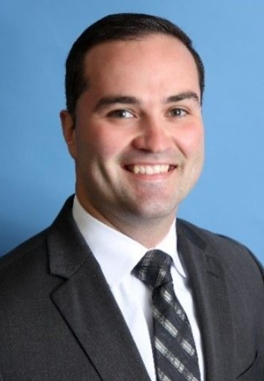

Nick Ficklin
Blue & Co.
Director
Nick Ficklin is a Director with Blue & Co., LLC in the Louisville office working primarily with the reimbursement department. He has extensive experience working with hospitals on the Medicare & Medicaid disproportionate share hospital (DSH) calculations, SSI, worksheet S-10, E.H.R. incentive payments, eligibility verification, Medicare & Medicaid appeals as well as cost report preparation.
Mr. Ficklin graduated from the University of Southern Indiana with a degree in Accounting & Professional Services. Mr. Ficklin currently serves as the President for the KY Chapter of the Healthcare Financial Management Association. He is currently a member of YPAL, AICPA and KY CPA Society.

Slide 7

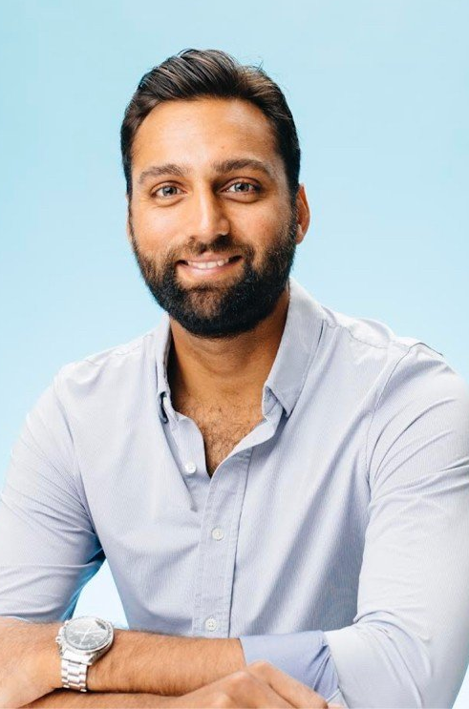
Nishaad Ruparel
Ascend
President
In my time as an investor, I saw sparks fly when people allowed themselves to set ambitious goals and built trust with one another along the way. My role at Ascend is to tend to that fire - marrying our passion to revitalize this industry with a warm spirit that forges partnership on the road ahead.
My favorite Ascend value is "Win Together." Nothing significant was ever accomplished alone, and it is far more fun to share success!
I am fortunate and grateful for the experiences that have led me here - my upbringing in a diverse suburban town in New Jersey, my decade in New York City, split between time spent studying at NYU (BS in Finance and International Business) and years working in Investment Banking (J.P. Morgan) and Private Equity (AEA Investors). My most recent chapter has been in Northern California, where I spent 2 years at Stanford (MBA) and was later recruited by Alpine Investors to launch Ascend.
Depending on the weekend, you might find my wife and I strolling San Francisco's hilly streets, or with friends, enjoying the outdoors on a golf course, hiking trail, or snowy ski run.

Slide 8
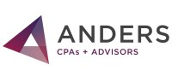
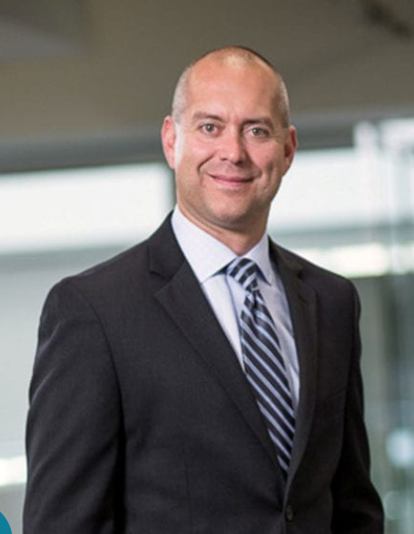
Rob Berger
Anders
Partner, Tax
A partner in tax, Rob works with closely-held business owners on individual and corporate tax consulting and retirement planning. As the Director of the Real Estate and Construction Group, Rob has been integral in developing the firm’s expertise, marketing plan and growth strategy in this industry. He works closely with real estate developers and construction contractors on tax planning and operational strategies, providing guidance on cost segregation analyses, like-kind exchanges and R&D tax credits. Invested in building the firm of the future, Rob is member of the executive committee and involved in the development and implementation of the firm’s strategic plan. A graduate of the Rainmaker Academy in 2017, Rob was named a 40 Under 40 in 2017 by the St. Louis Business Journal and chosen for the AICPA’s 2012 Leadership Academy.

