Slide 1


BIOS
COHORT 19
MPB | Leadership Accelerated

Slide 2

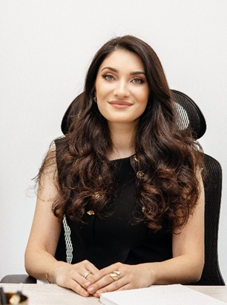
Madina Behretdinova
Miaccounting Co
Founder and CEO
Madina Bahretdinova (Mia) is the founder and CEO of Miaccounting Co with 10 years of overall experience in taxation and accounting. With over 5000 clients primarily Russian speaking small business owners and 20 employees the company has grown at a very fast pace and is continuing to grow providing clients with tailored personalized approach at affordable prices.
Mia is very passionate about the business and scaling this small firm by turning it into a large accounting corporation.

Slide 3

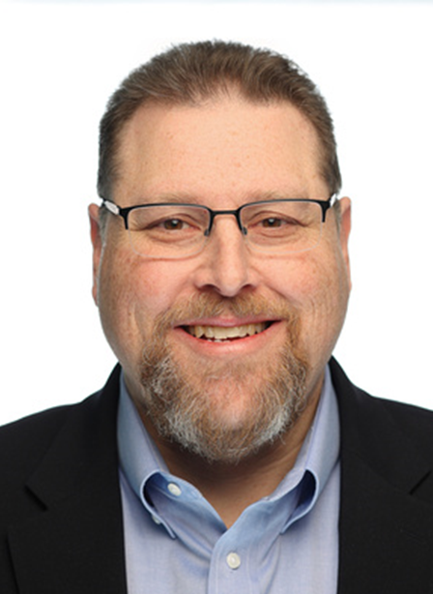
Jon Cohen
G-Squared Partners
Managing Director
For the last twelve years, Jon has been a Managing Director with G-Squared Partners, guiding and assisting venture-backed companies. Prior to that, he held various positions in publicly traded and privately held companies in the software, e-commerce, manufacturing, and distribution industries.
Throughout his career, he participated in more than 20 M&A transactions on the buy and sell sides.
Jon has served as VP, Chief Accounting, and Principal Financial Officer for two publicly traded firms. He received an MBA with a concentration in finance from LaSalle University and a B.S. in management/accounting from Hartwick College. He is a certified public accountant.

Slide 4

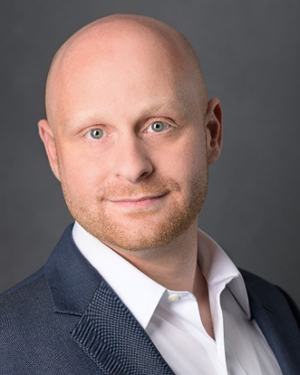
Alex Drost
Connection Builders
Managing Principal
Alex Drost is a growth-minded consultant with a proven track record of success in driving innovation, leading strategic initiatives, and championing tactical execution. He has nearly two decades of entrepreneurial experience and continually demonstrates his ability to navigate dynamic business environments. He is adept at managing complex projects, simplifying core objectives, and motivating teams to achieve their best work.
Beginning his career in financial services, Alex served as Vice President of Middle-Market Investment Banking with Cascade Partners. With nearly 15 years of M&A and private capital markets experience, he has successfully led capital raise, buy-side, and sell-side transactions in various industries, including professional services, physician practices, multi-site retail, and telecommunications.
Alex consults with middle-market advisory services firms on setting and attaining strategic initiatives to unlock growth potential and maximize value creation opportunities. His work includes strategic planning, retreat facilitation, and growth enablement services.
As a recognized middle-market expert, Alex has served as a Board Member of the Association for Corporate Growth (ACG) and is a current board member of the Association for Accounting Marketing (AAM).
Alex earned a Bachelor of Business Administration from Northwood University, with dual majors in accounting and finance, and holds an M.S.F. from Walsh College, specializing in corporate finance. He is also a registered CPA in the State of Michigan.

Slide 5

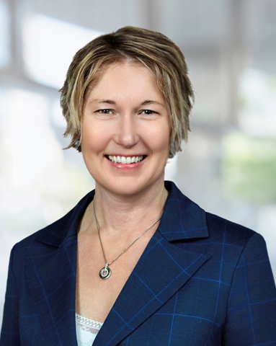
Melissa Griffiths
BDO
Western Region Relationship Director
Melissa has worked with CPA firms since 1995 and was responsible for BDO’s West Coast business development practice from 2000-2010. For many years she had her own practice providing business development strategy and consulting to CPA firms before moving into the legal industry, where she provided business development services to AmLaw 100 firms.
She is currently the Western Region Relationship Director for BDO’s Alliance program, responsible for managing relationships between CPA clients and BDO.

Slide 6
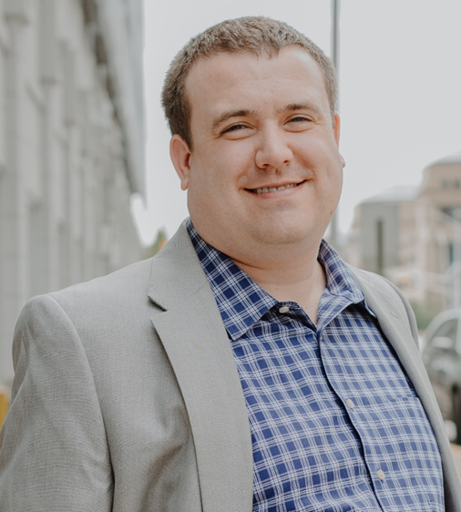

Michael Jamison
OnTarget CPA
Owner and Founder
Michael Jamison is the owner and founder of OnTarget CPA, and 2025 marks the firm’s 10-year anniversary. Located in the heart of downtown Indianapolis, OnTarget CPA specializes in accounting, taxation, IRS resolution, and consulting needs for individuals and rapidly growing companies.
The firm currently employs 20 professionals and has been named to Inc 5000’s list of fastest growing privately held U.S companies for three consecutive years.

Slide 7
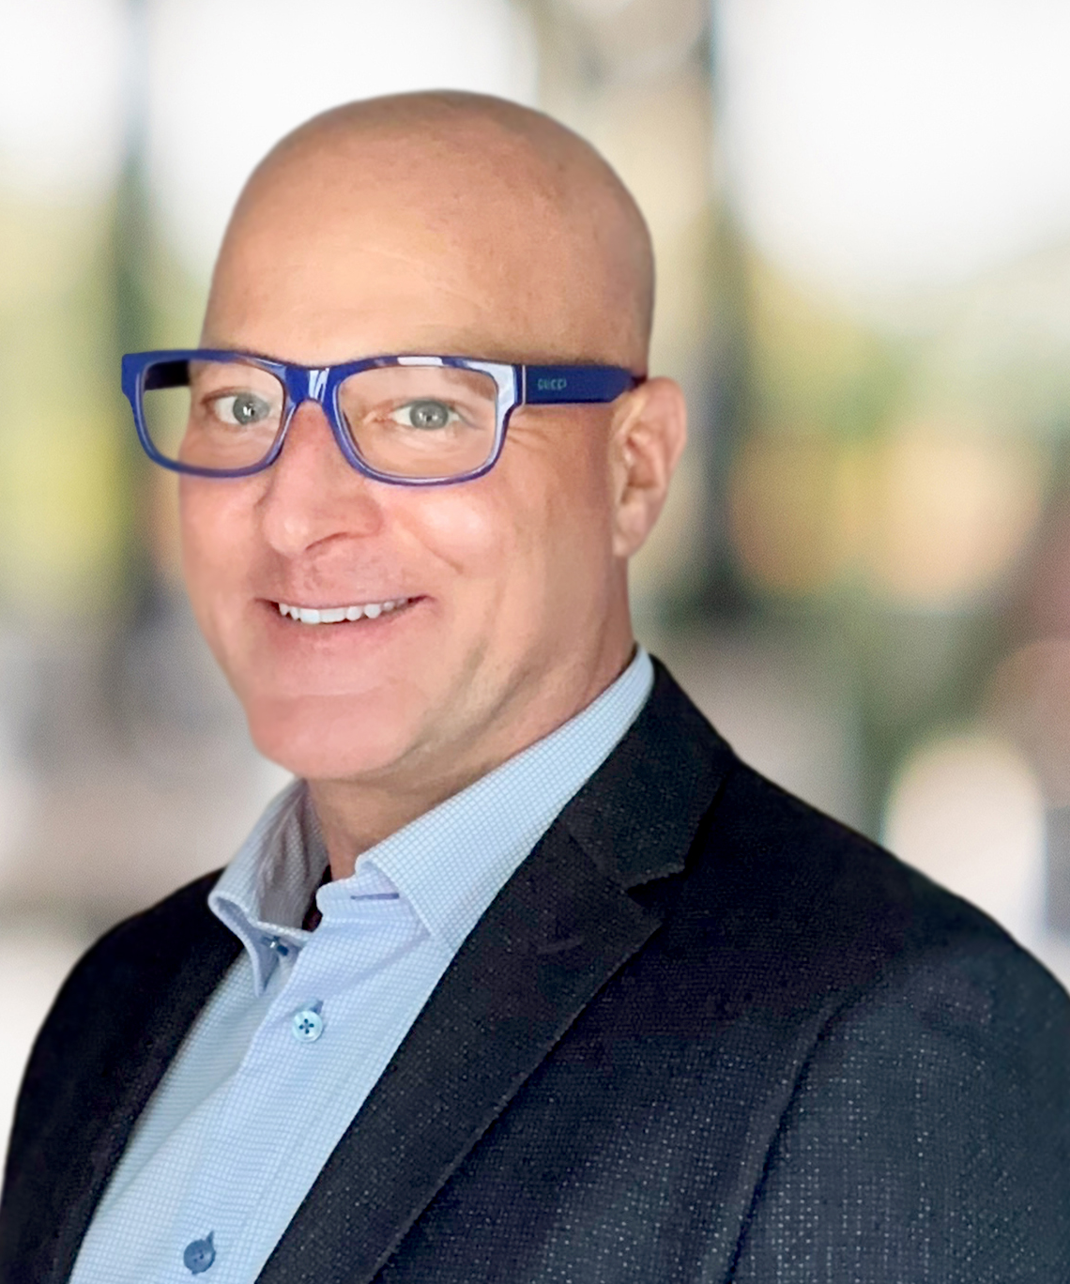

Kevin Kroskey
True Wealth Design
Founder
Kevin founded and bootstrapped True Wealth Design (TWD), an RIA firm, in northeast Ohio in 2007. Tax services were added a few years later, as were a few small CPA firm acquisitions 2023-25, beginning to build out more robust and tightly integrated services.
TWD has consistently won regional and national growth awards and has tripled in people over the last 3 years, experiencing the 'good kind of pains.'

Slide 8


Anthony Mangiarelli
KLR
Partner, Director of Strategic Business Services
My Name is Anthony Mangiarelli, a Shareholder at KLR, a top 100 CPA firm with primary headquarters in New England. I serve many roles at the firm including Board Member, Director of Strategic Business Services and Co-Chair of the Growth and Transition Service team. While I grew up on the audit side of the practice, I also obtained a master’s in taxation and primarily work with companies that are privately held or family-owned to assist navigating growth strategies, succession planning, taxation, and financial reporting.
I am the proud father of two amazing children (Lexi and Joey). When not working or spending time as We3, you can find me out for a run, enjoying live music and concerts, on the soccer field late night or early morning or driving around aimlessly with the top and doors off the Jeep.

Slide 9

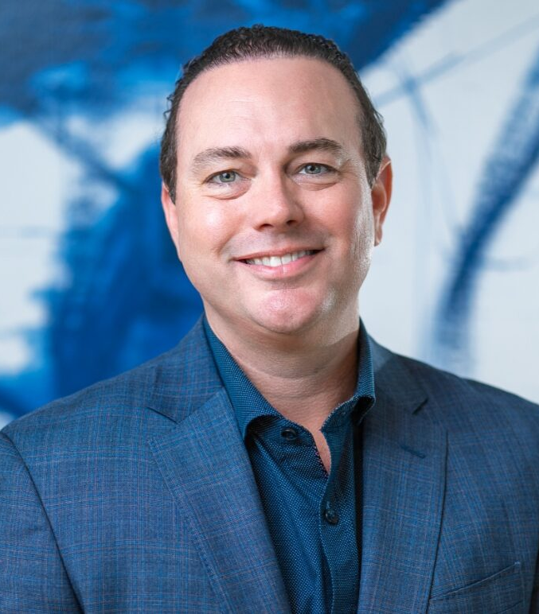
Brett Mills
McCarthy Rose & Mills
CEO, Managing Partner
Brett has been with MRM CPAs and Advisors for 20 years and has helped MRM grow from a local accounting practice to a nationally recognized CPA and wealth management firm. Brett holds two professional licenses –the Certified Public Accountant (CPA) license and the Personal Financial Specialist (PFS) license.
Brett is passionate about making valuable connections and helping others to reach their career and retirement goals.

Slide 10

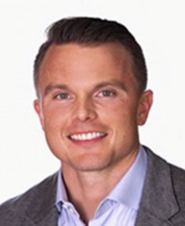
Patrick O’Neill
Firm360
CEO
Patrick O’Neill is the CEO of Firm360, where he’s focused on building software that actually makes life easier for accounting firms. With a background in Sales and Customer Success, he’s all about creating great teams, a strong culture, and products that deliver real value.
At his core, Patrick believes that if you take care of your people, they’ll take care of the business — and that philosophy has shaped every stage of Firm360’s growth.

Slide 11

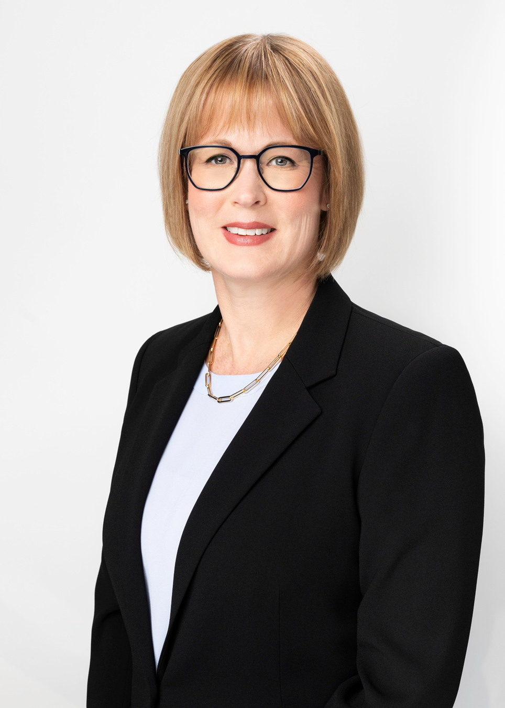
Jennifer Phipps
Manning Elliott, LLP
Managing Partner
Jennifer is the Managing Partner at Manning Elliott LLP, a leading accounting and business advisory firm with 275 employees and four offices serving the Greater Vancouver area of British Columbia, Canada. Prior to joining Manning Elliott in 2018, Jennifer was a founding partner at Leed Advisors Inc., a boutique accounting and tax services firm she managed with three other partners.
Jennifer has been practicing for 30 years, providing assurance, accounting, and tax services to businesses across a wide range of industries.

Slide 12
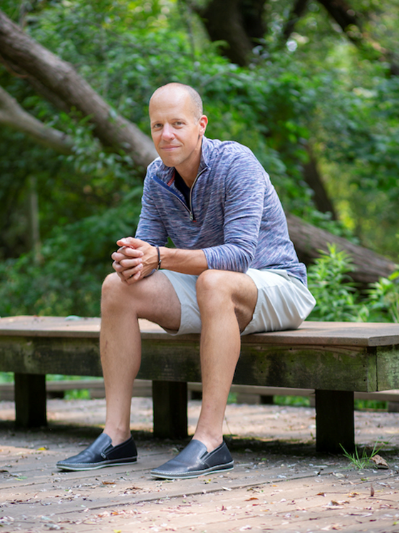

Todd Resnick
OneSeven
Co-Founder and CEO
Todd Resnick is Co-Founder and CEO of OneSeven, a rapidly growing RIA based in Cleveland, OH. Supporting move than 75 financial advisors and managing more than $5.3B in AUM, OneSeven is focused on creating life-changing opportunities for advisors, their staff, and clients.
Todd’s passion is for building relationships with everyone he connects with and provide them the resources and tools they need to build the life and business they desire.

Slide 13
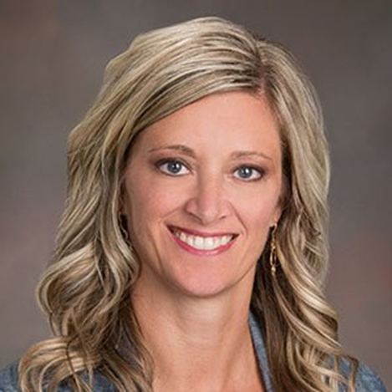

Jamie Rivette
Yeo & Yeo
Principal
Jamie L. Rivette, CPA, CGFM, Principal at Yeo & Yeo CPAs & Advisors. She has over 25 years of experience in audits for municipalities and government entities. Jamie is the leader of Yeo & Yeo’s Assurance Service Line and a member of the Board of Directors. As the Assurance Service Line leader, she oversees the quality and growth of Yeo & Yeo’s audit and assurance practice firm wide.
She was the past Government Services team leader and member of the Michigan Government Finance Officers Association (MGFOA) Board.

