Slide 1


BIOS
COHORT 20
MPB | Leadership Accelerated

Slide 2

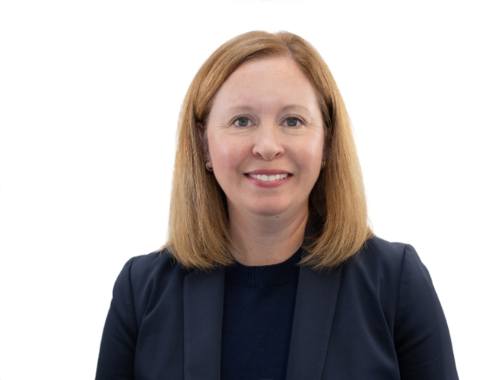
Colleen Mhley
BDO Alliance USA
National Marketing Director
Colleen Mhley is the National Marketing Director for DCO Alliance USA, a subsidiary of BDO USA, P.C. and the largest U.S.-based association of CPA and consulting firms serving over 400 member organizations and 25,000 professionals. She has over 25 years of experience in marketing and communications for accounting firms and associations. Colleen led the inception of BDO Alliance USA's marketing function in 2004 during a period of transition and growth, serving as a department of one for many years before expanding her team. As part of the BDO Alliance Leadership team, she oversees all marketing and communications activities, including strategy, budget, brand awareness, event sponsorship, email and web marketing, advertising, video, and social media. She is also the chair for BDO Alliance USA's annual EVOLVE conference in Las Vegas.
Colleen received a B.S. degree in Marketing from Boston College, and a M.A. degree in Psychology from Adler University.

Slide 3

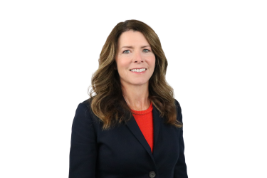
Brandy Vannoy
Johnson Lambert
Managing Partner-Elect
Brandy Vannoy is a Tax Partner and the incoming Managing Partner at Johnson Lamber, a multi-office firm specializing in audit, tax, and consulting services for insurance entities, nonprofit organizations, and employee benefit plans. With more than two decades of experience, Brandy brings deep expertise and a comprehensive understanding of the firm and its clients.
Brandy joined Johnson Lambert in 2004 and has since held numerous leadership positions, including serving on the firm's Executive Committee and as a leader in its tax practice. As a Tax Partner at Jonhson Lambert, she has over 25 years of experience in providing engagement management, tax compliance, and consulting services to the firm's clients. She also consults on federal and state tax issues, advises on business opportunities, and is experienced with IRS and state department exams. She holds a Master Accounting from North Carolina State University and a bachelor's degree from the University of North Carolina at Chapel Hill.

Slide 4


Camilo Maldonado
Windsor Path
Co-CEO
Camilo Maldonado is the Co-Founder and Co-CEO of Windsor Path, a growth-oriented platform that partners with entrepreneurial CPA firms to preserve their legacies while powering their next phase of expansion. In 2025, Windsor Path completed its inaugural acquisition of WFFA Advisors in New York. Camilo previously built two technology businesses and was an early employee at Bonobos (acquired by Walmart). Camilo holds an MBA from Harvard Business School and a finance degree from the Wharton School of the University of Pennsylvania.

Slide 5

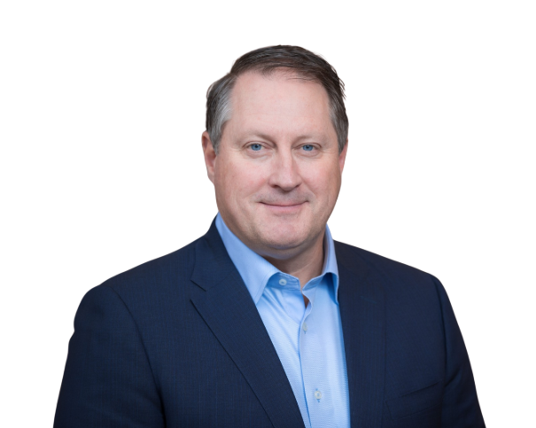
Erik Allen
Boulay
Managing Partner Elect
Erik Allen, CPA, CM&AA, Managing Partner Elect at Boulay PLLP, has more than 25 years of experience in accounting, auditing and management consulting. After graduating from Gustavus Adolphus College with a bachelor's degree in accounting, Allen started his career at Boulay. He was named a partner in 2002 and is a member of the Boulay PLLP and Boulay Finance Advisors, LLC Board of Directors. Allen previously led Boulay's audit department as the partner-in-charge of audit services. He currently oversees audit and other financial reporting engagements for client in a variety of industries, including ESOP-owned companies. As Manager Partner, Allen will lead the firm's strategic planning and direction, identify growth opportunities for Boulay, ensure the quality of the practice, and support the development of partner as well as client-service and operations team members.
Allen is a Certified Public Accountant and a Certified Mergers and Acquisitions Advisor. He served as a National Advisory Board Member of the Gustavus Adolphus College Department of Athletics and the Department of Economics and Management.

Slide 6

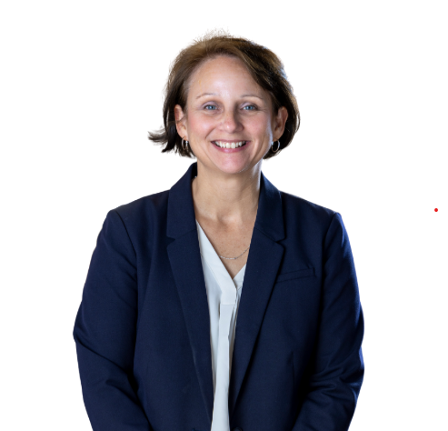
Paula Lathrop
Fiorita Kornhaas & Company, PC
Audit Partner
Paula started her accounting firm career with EY on the audit side after graduating from Siena College with an accounting degree. Paula was Assistant Controller for Saratoga Hospital for 10 years.
Paula Relocated to MA and worked for a small CPA in Foxboro for 3 years where she worked on the tax side.
In 2011, Paula began work for Fiorita Kornhaas & Company, PC. She has over 30 years of experience and manages the audit practice at FKC as well as overseeing firm quality management.

Slide 7

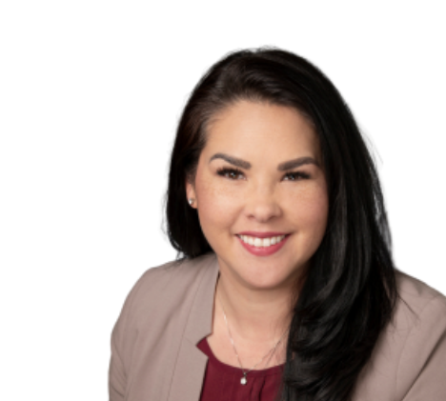
Gina James
MarksNelson
Partner
Gina is a highly accomplished Tax Partner with over 25 years of experience in financial accounting and taxation. Throughout her career, Gina has held significant leadership positions, including the owner of her own CPA firm and Managing Partner at UHY. Her extensive industry expertise span construction, golf, real estate, and the restaurant sector, making her a trusted advisor for clients across diverse fields.
Gina earned her Bachelor of Science in Management Accounting for Park University. She is an active member of several professional associations, including AICPA and MOCPA, where she stays at the forefront of industry standards and practices. Gina exemplifies professional excellence, making her a respected leader in both the account profession and her local community.

Slide 8

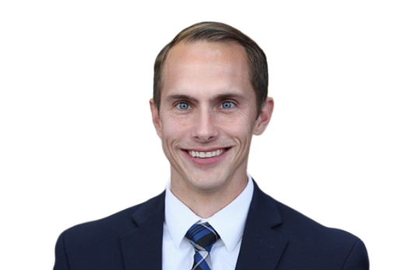
Aaron Apathy
Corrigan Krause
President & CEO
Aaron C. Apathy is the President & CEO of Corrigan Krause. He has almost 20 years of experience servicing closely-held businesses on financial reporting, consulting, and tax compliance. Aaron started at Corrigan Krause as an intern while he completed his MBA program at Baldwin Wallace University and was hired full-time after he graduated.
Today, Aaron helps lead our Healthcare/Dental specialty group, is focused on business development opportunities and leads the firm's management committee.

Slide 9

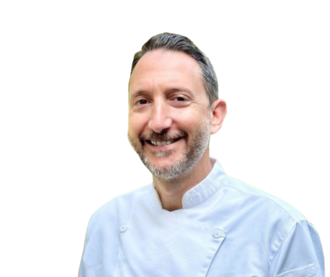
Brad Race
Kind of One Concepts
Culinary Director
Brad Race is a dynamic Culinary Executive with 20+ years of experience leading restaurant concepts from Michelin-starred fine dining to trend-forward multi-unit operations. Recognized for driving innovation, scaling operations, and building award-winning teams that deliver both unforgettable guest experiences and measurable business growth.
Brad's highlights include launching and operating restaurants coast-to-coast, from Jose Andres avant-garde Minibar and SLS Bazaar to Catch LA, where he led a 95-person team, serving as culinary director for Michael Voltaggio, shaping and expanding new concepts across Los Angeles, founding partner and Executive Chef of Bearnaise, a French brasserie in DC awarded 3 stars by The Washington Post, and leading culinary operations at The Last Page in Cleveland, where he oversaw menu development, vendor partnerships, P&L, and kitchen leadership – earning "Best New Restaurant" and multiple Silver Spoon awards.

Slide 10

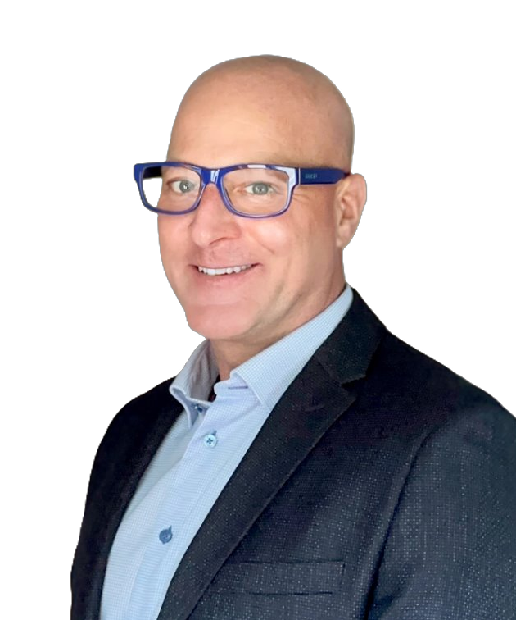
Kevin Kroskey
True Wealth Design
Founder & CEO
Kevin founded and bootstrapped True Wealth Design (TWD), an RIA firm, in northeast Ohio in 2007. Tax services were added a few years later, as were a few small CPA firm acquisitions in 2023-24, beginning to build out more robust and tightly integrated services. TWD has consistently won regional and national growth awards and has tripled in people over the last 4 years, experiencing the 'good kinds of pains'.

