Slide 1


BIOS COHORT 21
MPB | Leadership Accelerated

Slide 2

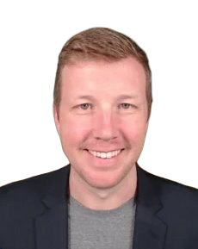
Brandon Hall
Hall CPA
CEO & Managing Partner
Brandon Hall is a Certified Public Accountant, national speaker, and is the Founder/Managing Partner of Hall CPA PLLC.
Brandon works with real estate investors, syndicates, and private equity funds to optimize tax positions and streamline accounting and business functions. He believes that real estate investing is critical to building sustainable and generational wealth.
Brandon worked at PricewaterhouseCoopers and Earnt & Young prior to launching his own CPA firm in 2016, Hall CPA PLLC (The Real Estate CPA).
Through the knowledge gained by working with real estate investors, Brandon has built a real estate portfolio of 25 units consisting of multi-family, single family, and short-term rentals.

Slide 3

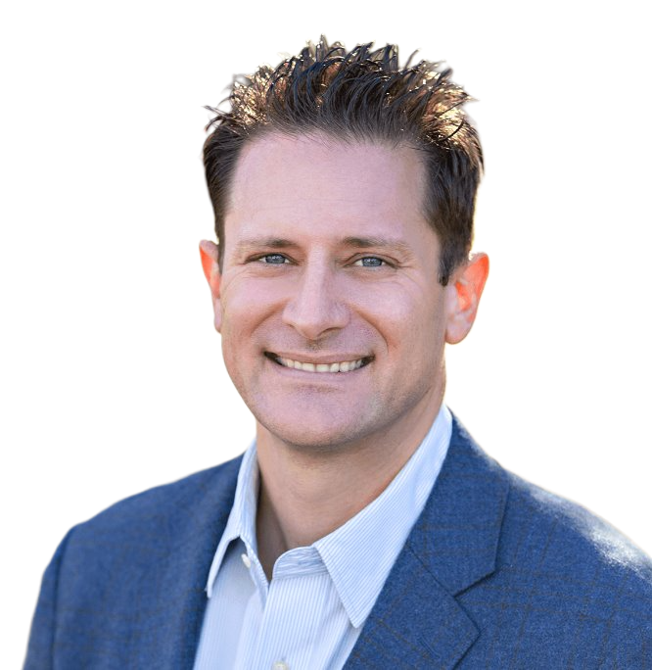
Scott Gilmore
Ascend Tax and Business Advisors
CEO & Managing Partner
Scott Gilmore is a specialist in tax minimization and compliance and provides all types of audit and assurance work to a variety of clients while meeting their special needs. Scott has extensive experience in the real estate industry working with clients for the entire cycle of their real estate assets. Scott "digs in" during the due diligence period to lend his expertise to the acquisition, helps with investor and financial reporting along the way, and assists with the various options and hurdles that come with the sale or exchange of real property.
Scott has also worked with a variety of service providers in numerous industries with all of their tax and accounting needs. His goal of top-notch service to each and every client has helped highly compensated individuals and firms focus on what they do best, while he takes care of the rest.

Slide 4

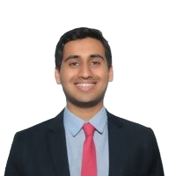
Vinay Kasat
Modus Audit
Co-founder & COO
Vinay is the COO & Co-Founder of Modus. Modus aims to re-imagine the financial audit with the goal of delivering the highest quality audit, in a fraction of the time. Prior to Modus, Vinay was a Portfolio Manager at Squarepoint Capital. He graduated from the University of Pennsylvania with degrees in Finance, Statistics, and Data Science.

Slide 5

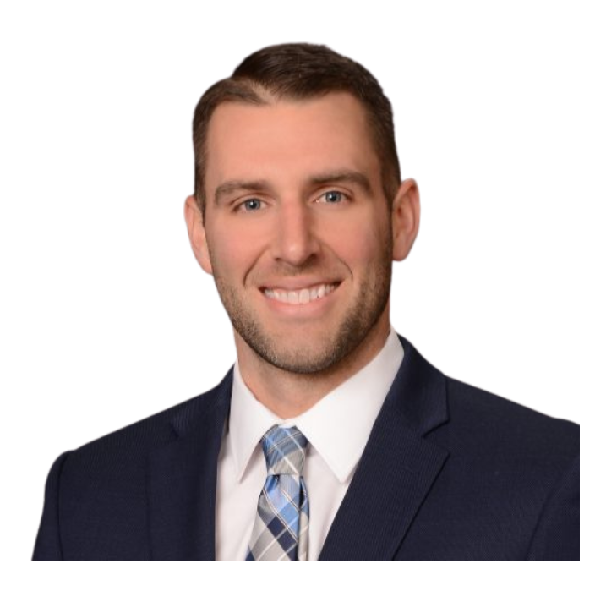
Trey Gailey
KatzAbosch / BlueStone Accounting Solutions
Managing Partner Elect / Managing Director
Trey Gailey currently serves as the Managing Partner of BlueStone Accounting Solutions, LLC, a KatzAbosch subsidiary that provides outsourced business solutions. Bringing a wealth of experience in providing accounting services across diverse industries, including medical practices, distribution, and legal services. Trey plays a crucial role in guiding clients not only in the United States but also in various international regions. His expertise extends to international tax law. As a key leader for the firm, he drives innovation, fosters collaboration, and cultivates a culture of excellence, thereby propelling the firm and its subsidiary, BlueStone Accounting Solutions, towards sustained growth and success.

Slide 6


Tyler Kowal
Pitch CPA
Founder & Managing Partner
As Founder and Principal of Pitch CPA, Tyler has a passion for building strong financial foundations for individuals and businesses. He received his degree in Accounting and Finance from one of the top accounting programs in the country at Gonzaga University. His career began at Deloitte, where he spent time working with large SEC clients and small venture-backed startups. He further refined his expertise at Amazon, helping grow and expand AWS to a global brand, onboarding acquired subsidiaries, and navigating SEC reporting. Tyler founded Pitch from a strong desire to return to public accounting and offer high-level CPA services to individuals and businesses. He is passionate about sharing his experiences in real estate, stock-based compensation, and small businesses. In his free time, Tyler enjoys watching soccer, playing golf and spending time with his wife and two children.

Slide 7

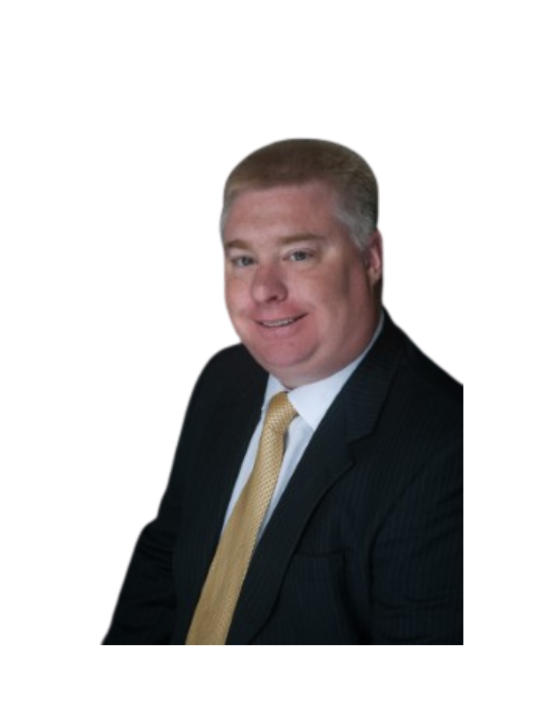
Tim Moy
MBE CPAs
Managing Partner
Tim Moy, CPA, is the Managing Partner of MBE CPAs. In this role, he not only directs the firm but also plays a fundamental part in advising business clients clients on how to achieve long-term success. Through thoughtful accounting and tax strategies, combined with real-world life experience, Tim helps clients navigate complex decisions. Helping people succeed is at the core of his passion and drives the impact he strives to make with every client relationship.
His personal mission is "to be his client's most trusted advisor." Clients reply on Tim and the MBE professional family for guidance, planning, and execution as they work toward achieving their goals.
At heart, Tim is a serial entrepreneur. Through that experience, he quickly realized that accounting is the language of business. Accounting serves as a form of communication, reflecting both successes and failures and providing a clear way for businesses to keep score. A Critical part of that score is taxes. Many entrepreneurs overlooks how closely taxes are tied to measuring business success yet managing them effectively should be a core component of every entrepreneur's strategy.

Slide 8

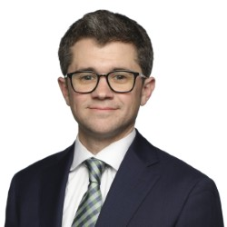
Matthew Geer
Cohen & Co Advisory, LLC
Director, Corporate Development
Matt is a detail-oriented team player who is committed to driving growth through strategic acquisitions, helping Cohen & Co better serve its clients. Always looking to stay up to date with the industry, he enjoys connecting with leaders at other professional services firms to learn from and about their organization.
Matt has over a decade of experience working in roles across the M&A lifecycle, with an extensive background in corporate development for firms in the professional services space. He is responsible for leading all elements of Cohen & Co's M&A growth efforts, including sourcing transactions, spearheading due diligence, and executing potential acquisition opportunities.

Slide 9

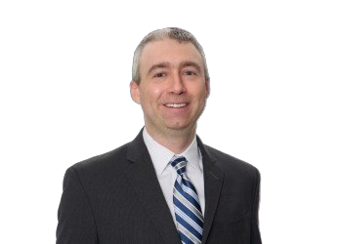
Daniel Lisella
BDO Alliance USA
BDO Alliance Central Region Alliance Director
Daniel is a Central region BDO Alliance Director serving as the relationship contact for the BDO Alliance Firms in the Ohio Valley and Midwest and as a liaison to the BDO offices in those markets. In this role, Daniel works closely with leaders from BDO Alliance firms to collaborate with BDO, align service offerings, identify growth opportunities, drive innovation, and develop best practices to ensure maximum value for these firms.
Prior to joining the Alliance team, Daniel was a director in BDO's Assurance Professional Practice Group, where he led the due diligence and integration of the audit practices of BDO's explanations, assisted members of the BDO Alliance with accounting and auditing matters, and participated in a variety of audit quality and policy projects. HE is a sought-after facilitator of internal firm training on a variety of technical accounting and auditing topics.

Slide 10

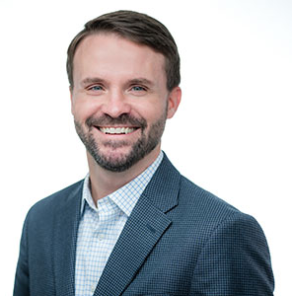
Ben Carver
LBMC
Shareholder
Ben Carver, CPA, is a Shareholder in the tax division of LBMC, PC and focuses the majority of his time assisting multi-state, multi-location clients in the Healthcare and Health IT industries with an emphasis on private equity and venture capital backed companies. He assists clients with a variety of tax issues including tax compliance, tac accounting assistance, financial statement reporting under ASC 740, multi-state tax planning, and other general tax consulting items. In addition, Ben has worked with clients on due diligence to projects both on the buy and sale side. This includes assisting clients with buy side structuring to ensure the most advantageous tax result. His goal while serving clients is to help reduce overall taxation through credits and incentives, structure related changes, management service agreements, etc. That result in tax reductions and advantages. Prior to rejoining LBMC in 2015, Ben led the tax group for CongentHMG, a Private-Equity backed healthcare company. During his tenure, Ben was able to successfully obtain a Private Letter Ruling with the IRS that resulted in reduction of federal tax in excess of $10M. In addition to healthcare, Ben has experience working with a variety of industries including manufacturing, distribution, real estate, software development and other services.

Slide 11
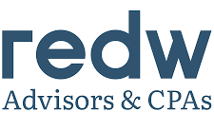
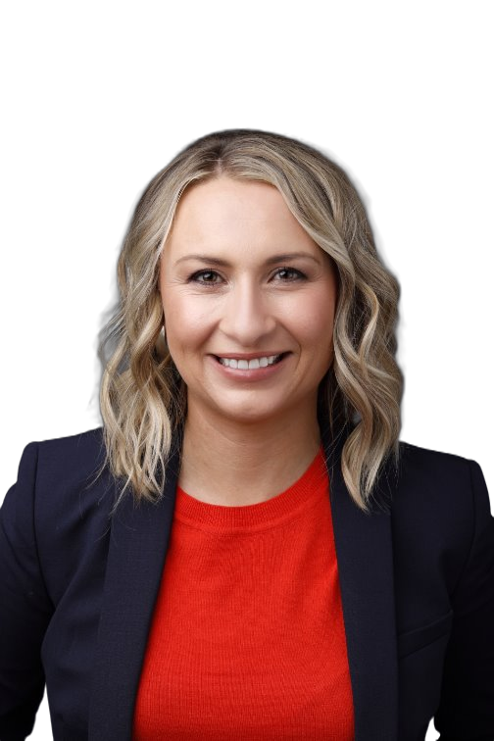
Lorin Saavedra
REDW Advisors & CPAs
Principal, Advisory & Accounting
As head of REDW's Client Advisory & Accounting Services (CAAS) Department, Lorin has broad experience in finance, accounting, operations, risk management, and compliance across a variety of industries—from financial services to hospitality, manufacturing, transportation, and warehousing. An analytical problem solver who likes to push the boundaries of what is possible, she oversees her team's operations to enhance and optimize service to clients. Lorin also lends her prior CFO experience and expertise to clients as an Outsourced CFO, as needed.
Prior to joining REDW in 2021, Lorin held a variety of executive-level position in banking and has experience with loan and origination, structuring, and servicing for consumer and business markets. Her responsibilities included helping to execute strategic goals and improve the overall institution and customer experience while staying in compliance with laws and regulations.

