Slide 1


MPB | SHARK, TEAM 1
MPB | Leadership Accelerated
Facilitator | David Toth
Melissa Griffiths
Jennifer Phipps
Jamie Rivette
Anthony Mangiarelli

Slide 2
MPB | SHARK, TEAM 2
MPB | Leadership Accelerated
Facilitator | Trisha Daho
Kevin Kroskey
Todd Resnick
Alex Drost
Jon Cohen

Slide 3
MPB | SHARK, TEAM 3
MPB | Leadership Accelerated
Facilitator | Ilana Katz
Madina Bahretdinova
Patrick O’Neill
Brett Mills
Michael Jamison

Slide 4

As part of MPB | Leadership Accelerated, you will be participating with your team in MPB Shark.
MPB Shark is our latest and greatest version of the
iLab presentation.

Slide 5
What Is MPB Shark?
You will be working with a team of your peers in MPB Shark to develop a product, service, or a concept that will benefit your firm and your industry.
Once this is developed, you will be making a pitch to three “Sharks” (preselected industry influencers) to partner with your team to bring the concept to life.
You will present the idea and make the offer to the Sharks at the next MPB session. The Sharks will ask questions and either accept or negotiate your offer or reject your offer.
The Pitch should last 10-15 minutes!

Slide 6
What Is MPB Shark?
The point is to use the knowledge and skills you’ve gained as a participant of MPB to develop and present a new business idea that will make a positive impact on the profession. For example, your initiative could be related to implementing a new learning blueprint, creating an innovation as it relates to firm culture, developing a new accounting software, etc.
You’ll use presentation and communication skills as you attempt to gain the buy-in of the sharks and your fellow cohorts.
Included in this document are some tips and tricks to help guide you in this process. We Look forward to seeing what you and your team members come up with.
We Look forward to seeing what you and your team members come up with.
Good luck teams!

Slide 7
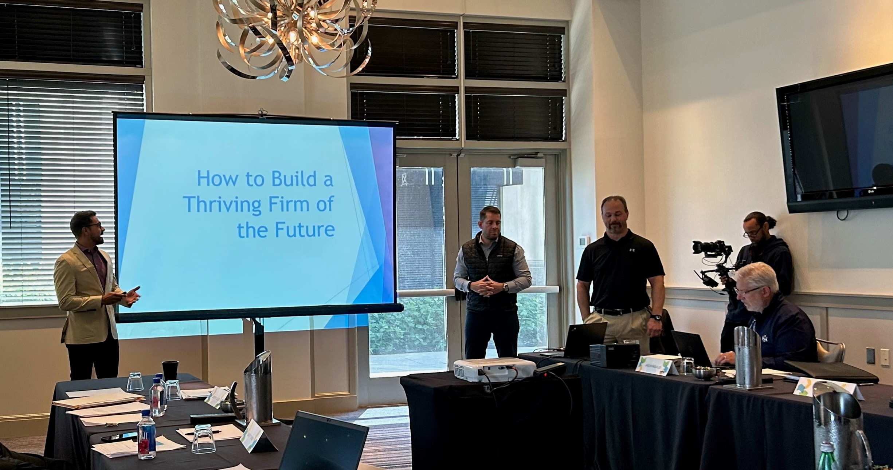
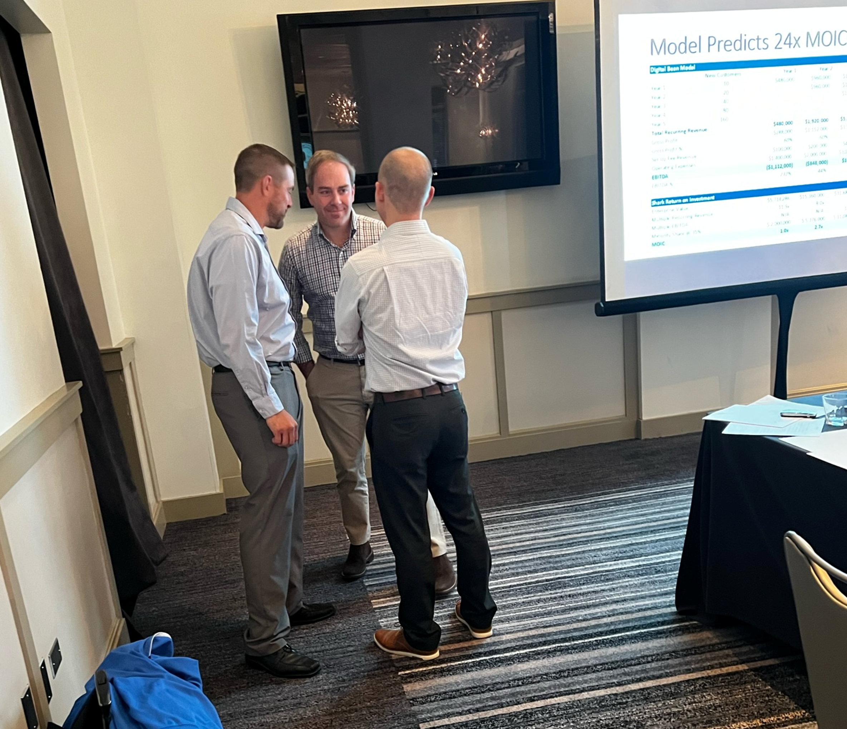
MPB SHARK
STRATEGIZING
PRESENTING

Slide 8
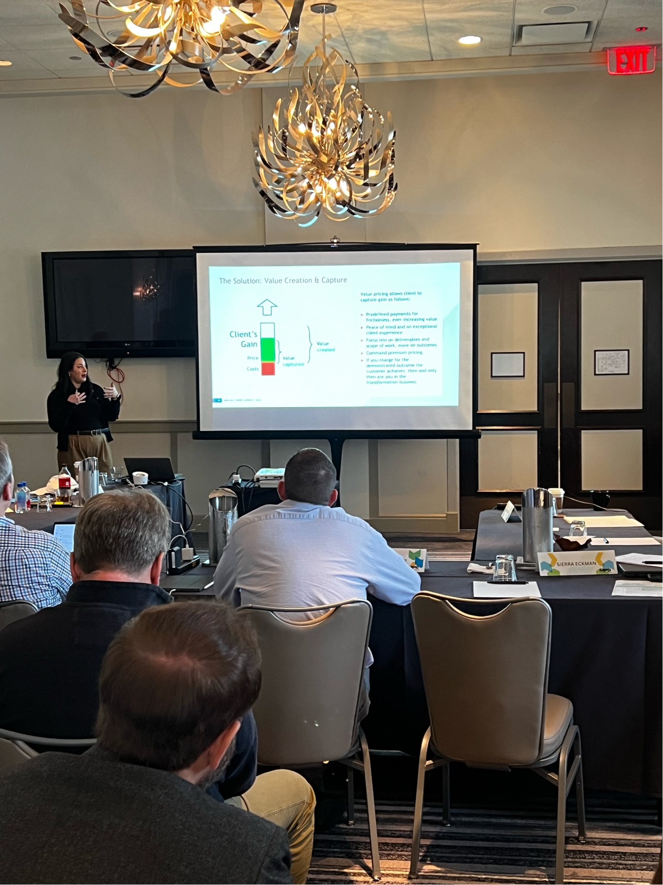
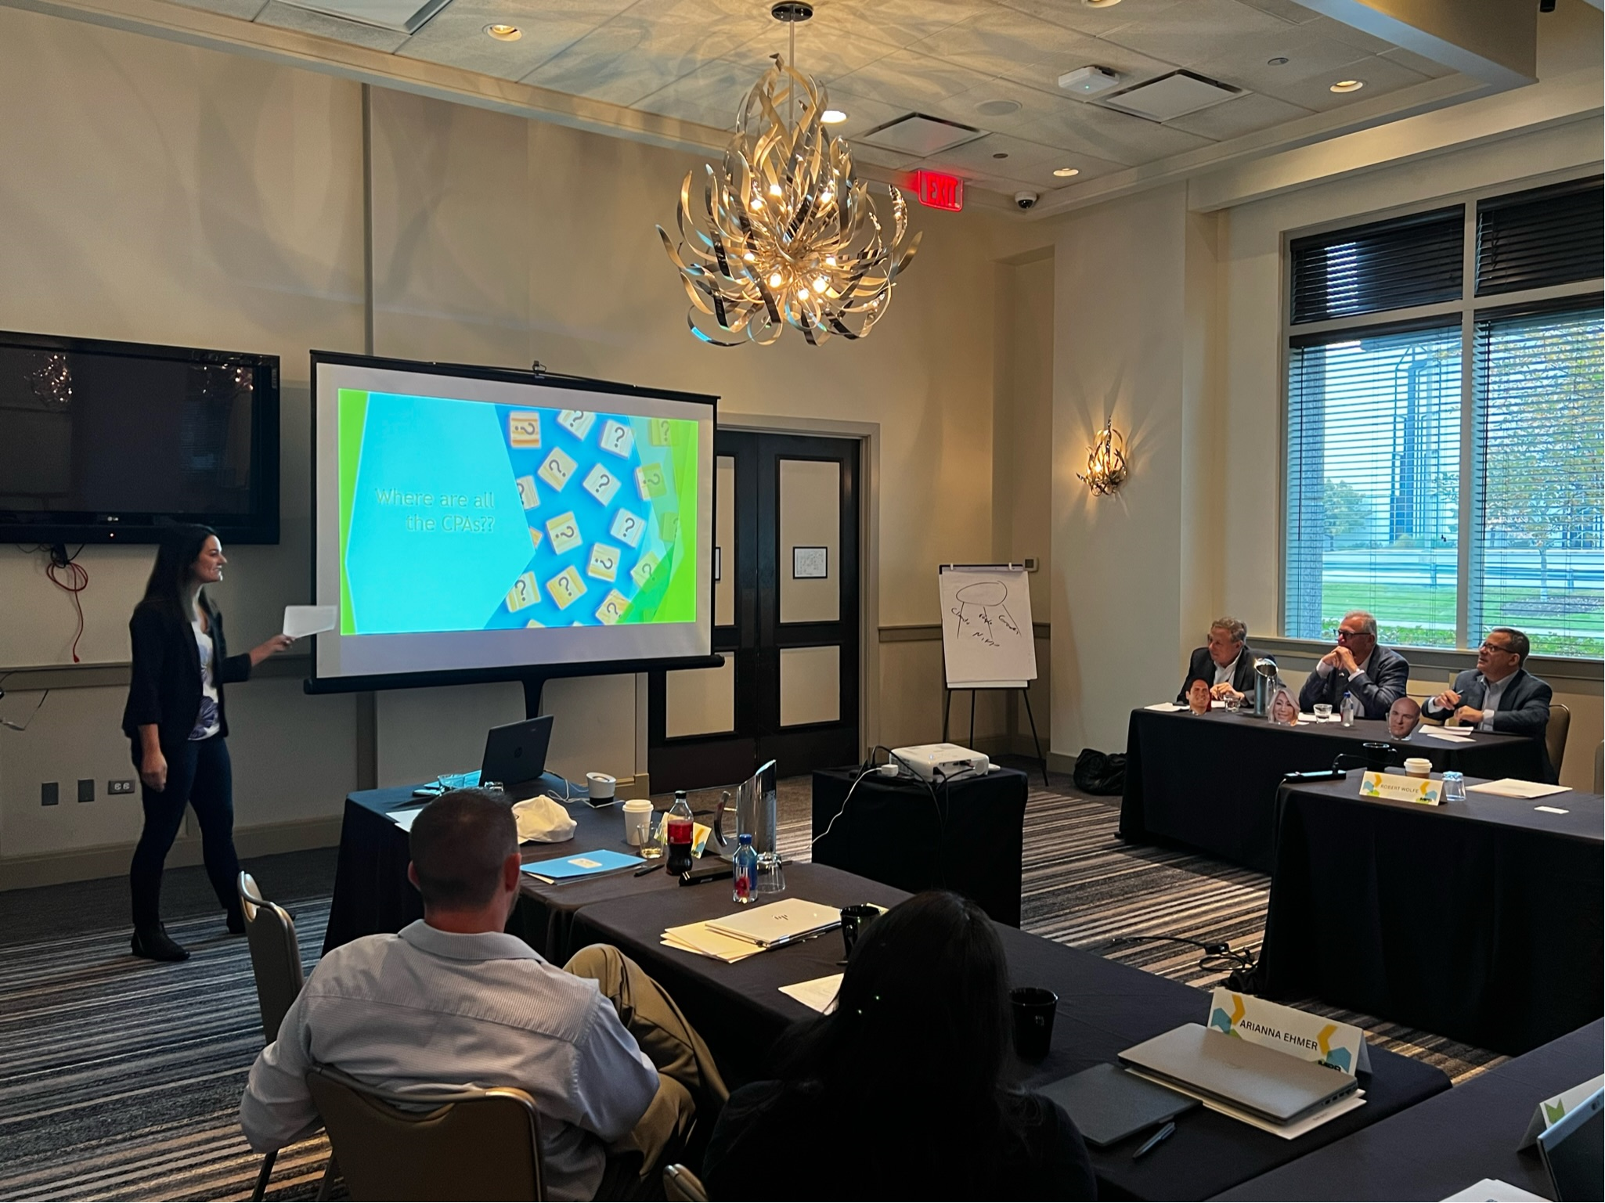
MPB SHARK
Persuading the Sharks

Slide 9
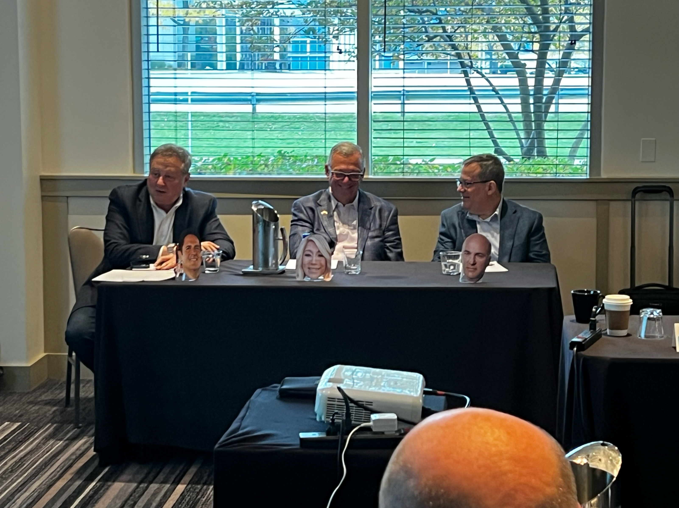
THE JUDGES:

Slide 10
General Tips for Your Next Presentation
The following slides entail considerations and planning strategies you can utilize when getting ready for your next presentation (including MPB Shark)

Slide 11
Questions to Answer as a MPB Shark Team
What will your new product/idea be?
What makes your idea unique? Why is it needed?
What competition does your idea have today? Does it have any pitfalls?
What will your pricing be? How much would a shark need to invest?

Slide 12
Other Questions to Answer Before You Present
How much time do you have?
How many people are attending? What positions?
Is this live or virtual?
Will you be on a stage/platform or in a conference room?
What are the expectations of your audience?
Are you presenting alone or with somebody else?
Will you have the capability for video or just PowerPoint?
What is your call-to-action for the audience?
Will there be deliverables in the form of handouts or worksheets?

Slide 13

Best of Luck!

