Slide 1


The Daily 9
MPB | Leadership Accelerated
Physical Wellbeing
Matt Terlop

Slide 2
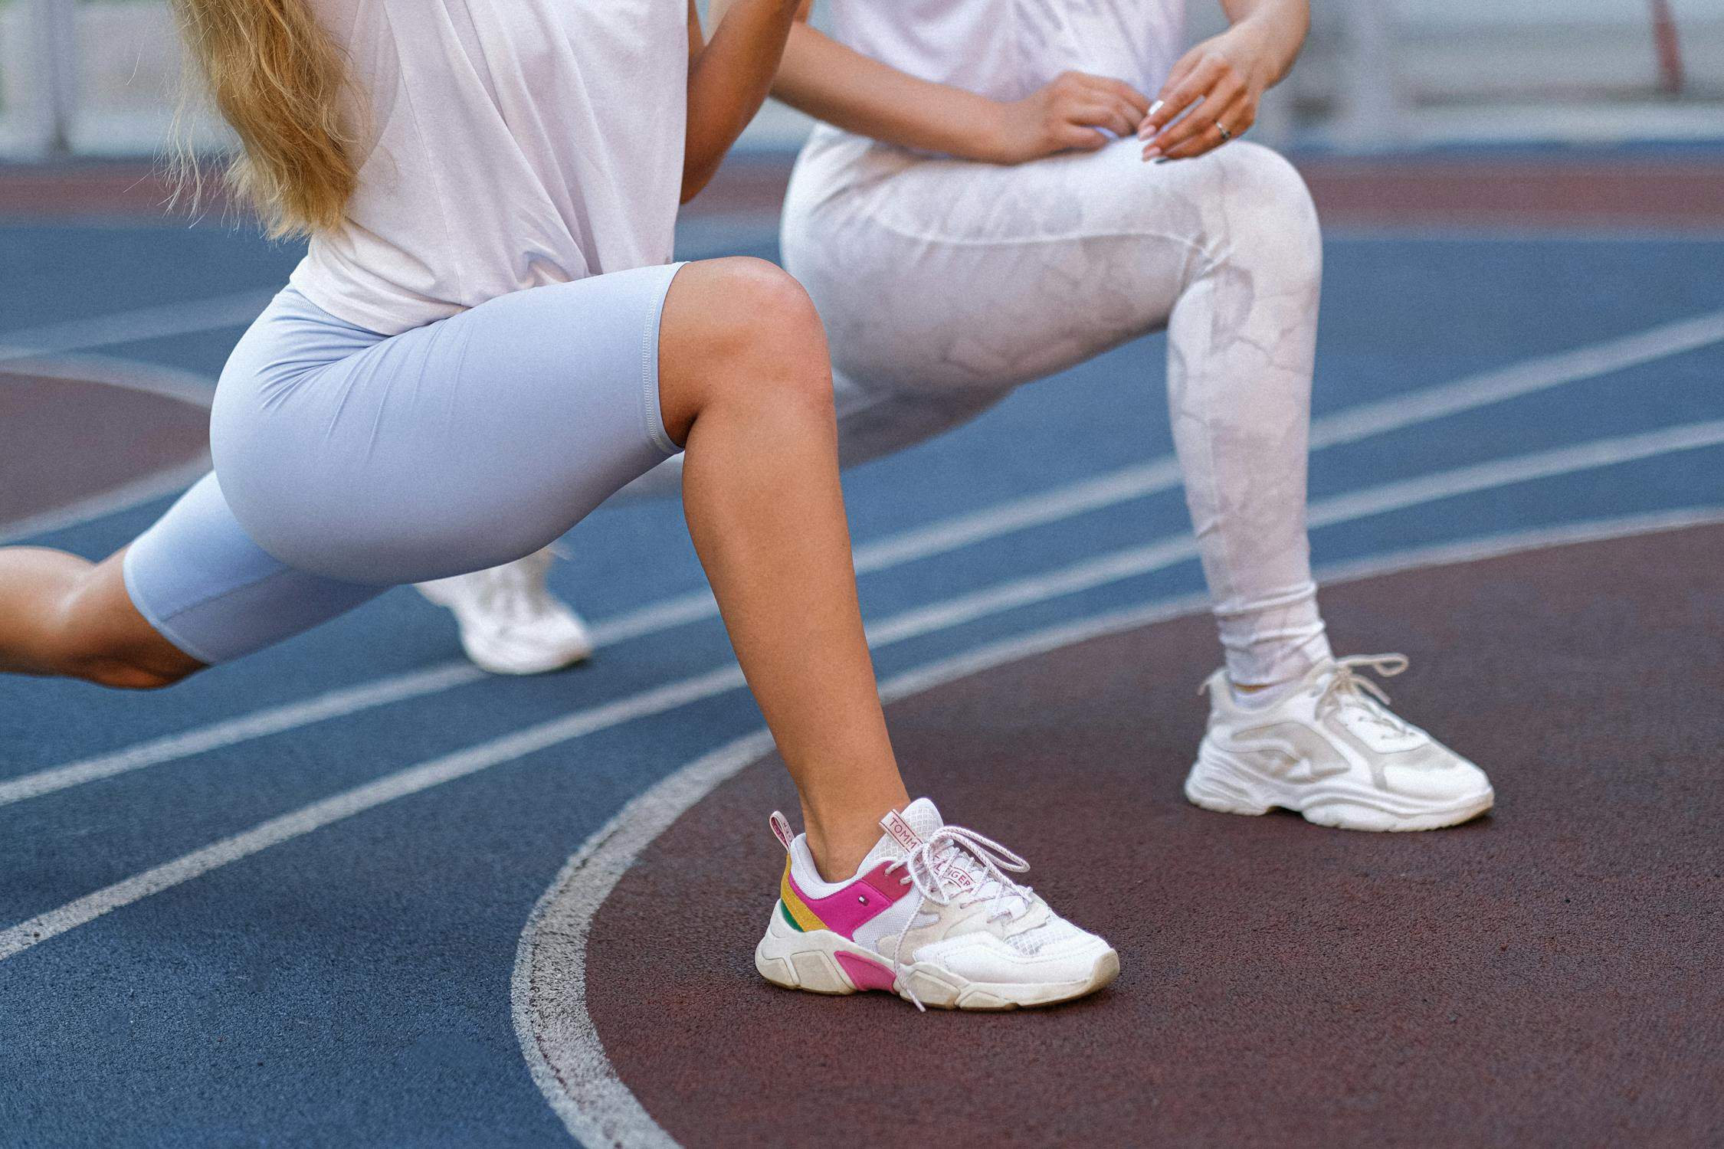
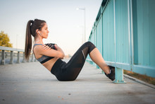
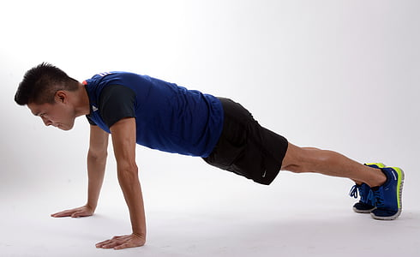
The Daily 9
20 of Each:
Jumping Jacks
Lunges
Push ups
Crunches
Side crunches
Hyper extensions
Dirty dogs
Mule kicks
Mountain Climbers

Slide 3
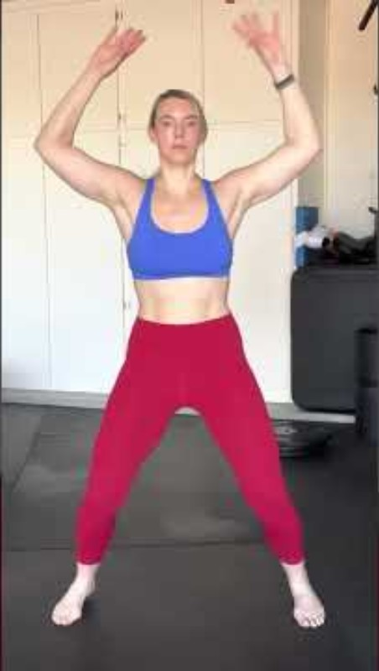
1.
JUMPING
JACKS

Slide 4
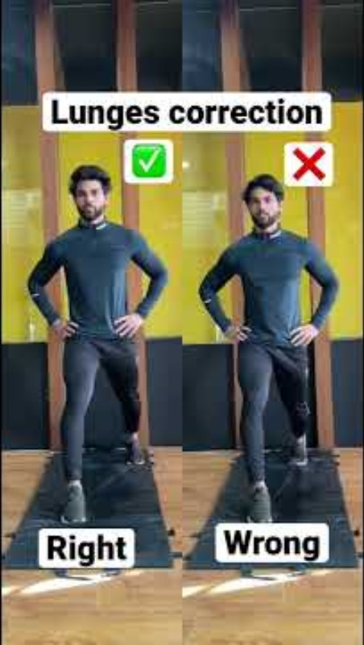
2.
Lunges

Slide 5

3.
Push-ups

Slide 6
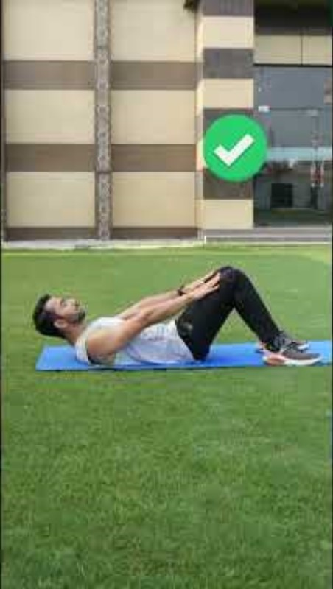
4.
Crunches

Slide 7

4.
Side crunches

Slide 8
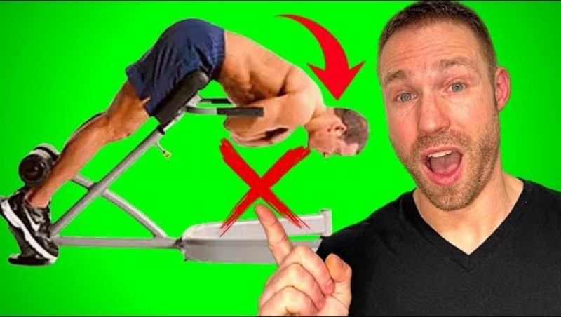
5.
Hyper
Extensions

Slide 9

7.
Dirty Dogs

Slide 10
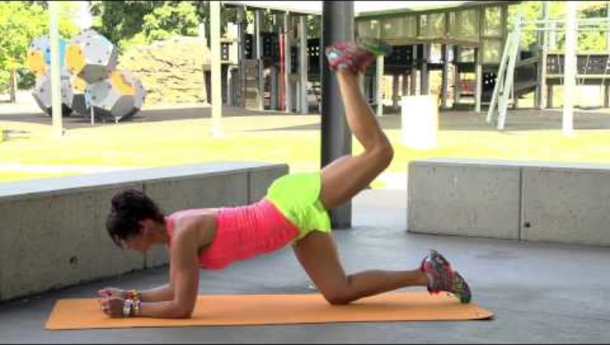
8.
Mule kicks

Slide 11
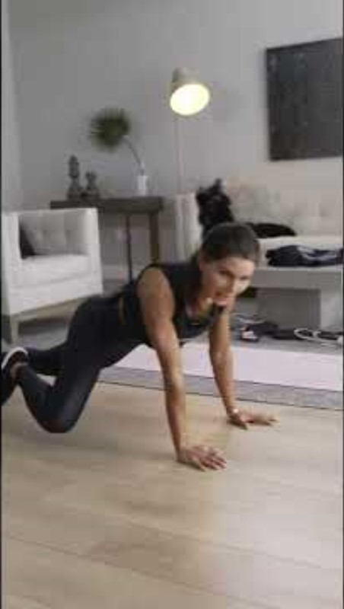
9.
Mountain
Climbers

Slide 12

I’m Here to Help
CONTACT
Motiv8matt@aol.com
P: 216.401.0276

